Slide 1
Auritas | Leaders in Data & Process Management
The Journey to S/4HANA: AMPD Methodology

Slide 2




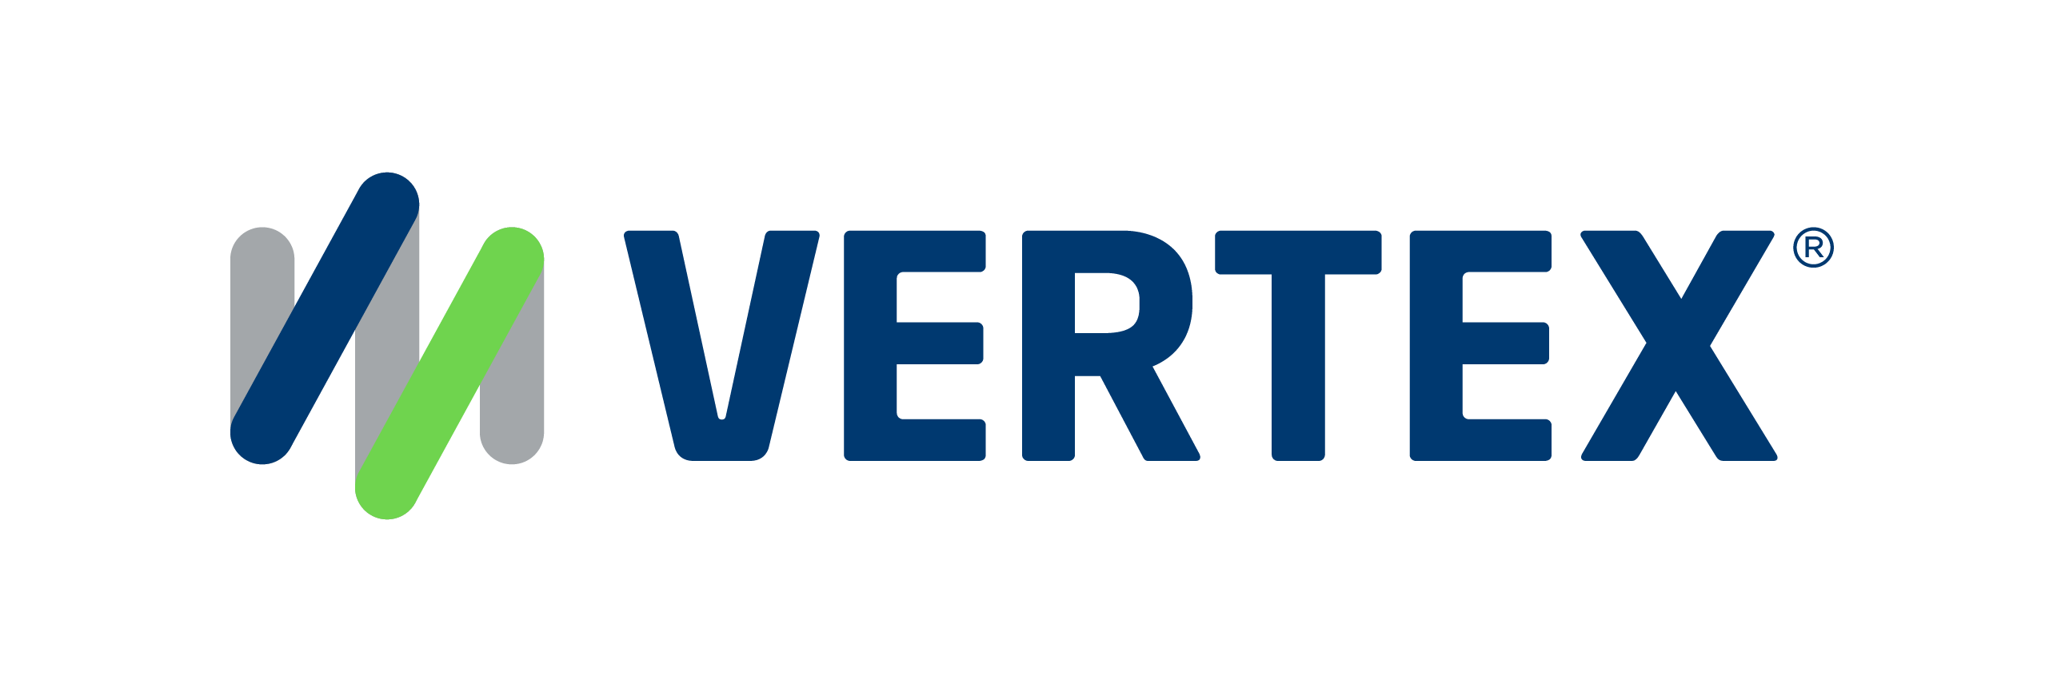
1,500
10,500+
25 Yrs
$1,5B
Successful Projects
TB of Data
Managed
Transforming Companies
Total Customer Savings
Driving Innovation, Empowering Transformations.
Data Management
Solution
implementation
Product
& Innovations
Strategic
Partnerships
  Data Archiving & ILM
  Retention Management
  HANA Memory Optimization (NSE)
  Data Governance
  Data Migration
  Cloud Migrations
  Data Privacy and Security
  Legacy Decommissioning
  Data Volume Assessment
  Data Quality Assessment
SAP S/4HANA & RISE
SAP BTP Deployment
  SAP Integration Suite
AI Implementation
SAP OpenText
  Extended ECM (xECM)
  Vendor Invoice Management
  Document Presentment
SAP Ariba
SAP Vertex
SAP Vistex
Geospatial Intelligence (GIS)
  Data ASSIST by Auritas
  (Data Archiving Automation)
  Data GUARD by Auritas
  (Legacy Decommissioning)
  Auritas Intelligent Accrual
  (Financial Automation)
  DMS+ by Auritas
  (Enhanced Document Storage)
SAP Gold Partner
SAP PartnerEdge, Sell
CCFlex – Cloud Choice Flex
PartnerEdge®
  (AMS + Hypercare)
CCFlex

Slide 3






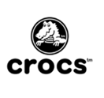






Customer Success
Services Across Multiple Industries – Verticals:

Slide 4

Journey to SAP S/4HANA
AMPD Methodology
Data Archiving
System Migration
Performance Testing
Legacy Decommissioning
Your Journey Starts Here

Slide 5


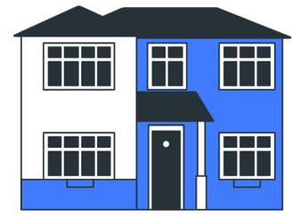
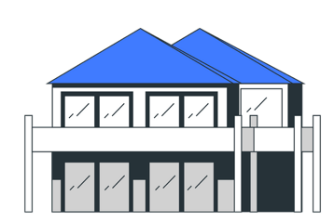

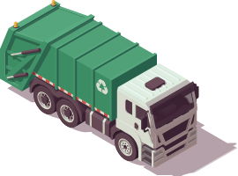
The Journey to S/4HANA:
rchive
Methodology
igration
erformance Test
ecommissioning
Start
1
2
Archive
Migration
Present Storage
Retention Management
Trash
& Repurpose
4
Decommissioning
Legacy Storage
3
Performance Testing

Slide 6

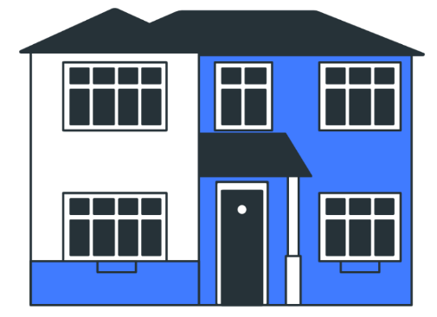
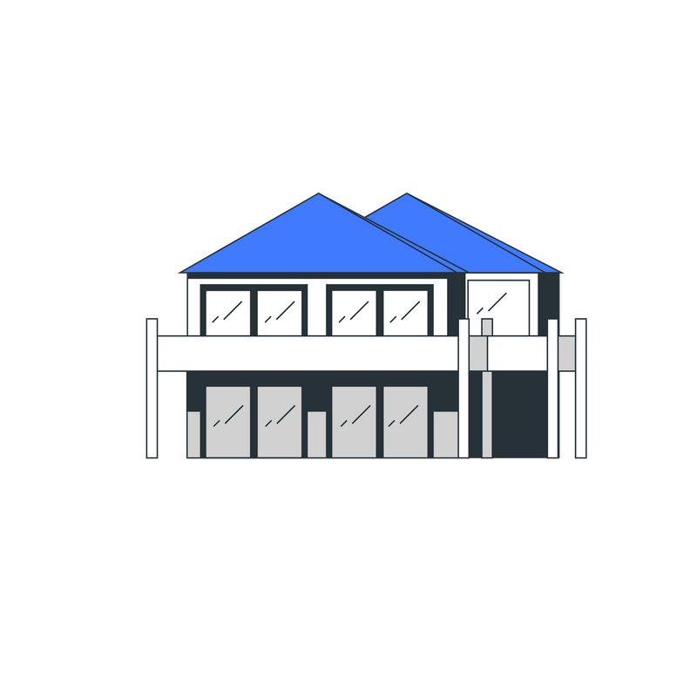




The Journey to S/4HANA:
Methodology
rchive
igration
erformance Test
ecommissioning
Start
1
2
Archive
Migration
Achieve smaller footprint on S4
- (RISE infrastructure and on-going memory cost savings)
Reduce migration effort (project cost savings)
Improve performance on current and future systems
Reduce Backup and Recovery time (cost savings)
Use a single console to manage and administer data movement
Track: timelines, data quality scores, workflows, outcomes, etc.
Capture analytics: ad-track requirements, customer decisions, and specifications for data mapping
Present Storage
Retention Management
ADA, xECM
Reduce legal exposure by following retention rules (cost avoidance)
Eliminate older data (increase in Master Data Quality)
Trash
& Repurpose
BTP Doc Services
Hyperscaler File Store
4
Decommissioning
Legacy Storage
3
Consolidate siloed data into a single repository (accelerate decision making)
Eliminate legacy system hardware (reduce operating and infrastructure cost)
Protect from audit, legal and compliance risk
Performance Testing
Tricentis provides a market-leading approach to test faster and reduce risks, all while cutting costs.

Slide 7
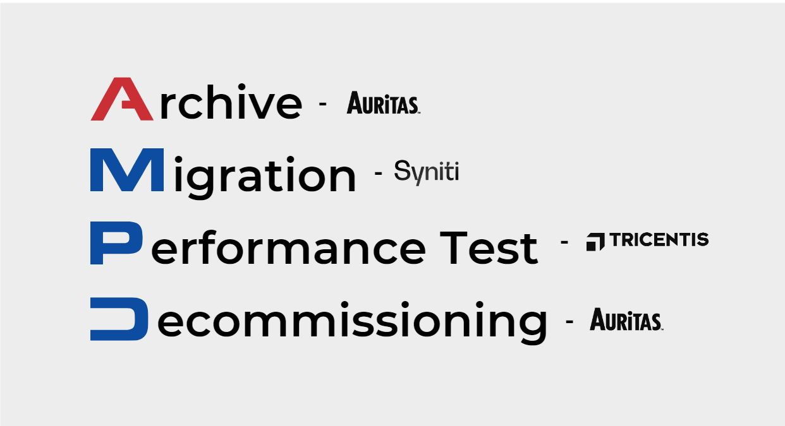
The Journey to S/4HANA: AMPD Methodology
Archiving: Focuses on managing data volume efficiently, reducing storage costs, and maintaining a streamlined data environment. Data ASSIST by Auritas ensures stored data remains accessible for historical insights while automating with Retention Management for compliance and data integrity.
Migration: SAP Advanced Data Migration and Management: Seamlessly transitions data to an Intelligent Enterprise with accurate tracking and insightful dashboards.
Performance Testing: Utilizes AI-driven, codeless automation to test IT landscapes, enhancing efficiency and reducing risks across SAP and non-SAP systems.
Decommissioning: Addresses outdated systems that hinder efficiency and incur high costs, offering tools like Data GUARD by Auritas to securely retire legacy hardware and preserve data access.

Slide 8

rchiving

Slide 9

What is Data Archiving?
Archiving Use Cases
Data archiving involves identifying and transferring data that is no longer actively used in daily operations to a separate archival storage system, typically with lower-cost infrastructure.
The primary goals of data archiving are to free up space on primary storage. Saving costs and ensuring long-term and compliant preservation of data.
The Data Archiving Process
Reduce database footprint: optimize space on primary storage systems.
Legal Compliance: Securely retain/manage historical records crucial for audits and privacy regulations (CCPA, GDPR, etc.)
Cut spending coming from the high total cost of ownership from licensing costs & hardware.
Tier existing systems into one, consolidating historical information.
Enhance system performance: faster data retrieval and processing for all transactions.
Efficiently manage document and content by systematically organizing and storing documents.
Monitor Database
Identify
Archive Objects
Schedule Archive Runs
Implement Archive Objects
Schedule Retention Runs
Data ASSIST by Auritas automates data archiving and scheduling. This solution provides master control over your ERP database size and growth.

Slide 10
Introduction to Data Archiving
SAP ECC
OpenText
Storage
SAP DATABASE
1.
2.
3.
Archive (Data is written to files)
Delete (Data is deleted from tables)
Seamless Access
Notes:
Deepak

Slide 11
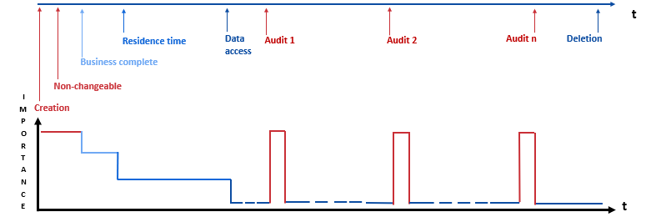
Life Cycle of Data with DVM
Database

Slide 12
Why Archive? HANA Sizing and Savings
HANA Requirement Without Data Discipline
HANA Requirement
With Data Discipline
$$
$$
Cleanse unneeded data
Typical 30-50% reduction
Near-line less-used data
Archive retention compliance data
$
“Data tiering can be achieved with traditional archiving as known from enterprise applications in the past, or by classifying data into actual and historical data coupled with aging historical data”
Hasso Plattner: The In-Memory Revolution
by Hasso Plattner and Bernd Leukert
Notes:
Higher storage costs for expired data
Risk legal discovery of expired data
Risk of historical data loss
during upgrades
Historical data bloat slows performance
Legacy systems add to
maintenance cost
Increased cost during mergers & divestiture
Inability to upgrade in time allotted

Slide 13

Maximizing Archiving Success:
The Power of Data ASSIST Automation
Automated scheduling helps avoid human error leading to cost savings and accurate DB reporting.
Intuitive data insights allow for quick understanding of the scope & impact of data management activities.
Central management ensures to view of all scheduled jobs from a single platform, simplifying operations.
Data health monitoring offers a real-time view into DB and reporting on size reduction and performance improvements.
Improved communication provides visual reports that allow sharing with stakeholders or management the value of archiving.
Customizable dashboards tailors the visual analysis dashboards to focus on key metrics to easily address business needs.
Notes:
For the messaging/title for each feature:
What feature are we talking about? (automated scheduling) – Advantage – What benefit/outcome it drives to the customers?
Visual rework

Slide 14

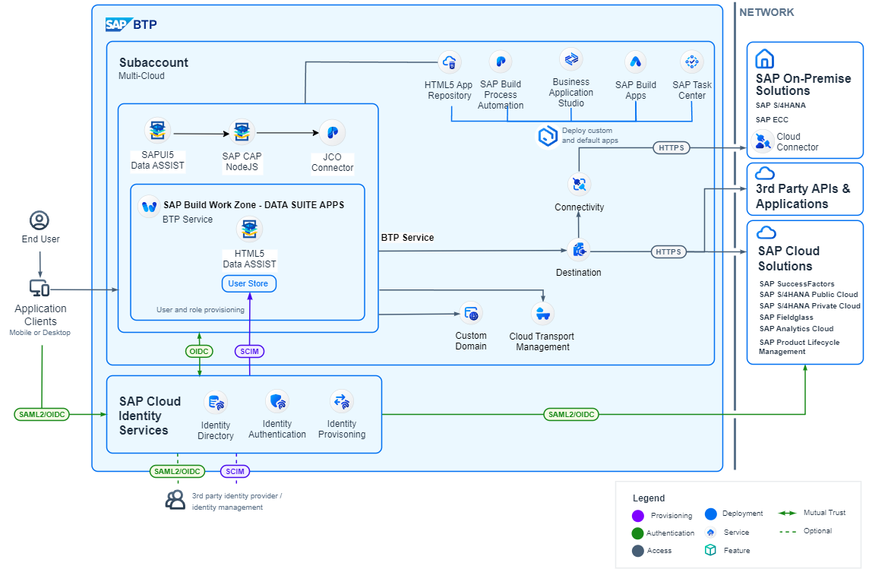
Notes:
Ask Silas for the new arch

Slide 15
The Compliance Process & Why We Do It
1.
3.
5.
Discovery Including Cross Reference Of Indirect Identifiers
Retention
Sequestering/Encryption/ Redaction Of Private Data Assets
2.
4.
Tagging
Discovery Including Cross Reference Of Indirect Identifiers

Slide 16

igration

Slide 17
“Migration is not as simple as I thought”
Strategic Importance (5 = High) | CIO Considerations | Greenfield | Brownfield
5 | Legacy Platform Overhead |  | ✓
5 | Downtime | ✓
4 | Data Pollution (MD + TD)*
4 | Bloated S/4 size on Day 1 | ✓
4 | Automated Retention Compliance
3 | Historical Business Rules Retained |  | ✓
3 | DVM for Future Growth
*Master Data & Transactional Data
Notes:
DECISION-MAKING
Incorrect decisions based on poor quality data negatively impact an organization’s revenue
Incorrect spend analytics leading to lost revenue
PROCESS BREAKDOWN
Data driven processes fail leading to business inefficiencies and lost revenue
Bad addresses lead to lost deliveries
LEGAL & REGULATORY ISSUES
Poor quality data leads to compliance issues resulting in fines & penalties
FINANCIAL IMPACT
Lost Revenue
Capital locked up in duplicate inventory
INCREASED PROCUREMENT SPEND
NOT OPTIMIZING INVENTORY LEVELS
INCREASED WAREHOUSE MANAGEMENT COSTS
POOR LEAD-TIME ACCURACY
DECREASE IN PRODUCTION EFFICIENCY
INEFFICIENT AND COSTLY FORECASTING AND PLANNING
LACK INFORMATION NEEDED TO MAKE CRITICAL DECISIONS
BUSINESS DECISIONS ARE CORRUPTED BY POOR DATA QUALITY
LACK OF CONSOLIDATED VIEW OF CUSTOMER DATA ACROSS ALL CHANNELS
CUSTOMER HIERARCHY AND GROUPING VISIBILITY/PROFITABILITY ANALYSIS

Slide 18
Auritas RDS for S/4 HANA
We can help no matter which route you take
We LOWER implementation cost
We LOWER implementation risk
We INCREASE deployment speed
Rapid Deployment Solution (RDS) by Auritas
is a purpose-built solution that:
Provides turnkey automation to ensure faster time-to-value and mitigate key data risks.
Orchestrates data migrations and empowers stakeholders to drive data value in MA&D transactions by streamlining transactions for any approach:
  New Systems
  System Consolidations / Transformations
  Carveouts / Spin-offs
  Clone & Delete

Slide 19
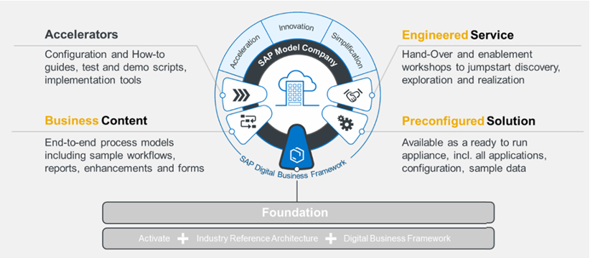
S/4HANA Implementation Key Elements
SAP Best Practices supports main processes with relevant business content and accelerators.
SAP Activate implementation methodology with its pre-configured business scenarios and pre-built docs.
Value-add functionalities leverage additional pre-configured functionalities, test scripts and other tools.

Slide 20

S/4HANA Implementation Key Elements
Experienced in the SAP Best Practice template based Activate methodology.
Auritas conducts business process, functional and transactional hands-on workshops to the project core team.
SAP's Accelerator tool Data Migration Cockpit will leveraged to speed and monitor the data migration effort.
  Data migration plan to include data objects required to be migrated to SAP S/4 for the business scenarios.
SAP Best Practice’s pre-configured forms/outputs and reports.
  Identify process & configuration gaps between to make the necessary enhancements to the configuration to address unique company’s needs.
Notes:
Auritas’ design by exception allows the design of business processes and workflows for each business function to ensure unique company’s needs are being addresses.
Solution validation, we provide with the company’s scenarios. We explain sap best practices, if that does not work for the company, we need to make an enhancement/change to the configuration to address that. Go mainly with sap best practices, but change in configuration to reflect companies needs…

Slide 21

Why Auritas?
Decades of knowledge and experience implementing SAP Best Practices and Activate methodology.
Holistic approach to S/4HANA implementation.
Prepare your team with hands-on workshops and training for comprehensive knowledge transfer.
SAP Accelerators for speedy and and smooth data migration efforts.
Complete Data Suite by Auritas to help with archiving efforts and legacy decommission needs.
Necessary enhancements to the configuration help ensure unique company’s needs are being addresses.
Close partnership with SAP, being a Gold Partner.

Slide 22

erformance

Slide 23

ecommissioning

Slide 24

What is Legacy Decommissioning?
Decommissioning Use Cases
Decommissioning streamlines operations by phasing out old tech, consolidating data, and dismantling data silos. It offers significant advantages for companies undergoing mergers or acquisitions.
Legacy system decommissioning entails permanently shutting down outdated systems after transferring necessary data to a new system, rendering the old system inoperative.
Streamline environment: Move an outdated, no longer used application from the data center.
Safely Divest systems when discontinuing
the ownership or operation.
Mitigate security risks and ensure enterprise grade compliance.
Modernize data management allowing for enhanced efficiency and scalability.
Reduce overall IT ecosystem complexity reducing the number of systems to manage.
Integration: Retire systems and applications that no longer integrate with newer technologies.
The Decommissioning Process
Data Migration + Compression
Build Custom Reports
Apply Data Retention Policies
Configure Access Authorization
Data Classification
Legal Configuration & Compliance
Data Guard
System Retirement Lifecycle
Data Extraction + Compression
Legacy System Deletion
Data GUARD by Auritas provides a unified UI to manage, decommission, and report data from retired legacy systems within a single integrated view.

Slide 25
  Growing maintenance and hardware costs
  Security risks on outdated systems
  Limited data access due to technology constraints
  Compliance for data retention and preservation
  Inefficient data management causing silos
  Lack of skilled personnel for legacy maintenance
  Incompatible with modern technologies and apps
  High energy use and carbon footprint
Challenges of Aging Systems
Notes:
Get Deepak and David’s input here

Slide 26

Data GUARD by Auritas facilitate organizations moving into a new system to retain accessibility to their legacy data for regulatory, legal, and business purposes. Additionally, it offers a unified interface to manage and decommission multiple systems efficiently.
Single View:
Provides a single view for managing & retiring SAP and non-SAP legacy systems.
Improved Performance:
Better visibility & tracking of extraction, transformation, and loading processes.
Access Historical Data:
Run advanced tailored reports on decommissioned data and have a single source of truth.
Notes:
We can add screenshots here
-- Rework the visual of slide 5

Slide 27
Data GUARD:
The Power of Decommissioning
One Source of Truth to Legacy Data
50% reduction in costs related to legacy data retrieval and delivery.
Audit/Legal/Regulatory Readiness 32% reduction in storage costs, 20% faster handling inquiries.
Cloud Architecture Flexibility 70% efficiency gain in shared services center.
Meet Sustainability Goals
Cloud migration can lower energy consumption by 65% & carbon emissions by 84%.
Lower TCO for Hardware & Infrastructure
Redirect financial resources saved from decommissioning to more strategic areas.
Notes:
For the messaging/title for each feature:
What feature are we talking about? (automated scheduling) – Advantage – What benefit/outcome it drives to the customers?
Visual rework

Slide 28
The Journey to S/4HANA:
Methodology
rchive
igration
erformance Test
ecommissioning
Start
1
2
Archive
Migration
Achieve smaller footprint on S4
- (RISE infrastructure and on-going memory cost savings)
Reduce migration effort (project cost savings)
Improve performance on current and future systems
Reduce Backup and Recovery time (cost savings)
Use a single console to manage and administer data movement
Track: timelines, data quality scores, workflows, outcomes, etc.
Capture analytics: ad-track requirements, customer decisions, and specifications for data mapping
Present Storage
Retention Management
ADA, xECM
Reduce legal exposure by following retention rules (cost avoidance)
Eliminate older data (increase in Master Data Quality)
Trash
& Repurpose
BTP Doc Services
Hyperscaler File Store
4
Decommissioning
Legacy Storage
3
Consolidate siloed data into a single repository (accelerate decision making)
Eliminate legacy system hardware (reduce operating and infrastructure cost)
Protect from audit, legal and compliance risk
Performance Testing
Tricentis provides a market-leading approach to test faster and reduce risks, all while cutting costs.

