Slide 1
Addressing SAP Spend Management: The Right Way
Ariba Modules
Overview and Value Proposition

Slide 2

SAP Ariba Source-to-Pay Overview

Slide 3
SAP Ariba Source-to-Pay Process
Supplier – Order to Cash
SAP Business Network
Source & Contract
Plan & Forecast
Buy & Deliver
Invoice & Pay
SLP and Risk
Spend Visibility
Collaborative Sourcing
Contract Management
Forecast & Scheduling
Inventory Collaboration
Procurement
Order Execution
Invoice
Cash Management
Open Platform
Customer Value Services
Registration & Onboarding
Diversity & Green Certs
Risk Management
Survey
Scorecards
Performance
Spend Classification
Category Management
Enrichment Services
Market Intelligence
D&B Insight
Spend Analysis
Supplier Discover
Strategic Sourcing
Reverse Auctions
Knowledge Repository
Optimization
Article Pricing
Lead Time
Award to Contract
Workflow
Authorizing
Repository
Lifecycle Notifications
Redlining
E-signatures
Forecast sharing
Forecast Commit
Exception Management
Scheduling Agreements
Releases
Inventory Visibility
Consignment Collaboration
Supplier Managed Inventory (SMI)
Quality Collaboration
Material and Services
Catalogs
Spot Buy
Robust Approval Workflows
Guided Buying
Workbench
Request Quotes
Mobile Ordering
Confirmations
Advances Ship Notice
Good Receiving
Rate Card Management
Returns
PO Flip
Invoice Automation
Intelligent Invoicing
Service Entry Sheets
ERS Tax Service
Terms Management
DPO Extension
Early Pay Discounts
Supply Chain Financing
Receivables Fin
Electronic Payment
Buyer – Source to Settle

Slide 4




















SAP Ariba Managed Gateway Spend & Network for Source To Pay - End to End
Business Network
Banks
Trading Partners
Trading Partners
Supplier Qualification and data sync
Invite supplier to Sourcing Event / e-auction
PO, Service PO, Receipt, Invoice Status, Rem. Advice,
SAP Ariba SLP & Risk
SAP Ariba Spend Analysis
SAP Ariba Contract Management
SAP Ariba Buying & Invoice Management
SAP Ariba Commerce Automation & Supply Chain Collaboration
SAP Ariba Sourcing
PO, PIR & Outline Agreement
Outline Agreement
Master Data Inventory SES Response Remittance Adv.
PO to Invoice
Invoice & Payment Status
Bi-directional Supplier data
Dynamic Discounting
Spend Data
Quality Assurance
Supply Chain Finance
Extensibility
SAP Managed gateway for spend management and SAP Business Network
Partner API
MS Active Directory.
LDAP etc..
Digital
Signature
Tax Engine
SAP S4HANA

Slide 5
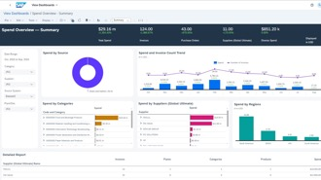
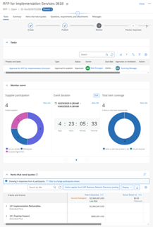
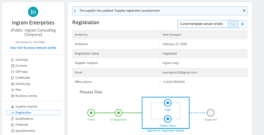


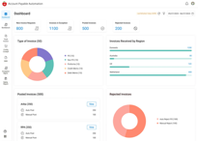
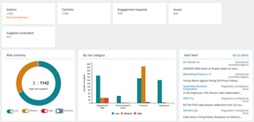

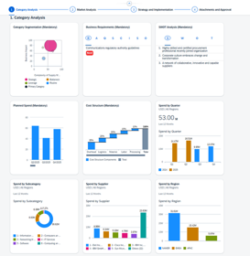
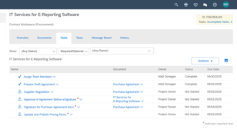
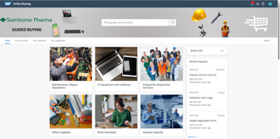
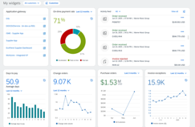
End to End Spend Management through SAP Ariba
Execute Sourcing Events
Onboard Suppliers and Assess Risk
Understand Your Spend
AP Automation
Build the Contract
Compliant Purchasing
Business Network
Analyze the Category

Slide 6

Ariba Modules Overview & Value Proposition

Slide 7

Ariba Sourcing
Source to Contract
Value
“The main value proposition of SAP Ariba Sourcing is its ability to digitally transform and optimize strategic sourcing processes, delivering cost savings, efficiency, and supplier collaboration.”
Accelerated Sourcing Cycles by automating and streamlining RFI / RFP / RFQ processes
Cost Savings & Spend Visibility through competitive bidding in auctions and analytics to identify savings opportunities
Improve Supplier Relationships through enhanced transparency in centralized platform for supplier communication
Increased Compliance & Risk Management by ensuring sourcing policies and approvals are followed
A Scalable & Global solution to support future growth by supporting multi-language and mult-currency sourcing events
Seamless integration with SAP ERP or S/4 and other solutions within the SAP Ariba realm such as SLP, Contracts & Procurement
Spend analysis
Category Management
eSourcing
Direct Material Sourcing
Savings & Benefits Tracking
Strategic Sourcing

Slide 8
Ariba Contract Management
Source to Contract
Value
“The main value proposition of the SAP Ariba Contract Management module is its ability to digitally manage the entire contract lifecycle, ensuring compliance, speed, and visibility while reducing risk and manual effort.”
Centralized Contract Repository which eliminates version confusion and provides easy access to current and historical contracts
Automates and Streamlines the Contract Management Lifecycle by using workflows, contract templates and clause libraries
Increases Compliance and Reduces Risk by ensuring contracts adhere to company policies and internal approvals
Enhanced Visibility & Analytics through real-time insights on contract statuses, value and performance using intuitive dashboards
Seamless integration with SAP ERP or S/4 and other solutions within the SAP Ariba realm such as SLP, Sourcing & Procurement
Contact authoring
Document collaboration
eSignature
Contract repository
Contract Management

Slide 9
Ariba Supplier Lifecycle & Performance
Source to Contract
Value
“The main value proposition of SAP Ariba Supplier Lifecycle and Performance (SLP) is to provide a centralized, intelligent, and integrated platform for managing supplier information, onboarding, qualification, and performance.”
Streamlines the Supplier Onboarding Process through onboarding workflows and reduced manual data entry
Cantralizes Supplier Data Management maintaining a single source of truth ensuring data consistency across modules
Minimizes Supplier Risk by helping to track supplier certifications or regulatory documents and flags potential areas of risk
Provides Supplier Qualification & Segmentation through dynamic questionnaires and scoring models and segmentation by category, region or business unit
Provides Supplier Monitoring by capturing Supplier KPIs and help facilitate corrective actions and continuous improvement
Seamless integration with SAP ERP or S/4 and other solutions within the SAP Ariba realm such as Sourcing, Contracts & Procurement
Supplier self service
Supplier information management
Supplier risk
Supplier Management

Slide 10
Ariba Supply Chain Collaboration
Plan and Forecast
Value
“The main value proposition of SAP Ariba Supply Chain Collaboration (SCC) is to enable real-time, multi-tier collaboration between buyers and suppliers across the supply chain, improving visibility, agility, and efficiency in supply chain operations and Direct Procurement.”
End-to-End Supply Chain Visibility with real-time insigths into supply, demand, inventory and logistics to help reduce blind spots in the direct procurement process
Collaborative Planning & Execution through joint forecasting, order confirmation and inventory management which improves alignment between suppliers and buyers to reduce stockouts and overstock
Reduce Splly Chain Risk by providing early alerts for delays, shortages or quality issues
Improved Supplier Performance with a solution that allows tracking of supplier KPIs and fulfillment metrics to help encourage accountability and continuos improvement
Helps Automate PO Collaboration and reduce manual errors and administrative overhead
Direct integration with SAP and orher Ariba modules
Supplier Managed Inventory
Consignment inventory
Refurbish / repair subcontract
Quality management
Supply Chain Collaboration

Slide 11
Ariba Buying with Guided Buying
Buy and Deliver
Value
“The main value proposition of SAP Ariba Buying with Guided Buying is to simplify and streamline the Indirect procurement process for end users while ensuring compliance, cost control, and policy adherence for organizations.”
Intuitive “Amazon-like UI for employees to easily find and request goods and services which helps increase user adoption
Policy Compliance by Design as it embeds procurement policies and supplier catalogs directly into the buying experience
Improved Spend Control ny envouraging use of preferred suppliers and pre-negotiated contracts, thus reducing maverick spending
Faster Procurement Cycles through streamlined requisition and approval workflows
A Scalable & Global solution to support future growth by supporting multi-language, multiple currencies and business units
Seamless integration with SAP ERP or S/4 and other solutions within the SAP Ariba realm such as Sourcing, Contracts & Invoice Management
Guided Buying
Supplier managed catalogs
Material reservations
Spot Buy
External Labor
Buying with Guided Buying

Slide 12

SAP Taulia
Invoice and Pay
Value
“The main value proposition of SAP Taulia is to help organizations unlock liquidity, optimize working capital, and strengthen supply chain resilience through a unified, AI-powered platform that integrates seamlessly with SAP’s ecosystem.”
Access to Affordable Liquidity by offering flexible financing options like Dynamic Discounting, Supply Chain Financing and Receivables Financing
Enables suppliers to get paid faster & buyers optimize cash flow
Manages the full cash conversion cycle: DIO, DSO and DPO and allow companies to simulate and refine working capital strategies
Provides real-time visibility into liquidity positions and help decision making through cash forecasting and performance benchmarking
Improves supplier relationships by offering predictable payments and financing diversity through a multifunder model
Embedded within SAP Business Network and seamless integration to SAP Treasury
Dynamic Discounting
Supply Chain Financing
Receivables Financing
Working Capital Management

