Slide 1
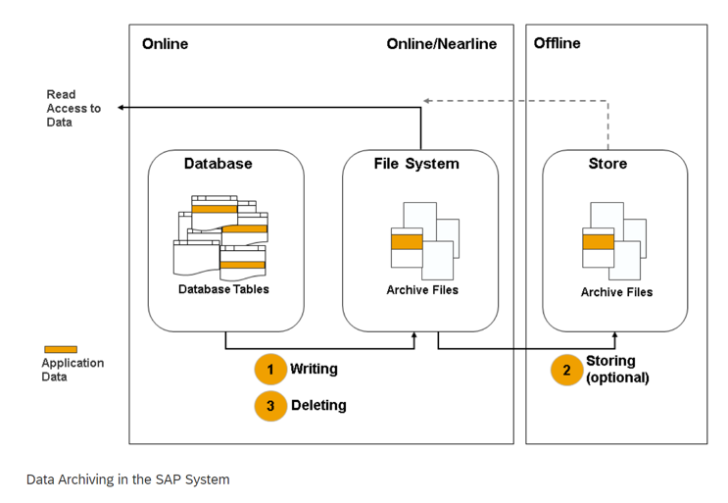
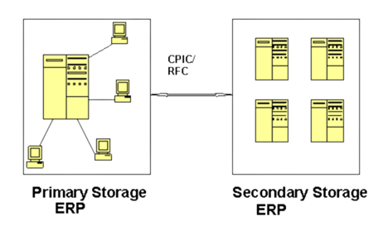
PRA Archiving: The Problem
Companies have historically chosen not to archive their Production Revenue Accounting (PRA) data due to the inability to update transactions after archiving.
This leads to large amounts of data increasing database size in their environment which needs to be addressed prior to any migration.
Historical PRA limitations (prior to EHP 8) included:
  Archived Enabled Transaction not available
  Certain additional archive features not available
  SAP alternative was PRA Data Management (separate DB(s), but not archived/compressed)
PRA Data Management
Notes:
Deepak
(Industry) Companies have historically chosen not to archive their PRA data due to the inability to update the transaction after archiving. This has led to huge amount of data taking up database size in their environment that needs to be addressed prior to any migration.

Slide 2




The Auritas Solution
To address this issue, Auritas developed a mechanism that uses SAP based archiving and still provides access to the archived transaction.
  Makes it possible for companies to archive PRA data and reduce your database size.
  Enables easy access to archived transaction before and after migration to S/4 or the cloud.
  Enhances existing SAP archive framework and does not impact ability to upgrade.
Customers taking advantage of Auritas PRA Solution:
Notes:
Deepak

Slide 3
Technical Explanation
PRA EHP 8 and above (example 10TB system)
  With enhancement points from Auritas, ability to “link” a reversal or entry to a specific archived object
  In the journal entry, reference the archive link in text field
  Ability to perform through individual entries or bulk batch process
  Example Result – 10TB down to ~5TB
PRA <EHP8 solution (example 10TB system)
  Even for companies below EHP8, Auritas can still provide immediate benefit
  Typical DB sizing is 60% PRA, 40% non-PRA
    Can address ~50% reduction in the non-PRA data
    For PRA data, can still address ~25% of index/log files/etc.
  Example Result – 10TB down to ~6.5TB
  Complimentary analysis to provide specific detail
Notes:
Deepak

Slide 4



Case Studies
Oil Industry
Public Traded
Utilities Industry
CenterPoint Energy
Similar requirements exist with utility companies given rate case adjustments.
Auritas was able to provide.
50% reduction in DB size.
Reporting and Audit access to the off-line archive data.
Ability to align a current period journal adjustment to an archived object.
Oil & Gas Customer
PRA was 75% of transactional database size.
Auritas ability to reduce PRA data from 24TB to 13TB.
Customer able to use archive link object in current period journal entry.
NBC
Archived separate company codes across 2 systems.
Able to reduce overall size from 40TB to 24TB.
Historical cross-company adjustments were made using the text field/link archive object.

Slide 5
Why Auritas

Slide 6

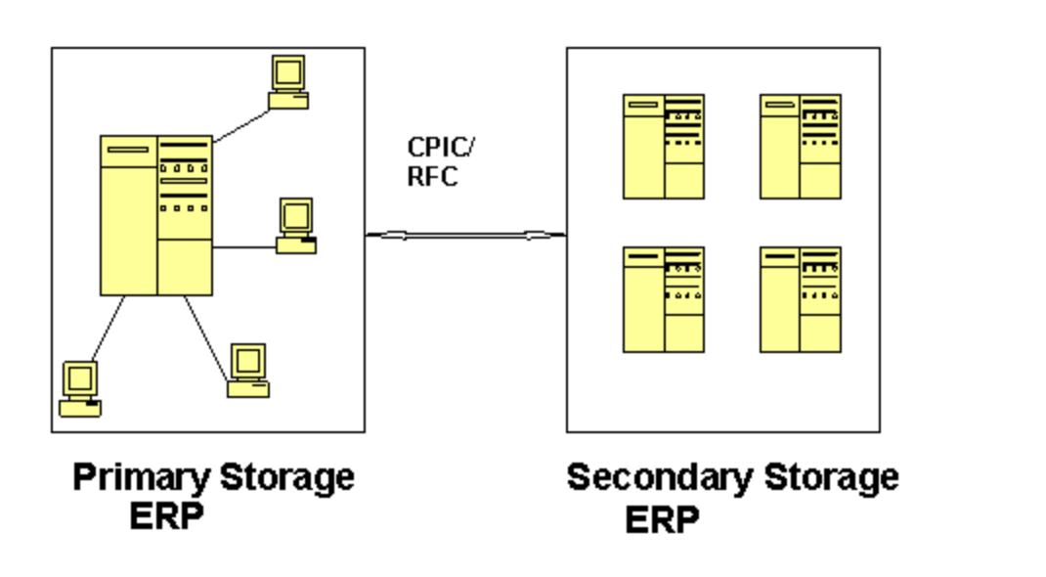
PRA – “I can’t archive because I update history”
Don’t really “update history” – simply post against a previous period entry
Historical PRA Limitations (Prior to EHP 8)
  Archived Enabled Tranasaction not available
  Certain additional archive features not available
  SAP alternative was PRA Data Management (separate DB(s), but not archived/compressed)
PRA Data Management
Notes:
Deepak

Slide 7
Technical Solution
PRA EHP 8 and above (example 10TB system)
  With enhancement points from Auritas, ability to “link” a reversal or entry to a specific archived object
  In the journal entry, reference the archive link in text field
  Ability to perform through individual entries or bulk batch process
  Example Result – 10TB down to ~5TB
PRA <EHP8 solution (example 10TB system)
  Even for companies below EHP8, Auritas can still provide immediate benefit
  Typical DB sizing is 60% PRA, 40% non-PRA
    Can address ~50% reduction in the non-PRA data
    For PRA data, can still address ~25% of index/log files/etc.
  Example Result – 10TB down to ~6.5TB
  Complimentary analysis to provide specific detail
Notes:
Deepak

Slide 8
Customer Examples
Similar scenarios across O&G, Publicly Traded Companies, Utilities
O&G Customer
  PRA was 75% of transactional DB size
  Auritas ability to reduce PRA data from 24TB to 13TB
  Customer able to use archive link object in current period journal entry
NBC
  Archived separate company codes across 2 systems
  Able to reduce overall size from 40TB to 24TB
  Historical cross-company adjustments were made using the text field/link archive object
Centerpoint Energy
  Similar requirements exist with utility companies given rate case adjustments
  Auritas was able to provide
    ~50 reduction in DB size
    Reporting and Audit access to the off-line archive data
    Ability to align a current period journal adjustment to an archived object
Notes:
Deepak

