Slide 1
Driving Innovation, Empowering Transformation
Auritas SAP Document Management Services

Slide 2






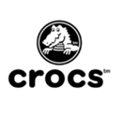






Customer Success
Services Across Multiple Industries – Verticals:

Slide 3




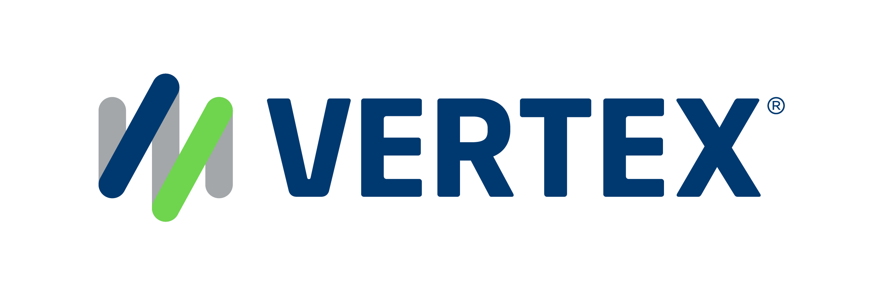
1,500
10,500+
25 Yrs
$1,5B
Successful Projects
TB of Data
Managed
Transforming Companies
Total Customer Savings
Driving Innovation, Empowering Transformations.
Data Management
Solution
implementation
Product
& Innovations
Strategic
Partnerships
  Data Archiving & ILM
  Retention Management
  HANA Memory Optimization (NSE)
  Data Governance
  Data Migration
  Cloud Migrations
  Data Privacy and Security
  Legacy Decommissioning
  Data Volume Assessment
  Data Quality Assessment
SAP S/4HANA & RISE
SAP BTP Deployment
  SAP Integration Suite
AI Implementation
SAP OpenText
  Extended ECM (xECM)
  Vendor Invoice Management
  Document Presentment
SAP Ariba
SAP Vertex
SAP Vistex
Geospatial Intelligence (GIS)
  Data ASSIST by Auritas
  (Data Archiving Automation)
  Data GUARD by Auritas
  (Legacy Decommissioning)
  Auritas Intelligent Accrual
  (Financial Automation)
  DMS+ by Auritas
  (Enhanced Document Storage)
SAP Gold Partner
SAP PartnerEdge, Sell
CCFlex – Cloud Choice Flex
PartnerEdge®
  (AMS + Hypercare)
CCFlex

Slide 4
Key Benefits of SAP Document Management
Centralized Document Repository:
Securely manage documents across
multiple business processes.
Compliance & Security:
Ensure lifecycle management, retention policies, and regulatory compliance.
Process Automation:
Save time with automated workflows for document approvals and routing.
Improved Collaboration:
Employees can securely access, share, edit, and download documents in real time.

Slide 5


SAP Document Management
Auritas implements document management solutions from SAP, including SAP DMS and third-party cloud solutions.
SAP Document Management service is a ready-to-use web application on SAP BTP, designed to manage digital documents efficiently within and across business applications.
+

Slide 6
Your Goal: Document Management Improvement
Better Filing
  Limited benefit
  More challenges with growing business
Harness SAP documents management features
  No additional software/licenses
  Limited user training
  Integration of Data and Documents
Add Document Management Solution
  Centralized place for managing documents- SAP and others
  Take to the next level-True Enterprise Content Management(ECM)
Our Expertise
Tailored Solutions
Auritas Data Suite – DVM tools for automated archiving & a decommissioning hub
  Integrates with Document Management Services
Single solution for handling transactional data and document

Slide 7
Summary: SAP Archiving Alternatives
Alternatives | Basic File System | SAP Content Server/SAP BTP | Third-Party Archiving Solution
Archive Files and Delete Methods | Yes | Yes | Yes
Retrieval Methods | Yes | Yes | Yes
Inbound Documents and Imaging | No | Yes (Auritas) | Yes
Outbound Documents and Printlists | No | Yes | Yes
Archive Server (Storage System) | No | Yes | Yes
Optical Media (WORM, CD) and Tape | No | No | Yes
Software Cost | None | None | Yes
Multiple SAP Systems with Single Server | No | Yes | Yes
SAP Support | No | Yes | No
Multiple Media Types with Single Server | No | No | Yes

Slide 8
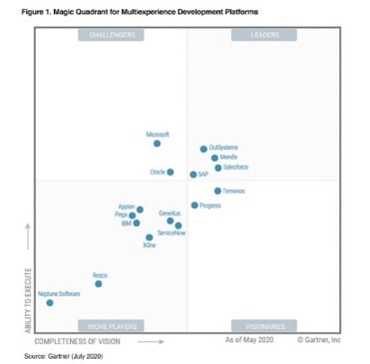
SAP BTP Document Management
The SAP Intelligent Enterprise vision
SAP Business Technology Platform helps manage business data, including structured data in the database, and unstructured data including document attachments.
SAP solutions manage the lifecycle of data and documents in business context to help:
simplify and accelerate business process,
reduce operating and infrastructure costs
protect the organization from audit, legal and regulatory compliance risk.
BUSINESS NETWORK
BUSINESS
PROCESSES
Across all functions
EXPERIENCE MANAGEMENT
APPLICATIONS
INTELLIGENT SUITE
INDUSTRY CLOUD
SUSTAINABILITY MANAGEMENT
BUSINESS TECHNOLOGY PLATFORM
TECHNOLOGY
Database & Data Management
Analytics
Application Development & Integration
Intelligent
Technologies
Data
Documents

Slide 9
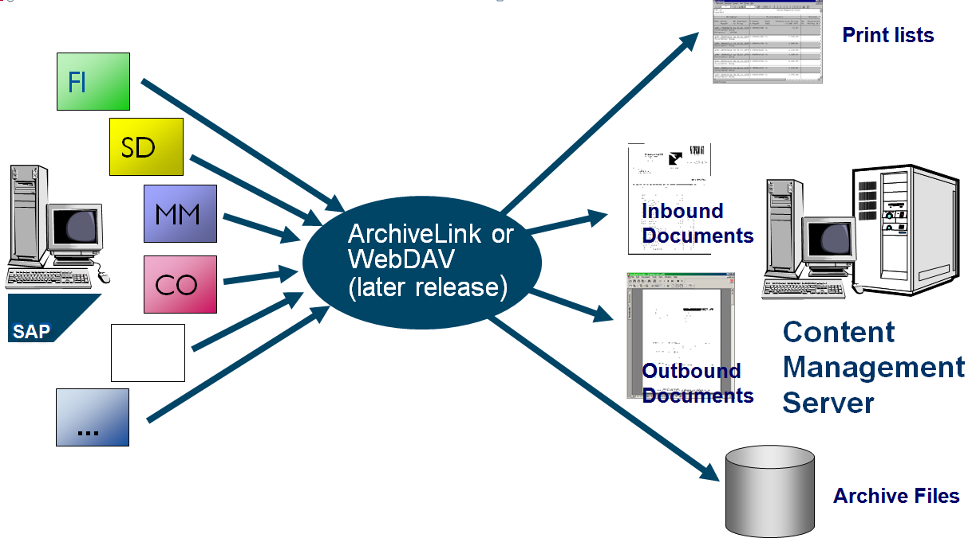
Use SAP to Integrate Documents
FI
SD
ArchiveLink or
CMIS
(later release)
MM
Content Management Solution
CO
…

Slide 10
Third Party Storage Solutions for Doc Management
Notes:
Other solutions for front end – consider a scanning service
Mention the outbound version of this model
Portal access allows for all the types of devices out there

Slide 11
Storage Solution Selection Considerations
What kind of data and documents do you want to store?
Will your storage solution be managing data and documents linked to SAP or non-SAP documents? Both?
Certification with SAP Archivelink/CMIS
Scalability
Cost
Linked hardware/software (proprietary/generic)
Disaster recovery
Migration
Features (Web access, full text, OCR, Output Management, document destruction, etc.)

Slide 12
Common Incoming Documents and SAP Objects
FI Documents
  Vendor Invoices
  Correspondence
  Customer Purchase Orders
Delivery
  Signed Bills of Lading
Vendor Master
  Contracts
Customer Master
  Contracts
  Terms
  Credit Application
Material Master MKPF
  CAD Drawings
  MSDS Sheets
HR Documentation PREL
  Entire Personnel folder
Travel & Expenses
  Trip report and Expenses
Service Orders
  Service Order Sign off
Customer Invoices
  Customer Checks and remittance
Real Estate Master
  Contracts
Fixed Asset Master
  Vendor Invoices
  Manuals and Contracts
Purchase Orders
  Receiving documentation
  Purchase Order Request
Material Document
  Receiving Documentation
WBS Elements
Notes:
All the scenarios that can be used - D

Slide 13

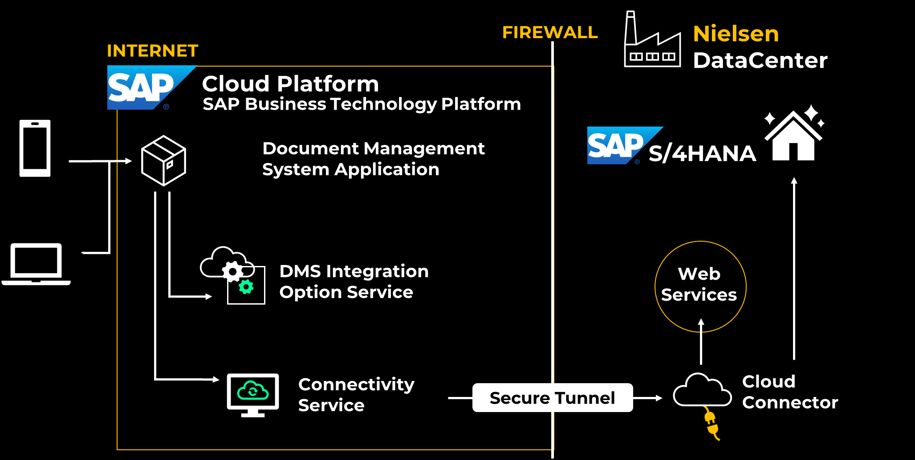
Technical Design Document
SAP BTP Document Management Service
SAP Business Technology Platform
BTP Global Account
BTP Subaccount
Cloud Foundry Env.
Services
1. Doc Management Service Integration Option

Slide 14

Actual Benefits
  Empowered employees with secure-access to real-time data & documents
  Access to Data and linked Documents from SAP, FIORI & BTP
  Compliance and reduction of operational and legal risk
  Secured long-term storage in durable, tamperproof form
  Deployed a highly scalable content management solution S/4HANA that can be leveraged for Success Factor, and Ariba
  Increased process efficiency to access SAP data & documents in business process views
  Leverage storage lifecycle for lower costs

Slide 15


Research
Success Story:
Implement & Streamline SAP BTP Document Management
Pain Points & Context:
  Recently completed divestiture of Buy and Watch business units.
  Recent move to S/4HANA open possibilities to explore SAP BTP capabilities.
  Looking to enhance its document management processes.
Solution:
  Auritas and SAP created a Proof of Value with cost benefits and options.
  Optimization of document management using ArchiveLink and SAP DMS.
  ArchiveLink shifted attachment storage to BTP from SAP database, making it accessible from SAP.
  SAPOffice DMS used for storage, facilitating document transfer.
  Validation process with thorough testing for configuration efficiency.
Results:
  Data/Document segregation to support retention management,
  Cost savings due to SAP BTP cost-effectiveness.
  Enhanced the efficiency of content management strategies.
  Company became self-sufficient rapidaly, better positioned for technological updated.

Slide 16

Our Expertise
Tailored Solutions
Auritas Data Suite – DVM tools for automated archiving & a decommissioning hub
  Integrates with Document Management Services
Single solution for handling transactional data and document
Key Benefits
  Services cover all pillars of Data Management, Enterprise Content Management & Process Optimization
  Proven track record across all industries
  Rich expertise and innovation has driven us to become SAP's go-to partner.

