Slide 1
Driving Innovation, Empowering Transformation
Auritas Master Data Governance Approach

Slide 2





1,500
10,500+
25 Yrs
$1,5B
Successful Projects
TB of Data
Managed
Transforming Companies
Total Customer Savings
Driving Innovation, Empowering Transformations.
Data Management
Solution
implementation
Product
& Innovations
Strategic
Partnerships
  Data Archiving & ILM
  Retention Management
  HANA Memory Optimization (NSE)
  Data Governance
  Data Migration
  Cloud Migrations
  Data Privacy and Security
  Legacy Decommissioning
  Data Volume Assessment
  Data Quality Assessment
SAP S/4HANA & RISE
SAP BTP Deployment
  SAP Integration Suite
AI Implementation
SAP OpenText
  Extended ECM (xECM)
  Vendor Invoice Management
  Document Presentment
SAP Ariba
SAP Vertex
SAP Vistex
Geospatial Intelligence (GIS)
  Data ASSIST by Auritas
  (Data Archiving Automation)
  Data GUARD by Auritas
  (Legacy Decommissioning)
  Auritas Intelligent Accrual
  (Financial Automation)
  DMS+ by Auritas
  (Enhanced Document Storage)
SAP Gold Partner
SAP PartnerEdge, Sell
CCFlex – Cloud Choice Flex
PartnerEdge®
  (AMS + Hypercare)
CCFlex

Slide 3













Customer Success
Services Across Multiple Industries – Verticals:

Slide 4

Auritas Data Management Factory
  Assess
  Address
  Sustain
SAP Master Data Governance
Auritas Accelerators
Continuous Support - AuriCare

Slide 5
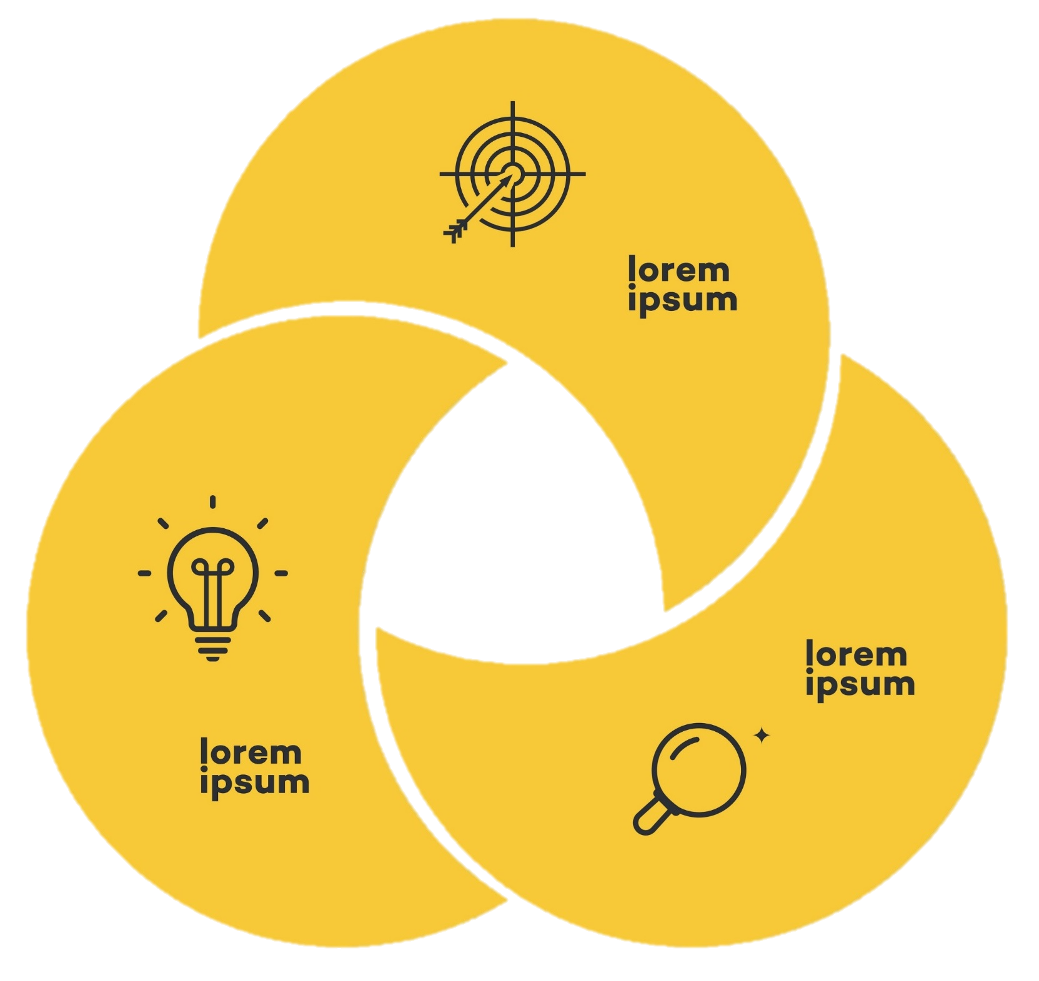

Holistic Approach to Data Quality
Auritas recognizes that true success in the pursuit of data quality lies in the seamless integration of People, Process, Technology and Data.
The right solution for your quality issues is a tailored outcome-based strategy, focused on your unique needs of your organization to successfully govern your data.
People
Process
Data
Technology

Slide 6

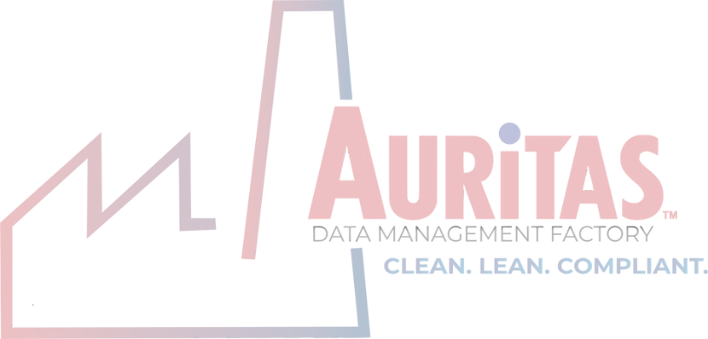
Auritas Data Management Factory

Slide 7

Auritas Project Methodology​
Assess
Data governance maturity assessment.
Review and draft data quality and governance standards.
Address
Detailed data profiling against established standards.
Develop data transformation/governance plan.
Data transformation: standardize, cleanse & enrich.
Sustain
Operationalize active/passive data governance.

Slide 8
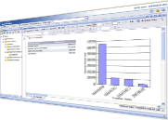




2
4
1
9
8
6
5
3
7

Slide 9

1. Assess
Priorities are established according to value, impact, and quality evolution.
Understand your practices and processes for managing data.
Capture the business context.
Identify business critical data.
Establish standards and rules for data quality remediation and governing critical data elements.
Create a common language through glossary and dictionary.
Inform the organizational readiness model – ensure data ownership, stewardship, and accountability.

Slide 10
Data Governance ​
Maturity Assessment​
Strategic - Data
Governance Council
Operational - Data Stewards
& Data Owners
Operational - Users
Operational - Working
Groups
Tactical - Steering
Committee
Data Standards
  Identify attributes across the enterprise
  Principle of “One”
  Data is optimized for data consumption
Business Processes and Controls
  Understanding the business processes that impact EDM
  Alignment to compliance rules and regulations
  Set up policies that comply to the enterprise needs
Quality Metrics
  Set up appropriate measures of data quality and service levels
  Set up remediation guidelines
  Ensure data is “fit-for-use”
Data Governance Model

Slide 11
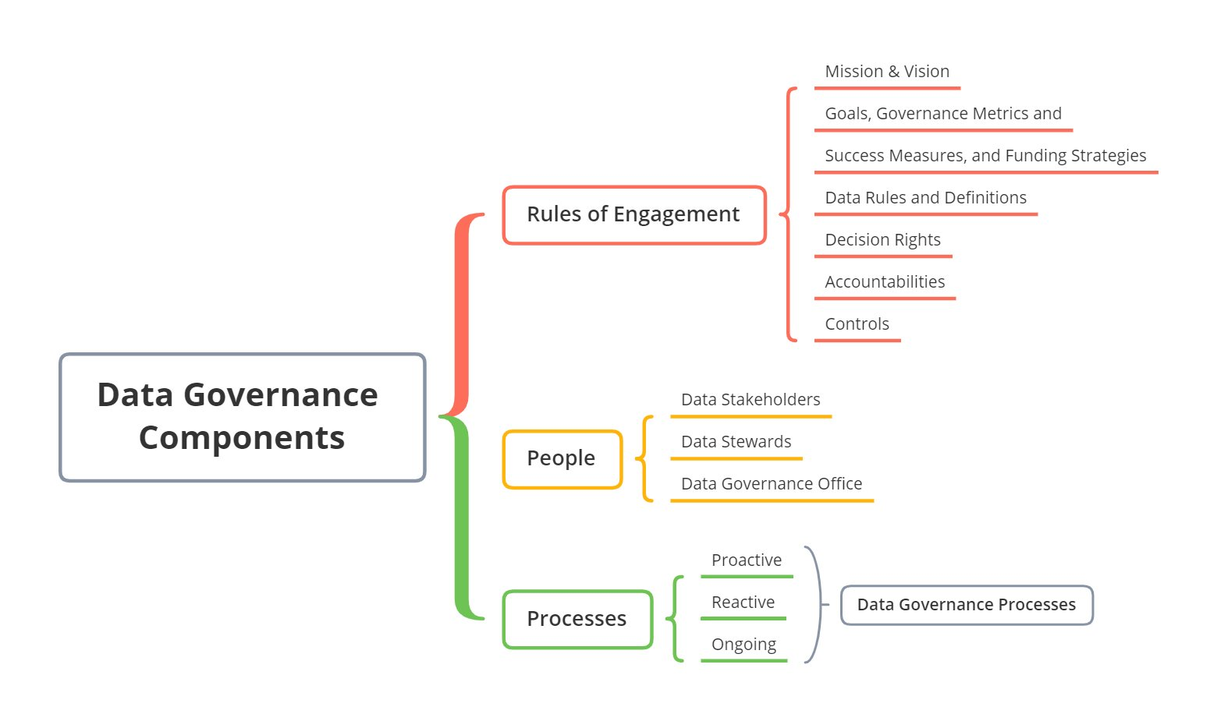
Data Governance ​Maturity Assessment
Components​

Slide 12


Data Quality Assessment
A Data Quality Assessment is a comprehensive analysis of a database's content, within any SAP and non-SAP environment.
Assessment Use Case
  Data Doctors perform diagnostics of the health of your SAP Master & Transactional Data through a battery of 297 tests.
    The assessment requires little engagement from corporate resources (2 hours per object from internal staff).
    The comprehensive report includes the current data health and the recommended remediation alternatives, both process and technology.
Receive Your Results in 10 days!

Slide 13

2. Address
With deep understanding of the landscape and business requirements, Auritas experts implement the recommendations from assess phase.
  Cleanse the data;
  Creating standards and policies;
  Setting you data governance organization;
  And more.

Slide 14
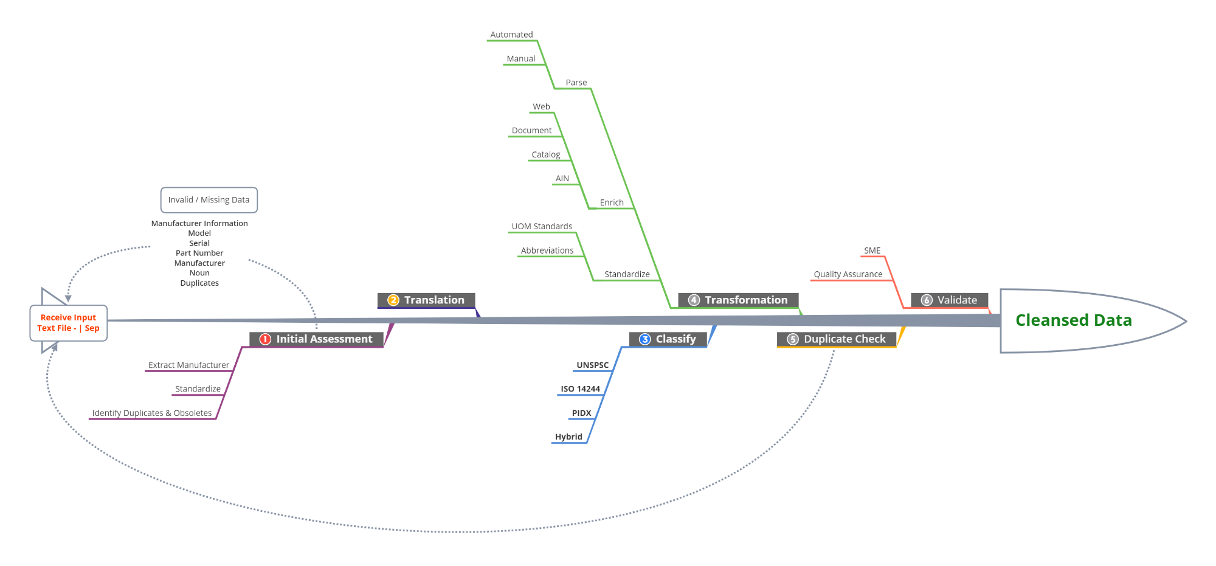
Data Transformation Process

Slide 15
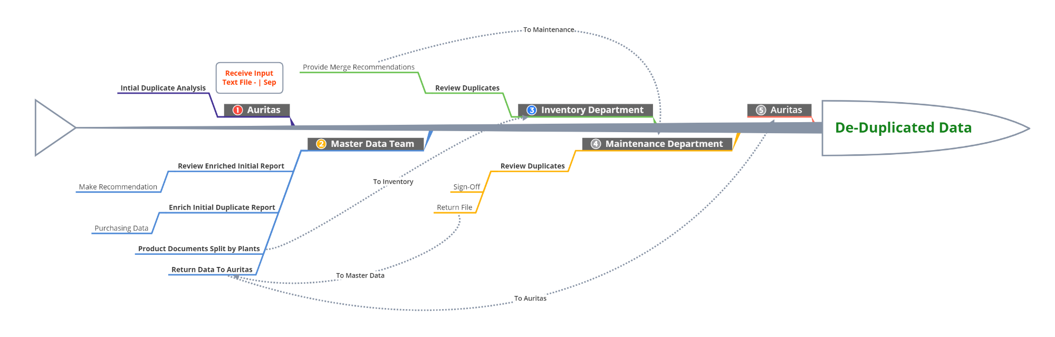
De-Duplication Process

Slide 16
2. Address
Auritas POV:
There is no silver bullet for data remediation – ~20% hit rate for AI/Machine Learning.
Many third-party catalogs and repositories are not maintained or updated infrequently.
Data remediation should be a one-time event – get it clean then keep it clean.
Proper analysis of existing data with established standards and business rules must take place first.
Most projects that involve the customer taking ownership of data remediation do not achieve the desired outcome – Expensive and lack of subject matter expertise.

Slide 17
2. Address
Implement Master Data Governance tools [SAP Master Data Governance].
Centralizes critical business data for a unified source of truth.
Validate and enrich master data, boosting accuracy and reducing errors.
Ensures structured data governance with controlled, workflow-driven processes.
Highly adaptable, MDG tailors to specific needs, supporting various data domains.
Seamless integration with SAP and non-SAP systems ensures consistent master data across the IT landscape.

Slide 18

The Technology:
SAP Master Data Governance

Slide 19


SAP Master Data Governance
Tackling the master data challenge with consolidation and central governance.
Get data clean
Consolidate master data from de-central sources
Centrally govern and distribute master data
LoB processes
De-central
IT landscape
On-premise systems
SAP MDG
Cloud applications
Cloud
3rd party apps
Other LoB
Mergers and Acquisitions
Keep data clean
Notes:
MDG Overview

Slide 20






SAP MDG – Process Flow
External Providers
External Services
SAP Master Data Governance
Re-use existing business logic,
integrate external services
for data enrichment, address
cleansing, duplicate detection, …
Collaboration
Adaptable workflow
Auditable change process
2
3
Maintain
Approve
Validate
Replicate
Adapt
Maintain
Validate
Approve
Replicate
Central maintenance of
master data in staging area
1
4
Automatic replication to
non-SAP and SAP systems
Business Processes
5
Adapt
Adaptation / enrichment in local systems

Slide 21
SAP MDG – Integrated Object Model
Supplier & Customer
Enterprise Asset Mgmt.
Retail & Fashion Mgmt.
Financials
Material
Out-of-the box delivery of proven data models for operational and financial master data
Accounting ,Controlling and Consolidation
Basic & Classification Data
Business Partner Attributes
Asset Structures
Basic & Classification Data
GL Account* /
Chart of Accounts
General Data &
Descriptions
Central Data
Roles
Work Centers
Descriptions
Units of Measure
Equipment Master
Linear Asset Capabilities
Tax
Bill of Material
Cost Element* /
Hierarchies
Units of Measure
Bank Details
Identification
Functional Location
Textile Components
& Fiber Codes
Quality Data
Tax Numbers
Industry Sectors
Object Links and Networks
Characteristics
Assignment & Variants
Financial Reporting
Structures:
Balance Sheet,
P&L Statement
EAN, UPC
Addresses with Usage and Versions
Work Management
& Procurement
Distribution Curve
Classification
Business Partner Relationships
Maintenance Plans
Maintenance Items
Purch.
Cost Center /
Hierarchies
Document Link
Purchase Info Record
Supplier Attributes
Customer Attributes
Measuring Points
Purchasing Org / Vendor / Site
Logistics Data
General Data
General Data
Profit Center /
Hierarchies
Sales Data
Task Lists
Logistics, Listing, Sales
Stores
Distribution Cntrs.
Plant Data
Comp. Code Data
Service Master
Listing
Layout Module
Internal Order
Comp. Code Data
Point of Sales
Sales Org. Data
Storage &
Warehouse Data
Sales Area Data
MRO
Bill of Material
Assortment
Season Assignmt.
Company
Purchasing Data
Tax Indicators
Header: Identifying and Quantity,
Validity Data, Material Data, Texts
Additionals
Article Hierarchy
Consolidation:
Item, Group &
Hierarchies, Unit,
Break Down Category
Production Version
Substitution
Additional Texts
Value
Contract Account Attributes
Item: Detail, Quantity, Status,
MRP and Purchasing Data,
Text and Document Assignment
Document Management System
Valuation, Costing,
Material Ledger
General Data
Partner-specific Data
FMS
Segmentation
Seasons
* User interface integration between GL Account and Cost Element only supported in SAP MDG on SAP S/4HANA

Slide 22
Implementation Methodology
2. Discover
4. Explore
6. Run
Conduct workshops to understand business requirements.
Document current state processes & pain points.
Identify master data objects and key data elements.
Develop a high-level data model.
Identify data quality issues and challenges.
Conduct integration and user acceptance testing.
Fine-tune configurations based on testing feedback.
Develop and deliver end-user training.
Develop data migration and conversion plans.
Finalize documentation for the solution.
Establish ongoing support and maintenance processes.
Monitor system performance and data quality.
Address and resolve issues as they arise.
Implement continuous improvement initiatives.
Capture and analyze user feedback for future enhancements.
1. Project Preparation
3. Prepare
5. Deploy
7. Review & Close
Define project scope, objectives, and goals.
Identify and assemble the project team.
Establish project governance and communication plans.
Develop the project plan and schedule.
Set up the project infrastructure.
Develop a detailed blueprint for the solution.
Define master data processes and workflows.
Configure SAP MDG based on blueprint specifications.
Design and implement data models.
Develop and configure data quality and validation rules.
Execute cutover activities to transition to the live system.
Load and validate master data in the production system.
Monitor system performance and resolve issues.
Provide post-go-live support.
Conduct training for support teams.
Conduct a project review to assess success and lessons learned.
Finalize and close project documentation.
Hand over the solution to the operational teams.
Archive project information and knowledge.
Notes:
Talk to Raja – key tasks under each::
SAP activate methodology
Discover
Prepare
Explore
Realize
Deploy
Run

Slide 23

3. Sustain
Monitor & maintain:
Continuously monitor data quality to ensure ongoing adherence to standards.
Regularly assess and optimize governance processes.
Track KPIs to gauge and adjust the effectiveness.
MDG Tool Maintenance: Ensure uninterrupted functionality through regular updates and fixes.
Update governance strategies to meet evolving needs.
Auritas’ AuriCare

Slide 24

System Administration & Regular Maintenance
Guidance, Break Fix & Technical Support
Auritas Application Management Services for Ongoing Support
System Performance & Health Advisory
Our service structure ensures that you pay only for what you need without a compromise on quality.
System Upgrade Advisory
On-Demand Packages

Slide 25

With Auritas, you have a partner that is dedicated to the long-term success of your data governance efforts.

Slide 27



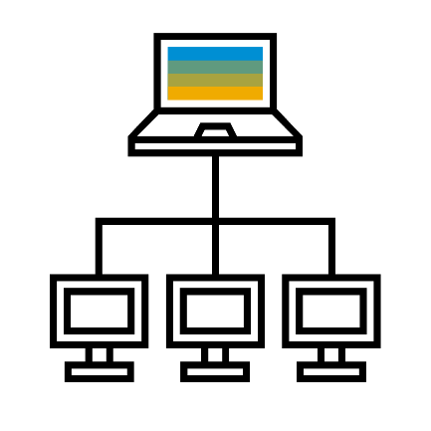




SAP Information Steward – Key Capabilities
Profile, Assess, Monitor, Manage and Analyze Data Quality
SAP BW
SAP Business Suite
1
Discover enterprise data quality and metadata.
SAP
HANA
1. Discover
3. Workflow
2. Define
4. Monitor
5. Analyze
Databases
SAP Information Steward
2
Define polices, terms, validation rules and cleansing rules using profiling results.
Hadoop
3
Enable workflow for data quality task ownership of data assets.
BI systems
ETL tools
4
Monitor and resolve data quality issues with pre-loaded templates
Delimited files
Data Modeling tools
5
Analyze data quality using business value analysis to quantify financial impact.
Sources
Data Discovery & Stewardship
Notes:
At a high-level, this is how SAP Information Steward works:
Use Information Steward to connect to supported data sources. Perform profiling on the content, quality, structure and relationship of the connected sources. Or capture the metadata information of the connected sources.
Define validation rules and cleansing rules to determine the level of data quality of key data metrics. Define business terms and policies associated with metadata structures to provide business context.
Perform data assessment and catalog the level of data quality of key data metrics.
Monitor the data quality of key data metrics over time and point-in-time with a data quality dashboard and scorecards.
Analyze data quality impact to business outcomes with the Business Value Analysis feature.

