Slide 1
DMS+
by Auritas

Slide 2




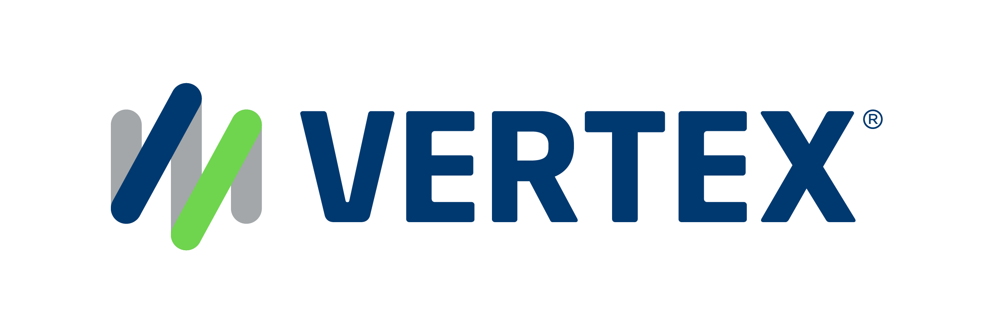
1,500
10,500+
25 Yrs
$1.5B
Successful Projects
TB of Data
Managed
Transforming Companies
Total Customer Savings
Driving Innovation, Empowering Transformations.
Data Management
Solution
implementation
Product
& Innovations
Strategic
Partnerships
  Data Archiving & ILM
  Retention Management
  HANA Memory Optimization (NSE)
  Data Governance
  Data Migration
  Cloud Migrations
  Data Privacy and Security
  Legacy Decommissioning
  Data Volume Assessment
  Data Quality Assessment
SAP S/4HANA & RISE
SAP BTP Deployment
  SAP Integration Suite
AI Implementation
SAP OpenText
  Extended ECM (xECM)
  Vendor Invoice Management
  Document Presentment
SAP Ariba
SAP Vertex
SAP Vistex
Geospatial Intelligence (GIS)
  Data ASSIST by Auritas
  (Data Archiving Automation)
  Data GUARD by Auritas
  (Legacy Decommissioning)
  Auritas Intelligent Accrual
  (Financial Automation)
  DMS+ by Auritas
  (Enhanced Document Storage)
SAP Gold Partner
SAP PartnerEdge, Sell
CCFlex – Cloud Choice Flex
PartnerEdge®
  (AMS + Hypercare)
CCFlex

Slide 3













Customer Success
Services Across Multiple Industries – Verticals:

Slide 4
Content Management Challenges
Excessive time spent on document creation, retrieval, and approval workflows
Rising storage and management costs due to lack of automation and inefficient resource utilization
Difficulty managing content across global operations, limiting seamless collaboration & visibility
Challenges locating the right documents quickly, manually searching through large volumes of files
Ongoing struggles to meet regulatory & compliance requirements, increasing risk and audit complexity
Limited cross-department collaboration, no appropriate access and usability for all users
Disconnected content silos prevent integration with SAP business processes & limit contextual access
Overly complex and rigid folder structures, forcing users to memorize navigation paths

Slide 5
The Role of Content Management
From finance and procurement to supply chain and HR, compliance-driven content management solutions and processes, are design so teams gain immediate access to the right content, at the right time.
Connect content and digital media with business data and relationships to bring value
Increase efficiency by reducing time on document handling, retrieval, & approval
Meet regulatory compliance in document handling across different departments
Businesses struggling with silos and need to integrate content with SAP
Seamless content management & collaboration across geographies
Complete control over unstructured content across its lifecycle for risk reduction
Notes:
Mani

Slide 6

DMS+ by Auritas is an advanced content management solution built to overcome the limitations of standard SAP BTP DMS and elevate it to enterprise-grade performance with AI-driven analysis, intelligent redaction, metadata management, cross-system synchronization, and more.
Intelligent, AI-Enhanced Document Management on SAP BTP
DMS+ elevates SAP BTP DMS with AI-driven search, summaries, metadata enrichment, redaction, and contextual insights, enabling users to quickly understand and act on documents without manual effort.
Unified Content Access with Enterprise-Grade Governance
The solution consolidates documents across SAP modules and third-party systems into a single repository while enforcing records management for compliance and audit readiness.
Seamless SAP Ecosystem Integration with Flexible Use Cases
Built as an enhancement layer over BTP DMS, DMS+ integrates with tools like Data GUARD and Data ASSIST to support volume management, decommissioning, and more.
Notes:
We can add screenshots here
-- Rework the visual of slide 5

Slide 7
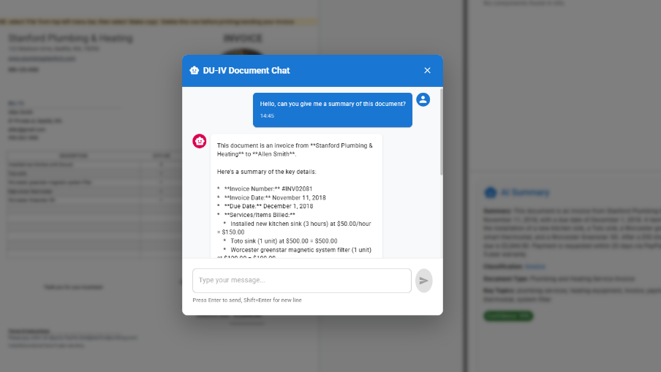
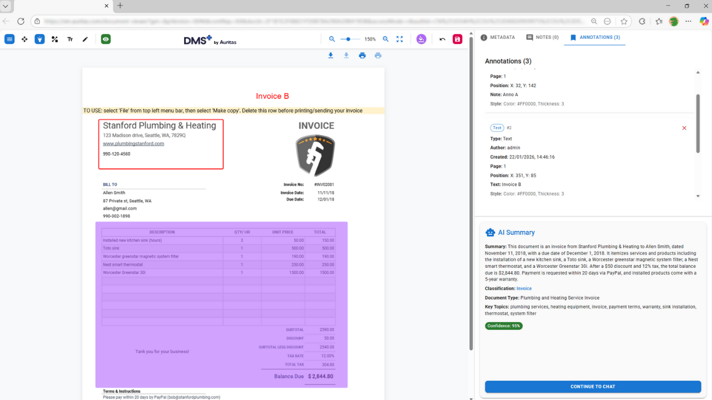
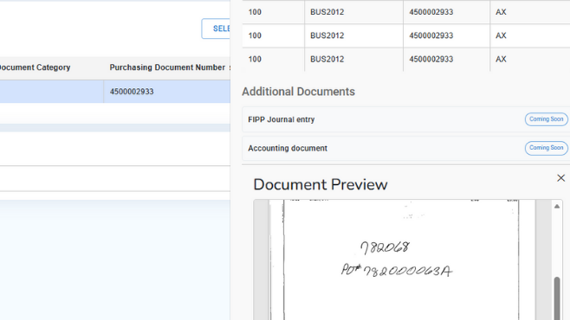
Revolutionize SAP DMS with AI-enabled Intelligent Management
Intelligent Document Access & Viewing
Annotations, Notes
& Collaboration
Metadata, Search & Operational Context
Provides instant access to documents from any SAP business object with an AI-enhanced viewer for summaries, insights, and annotations.
Enables secure annotations, highlights, and notes directly within documents, governed by user roles and access permissions.
Enriches documents with SAP operational data and synchronized metadata, enabling precise, contextual, user-initiated search from any screen.

Slide 8
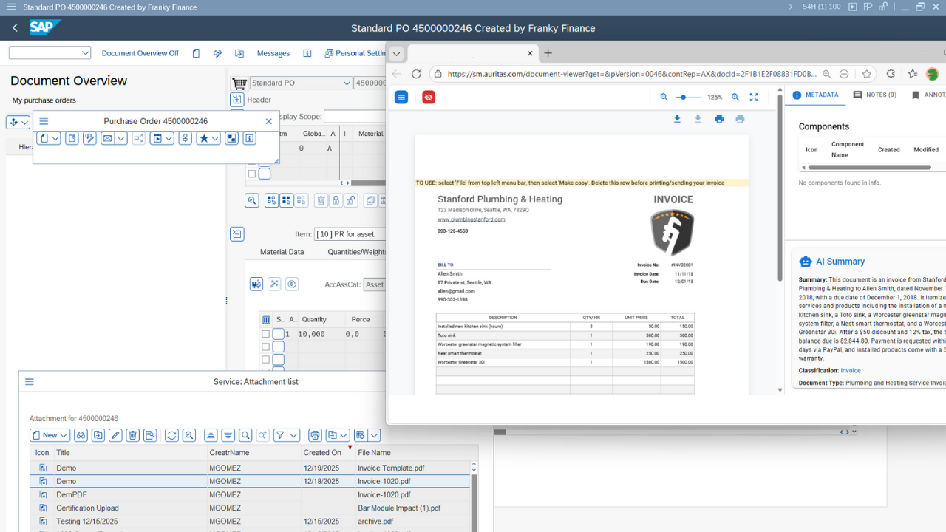
CMIS and ArchiveLink certification
DMS+ enables your ERP to store archive (ADK) files and attachments on SAP BTP DMS.
With the solution, organization can have easy access to legacy data and files while ensuring seamless compliance.
For organizations that already use DMS as a repository for archived data or are considering it, DMS+ by Auritas provides a compliant alternative.
DMS+ enables organizations to leverage SAP DMS for archive files.

Slide 9
Security and Access Controls
Uses AI to automate document processing, deliver contextual understanding, and power advanced semantic search and knowledge mining.
Content Management Automation & Compliance
Automation for Compliance Assurance
Applies role-based visibility, field masking, and ILM-aligned records management to ensure compliant and controlled document access.
One Source of Truth & Storage Optimization
Consolidates all documents into a unified global repository, eliminating module silos and addressing storage limitations across platforms.
Context-Aware Guidance
AI uses the associated SAP record when available to surface the most relevant information from your search.
Notes:
For the messaging/title for each feature:
What feature are we talking about? (automated scheduling) – Advantage – What benefit/outcome it drives to the customers?
Visual rework

Slide 10
Intelligent Viewer
Intentional, secure visibility to documents and content
Single viewer screen that allows for AI search with contextual information, connection across applications and security/compliance based on user groups across the organization.
Access‑level‑based rendering/visibility: each document is presented according to the user’s access profile; fields are hidden/masked and disallowed actions are removed.
AI chat: ask questions about the content, executive summaries and key‑data extraction (restricted to content the user is entitled to see).
Unified access and view: the Intelligent Viewer can be invoked from SAP, 3rd‑party apps, or the DMS+ access layer.
Annotations + AI + Access Levels = True Content Value
Notes:
For the messaging/title for each feature:
What feature are we talking about? (automated scheduling) – Advantage – What benefit/outcome it drives to the customers?
Visual rework

Slide 11
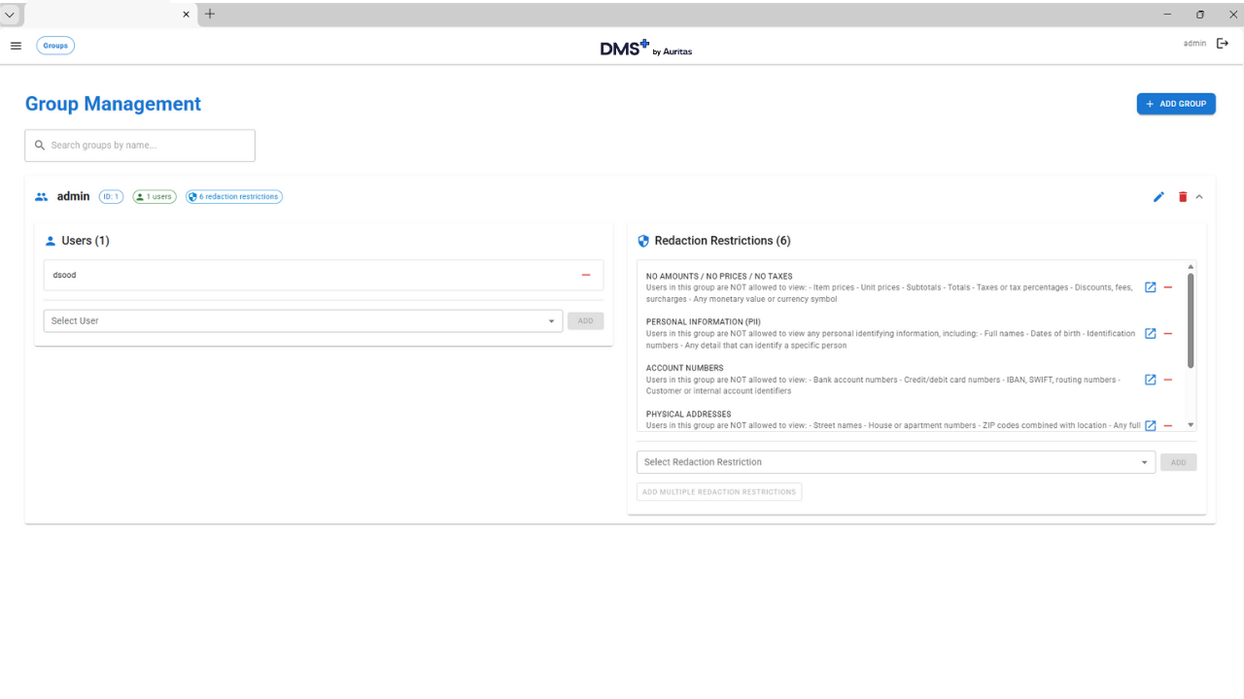
Enhancing SAP BTP DMS with DMS+
Annotations, notes and collaboration
Enterprise-grade governance
It allows secure annotations, highlights, and notes directly within your documents, facilitating seamless team collaboration in SAP while maintaining full historical access.
Uses artificial intelligence (AI) to automate document processing, deliver contextual understanding, and power advanced semantic search and intelligent knowledge mining.

Slide 12
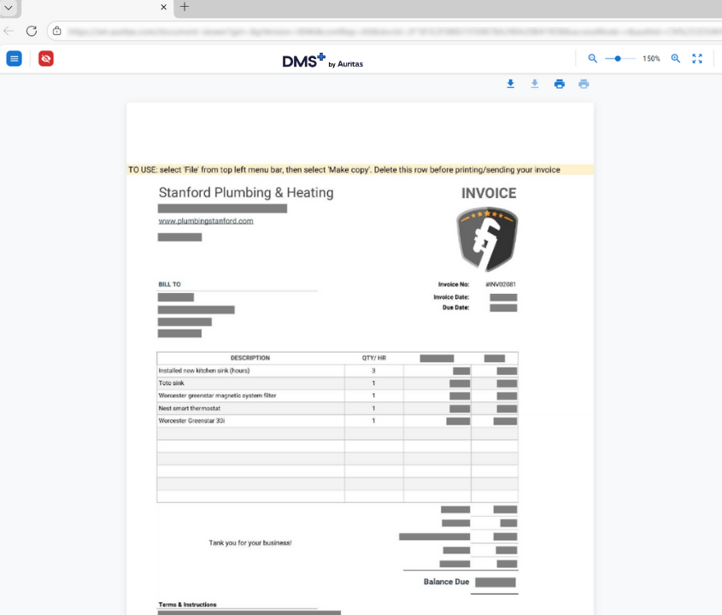
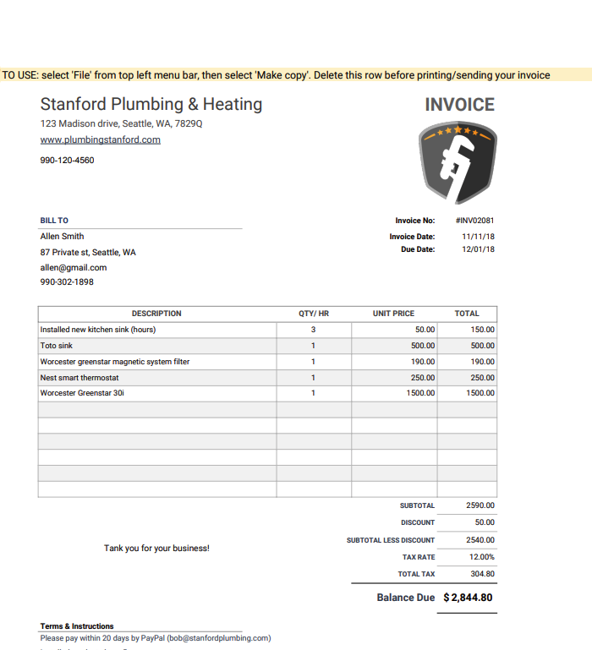
Smart, dynamic redaction to protect sensitive data & ensure compliance
With active redaction features, DMS+ users are assigned into groups groups that define visibility, ensuring only necessary information is shown, protecting sensitive data while ensuring compliance across the organization.
x
Define your visibility parameters based on groups.
Admin users view (original document - no redaction)
User view, limited info accessibility (redacted document)

Slide 13
DMS+ : The single-source-of-truth
Architecture
SAP S/4HANA
SuccessFactors
SAP Commerce
…
LEGEND
1
SAP data is stored in compliant long-term storage
Business Partner
Account
Account Team
2
SAP DMS documents are stored and published in business Document Container
SAP Data Archiving, ILM, DaRT, Legacy Decommission
Documents from SAP
Auritas Storage Manager Config
Auritas Storage Manager Connector
Auritas Storage Manager Connector
3
SAP ArchiveLink documents are stored and published in business Document Container of linked objects
SAP DMS Document
ArchiveLink Document
GOS Documents
4
SAP GOS documents are stored published in business Document Container
1
2
3
4
5
6
7
8
5
Manage content in business workspaces inside SAP incl. SAP documents
Auritas Storage Manager .
CMIS Repository
6
Manage content in business workspaces inside Salesforce; ingest documents as document attachments
7
Manage content in business workspaces inside Teams or synchronize Teams documents to business Container
Document view container
8
Auritas Storage Manager APIs to build own business workspace integration
Store data and documents via ArchiveLink interface
Storage Provider
Store document via CMIS interface
Publish document in
business workspace
Azure Storage, AWS S3, GCP and Big Query
Open, create & update business Container
Notes:
Content-fueled driven business processes in SAP
One version of truth in SAP applications with a tightly integrated repository in SAP solutions
Supporting SAP business processes end-to-end across applications
Increase efficiency by making content accessible in and out of SAP
Keep Business Workspaces automatically in sync with SAP Business Objects and SAP document types like SAP DMS, SAP ArchiveLink
Data archiving and document archiving
Certified for SAP S/4HANA, SAP Fiori and SAP HANA Database

Slide 14
DMS+ by Auritas
SAP BTP pre-requisite services:
Service Name | Role / Functionality | Service Plan (best) | Metric | Quantity
SAP Build Code (build-code) | Pro-code dev environment for backends/frontends; includes Joule copilot | Standard (Application) | Subscription | 1
SAP Build Work Zone, standard edition | Digital workplace/portal to centralize access to apps, content, and integrations | Standard edition | Active Users | 100 Active Users (starter tier; adjust to expected users)
Cloud Foundry Runtime | Run and deploy the 3 backends + 3 frontends; manage routes (public vs. private) and health checks | Standard | GB runtime memory | 36 GB (baseline PROD; scale up/down based on load)
Connectivity Service | Enable Cloud Connector tunneling from SAP landscapes to private /api/sap endpoints | Standard | Service instance | 1
Destination Service | Define and manage HTTP destinations (e.g., SAP → DMS+ Core /api/sap) | Standard | Service instance | 1
Credential Store | Secure storage for secrets/credentials; backends reference only the credential name | Standard | Service instance | 1
PostgreSQL (Hyperscaler) | Persist mappings (systems, storages, connections, API-key grants) | Standard | DB instance + storage | 1 DB + 100 GB
Application Logging | Centralized JSON logs and request correlation for operations and troubleshooting | Standard (cloud logging) | Logs ingest (GB/day) | 1 GB/day (baseline PROD; adjust to traffic)
XSUAA | Identity/token service for UIs or service-to-service OAuth tokens (otherwise API Key + mTLS) | Application | Service instance | 1–2 (1 if unified; 2 if you split UI vs API)
Object Store | Store all business documents and archive files (business data) | Standard | Storage (GB) | 1 TB (baseline PROD; adjust to retention/volume)

Slide 15
Enhance Your SAP Content Management with DMS+
No matter where you are in your SAP BTP DMS journey, DMS+ expands and strengthens your content storage capabilities. From full DMS implementations to enhancements of existing environments, we help you get more value from your documents.
Implement SAP BTP DMS from the ground up
Centralize doc storage across SAP & non-SAP
Extend DMS with automation + AI

Slide 16



DMS+ by Auritas Use Cases
Industry: Manufacturing
Industry: Construction
Industry: Utilities
Use Case Built for:
Use Case Built for:
Use Case Built for:
Background:
  Already had BTP DMS solution
  Needed a document management solution that handled data archive files and SAP documents
    DMS does not support archive files it as of October 2025
  Implemented DMS+ by Auritas solution
Background:
New S/4HANA implementation
Looking for shutting their legacy content mgmt. solution and inhouse solution
Needed to improve performance and speed of document retrieval
Looking for a solution that addresses all requirements of content management for SAP and SuccessFactors.
DMS+ by Auritas implementation
Background:
  Looking to replace Filenet content management platform
  Needed a tool that is built on cloud architecture
  DMS+ offered a serverless architecture
  and was highly scalable
Results and ROI:
  Storage of archive files on BTM DMS with DMS+
  Integration with SAP and SAP Commerce
  AI capabilities to search and summarize files on BTP storage
Expected Results:
  Management of all customer bills on centralized platform
  Single platform for all media content
  Manage archive archive files with DMS+
Results and ROI:
  Standardized & centralized processes
  Higher accuracy on business transactions.
  Increased planning & forecasting capability
  centralized content management tool

