Slide 1

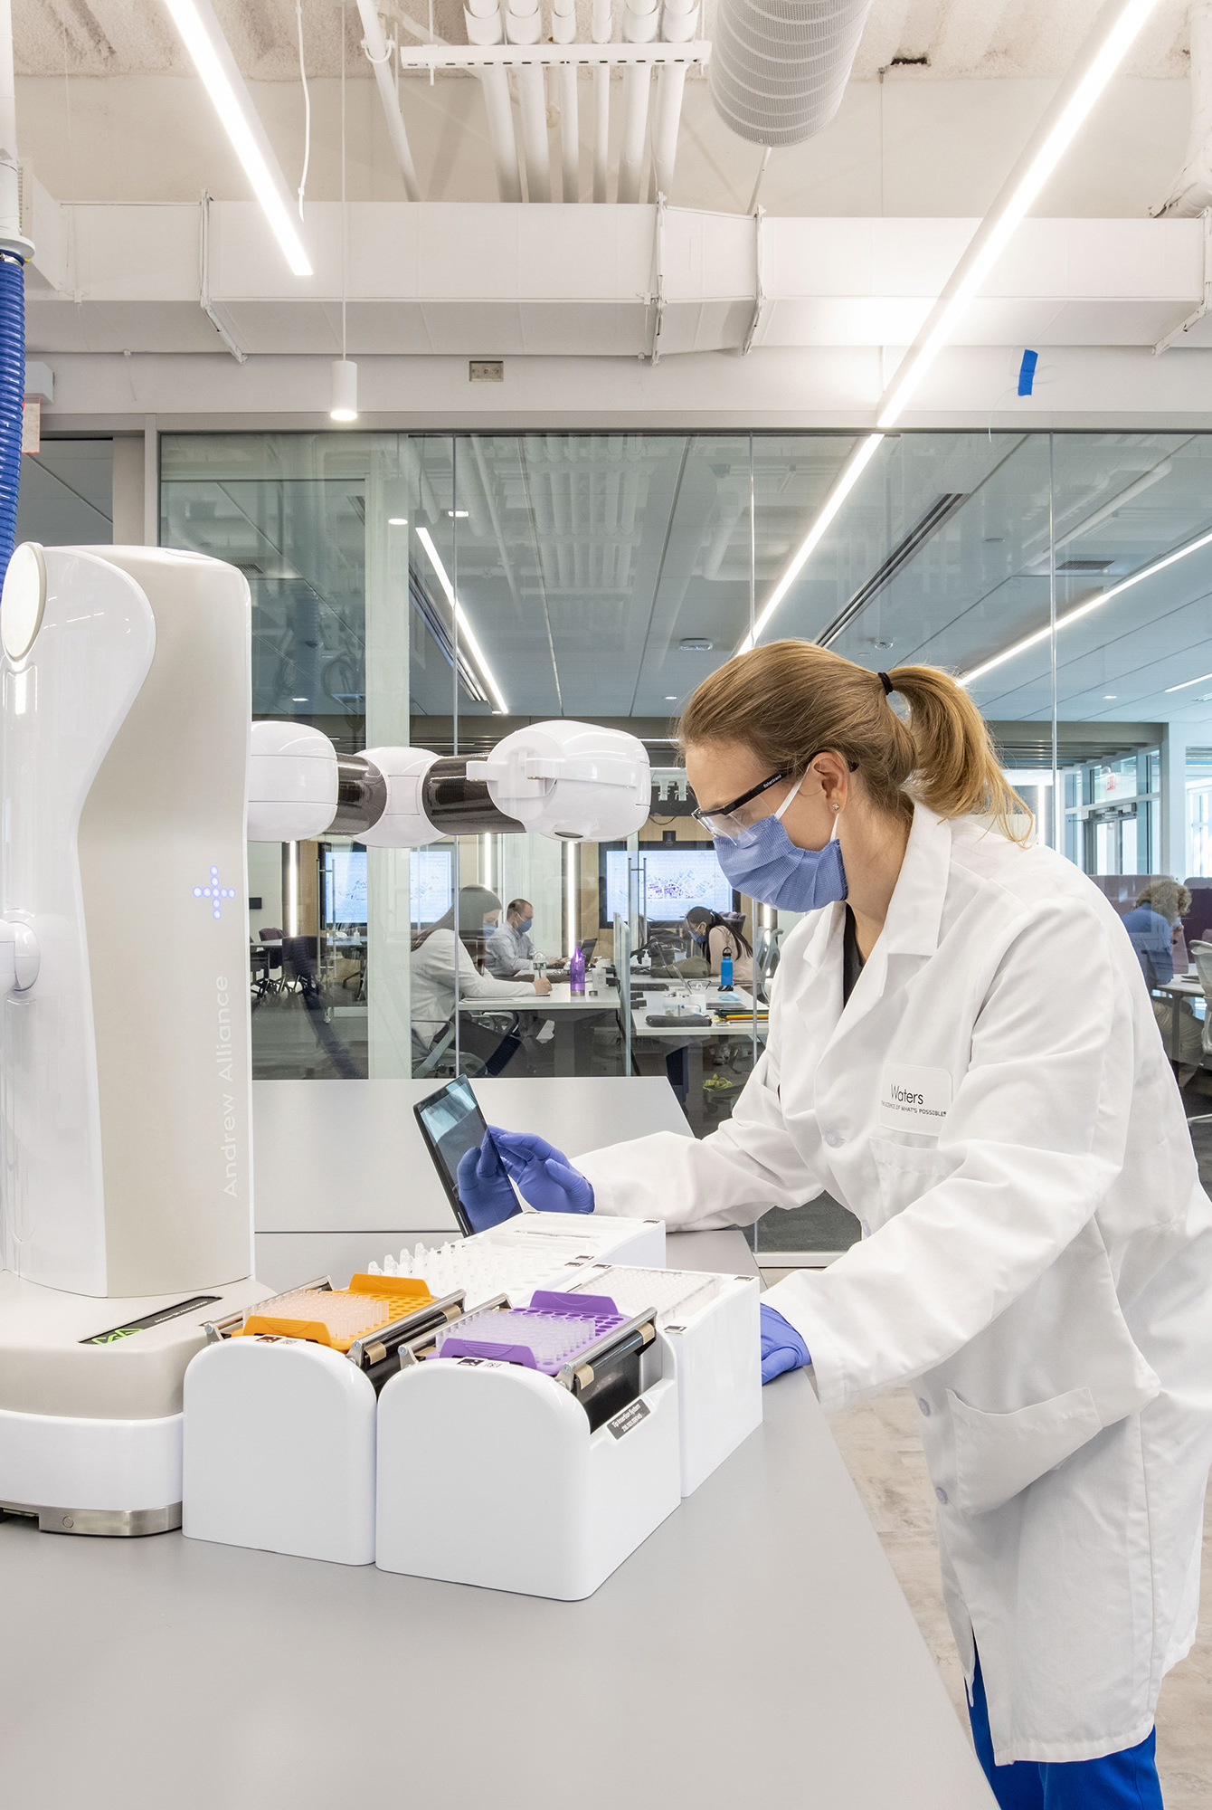
Manufacturing
Success Story:
55% Size Reduction & $5M
In Savings with SAP Data Volume
Management and Data ASSIST
Background & Pain Points:
  Waters aimed to move to SAP RISE but high cost was a major hurdle to getting approval
  A financial analysis showed that the project would only be viable if the system size was reduced by 40% before migration
  Achieving such a significant reduction posed a complex optimization challenge
Solution:
  Data Volume Assessment (DB02) identified archiving opportunities
  Phased approach to minimize risk and accelerate progress
  9 distinct archiving objects were implemented across 4 SAP system
  Implemented Data ASSIST for long-term cost savings and performance optimizations in SAP RISE
Results & ROI:
  Projected cumulative savings surpassed $5M
  55% size reduction across SAP landscape, including ECC, GTS, BW, APO systems
  Prepared landscape to move to SAP RISE, ensuring project stayed on schedule and achieved targeted budget
  Data ASSIST provided ongoing growth control, ensuring costs stayed low even in the new environment while providing insights into their database

Slide 2


Industrial Goods and Machinery
Success Story:
Enterprise Database Reduction by 60% with Data Archiving
Background & Pain Points:
  System performance challenges and disruption risks.
  Business users unhappy with functionality issues.
  Challenges keeping up with manual processes.
  Hardware and Cloud hosting/backup costs continued to rise.
Solution:
  Analyzed the current data footprint.
  Data ASSIST:
  Facilitated identification reductions through itemized archiving objects.
  Automated the archival process of historical data with dynamic scheduling.
  Defined retention requirements and implementing a compliance strategy.
Results & ROI:
  Database size reduction by 60%
  Real-time, custom-query reporting.
  Database performance increased by 19%.
  Improved user experience, enhanced system efficiency.
  BTP provided a scalable framework.
  Archived content was securely stored yet easily retrievable.

Slide 3


Consumer Goods/Retail
Success Story:
Improved System Performance & Cost Savings with Data ASSIST
Background & Pain Points:
  Continuously growing table sizes and overall data volume in the primary DB.
  Database size has grown to over 230%, with a current growth of approximately 15% per month.
  No data volume management or archiving strategy in place.
  Growing costs associated with growing volume.
  Recurrent need to reallocate resources to address any issues with memory.
Results & ROI:
  Reduced storage needs, with cumulative cost savings for the first three years surpassing $200k.
  Reduced migration time periods.
  Improved system performance and speed to access information.
  Maintaining the database size and growth with automated scheduling.
  Implementation of retention policies for compliance.
  Database size reduction by estimated 40%.

Slide 4

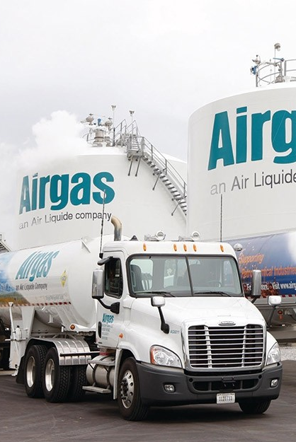
INTERNAL USE ONLY
Success Story:
Data Archiving for S/4HANA Migration Preparation
Pain Points:
  Data footprint increased by 6% annually, leading to a substantial production database size (11.8TB), complicating the migration process.
  Migrating vast amounts of data would be costly.
  Large database threatened to extend the migration timeline, causing potential delays.
  Risk of interrupting daily operations, risking business continuity during transition.
Solution:
  Implemented a phased data archiving approach.
  Archiving without any business interruptions.
  Leveraged AWS S3 as the archiving repository.
  Automation with Data ASSIST
    Gain insights into the database, identifying patterns & opportunities.
Results:
  Achieved an 79% size reduction:
    Archiving 8.7TB initially and further optimizing data for a total reduction of 9.3TB.
  Reduced the timeline for migration.
  Achieve NetZero database growth, ensure predictable costs for the S/4HANA migration.
  Annual savings from the project exceeded $600K. Cumulative savings surpassing $2M.

Slide 5


Oil & Gas
Success Story:
80% System Reduction with Accessible & Compliant PRA Archive for SAP S/4HANA Prep
Solution
  Implement proprietary PRA archiving mechanism to preserve access to archived PRA transactions while maintaining compliance.
    Enabled PRA reversals or entries to be “linked” directly to a specific archived object.
    Within the journal entry, the archive link was referenced in the text field, allowing users to retrieve details seamlessly.
  Data ASSIST:
    Automated the archival process of historical data with dynamic scheduling.
    Defined retention requirements and implementing a compliance strategy.
Results & ROI:
  81% size reduction across the SAP landscape, achieving the initial requirement for transition.
  PRA archiving allowed for savings and size reduction while retaining access and ensuring compliance.
  Monetary savings when migrating a smaller database to SAP S/4HANA.
  Data ASSIST provided ongoing growth control, ensuring costs stayed low even in the new environment while providing insights into their database.

