Slide 1
Master Overview Deck
Data Archiving & ILM

Slide 2





1,500
10,500+
25 Yrs
$1.5B
Successful Projects
TB of Data
Managed
Transforming Companies
Total Customer Savings
Driving Innovation, Empowering Transformations.
Data Management
Solution
Implementation
Product
& Innovations
Strategic
Partnerships
  Data Archiving & ILM
  Retention Management
  HANA Memory Optimization (NSE)
  Data Governance
  Data Migration
  Cloud Migrations
  Data Privacy and Security
  Legacy Decommissioning
  Data Volume Assessment
  Data Quality Assessment
SAP S/4HANA & RISE
SAP BTP Deployment
  SAP Integration Suite
AI Implementation
SAP OpenText
  Extended ECM (xECM)
  Vendor Invoice Management
  Document Presentment
SAP Ariba
SAP Vertex
SAP Vistex
Geospatial Intelligence (GIS)
  Data ASSIST by Auritas
  (Data Archiving Automation)
  Data GUARD by Auritas
  (Legacy Decommissioning)
  Auritas Intelligent Accrual
  (Financial Automation)
  DMS+ by Auritas
  (Enhanced Document Storage)
SAP Gold Partner
SAP PartnerEdge, Sell
CCFlex – Cloud Choice Flex
PartnerEdge®
  (AMS + Hypercare)
CCFlex

Slide 3













Customer Success
Services Across Multiple Industries – Verticals:

Slide 4



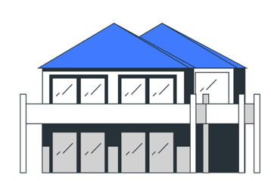


The Journey to S/4HANA:
rchive
Methodology
igration
erformance Test
ecommissioning
Start
1
2
Archive
Migration
Present Storage
Retention Management
Trash
& Repurpose
4
Decommissioning
Legacy Storage
3
Performance Testing

Slide 5
S/4HANA Timeline
NOW
SAP S/4HANA
Customers on their S/4 journey.
Customers building and planning their S/4 journey.
Customers waiting for S/4 but seeking value now.
Optimize Data
Reduce production data volume using archiving & retention.
Keep transactional & master data clean.
Decommission legacy systems reducing IT spend.
Data-Driven Decisioning
Cross-process data-driven decision-making
will improve a customer's return on asset.
Initial focus around cash and spend management will ensure organization stability.
Continuous Process Automation
Further simplify processes across the enterprise with easy to create workflows. Automate high-volume, and repetitive manual tasks with intelligent bots will help adoption
Clean Application
Keep the core clean and improve operations with side-by-side enhancements. Leverage pre-built integrations, improving time to market for new capability
202x
Low-Code Extensions
Starting to change behavior with a new application is often the linchpin to success. Enabling low-code/no-code solutions help organization deploy new capabilities weekly and keep up with dev backlog.
Quality Assurance
De-risk and accelerate RISE projects by analyzing the impact of software changes to better scope and automate what needs to be verified. Ensure that any changes do not break end-to-end business processes, slow application performance, or introduce data errors.

Slide 6
Your Data is Growing.
“So, how do we flatten the curve?”
Notes:
Deepak
Question: How can enterprises start to flatten their data growth?

Slide 7





What if…
What if... You could eliminate transactional data older than 7 years (per your company’s retention policy)?
What if... you could reduce recovery time by 36%?
What if... you could extend the life of your HANA hardware by 30%?
What if... you could reduce active storage by 40-60%?
What if... you could reduce the cost of appliance acquisition and future expansion?

Slide 8
Why Archive? HANA Sizing and Savings
HANA Requirement Without Data Discipline
HANA Requirement
With Data Discipline
$
Cleanse: unneeded data
Typical 30-50% reduction
Near-line: less-used data
Reduction
Archive: retention compliance data
Accumulated
Data Volume
“Data tiering can be achieved with traditional archiving as known from enterprise applications in the past, or by classifying data into actual and historical data coupled with aging historical data”
$
Shrunken DB
Hasso Plattner: The In-Memory Revolution
by Hasso Plattner and Bernd Leukert
Notes:
Higher storage costs for expired data
Risk legal discovery of expired data
Risk of historical data loss
during upgrades
Historical data bloat slows performance
Legacy systems add to
maintenance cost
Increased cost during mergers & divestiture
Inability to upgrade in time allotted

Slide 9
Introduction to Data Archiving
SAP ECC
OpenText
Storage
SAP DATABASE
1.
2.
3.
Archive (Data is written to files)
Delete (Data is deleted from tables)
Seamless Access
Notes:
Deepak

Slide 10
Drivers Pushing Every Industry to ILM
Mergers & Acquisitions
Acquisition, joint venture
Divestitures
Business area organized as independent company, subsidiary spun off, part of company sold
Corporate restructuring & Data Privacy
Change organizational units in landscape accordingly
Business process optimization
Adapt processes in systems, unified accounting, master data cleansing
Consolidation of IT landscapes
Merge systems, harmonize system landscape, provide cross-system functions, reduce TCO
Notes:
Deepak

Slide 11

Negative Impact To Organizations Without ILM
Increased spend (licenses & hardware)
Exposure to increased penalties w/ historical data
Increased S/4HANA implementation costs
Bleeding of funds managing legacy data
Decreased production efficiency
System not optimized for service excellence
Inefficient And Costly SAP Systems
Critical Decisions Compromised Due To Data Pollution
Business Decisions Are Corrupted By Poor Data Quality
Lack Of Consolidated View Of Data Across All Channels
Exposure To Potential Lawsuits In Data Privacy
Notes:
Deepak

Slide 12

ILM GAPS
Identify what data can be archived?
Ability to determine savings and ROI before project execution
Automation of archiving process
  Dynamic variants
  Scheduling
  Sequencing
  Pre-requisites
Data driven matrix for archiving outcomes

Slide 13
Data Archiving
Analyze data volumes
Securely move data from the database to the archive
Comfortably access archived data
Archive SAP NW BW data (near-line storage)
Data Blocking, Retention, Deletion for SAP Landscapes:
Volume Management
Retention Management
Manage all retention policies across the enterprise
Manage the responsible destruction of data based on policies
Enforce retention policies
Use secure ILM-aware storage (partner offerings)
Perform e-Discovery and set legal holds
Manage all archiving & retention policies across the enterprise
Responsible destruction of data based on policies
Enforce retention policies
Use secure ILM-aware storage (partner offerings)
Perform e-Discovery and set legal holds
SAP Information
Lifecycle Management (ILM)
End-of-life Data
System Decommissioning
Enforce retention policies on data from shut-down system
Run reporting on data from shut-down system (SAP BW)
Use predefined BW tax content and reporting interface
Benefit from independently understandable archive
End-of-life System

Slide 14

The Data Archiving Process
1.
2.
3.
Analyze
Go-Live
Steady State
ROI
Savings
Residency
Identify Objects
  ↓
Implementation of Objects
Variant Creation
Archive Run
Dependency Sequences
Scheduling
Status Updates
  Analytics
Execution
Scheduling
Archive Run
Dependency Sequences
Scheduling
Analytics for future object

Slide 15

Project Management Methodology

Slide 16
Project Management Methodology
Defined Quality Gates and Quality Gate Checklist required to exit each phase.
6-Steps with specific inputs and outputs for each phase.
Plan
Blue-Print
Realize
Go - Live
Hypercare
Closure
Key Tasks:
Create Project Plan
Mobilize Team
Establish project standards
Kickoff Project
Deliverables:
Initial Project Plan
Mobilized Project Team
Roles and Responsibilities defined
Kickoff
Key Tasks:
Review current system and processes
Project Plan Finalization
Identify Gaps
Perform Req. Gathering
Identify RICEF if necessary
Identify Data Requirements
Finalize Blueprint
Obtain Signoff
Deliverables:
Business Solution Sign-off
Initial Training Plan
Finalized Project plan
Key Tasks:
Functional and technical design documents
System configuration and unit testing
Security requirements
Master Data and Security Requirements
Development/Testing if necessary
Initial Cutover plan
Create Testing Scenarios
Integration Testing within all SAP Modules
User Acceptance Testing
Training & document creation
Deliverables:
Configured and working system package
Technical Specifications
Testing Specifications
Testing with no negative impact on other systems
User sign off system package
Training plan & documents
Final Cutover Plan
Key Tasks:
Train End Users
Prepare production systems for cutover
Complete Go/No Go analysis
Migrate System configuration & setup
Convert & validate data
Mobilize Go-Live Team
Testing of functionality, configuration and RICEF changes
User Acceptance Testing
Train trainers
Deliverables:
Fully integrated testing with no negative impact on other systems
User signoff of system package
Final Cutover plan
Key Tasks:
Train end users
Prepare Production systems for cutover
Complete Go/No Go Analysis
Migrate system configuration and setup
Convert and validate data
Mobilize Go-Live team
Complete Cut-over to Production
Deliverables:
Trained & proficient end users
Configured & working production system
Go-live Support Team ready
Converted data
Key Tasks:
Customer Feedback
Close out project
Lessons learned
Deliverables:
All files checked into version control
Customer Survey
Closure Report
Notes:
Luke

Slide 17
Project Structure
Key Roles & Responsibilities
VP
& AVP
Practice
Managers/ Delivery Manager
Project Director
Lead Consultant
Consultant: Functional /Technical/ABAP
Leadership | Steering Committee Representation on Strategic Projects Cross-BU Leadership Collaboration for Risks Mitigation and Critical Issues Resolution Customer Sponsor Level Stakeholder Relationships Management
Managers | Escalation Resolution Collaboration support for Risks Mitigation and Critical Issues Resolution Talent and Resource Gaps and Issues Resolution Oversee Process, Metrics and Controls adherence Solution Quality Assurance, RAID Impacts Leadership
Project Director | Develop, maintain and monitor project plan Report project status Be the SPOC for all RAID identification & closure Ensure deliverables are complete and signed-off Budget Management, Time Sheets, CRs
Lead Consultant | Own client business needs and solution scope Own Design and Solutions, Landscape, Architecture, Security, Testing Config Validations, Code Reviews, Documentation Reviews Integration testing and User Acceptance Testing Knowledge Transfer and Training
Consultant | Understanding of client business needs and solution scope Solution Configuration, Setup, Development, Testing Integration testing and User Acceptance Testing Resolution of Issues Documentation of Deliverables
General Escalation Path
Notes:
Luke

Slide 18
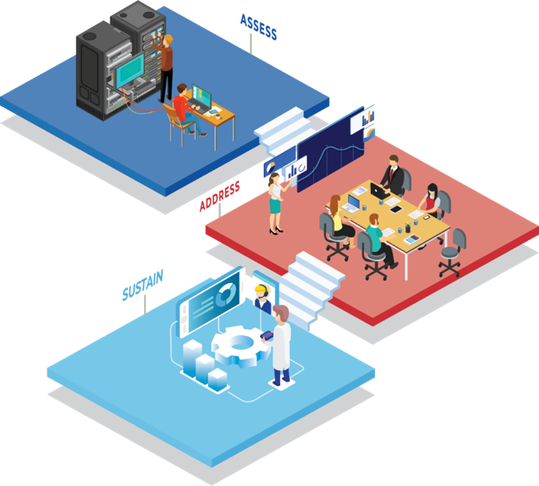
Our Solution Approach
A three-stage process that results in a highly effective implementation of data volume management.
  Assess
  Address
  Sustain
Notes:
Tim

Slide 19
Our Solution Approach
Apply industry best practice residence and retention policies.
Leverage accelerators that speed up analysis and provide specialized insight for the archiving strategy
Well honed advocacy for compliance and retention standards
Identifying t-code and reports that are required to access data in the archive and enhance them if required.
Resolve open items, close transactions so they can meet SAP requirements to move the record(s) to the archive
Maximize effectiveness of archiving
Minimize impact on the user experience while remaining compliant
Notes:
Tim

Slide 20
Assess: 6Rs of Data Archiving
Residence
Retention
Restrictions
Requirements
Reporting
Retrieval
The period of time a document remains in the online database.
The “life” of a record in ERP system (e.g. Finance = 7y)
Doc types
Countries
Military/ Gov. partners
Regulated Company
Documents
Z tables
Data quality
Testing scenarios
Integrated systems
Historical v/s current data access
HANA Ent/SLT
Standard SAP delivered t-code and reports
DRB – Learn ALO1
DaRT, BW
Decide how long you keep your data in database then migrate to archives
Match retention scheduled to corporate policies
Decide if these reports need archive enabling
Identify extractors to be archive enables for BW
Define consistent selection criteria for managing your data
Identify transactions and reports impacted by archiving
Evaluate and choose options for storage & retrieval
Notes:
Tim

Slide 21
Assess: Accelerators
SDAT
ADQ
Accelerators for Assessment | Assessment Outcomes Impacted
Strategic Data Assessment Tool (SDAT): Used to identify custom reports that may be impacted by archiving | Tables & Table Sizes Data Access & Retrieval Requirements Operation Requirements Statutory & Legal Requirements including Legal holds Archiving objects and dependencies
Auritas Data Quality Tool (ADQ): Data quality analysis tool that identifies the amount and type of open conditions for various archiving objects
Notes:
Deepak

Slide 22
Assess: Workshops
Requirements Stakeholders
Requirements Workshops
Assessment of Business Transactions
Identifying opportunities and solutions that can maximize efficiency of archiving efforts
Achieving best practice residence periods,
Prerequisite archiving dependencies
Data quality assessments (open items)
Archive enabling reports and other means to access archived data.
Table growth & input sources
Business complete documents that are eligible and available to archive.
Business complete transactions that are not technically updated.
Business in-complete transactions
Process Dependencies
Notes:
Tim

Slide 23
Address
Setup & configure ADK to meet requirements elicited during assessment
Technical Data Cleanup / Housekeeping
ECC Unstructured Data Migration Using Migration
ECC Functional Data
All other functional data (e.g., Finance, Sales, Procurement, HR) will require inputs from the functional SMEs and business users in the form of requirements and user acceptance testing
Execution of blueprint developed through workshops with functional SMEs and Business users.
Technical tables and objects that can be addressed with limited requirements from business user.
Requirements and testing are relatively simple and can be implemented in a relatively short time.
Move documents stored on the database to a secondary storage.
Technical implementation requires little if any business or functional resources
Notes:
Tim

Slide 24
Sustain
Operationalize & execute archiving strategy to comply with residence and retention policies.
Data ASSIST by Auritas for automating and scheduling steady state archiving. Variants are configured in Data Assist to support steady state data archiving.
Execution of archive and deletion jobs that triggers the archiving process (including delete jobs)
On-going Archiving
Move data out of SAP and to the storage repository.
Steady-State Archiving

Slide 25

Roadmap Your ILM Implementation
1. Identification and Mapping
Analysis of requirements of data, business and regulatory inventory
Solution design
Security audit
Data & Document retention policies
Chain of custody & Ownership
2. Discovery
Mapping of data to retention policies
Auditing
Billing and charge-back
3. Retention Implementation
Backup and disaster recovery
Legal holds
Data & Document splitting
Information Destruction based on policies
4. Execution and Maintenance
Notes:
Deepak

Slide 26

SAP Data Retention Tool (DaRT)
+
SAP DaRT enables extracting and retaining access to tax-relevant SAP data for audits, legal compliance, and regulatory reporting.
  Structured, ready-to-use reports and data files
  Ensured compliance with tax regulations
  Simplified tax audits
  Secure financial data retention
  Data extraction in easily accessible formats
DaRT
SAP DaRT install
Configuration of extraction rules.
Extraction of financial and tax-relevant data
Data retention & compliance management
Custom reports & views generation
Audit support & consulting
Enhancements:
  DaRT for system decommissioning
  Dynamic reporting using Datasphere & SAC

Slide 27
SAP DART Process (Simplified)
R/3 DB
Report Generated
User
Flat file
Extract
User view
Archive
Archive
Data Sources

Slide 28
Data Volume Assessment
Receive Your Results
in One-Week!
A Data Volume Assessment (DVA), or DB02 Analysis, is a comprehensive analysis of an SAP database from a volume and size perspective.
Assessment Details:
  Analysis of existing database tables.
  Identification of the largest tables in the database.
  Identification of potential archiving opportunities.
  Determine what can be deleted or archived and what cannot.
  Estimation of database size reduction.
Journey Starts
Complete the questionnaire and send the required documentation.
1.
Assessment Execution
Data experts complete the database assessment.
2.
Assessment Benefits:
  Report on existing enterprise data distribution.
  Knowledge of projected reduction in database size with archiving and deletion.
  Forecasted savings and database size reduction percentage.
  Recommendations on technical, functional, migration, and deletion objects.
  Readout of the results with Auritas’ experts.
  ROI predictions with DB volume management recommendations.
Results Analysis
Auritas’ SMEs review assessment and results for final report.
3.
Assessment Readout
The analytical report will be ready for the presentation meeting.
4.

Slide 29
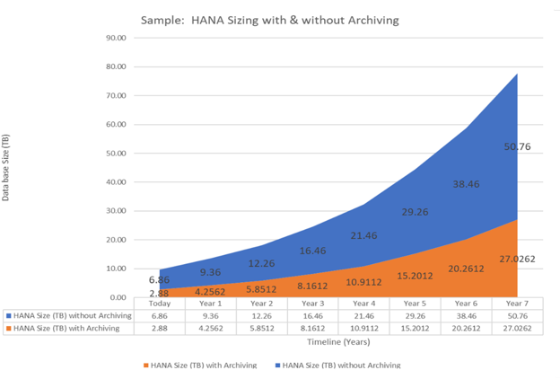
Data Volume Management Benefits
Massive reduction in SAP DB Size
Controlled database growth
Improved system performance
Reduced Migration & Backup durations
Extend life of current HANA Infrastructure

Slide 30
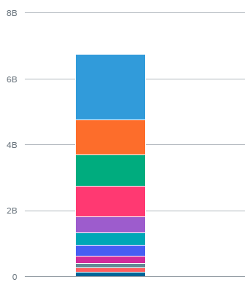
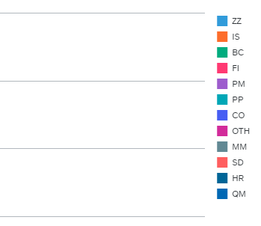

Data Distribution: By Stacked Modules
CURRENT
POST-ARCHIVE

Slide 31
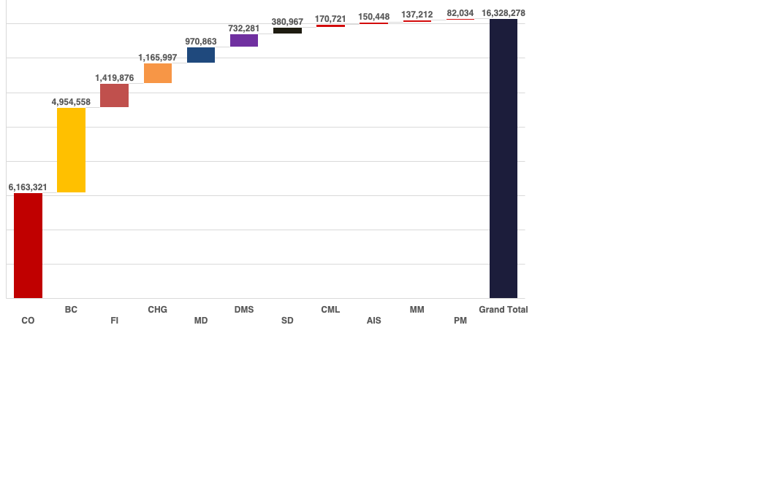
Visualizing Your Archiving Opportunity

Slide 32
Analyze your database, calculate ROI and automate your data archiving with Auritas’ all-in-one solution.
Data ASSIST by Auritas helps organizations efficiently optimize their SAP data volume management by automating the data archiving process. It simplifies identifying and archiving redundant or non-essential data, reducing database size, lowering storage costs, and improving overall SAP efficiency.
Visual Analysis, Insights Real-Time
& ROI Projections:
Analyze your data using customizable visual charts and graphs, allowing you to perform "what-if" analysis to help identify which items to archive for optimal ROI.
Automate Scheduling,
Eliminate Manual Errors:
Eliminate the need for manual intervention, and avoid the risks associated with employee turnover, forgetfulness, or human error.
Manage All Job Schedules from One Screen:
Save time by managing, configuring, and maintaining job schedules from a single, centralized screen.
Notes:
We can add screenshots here
-- Rework the visual of slide 5

Slide 33

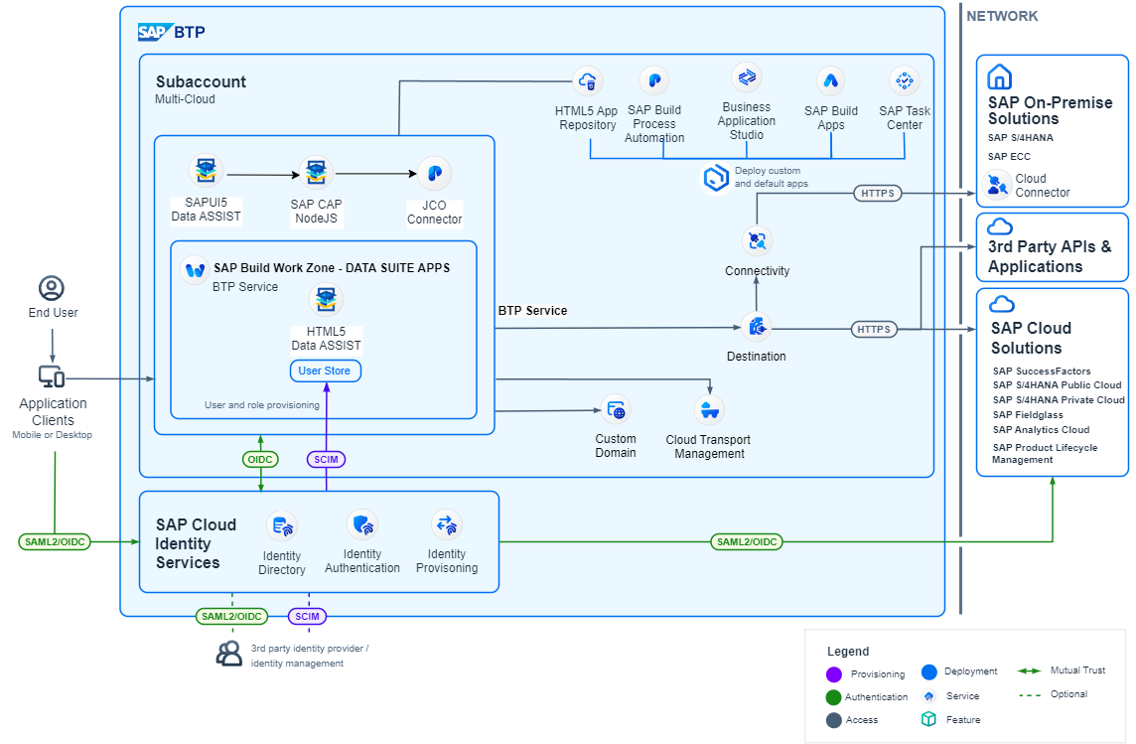
Notes:
Ask Silas for the new arch

Slide 34

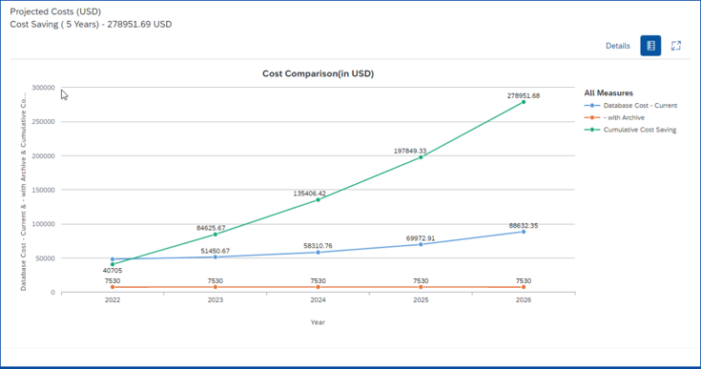
Calculating ROI
Quantifiable before and after results
10 or more objects difficult to manage
Loss of talent, vacations, etc.
Solved by automated, scheduled, archiving.

Slide 35
The Savings are Not Limited to Hardware Costs
Eliminate transactional data older than 7 yrs
Don’t migrate expired data (per corporate retention policy)
Retention Compliance
Reduce recovery time by up to 36%
Reduce in Cutover time during HANA go-live
Less data in active system requires less recovery time
Cost of Downtime
Extend the life of your HANA hardware by 30%
Data management critical for high performance
Optimized Performance
Reduce active storage by 40-60%
Move historical data to write media,
Manage time-value of data with data archiving
Storage Footprint
Reduced HANA Footprint
Reduced cost of appliance acquisition & future expansion
Smaller active data set requires less infrastructure
Steady state data aging techniques control data growth
Notes:
Tim

Slide 36
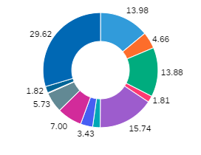
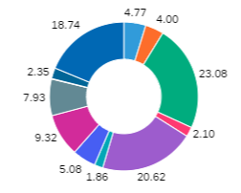

Data Distribution
Current
Post-Archiving

Slide 37
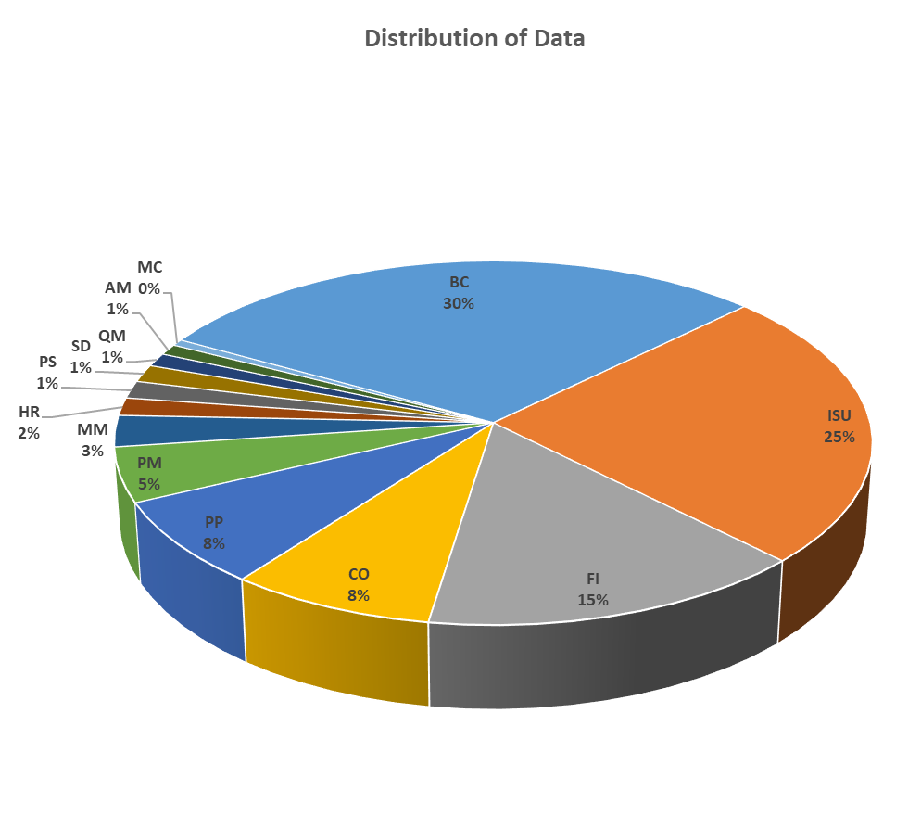
Auritas DM Assessment Results & Example

Slide 38

Our Experience: Success Stories

Slide 39


Industrial Goods and Machinery
Success Story:
Enterprise Database Reduction by 60% with Data Archiving
Background & Pain Points:
  System performance challenges and disruption risks.
  Business users unhappy with functionality issues.
  Challenges keeping up with manual processes.
  Hardware and Cloud hosting/backup costs continued to rise.
Solution:
  Analyzed the current data footprint.
  Data ASSIST:
  Facilitated identification reductions through itemized archiving objects.
  Automated the archival process of historical data with dynamic scheduling.
  Defined retention requirements and implementing a compliance strategy.
Results & ROI:
  Database size reduction by 60%
  Real-time, custom-query reporting.
  Database performance increased by 19%.
  Improved user experience, enhanced system efficiency.
  BTP provided a scalable framework.
  Archived content was securely stored yet easily retrievable.

Slide 40


Consumer Goods/Retail
Success Story:
Improved System Performance & Cost Savings with Data ASSIST
Background & Pain Points:
  Continuously growing table sizes and overall data volume in the primary DB.
  Database size has grown to over 230%, with a current growth of approximately 15% per month.
  No data volume management or archiving strategy in place.
  Growing costs associated with growing volume.
  Recurrent need to reallocate resources to address any issues with memory.
Results & ROI:
  Reduced storage needs, with cumulative cost savings for the first three years surpassing $200k.
  Reduced migration time periods.
  Improved system performance and speed to access information.
  Maintaining the database size and growth with automated scheduling.
  Implementation of retention policies for compliance.
  Database size reduction by estimated 40%.

Slide 41


Public Sector
Success Story:
Streamlined IT Landscape:
Data Volume Management
Background & Pain Points:
  IT landscape complexity. Third-party content management application outside SAP.
  Non-standardized environment and high data pollution.
  Inefficiencies in hardware management.
  Increased hardware costs due to inefficient management.
Solution:
  Robust data volume management strategy, leveraging Auritas' proprietary tools:
  Data archiving, using Auritas accelerators to introduce archiving objects.
  Decommission third-party content management:
    Migrate records to SAP-certified content management application.
Results & ROI:
  Simplified overall network architecture application retirement.
  Reduced database size, resulting in cost reductions.
  Eradicated data issues with a selected number of applications.
  Centralized content management platform integrated with their primary database.
  Ownership of applications and overall system.
  Comprehensive data volume management plan implemented within 13-months.

Slide 42

Utilities
Success Story:
Improved SAP System Performance & TCO with Advanced Data Archiving
Pain Points:
  Accumulated large amounts of data leading to system performance issues.
  Increased costs from database size.
  Reporting/planning impediments.
  Needed to remove divested data without affecting live information.
  Required verifiable audit trail and validation proofs for archived data.
Solution:
  Advanced archiving solution delivered on time and within budget
  Reduced database size and improved performance.
  Sustainable solution saves costs in human, technical, and infrastructure expenses.
  Automation and elimination of unnecessary steps.
Results:
  Sustainable framework incorporating data archiving, migration, and relocation.
  Identify and prioritize objects based on database growth & performance statistics.
  Advanced data archiving solution and estimated ROI and payback period.
  The tailored and transparent approach instilled confidence in the company's decision-makers.

Slide 43


Utilities
Success Story:
Managing Explosion of Data
Post-Implementation
Challenges and Pain Points:
  Company needs real-time data on customer consumption and buying behaviors such as how, when, and why customers engage and purchase.
  Over 21M transaction reads per day
  837% increase in data volume
  Now a 5-petabyte company
Opportunity:
  Company has gone through recent acquisition to expand its portfolio to emerging technologies
  Company has increased the size of its operating footprint from 6 states to 40
  Future acquisitions/market compression is driving speed to market requirements
Results & ROI:
  Reduced data volume by a factor of 9.
  Average annual savings appx $4.2 Millions.
  Reduced storage footprint​.
  Increased speed of access to more accurate data from hours to seconds​.
  Converted all accounting activities from manual to automated​.
  10% improvement in customer satisfaction. Faster resolution of issues and improved overall customer experience​.

Slide 44


Utilities
Success Story:
Database Transformation With Data Archiving For Reduction of 40%
Pain Points:
  Uncontrolled SAP databases size & growth
  No SAP Data strategy in place
  Not retention compliant in SAP & had legal risk
  OpenText underutilized for data management
Benefits:
  Completed Transformation within 7 Months
  40% Database Reduction - through archiving in SAP ECC and CRM
  Positioned for Legal and Regulatory compliance
  Deployed OpenText Solution for DVM storage
ROI:
  Cost savings related to moving SAP data off SAN storage
  HANA Readiness: Database controlled in time for HANA
  Extended life of infrastructure through controlled DB growth
  Readiness for retention management/Risk avoidance

Slide 45


Auto Manufacturing
Success Story:
Advanced Data Archiving Shunk Database from 5TB to 800GB
Pain Points:
  Rising hardware and Cloud hosting/backup costs to retain rarely accessed data
  Required solution that would keep employee access unchanged
  Sought to reduce financial burden from operations and compliance
  Strained storage capacity
Solution:
  SAP ILM for privacy and retention management
  SAP Document Access by OpenText for data and content storage
  Development of phase approach for quick wins and limit business disruption
Results & ROI:
  Enterprise data on SAP HANA shrunk from 5TB to 800GB
  Received project payback within 10 months
  Reduced risks associated with operational compliance
  Secured the achieve content storage easily accessible
  Significantly lowered costs for hardware and hosting
  Enables real-time, custom-query reporting
  Decreased migration time to new cloud

Slide 46


Customer Goods
Success Story:
Enhance Database Performance with Archiving & Retention Compliance
Pain Points:
  Uncontrolled ECC database growth
  Needed assistance to prepare database for migration to S/4HANA
  Global retention policies compliance – GDPR compliance risks
Solution:
  Implement a comprehensive data archiving strategy, starting with database assessment for object recommendations.
  Automated archiving scheduling for growth control.
  Launch a retention policy in accordance with privacy regulations, including GDPR.
  Implementation of Document Access (Extended ECM) for improved performance.
Results & ROI:
  Initial database reduction and controlled growth
  Better database performance – Reduction in database search and access times
  Improved application performance
  Reduction in backup times/ Increased system availability
  Extended the life of hardware investment to run ECC
  Reduced S/4HANA implementation risk and costs
  Foundation for GDPR and retention compliance to reduce future legal risks & fines

Slide 47

David Boeckle
CSO
Office: +1.407.834.8324 x284
Mobile: +1.813.545.2381
Email: DBoeckle@Auritas.com

