Slide 1
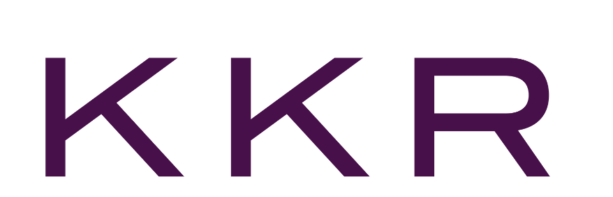

Success Story:
SAP ECC Decommissioning with Data GUARD for S/4HANA Prep
Finance
Challenge & Pain Points:
  Needing to prepare for S/4HANA migration and mitigate risks and complexity
  Legacy data retained in the ECC system caused performance degradation
  Rising infrastructure costs
  DB volume increased backup durations and recovery time objectives
  Need to maintain historical data & attachments secure, auditable, and accessible
Solution Data GUARD:
  Extract and transfer 1 TB of data and attachments from SAP ECC to Data GUARD
  Implementation of Data GUARD and a PostgreSQL database
  Build custom reports in Data GUARD, including vendor reports, GL transaction details, WBS codes to see deal costs, and financial statements
  Implement SAP BTP as the new content repository layer with a cloud connector link
Results:
  Maintain auditability and long-term accessibility to legacy data
  Improve current system performance and operational stability
  Prepare for S/4HANA migration, saving costs & lowered complexity and risk
  Reduced infrastructure costs and operational risk
  Secure, governed access to legacy data via Data GUARD

Slide 2


Manufacturing/Customer Goods
Success Story:
Managing and Retiring Multiple Legacy Systems with Data GUARD
Background & Pain Points:
  Growing maintenance and hardware costs.
  Security risks on outdated systems.
  Limited data access due to technology constraints.
  Compliance for data retention and preservation.
  Inefficient data management causing silos.
  Lack of skilled personnel for legacy maintenance.
  Incompatible with modern technologies and apps.
  High energy use and carbon footprint.
Results & ROI:
  Manage and retire multiple legacy systems with a single view.
  Apply corporate retention policies to all connected legacy systems.
  Decrease total cost of ownership of legacy hardware
  Securely access decommissioned data
  Run advanced tailored reports for retired legacy data

Slide 3
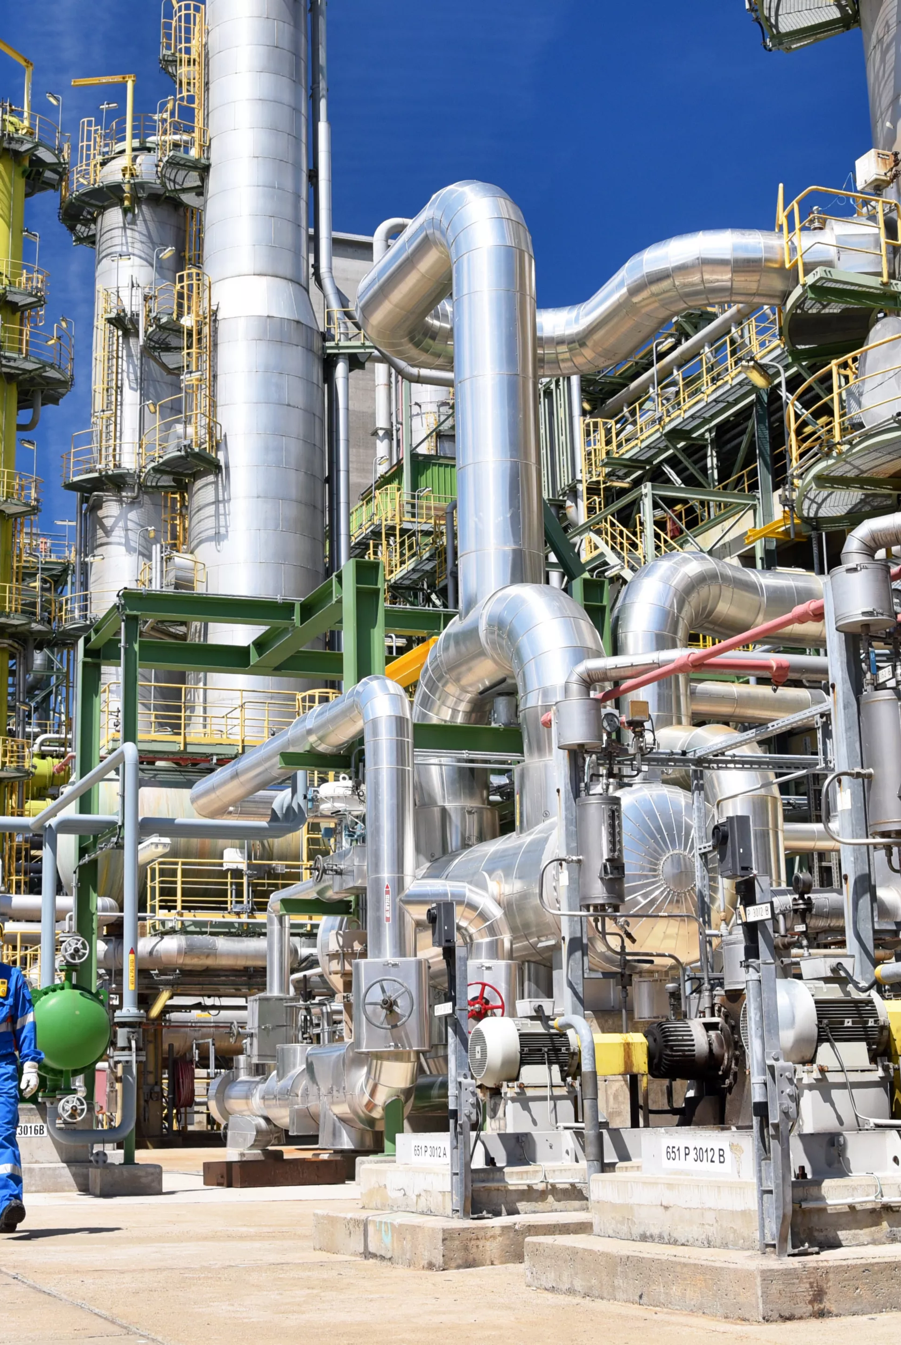
Chemicals
Success Story:
Legacy System Retirement & Retention Management
Pain Points:
  Over 200 legacy applications needed decommissioning
  Had diverse set of legacy systems, including both SAP and non-SAP systems
  Extracted data needed to be retrieved in a cost-effective manner
  Data within these legacy applications had to remain readily available
Benefits:
  Successfully decommissioned legacy SAP and Non-SAP Applications.
  Easy access to the data held within legacy environments
  Established a Clean Lean and Compliant Data Strategy
  Compliance and reduction of operational and legal risk
  Secured long-term storage in durable, tamperproof form
ROI:
  Millions in savings from decommissioned systems' licensing/infrastructure costs
  Lower TCO of IT landscape
  Reduced administration & resource consumption of legacy applications
  Increased process efficiency to access SAP data & documents
  Leverage storage lifecycle for lower costs

