Slide 1
Auritas | OpenText
ESG Reporting Solution: Automating & Achieving Reasonable Assurance

Slide 2





1,500
10,500+
25 Yrs
$1.5B
Successful Projects
TB of Data
Managed
Transforming Companies
Total Customer Savings
Driving Innovation, Empowering Transformations.
Data Management
Solution
Implementation
Product
& Innovations
Strategic
Partnerships
  Data Archiving & ILM
  Retention Management
  HANA Memory Optimization (NSE)
  Data Governance
  Data Migration
  Cloud Migrations
  Data Privacy and Security
  Legacy Decommissioning
  Data Volume Assessment
  Data Quality Assessment
SAP S/4HANA & RISE
SAP BTP Deployment
  SAP Integration Suite
AI Implementation
SAP OpenText
  Extended ECM (xECM)
  Vendor Invoice Management
  Document Presentment
SAP Ariba
SAP Vertex
SAP Vistex
Geospatial Intelligence (GIS)
  Data ASSIST by Auritas
  (Data Archiving Automation)
  Data GUARD by Auritas
  (Legacy Decommissioning)
  Auritas Intelligent Accrual
  (Financial Automation)
  DMS+ by Auritas
  (Enhanced Document Storage)
SAP Gold Partner
SAP PartnerEdge, Sell
CCFlex – Cloud Choice Flex
PartnerEdge®
  (AMS + Hypercare)
CCFlex

Slide 3
Reasonable Assurance for Sustainability Reporting Compliance
SB 253: Companies $1B+ in revenue doing business in CA must report Scope 1 and 2 emissions in August 2026 and Scope 3 in 2027.
SB 261: Companies $500M+ in revenue must publicly report Climate-related financial risks every two years.
ISSB Standards: Global baseline sustainability disclosure standards (IFRS S1 for general ESG and S2 for climate).
SEC Climate Disclosure: Climate-related disclosure requires publicly traded companies to disclose climate risks & information in their filings.
CSRD requires U.S. companies with EU subsidiaries or U.S.-based multinationals listed on EU-regulated markets to disclose detailed ESG information.
ESRS requires companies to follow regulation incorporating double materiality (impact and risk) across a broad range of ESG factors.
EU Taxonomy classifies environmentally sustainable activities for reporting purposes, including (not limited to) climate change mitigation and adaptation and sustainable use of water.

Slide 4

Preface: SAP Invoice Management leading AP Automation Solution
Your Supplier
Insight & Control
Invoices
Invoice
Recognition
Collaboration
& Monitoring
Payment
Ingestion
Verification
Completion
SAP Business Network
Receive
Transform
Verify and
Complete
Exception
Handling
Approve
Pay
< />
XML
IDoc
Electronic
Data Mapping
Validate Data
Comment
Finalize for
posting
Scanning
Trigger Workflows
Return to Vendor
Archive
Audit Trail
SAP Archiving*
Machine Read & Learning
Approval
Inquiry
Archiving
SAP Intelligent Capture
SAP S/4HANA
SAP Business Suite
Supplier
Self-Service
SAP Invoice Management
Notes:
As a completely pre-configured solution, SAP Invoice Management (IM) needs to accomplish many if not all different ways to receive invoices, to transform, SAP IM accepts invoices from any channel in the most common formats: traditional paper invoices that are scanned, PDF and XML invoices submitted electronically or invoices received directly from the supplier through EDI or a business network such as Ariba. While the invoices come in different formats they have something in common: They contain details about who needs to pay how much for what items to which recipient at which time.
SAP IM manages this information in SAP tables and then applies business rules to check data consistency and completeness. Since everything runs inside the ERP, it always uses real-time data and avoids costly replication and synchronization issues. Each rule has a role assigned that is responsible to look into the corresponding problem. In addition the solution also contains predefined actions that the user can take to resolve the problem. I’ll tell more about it later.
Depending on the detailed configuration, the invoice will be parked or posted and blocked throughout the process.
But once all exceptions are resolved and every necessary approval is received, the invoice is unblocked and free for payment. In between all actions a user takes are recorded in the audit trail and directly visible for all other stakeholders. This optimizes and accelerates the collaboration significantly. Once the process is terminated we also
<click>
Render the complete audit trail into a PDF document that is attached to the process plus the invoice document. That way auditors have complete insight into the process without relying on data in SAP tables.
<click>
Full transparency is really important for internal staff as well as the suppliers. This is why SAP IM also includes a very easy to use supplier self-service: Suppliers and internal staff simply see the invoice status by entering a few fields like invoice reference and amount. This eliminates calls and emails to the AP specialist who can solely focus on accounting activities.
SAP IM traces each and every step for two reasons: first of all for compliance purposes: You always need to know who decided what. But secondly it also allows detailed reporting and continuous process optimization: You know exactly which suppliers/plants/organizational units cause costs and delays in invoice processing. We’ll later discuss this important aspect in more detail.
Let me quickly touch an important topic: simplicity.
<click>
SAP IM has exactly two price items: First of all the solution itself including the supplier self-service and all web and mobile approval components.
<click>
Secondly the optional OCR that also include the scanning software.
<click>
The OCR is deeply integrated with your ERP: It stores all configuration within SAP, retrieves all documents that require OCR processing from SAP (and the attached Archive). So from an infrastructure perspective it is a really simple solution. The invoice process itself uses SAP Business Workflow with the huge advantage that you need not reinvent Org-models, substitutions and so much more: Everything that you have already is used. The same applies for reporting: It scales from ABAP reports, via WebDynpro to BW content.
Let me walk you through some additional details of the individual processing steps in the next minutes.

Slide 5
Sustainability Data Capture Flow
OD INVOICE POSTED
(EMAIL, SCANNING, EDI)
INTAKE
(OD Invoices)
OD INVOICE
RECOGNITION
OD INVOICE
VERIFICATION
OD MAP
COMPLETION
REPORTING
PROCESS:
Register OD-related invoices.
Capture pertinent data points.
Reporting Options:
Excel dump
BI reporting
POST INVOICES
INTAKE
TRANSFORM
VERIFY & COMPLETE
MAPPING DATA
KPI
EMAIL/EDI
REPROCESS UTIL INVOICES
INTEGRATION
VALIDATE DATA
MAP DATA
ARCHIVING
REGISTER
VALIDATION
FINALIZE
APPROVALS
OCR OPTION FOR APPL
AUTOMATE AND MAPPING
POST INVOICE
SAP INVOICE MANAGEMENT
BUSINESS CENTER (BC)
ERP (BW)

Slide 6

The Solution: Power Your Sustainability Reporting
+
Leverage existing infrastructure:
Advanced sustainability and carbon footprint reporting, without introducing additional third-party systems.
Inbound channel & processing:
Utilize the flexibility of OpenText IM to capture, validate, structure, and record utility invoices and OD o from multiple workflows.
Enrich and standardize operational data:
Create a trusted, structured foundation for advanced analytics, forecasting, and sustainability performance insights.
Support global sustainability initiatives:
Accommodating multiple languages, regulatory requirements, and localized formats such as dates and currencies.
Robust exception management:
Maintain high data integrity. Include intelligent identification, flagging, and handling of OD inconsistencies.
Integrate sustainability operational data:
Connect with the SAP Sustainability Cockpit or platforms such as Power BI, Tableau, Salesforce, and others.

Slide 7
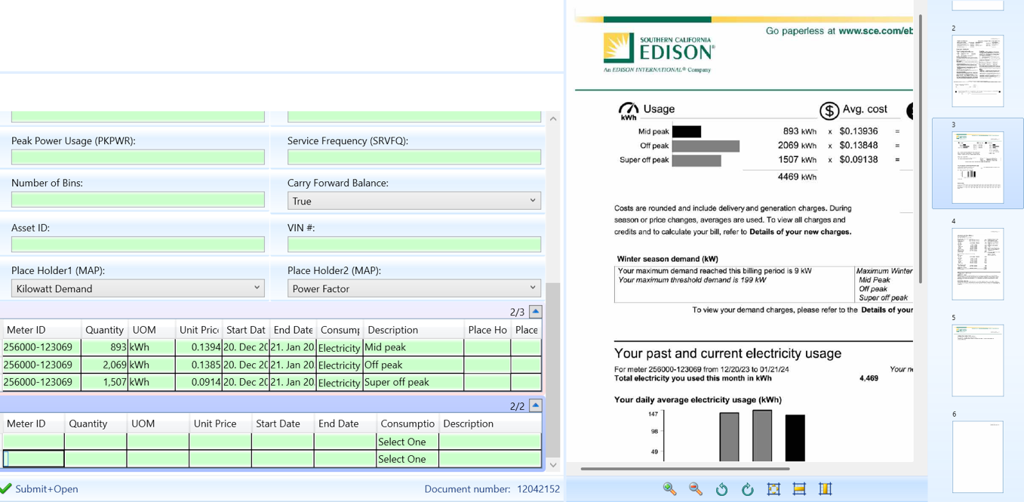
OD Capture
HEADER
RATE SLABS
ITEMS
Header: Used for capture of Invoices with just one item
Rate Slabs: Used to capture Rate slabs for utilities.
Item: Generally used for cases where an Invoice has more than one consumption category.

Slide 8
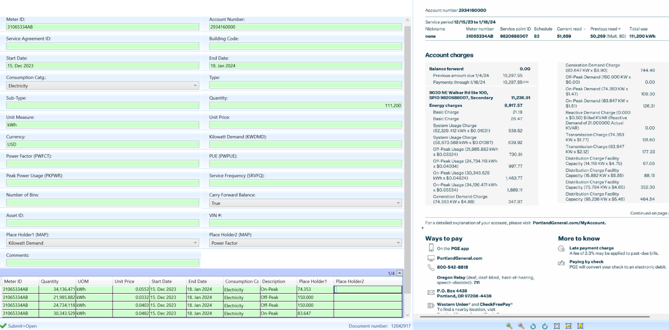
OCR Screen Overview

Slide 9
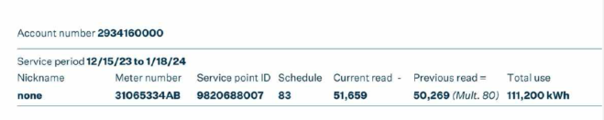
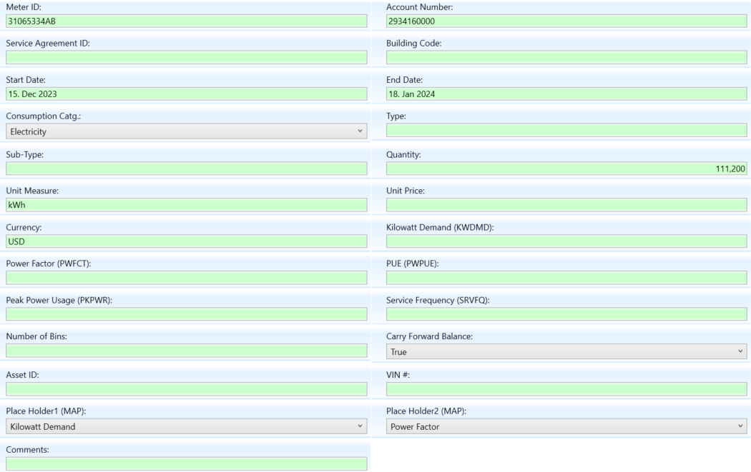
Header Level Information
Mapping in OCR

Slide 10
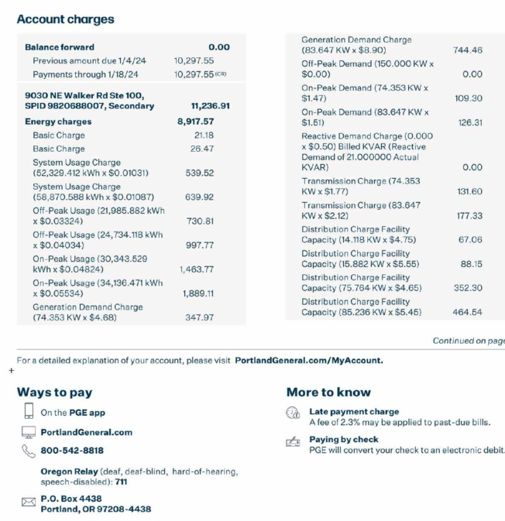
Attribute / Placeholder
Details
Itemized
Consumption

Slide 11
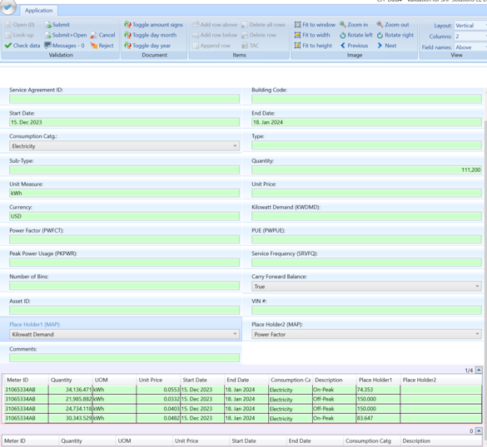
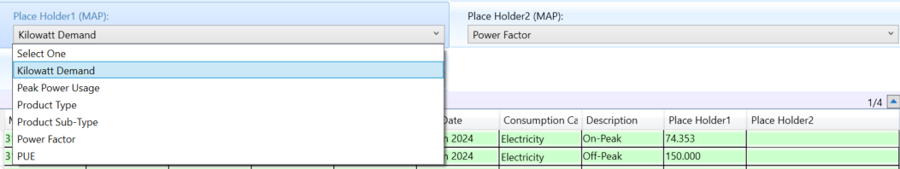
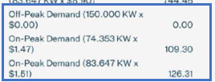
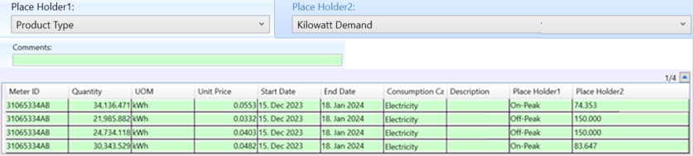
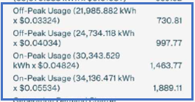
Field Mapping
Attributes
Consumptions

Slide 12

How RPA is Used
Document Classification, Invoice Intake and Rejections
Enrich information
Match to Master Data for Reporting
Apply the right set of business rules
Audited Data: Ready for publishing

Slide 13

Demo

