Slide 1

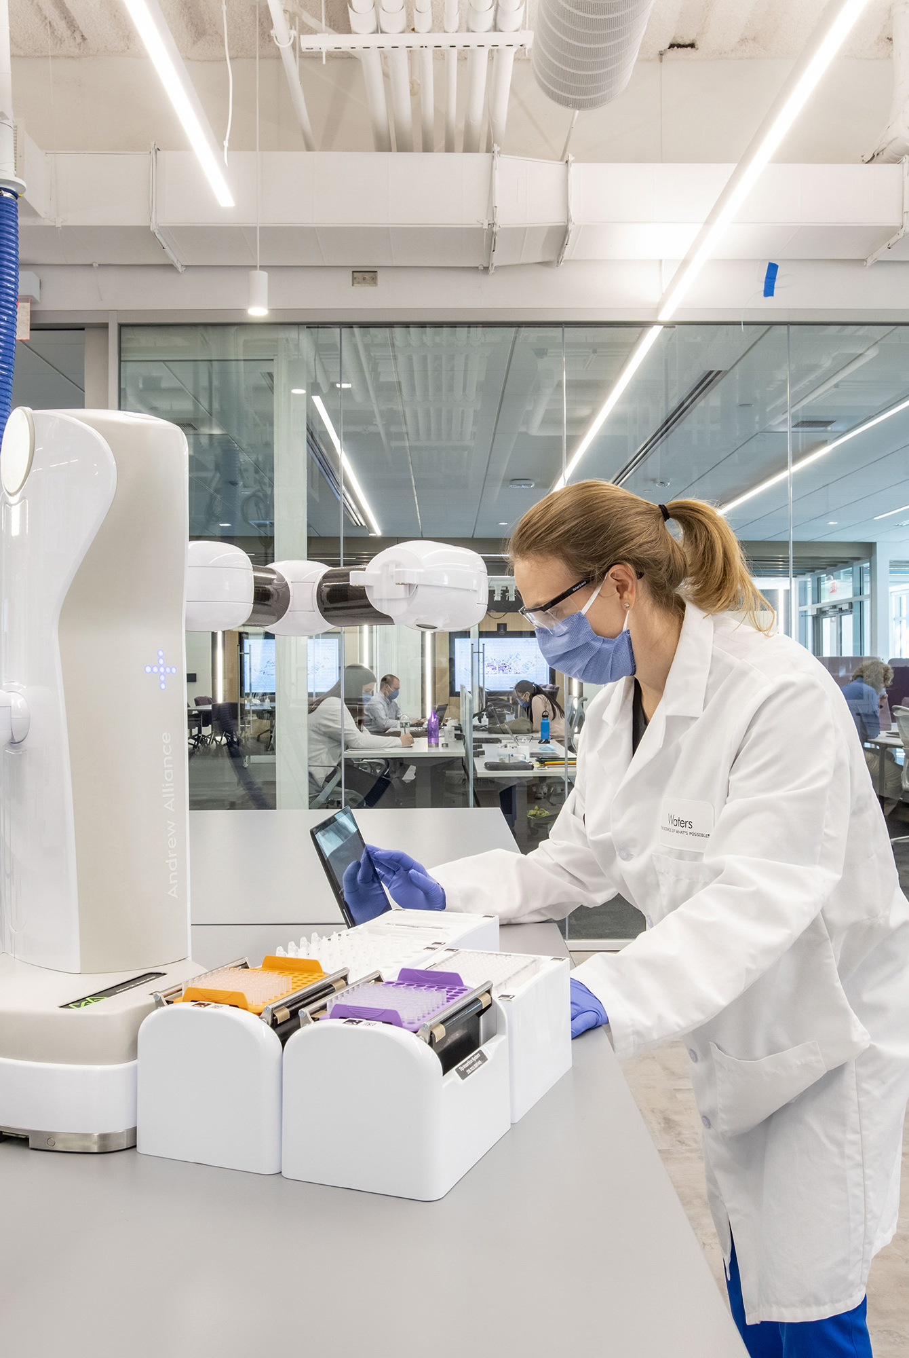
Manufacturing
Success Story:
55% Size Reduction & $5M
In Savings with SAP Data Volume
Management and Data ASSIST
Background & Pain Points:
  Waters aimed to move to SAP RISE but high cost was a major hurdle to getting approval
  A financial analysis showed that the project would only be viable if the system size was reduced by 40% before migration
  Achieving such a significant reduction posed a complex optimization challenge
Solution:
  Data Volume Assessment (DB02) identified archiving opportunities
  Phased approach to minimize risk and accelerate progress
  9 distinct archiving objects were implemented across 4 SAP system
  Implemented Data ASSIST for long-term cost savings and performance optimizations in SAP RISE
Results & ROI:
  Projected cumulative savings surpassed $5M
  55% size reduction across SAP landscape, including ECC, GTS, BW, APO systems
  Prepared landscape to move to SAP RISE, ensuring project stayed on schedule and achieved targeted budget
  Data ASSIST provided ongoing growth control, ensuring costs stayed low even in the new environment while providing insights into their database

Slide 2


Industrial Goods and Machinery
Success Story:
Enterprise Database Reduction by 60% with Data Archiving
Background & Pain Points:
  System performance challenges and disruption risks.
  Business users unhappy with functionality issues.
  Challenges keeping up with manual processes.
  Hardware and Cloud hosting/backup costs continued to rise.
Solution:
  Analyzed the current data footprint.
  Data ASSIST:
  Facilitated identification reductions through itemized archiving objects.
  Automated the archival process of historical data with dynamic scheduling.
  Defined retention requirements and implementing a compliance strategy.
Results & ROI:
  Database size reduction by 60%
  Real-time, custom-query reporting.
  Database performance increased by 19%.
  Improved user experience, enhanced system efficiency.
  BTP provided a scalable framework.
  Archived content was securely stored yet easily retrievable.

Slide 3


Consumer Goods/Retail
Success Story:
Improved System Performance & Cost Savings with Data ASSIST
Background & Pain Points:
  Continuously growing table sizes and overall data volume in the primary DB.
  Database size has grown to over 230%, with a current growth of approximately 15% per month.
  No data volume management or archiving strategy in place.
  Growing costs associated with growing volume.
  Recurrent need to reallocate resources to address any issues with memory.
Results & ROI:
  Reduced storage needs, with cumulative cost savings for the first three years surpassing $200k.
  Reduced migration time periods.
  Improved system performance and speed to access information.
  Maintaining the database size and growth with automated scheduling.
  Implementation of retention policies for compliance.
  Database size reduction by estimated 40%.

Slide 4


Public Sector
Success Story:
Streamlined IT Landscape:
Data Volume Management
Background & Pain Points:
  IT landscape complexity. Third-party content management application outside SAP.
  Non-standardized environment and high data pollution.
  Inefficiencies in hardware management.
  Increased hardware costs due to inefficient management.
Solution:
  Robust data volume management strategy, leveraging Auritas' proprietary tools:
  Data archiving, using Auritas accelerators to introduce archiving objects.
  Decommission third-party content management:
    Migrate records to SAP-certified content management application.
Results & ROI:
  Simplified overall network architecture application retirement.
  Reduced database size, resulting in cost reductions.
  Eradicated data issues with a selected number of applications.
  Centralized content management platform integrated with their primary database.
  Ownership of applications and overall system.
  Comprehensive data volume management plan implemented within 13-months.

Slide 5

Utilities
Success Story:
Improved SAP System Performance & TCO with Advanced Data Archiving
Pain Points:
  Accumulated large amounts of data leading to system performance issues.
  Increased costs from database size.
  Reporting/planning impediments.
  Needed to remove divested data without affecting live information.
  Required verifiable audit trail and validation proofs for archived data.
Solution:
  Advanced archiving solution delivered on time and within budget
  Reduced database size and improved performance.
  Sustainable solution saves costs in human, technical, and infrastructure expenses.
  Automation and elimination of unnecessary steps.
Results:
  Sustainable framework incorporating data archiving, migration, and relocation.
  Identify and prioritize objects based on database growth & performance statistics.
  Advanced data archiving solution and estimated ROI and payback period.
  The tailored and transparent approach instilled confidence in the company's decision-makers.

Slide 6


Utilities
Success Story:
Managing Explosion of Data
Post-Implementation
Challenges and Pain Points:
  Company needs real-time data on customer consumption and buying behaviors such as how, when, and why customers engage and purchase.
  Over 21M transaction reads per day
  837% increase in data volume
  Now a 5-petabyte company
Opportunity:
  Company has gone through recent acquisition to expand its portfolio to emerging technologies
  Company has increased the size of its operating footprint from 6 states to 40
  Future acquisitions/market compression is driving speed to market requirements
Results & ROI:
  Reduced data volume by a factor of 9.
  Average annual savings appx $4.2 Millions.
  Reduced storage footprint​.
  Increased speed of access to more accurate data from hours to seconds​.
  Converted all accounting activities from manual to automated​.
  10% improvement in customer satisfaction. Faster resolution of issues and improved overall customer experience​.

Slide 7


Utilities
Success Story:
Database Transformation With Data Archiving For Reduction of 40%
Pain Points:
  Uncontrolled SAP databases size & growth
  No SAP Data strategy in place
  Not retention compliant in SAP & had legal risk
  OpenText underutilized for data management
Benefits:
  Completed Transformation within 7 Months
  40% Database Reduction - through archiving in SAP ECC and CRM
  Positioned for Legal and Regulatory compliance
  Deployed OpenText Solution for DVM storage
ROI:
  Cost savings related to moving SAP data off SAN storage
  HANA Readiness: Database controlled in time for HANA
  Extended life of infrastructure through controlled DB growth
  Readiness for retention management/Risk avoidance

Slide 8


Auto Manufacturing
Success Story:
Advanced Data Archiving Shrunk Database from 5TB to 800GB
Pain Points:
  Rising hardware and Cloud hosting/backup costs to retain rarely accessed data
  Required solution that would keep employee access unchanged
  Sought to reduce financial burden from operations and compliance
  Strained storage capacity
Solution:
  SAP ILM for privacy and retention management
  SAP Document Access by OpenText for data and content storage
  Development of phase approach for quick wins and limit business disruption
Results & ROI:
  Enterprise data on SAP HANA shrunk from 5TB to 800GB (84%)
  Received project payback within 10 months
  Reduced risks associated with operational compliance
  Secured the achieve content storage easily accessible
  Significantly lowered costs for hardware and hosting
  Enables real-time, custom-query reporting
  Decreased migration time to new cloud

Slide 9

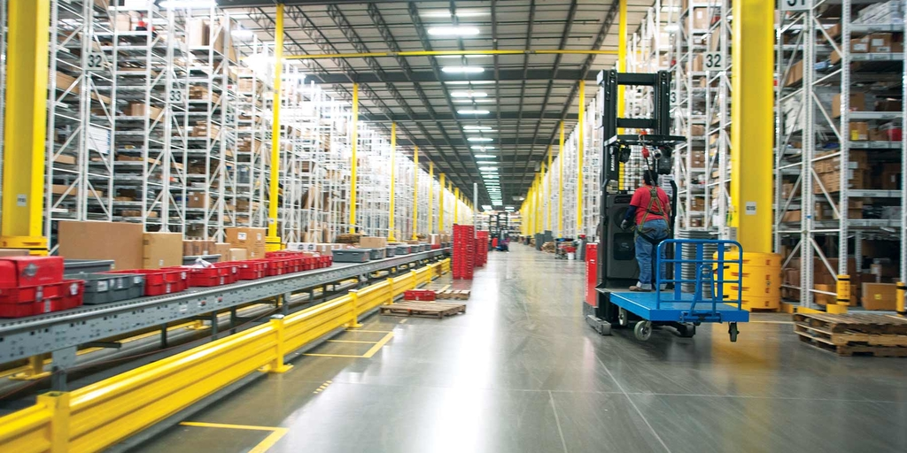
Distribution
Success Story:
Reduce Database Size From 21TB to 7TB With Advanced Data Archiving
Background & Pain Points:
  Multiple tables over 10 billion rows.
  86 application servers required in production environment.
  Database was 30 terabytes and growing at .5 terabyte per month.
  Challenge to reduce database size without compromising operations.
Benefits:
  Grainger has been archiving across the ECC application for over ten years.
  Grainger plans on moving to S4 within a year.
  Avoiding archive index growth.
  Converted Clusters and LOB tables to manageable transparent tables.
Results & ROI:
  Reduced data volume by 66%.
  Growth reduced by 85%.
  $4.4M in cumulative savings
  Approaching NetZero HANA Migration down time.
  Reduced HANA sizing from estimated 21 TB appliance to 7 TB appliance.

Slide 10


Customer Goods
Success Story:
Enhance Database Performance with Archiving & Retention Compliance
Pain Points:
  Uncontrolled ECC database growth
  Needed assistance to prepare database for migration to S/4HANA
  Global retention policies compliance – GDPR compliance risks
Solution:
  Implement a comprehensive data archiving strategy, starting with database assessment for object recommendations.
  Automated archiving scheduling for growth control.
  Launch a retention policy in accordance with privacy regulations, including GDPR.
  Implementation of Document Access (Extended ECM) for improved performance.
Results & ROI:
  Initial database reduction and controlled growth
  Better database performance – Reduction in database search and access times
  Improved application performance
  Reduction in backup times/ Increased system availability
  Extended the life of hardware investment to run ECC
  Reduced S/4HANA implementation risk and costs
  Foundation for GDPR and retention compliance to reduce future legal risks & fines

Slide 11

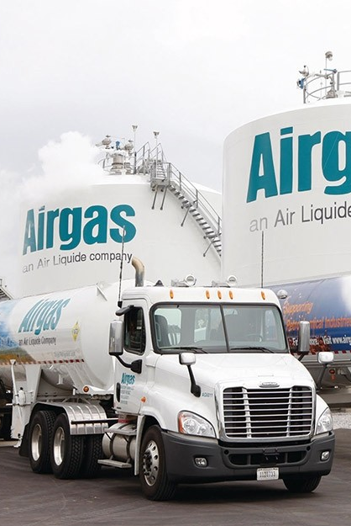
INTERNAL USE ONLY
Success Story:
Data Archiving for S/4HANA Migration Preparation
Pain Points:
  Data footprint increased by 6% annually, leading to a substantial production database size (11.8TB), complicating the migration process.
  Migrating vast amounts of data would be costly.
  Large database threatened to extend the migration timeline, causing potential delays.
  Risk of interrupting daily operations, risking business continuity during transition.
Solution:
  Implemented a phased data archiving approach.
  Archiving without any business interruptions.
  Leveraged AWS S3 as the archiving repository.
  Automation with Data ASSIST
    Gain insights into the database, identifying patterns & opportunities.
Results:
  Achieved an 79% size reduction:
    Archiving 8.7TB initially and further optimizing data for a total reduction of 9.3TB.
  Reduced the timeline for migration.
  Achieve NetZero database growth, ensure predictable costs for the S/4HANA migration.
  Annual savings from the project exceeded $600K. Cumulative savings surpassing $2M.

Slide 12



Tech
Success Story:
Streamlining Migration to S/4HANA with Database Size Reduction
Background & Pain Points:
  Large ECC database​ with high growth rate increases costs associated.
  Issues with GDPR compliance bring legal risks for an organization.​
  Eminent move to SAP S/4HANA:
    Need to prepare the database for the migration.
    Reduce database size for cost savings when migrating & operating on S/4.
Solution:
  Implement a comprehensive data archiving strategy, starting with database assessment for object recommendations.
  Launch a retention policy in accordance with privacy regulations, including GDPR.
  Implement OpenText Document Access/Extended ECM ​for enhanced performance, including search, access and retrieval of data.
Results:
  Extended life of ECC hardware investments​.
  Database size reduction with data archiving.
  Reduced S/4 HANA implementation costs​.
  Retention management implementation for reduced compliance risks.
  Better database performance:
    Reduction in database search and ​access times.​
    Reduction in backup times/increased system availability​.
  Streamlined migration journey to SAP S/4HANA.

Slide 13

Distribution
Success Story:
Fast Tracking S/4HANA Adoption
Background & Pain Points:
  Looking to prepare database for transition to S/4HANA.
    Minimize the risk of downtime during the cloud adoption.
    Save costs when transitioning to new system.
  Multiple tables over 10 billion rows.
  86 application servers required in production environment.
  Database was 30 terabytes and growing at .5 terabyte per month.
  Challenge is to reduce database space by half through optimizing existing archiving program and doing so quick.
Results & ROI:
  Grainger plans on moving to S/4 within a year.
  Avoiding archive index growth.
  Converted Clusters and LOB tables to manageable transparent tables.
  Growth reduced by 85%.
  Approaching NetZero HANA Migration down time.
  Reduced HANA sizing from estimated 21TB appliance to 7TB appliance.
  $1.5M annual savings from hardware costs alone.

Slide 14


INTERNAL USE ONLY
Success Story:
Archiving Accelerated Move to RISE with Size Reduction of 80%
Pain Points:
Economics of the deal didn’t support a move from on-prem to RISE/cloud
  Current system was 5TB requiring larger infrastructure to support compute and storage
  Non-prod systems added to cost structure
  Included growth calculations reduced the value proposition for a cloud migration
Solution:
  Reduce the DB size through an Archiving strategy:
    Reducing the source DB size results in a smaller target requirement
    Migration time is reduced with less data to transfer
    With fewer objects, there is less risk in the overall project
  Infrastructure costs are reduced as well as overall project services
Results:
  Peabody was able to reduce their source system from 5TB to 1TB
    80% size reduction
  $1M estimated cumulative savings from reducing data footprint.
  A smaller infrastructure footprint provided the needed value proposition for RISE
  Beyond the initial activity, by putting an archiving strategy in place, Peabody can manage their growth and focus investment on new technologies as opposed to infrastructure spend

Slide 15


Oil & Gas
Success Story:
80% System Reduction with Accessible & Compliant PRA Archive for SAP S/4HANA Prep
Solution
  Implement proprietary PRA archiving mechanism to preserve access to archived PRA transactions while maintaining compliance.
    Enabled PRA reversals or entries to be “linked” directly to a specific archived object.
    Within the journal entry, the archive link was referenced in the text field, allowing users to retrieve details seamlessly.
  Data ASSIST:
    Automated the archival process of historical data with dynamic scheduling.
    Defined retention requirements and implementing a compliance strategy.
Results & ROI:
  81% size reduction across the SAP landscape, achieving the initial requirement for transition.
  PRA archiving allowed for savings and size reduction while retaining access and ensuring compliance.
  Monetary savings when migrating a smaller database to SAP S/4HANA.
  Data ASSIST provided ongoing growth control, ensuring costs stayed low even in the new environment while providing insights into their database.

