Slide 1
Driving Innovation, Empowering Transformation
Connect Everything:
SAP Integration Suite

Slide 2



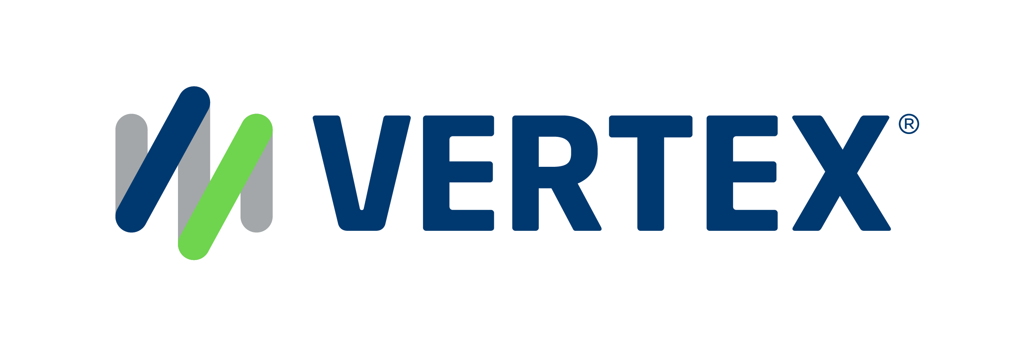
1,500
10,500+
22+
$1,5B
Successful Projects
TB of Data
Managed
Years Evolving Companies
Total Customer Savings
Driving Innovation, Empowering Transformations.
Data Management
Solution
implementation
Product
& Innovations
Strategic
Partnerships
  SAP Data Archiving
  SAP DaRT
  Data Quality & Governance
  Data Migration
  System Decommissioning
  Data Privacy
S/4HANA Implementation
SAP Business Data Cloud (BDC)
SAP BTP Deployment
SAP OpenText
  Extended ECM
  Vendor Invoice Management
  Doc Presentment
SAP Ariba
SAP Vistex
SAP Vertex
AI Implementation
Cloud Migrations
  Data ASSIST by Auritas
  (Data Archiving Automation)
  Data GUARD by Auritas
  (Legacy Decommissioning)
  Auritas Intelligent Accrual
  (Financial Automation)
SAP Gold Partner
SAP PartnerEdge, Sell
CCFlex – Cloud Choice Flex
  (AMS + Hypercare)
PartnerEdge®
CCFlex

Slide 3

Reasons to Move to Integration Suite
SAP PI/PO mainstream support ends in 2027.
SAP Integration Suite is a more modern solution for enterprises.
Allows streamlined connection cloud to on-prem, SAP to non-SAP, within SAP BTP.

Slide 4
The Previous Solution: PI/PO
Area | SAP PI/PO Limitations | SAP Integration Suite
Deployment | On-premise only | Cloud-native, multi-cloud deployment (SAP BTP)
Scalability | Limited horizontal scaling | Elastic scaling with auto-scale features in the cloud
Adapters | Limited to SAP-provided adapters | More pre-built adapters + partner ecosystem + APIs
Modern Protocol Support | Limited support for modern APIs (GraphQL, Webhooks) | Full support for REST, Webhooks, OData v4, GraphQL, etc.
Integration Patterns | Traditional EAI patterns | Supports modern iPaaS patterns, API-led integration, event mesh
Development Experience | Requires Java for custom development | Low-code/no-code options with Flow Builder
API Management | Not available | Embedded API Management & Developer Portal
Machine Learning/AI | Not integrated | Native integration with SAP AI Core and AI APIs
Hybrid Integration | Harder to manage hybrid landscapes | Designed for hybrid landscapes (on-prem + cloud)
Upgrades & Maintenance | Requires manual upgrades and patching | Managed and updated by SAP automatically
End of Life | PI/PO nearing sunset (2027 mainstream, 2030 ext.) | Future-proof, aligned with SAP's cloud-first strategy

Slide 5

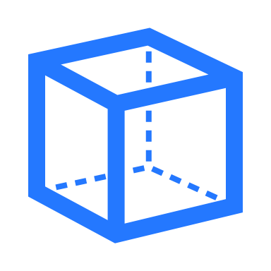


Moving From PI/PO to Integration Suite
Enhanced Capabilities
and Features
Modern and Scalable
Architecture
SAP Integration Suite enhances data processing, automates integration flows, and adapts to your workflows—delivering greater speed, efficiency, and agility than traditional PI/PO tools.
Built on modern architecture, SAP Integration Suite scales effortlessly and adapts to your evolving business needs. Grows with your business without performance loss.
Improved User Experience
& Interface
Integration with Cloud
& Hybrid Landscapes
An intuitive interface simplifies complex tasks, enhances user experience, and boosts productivity. It allows users to manage integration tasks more efficiently, leading to better workflow.
Enables end-to-end process integration across various applications by facilitating message exchanges. This capability allows for the development and utilization of predefined integration content.

Slide 6








Benefits of Integration Suite
Streamlined connectivity between various cloud services.
Adheres to industry standards for data protection & compliance.
Scalability and cost-effectiveness through seamless integration.
Advanced security features to prevent breaches.
Enhanced flexibility, allowing organizations to adapt quickly.
Robust monitoring tools for insights into their integration processes.
Leverage real-time data to optimize processes and outcomes.
Features ensure the integrity of data across all systems.
Notes:
This how SAP is moving
This is why you should move too.

Slide 7




Auritas' Expertise in Integration Suite
With Auritas, we help from deployment to post-live support, ensuring no more juggling disconnected systems.
Solution deployment on SAP BTP
Auritas has successfully transitioned numerous organizations to the Integration Suite and have strong expertise in BTP.
Migration from legacy systems
Decades of experience working with data migration. Certified team members that work with SAP and non-SAP legacy systems.
Integration with multiple ERP solutions
Certified professionals who possess deep knowledge of Integration Suite and a number of SAP & non-SAP environments for connection.
Tailored solutions & support
We provide personalized support throughout the implementation process and partner for long-term success post-implementation.

Slide 8
Integration Suite – Use Cases
Application Integration
Synchronize data across systems, such as integrating SAP S/4HANA with Salesforce to streamline quote-to-cash or syncing SuccessFactors with ERP for aligned HR and finance data.
API Management
Expose, manage, and secure APIs to enable innovation and accelerate digital transformation, such as creating APIs for customer data to fuel mobile development or partner collaboration.
Finance Automation
Automate invoice approvals and journal postings by integrating your SAP ERP with OpenText VIM and external payment platforms.
Hybrid Cloud Integration
Bridge cloud and on-premise environments by connecting SAP ECC or S/4HANA with cloud-based apps to support end-to-end business processes across hybrid IT landscapes.
Sales & CRM
Connect Salesforce with SAP master and transactional data to give your sales team instant access to inventory, pricing, and order status.
Accelerate Procurement
Streamline purchase requisitions and PO workflows by syncing SAP Ariba with S/4HANA and third-party vendor systems in real time.

