Slide 1

Solution for Data Volume Management and Storage Management

Slide 2





1,500
10,500+
22+
$1,5B
Successful Projects
TB of Data
Managed
Years Evolving Companies
Total Customer Savings
Driving Innovation, Empowering Transformations.
Data Management
Solution
implementation
Product
& Innovations
Strategic
Partnerships
  Data Archiving & ILM
  Retention Management
  HANA Memory Optimization (NSE)
  Data Governance
  Data Migration
  Cloud Migrations
  Data Privacy and Security
  Legacy Decommissioning
  Data Volume Assessment
  Data Quality Assessment
SAP S/4HANA & RISE
SAP BTP Deployment
  SAP Integration Suite
AI Implementation
SAP OpenText
  Extended ECM (xECM)
  Vendor Invoice Management
  Document Presentment
SAP Ariba
SAP Vertex
SAP Vistex
Geospatial Intelligence (GIS)
  Data ASSIST by Auritas
  (Data Archiving Automation)
  Data GUARD by Auritas
  (Legacy Decommissioning)
  Auritas Intelligent Accrual
  (Financial Automation)
  DMS+ by Auritas
  (Enhanced Document Storage)
SAP Gold Partner
SAP PartnerEdge, Sell
CCFlex – Cloud Choice Flex
PartnerEdge®
  (AMS + Hypercare)
CCFlex

Slide 3













Customer Success
Services Across Multiple Industries – Verticals:

Slide 4
  Growing cost and expense of database storage.
  Excessive database memory usage.
  Extended backup durations impacting data recovery times.
  More frequent need for system maintenance.
  Legal retention & compliance issues due to increasing regulations.
  Highly complex & costly journey to S/4HANA.
  Human errors when archiving due to manual activities, such as incomplete archiving due to incorrect job sequences.
  Challenges in retaining skilled archiving staff.
  Complex post-archiving maintenance requirements creating additional overhead for IT teams.
Common Challenges:
Notes:
Get Deepak and David’s input here

Slide 5

Data ASSIST brings in comprehensive data analysis and implementation of automated archive scheduling.
Data Identification
& Analysis
Archive Scheduling Manager

Slide 6

Data ASSIST by Auritas helps organizations efficiently optimize their SAP data volume management by automating the data archiving process. It simplifies identifying and archiving redundant or non-essential data, reducing database size, lowering storage costs, and improving overall SAP efficiency.
Visual Analysis, Insights Real-Time
& ROI Projections:
Analyze your data using customizable visual charts and graphs, allowing you to perform "what-if" analysis to help identify which items to archive for optimal ROI.
Automate Scheduling,
Eliminate Manual Errors:
Eliminate the need for manual intervention, and avoid the risks associated with employee turnover, forgetfulness, or human error.
Manage All Job Schedules from One Screen:
Save time by managing, configuring, and maintaining job schedules from a single, centralized screen.
Notes:
We can add screenshots here
-- Rework the visual of slide 5

Slide 7
Maximizing Archiving Success:
The Power of Data ASSIST Automation
Automated scheduling helps avoid human error leading to cost savings and accurate DB reporting.
Intuitive data insights allow for quick understanding of the scope & impact of data management activities.
Central management ensures to view of all scheduled jobs from a single platform, simplifying operations.
Data health monitoring offers a real-time view into DB and reporting on size reduction and performance improvements.
Improved communication provides visual reports that allow sharing with stakeholders or management the value of archiving.
Customizable dashboards tailors the visual analysis dashboards to focus on key metrics to easily address business needs.
Notes:
For the messaging/title for each feature:
What feature are we talking about? (automated scheduling) – Advantage – What benefit/outcome it drives to the customers?
Visual rework

Slide 8

Data Identification & Analysis Benefits
Intuitive Data Insights
Visualizations of data help users quickly understand the scope and impact of their data management activities.
Data Health Monitoring
Visual representations help identify areas where data archiving can reduce database size and improve system performance.
Actionable Insights for Optimization
Users can identify inefficiencies and proactively optimize storage and data management strategies.
Customizable Dashboards
Users can tailor the visual analysis dashboards to focus on key metrics that are most relevant to their organization.
Improved Communication and Reporting
Share reports with stakeholders or management, making it easier to communicate the value of data.
Enhanced User Engagement
The graphical nature of the visual analysis encourages engagement, even from non-technical users.
Notes:
Rework the titles

Slide 9

Automated Archive Scheduling Benefits
Consistency
Scheduled jobs run at predefined intervals, ensuring tasks are executed consistently and on time, reducing the risk of human error.
Reduced Manual Effort
Data ASSIST automates scheduling process, significantly cutting down on manual effort.
Resource Optimization
By scheduling jobs during off-peak hours or optimizing job execution, reducing system downtime and operational disruptions.
Job Monitoring and Alerts
Monitoring tools that alert users to any issues or failures in scheduled jobs, allowing for quick resolution.
Compliance for Auditing
Consistent execution and provides detailed logging, which is beneficial for compliance and auditing purposes.
Centralized Management
Manage and monitor all scheduled jobs from a single interface.
Notes:
Rework the titles

Slide 10
Archivability Discover Archiving Potential and Eliminate Barrier
The Archivability feature scans your system data to pinpoint archivable records, giving you instant insights into eligibility and closure requirements.
Know What’s Ready: Instantly discover which records meet archiving criteria and can be moved to long-term storage.
Identify Gaps: Get actionable recommendations on open dependencies and steps needed to close records for archiving.
Optimize Your Workflow: Simplify retention management, reduce system clutter, and enhance compliance with minimal effort.
Identifying what’s ready to be archived and what’s holding you back.
Notes:
For the messaging/title for each feature:
What feature are we talking about? (automated scheduling) – Advantage – What benefit/outcome it drives to the customers?
Visual rework

Slide 11

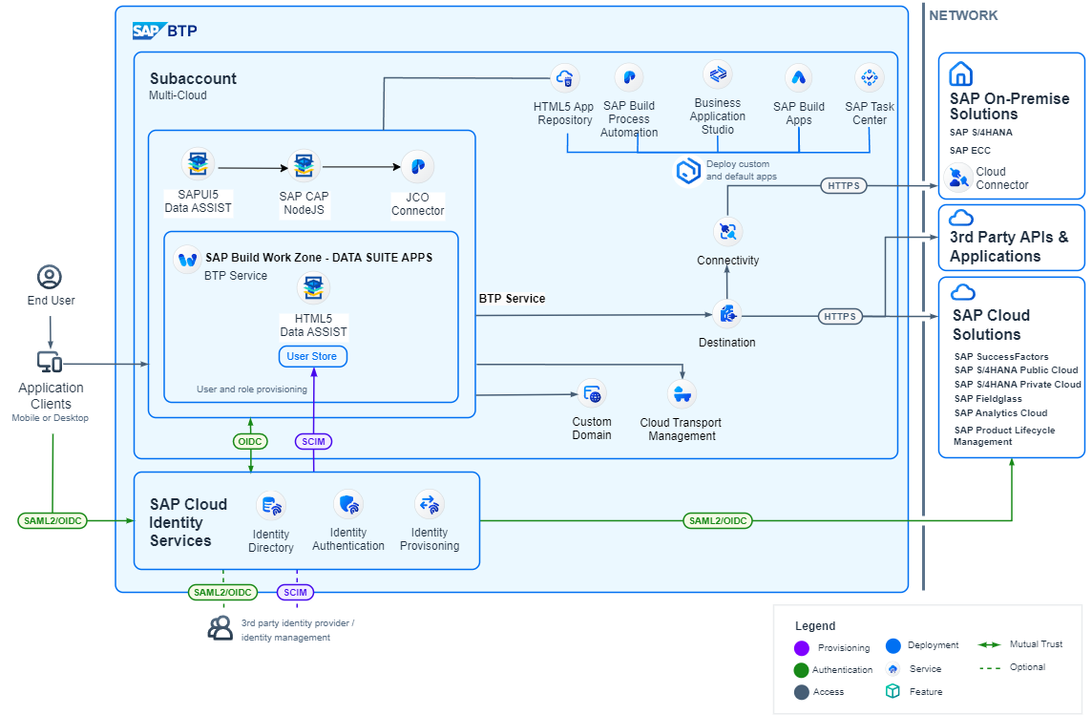
Notes:
Ask Silas for the new arch

Slide 12
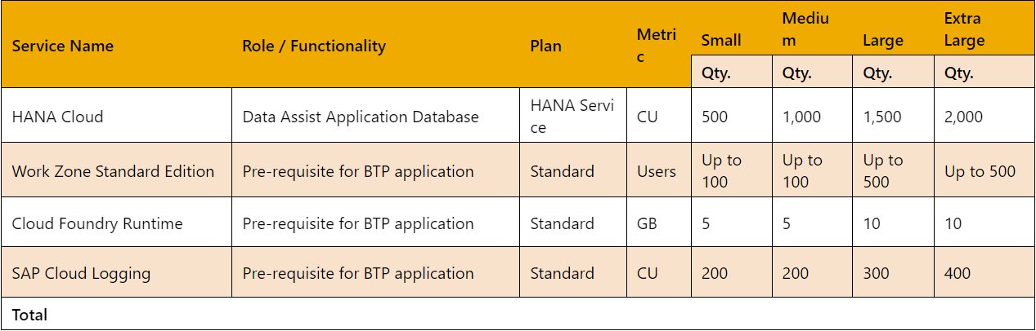
Data ASSIST by Auritas
SAP BTP pre-requisite services (yearly estimation):
*WorkZone is licensed per subaccount.
*All the services above need to be on the same subaccount.

Slide 13

Demo

Slide 14
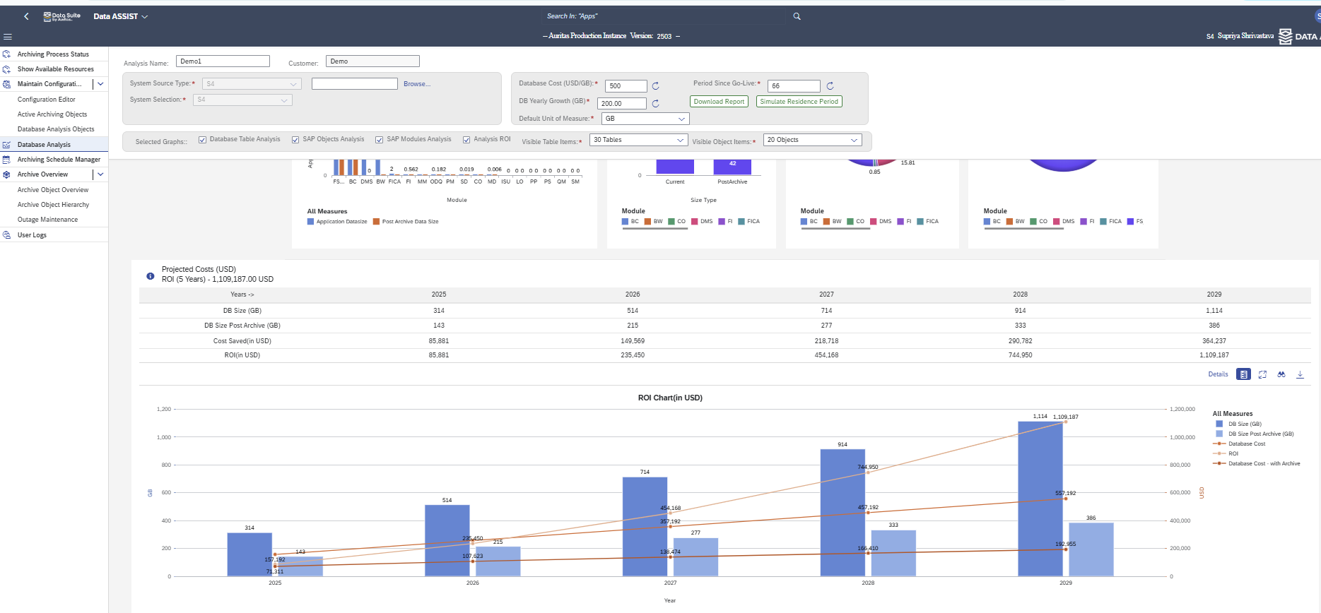
ROI Analysis
1. Get quick insights into the ROI of your initiative for the next 5 years.
2. Compare your database size with and without archiving and view ROI.
1
2

Slide 15
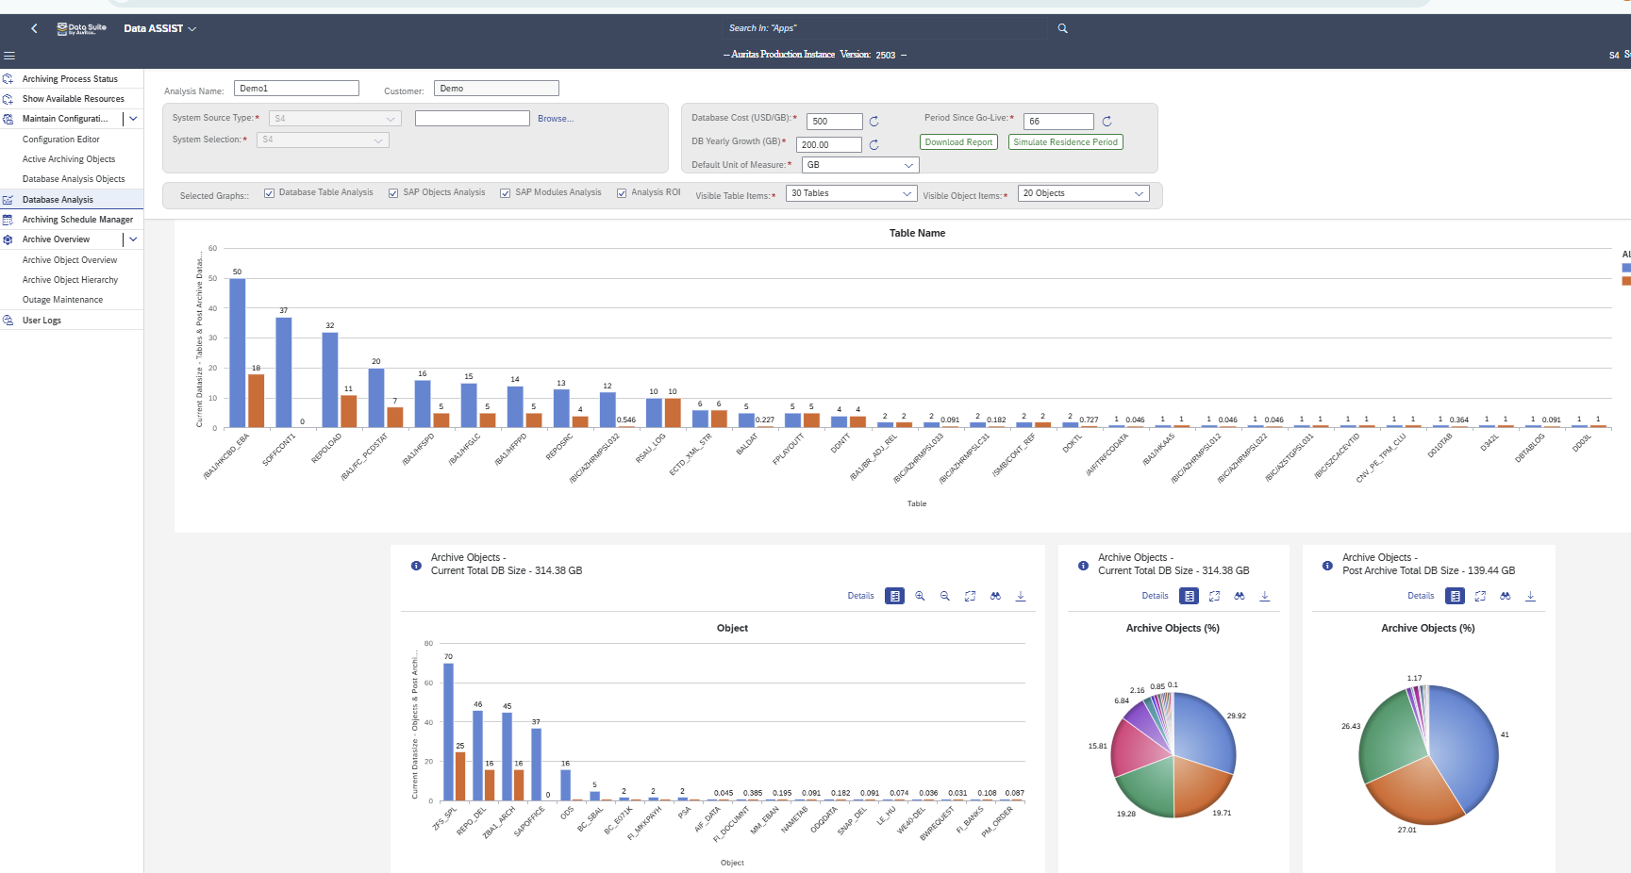
Visual Insights Into Your DB
1. Compare the size of your largest tables before and after archiving.
2. View the size of your DB before and after implementing the recommended archive objects.
1
2

Slide 16
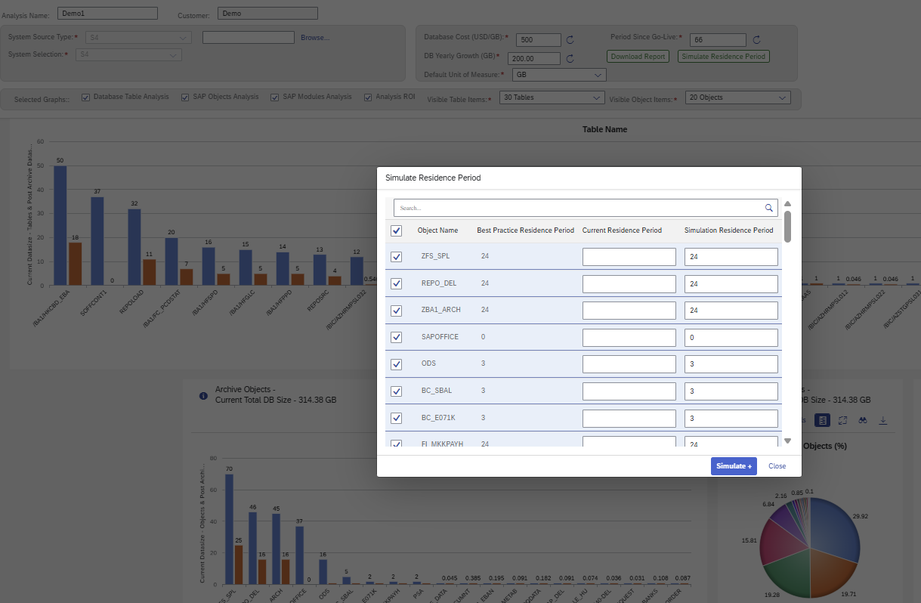
Simulate Residence Period
1. Simulate the residency period for each object based on best practices or company policy.
2. View the results in real time!
1

Slide 17
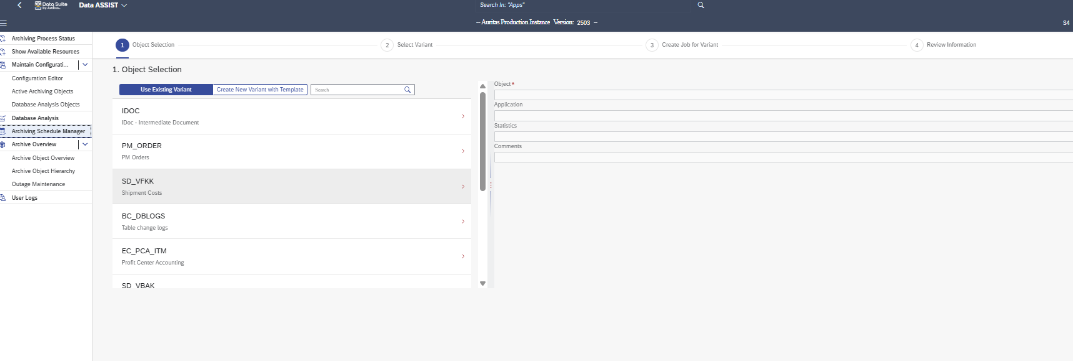
1. Create new variants , reducing the manual efforts required. Automate the variant creation process and create multiple variants in a few seconds.
Archive Schedule Manager
Simplify variant creation and managing jobs scheduling.
1

Slide 18
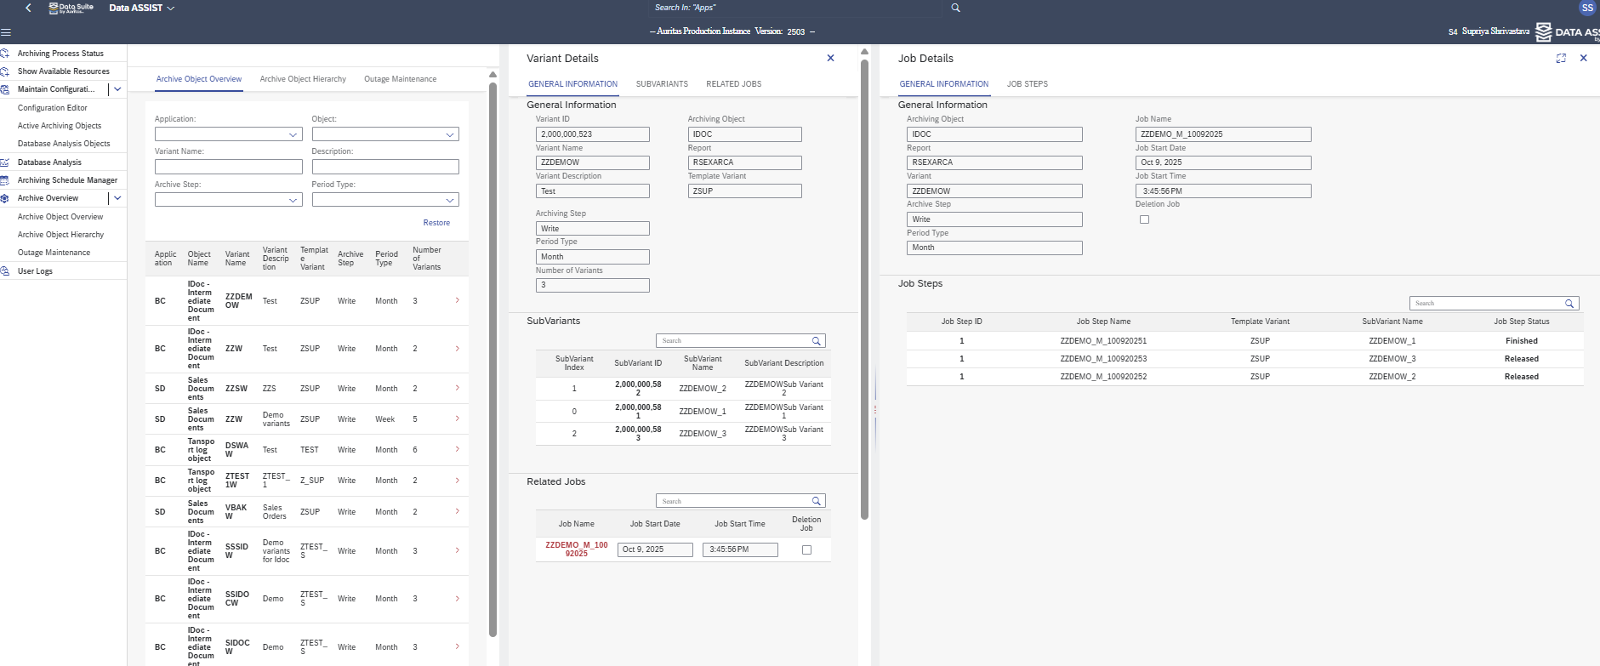
Scheduling Archive Objects Jobs
1. Allows creation of multiple jobs for existing variants or new variants simultaneously with a simple visual tool.
2. Reduces complexity in job scheduling, automating repetitive tasks.
1

Slide 19
Scheduling Archive Objects Jobs
1. Real-time visualization of job and variant execution.
2. Provides transparency and control, unlike manual methods that lack real-time insights.
1

Slide 20

Use Cases & Success Stories

Slide 21


Manufacturing
Success Story:
55% Size Reduction & $5M
In Savings with SAP Data Volume
Management and Data ASSIST
Background & Pain Points:
  Waters aimed to move to SAP RISE but high cost was a major hurdle to getting approval
  A financial analysis showed that the project would only be viable if the system size was reduced by 40% before migration
  Achieving such a significant reduction posed a complex optimization challenge
Solution:
  Data Volume Assessment (DB02) identified archiving opportunities
  Phased approach to minimize risk and accelerate progress
  9 distinct archiving objects were implemented across 4 SAP system
  implementing Data ASSIST for long-term cost savings and performance optimizations in SAP RISE
Results & ROI:
  Projected cumulative savings surpassed $5M
  55% size reduction across SAP landscape, including ECC, GTS, BW, APO systems
  Prepared landscape to move to SAP RISE, ensuring project stayed on schedule and achieved targeted budget
  Data ASSIST provided ongoing growth control, ensuring costs stayed low even in the new environment while providing insights into their database

Slide 22


Industrial Goods and Machinery
Success Story:
Enterprise Database Reduction by 60% with Data Archiving
Background & Pain Points:
  System performance challenges and disruption risks.
  Business users unhappy with functionality issues.
  Challenges keeping up with manual processes.
  Hardware and Cloud hosting/backup costs continued to rise.
Solution:
  Analyzed the current data footprint.
  Data ASSIST:
  Facilitated identification reductions through itemized archiving objects.
  Automated the archival process of historical data with dynamic scheduling.
  Defined retention requirements and implementing a compliance strategy.
Results & ROI:
  Database size reduction by 60%
  Real-time, custom-query reporting.
  Database performance increased by 19%.
  Improved user experience, enhanced system efficiency.
  BTP provided a scalable framework.
  Archived content was securely stored yet easily retrievable.

Slide 23

Global Consumer Product
Data Archiving for Improved System Performance and Cost Savings
Background & Pain Points:
  Continuously growing table sizes and overall data volume in the primary DB.
    Database size has grown to over 230%, with a current growth of approximately 15% per month.
  No data volume management or archiving strategy in place.
  Growing costs associated with growing volume.
  Recurrent need to reallocate resources to address any issues with memory.
Solution:
  Deploy Data ASSIST by Auritas, comprehensive data archiving tool.
  Implemented 2 functional objects, 3 technical objects
  Complete a thorough cleanup of their database.
Results:
  Reduced storage needs, with cumulative cost savings for the first three years surpassing $200k.
  Reduced migration time periods.
  Improved system performance and speed to access information.
  Maintaining the new database size and growth with automated scheduling
  Implementation of retention policies for compliance.
  Database size reduction by estimated 40%.

Slide 24

Data reduction of 1/3 of the system size!
We knew we needed to do some major data archiving so partnered with Auritas to help us with this project. Their team taught us about the SAP archiving process and brought us Data ASSIST by Auritas to help us with the heavy lifting for archiving the initial data as well as the ongoing maintenance.
- Troy Bohanon
Vice President, IT Architecture

