Slide 1
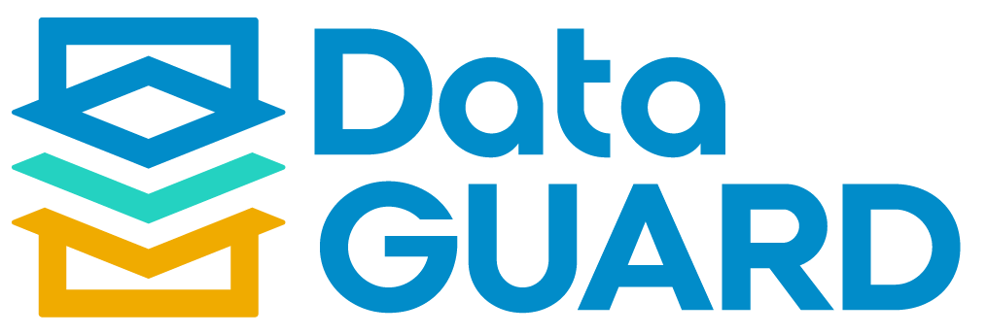
Multi-system Decommissioning & Retention Tool

Slide 2




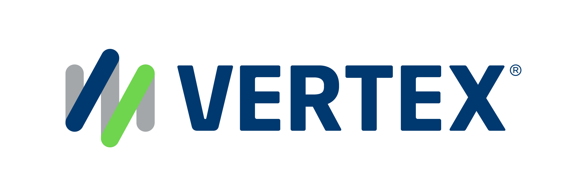
1,500
10,500+
22+
$1,5B
Successful Projects
TB of Data
Managed
Years Evolving Companies
Total Customer Savings
Driving Innovation, Empowering Transformations.
Data Management
Solution
implementation
Product
& Innovations
Strategic
Partnerships
  Data Archiving & ILM
  Retention Management
  HANA Memory Optimization (NSE)
  Data Governance
  Data Migration
  Cloud Migrations
  Data Privacy and Security
  Legacy Decommissioning
  Data Volume Assessment
  Data Quality Assessment
SAP S/4HANA & RISE
SAP BTP Deployment
  SAP Integration Suite
AI Implementation
SAP OpenText
  Extended ECM (xECM)
  Vendor Invoice Management
  Document Presentment
SAP Ariba
SAP Vertex
SAP Vistex
Geospatial Intelligence (GIS)
  Data ASSIST by Auritas
  (Data Archiving Automation)
  Data GUARD by Auritas
  (Legacy Decommissioning)
  Auritas Intelligent Accrual
  (Financial Automation)
  DMS+ by Auritas
  (Enhanced Document Storage)
SAP Gold Partner
SAP PartnerEdge, Sell
CCFlex – Cloud Choice Flex
PartnerEdge®
  (AMS + Hypercare)
CCFlex

Slide 3






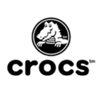


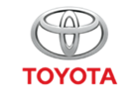



Customer Success
Services Across Multiple Industries – Verticals:

Slide 4

Legacy System Decommissioning

Slide 5
  Growing maintenance and hardware costs
  Security risks on outdated systems
  Limited data access due to technology constraints
  Compliance for data retention and preservation
  Inefficient data management causing silos
  Lack of skilled personnel for legacy maintenance
  Incompatible with modern technologies and apps
  High energy use and carbon footprint
Challenges of Aging Systems
Notes:
Get Deepak and David’s input here

Slide 6
The Solution:
The Power of Decommissioning
One Source of Truth to Legacy Data
50% reduction in costs related to legacy data retrieval and delivery.
Audit/Legal/Regulatory Readiness 32% reduction in storage costs, 20% faster handling inquiries.
Cloud Architecture Flexibility 70% efficiency gain in shared services center.
Meet Sustainability Goals
Cloud migration can lower energy consumption by 65% & carbon emissions by 84%.
Lower TCO for Hardware & Infrastructure
Redirect financial resources saved from decommissioning to more strategic areas.
Notes:
For the messaging/title for each feature:
What feature are we talking about? (automated scheduling) – Advantage – What benefit/outcome it drives to the customers?
Visual rework

Slide 7

Data GUARD by Auritas

Slide 8
Data GUARD by Auritas facilitate organizations to decommission legacy SAP and non-SAP systems while retaining accessibility to the data for regulatory, legal, and business purposes. Ensure reporting capability on data and documents retired and stored in Data GUARD.
Single View:
Provides a single view for managing & retiring SAP and non-SAP legacy systems.
Reporting on Legacy Systems:
Build customized report with the data, document, tables and all the information decommissioned.
Access Historical Data:
Run advanced tailored reports on decommissioned data and have a single source of truth.
Notes:
We can add screenshots here
-- Rework the visual of slide 5

Slide 9






Data GUARD: Capabilities
Decommission and manage multiple systems within your Data GUARD instance
Store structured and unstructured data within Data GUARD for single source of truth.
Migration capabilities: Convert any kind of source system into Data GUARD storage
Supported ERP Platforms
And more…

Slide 10
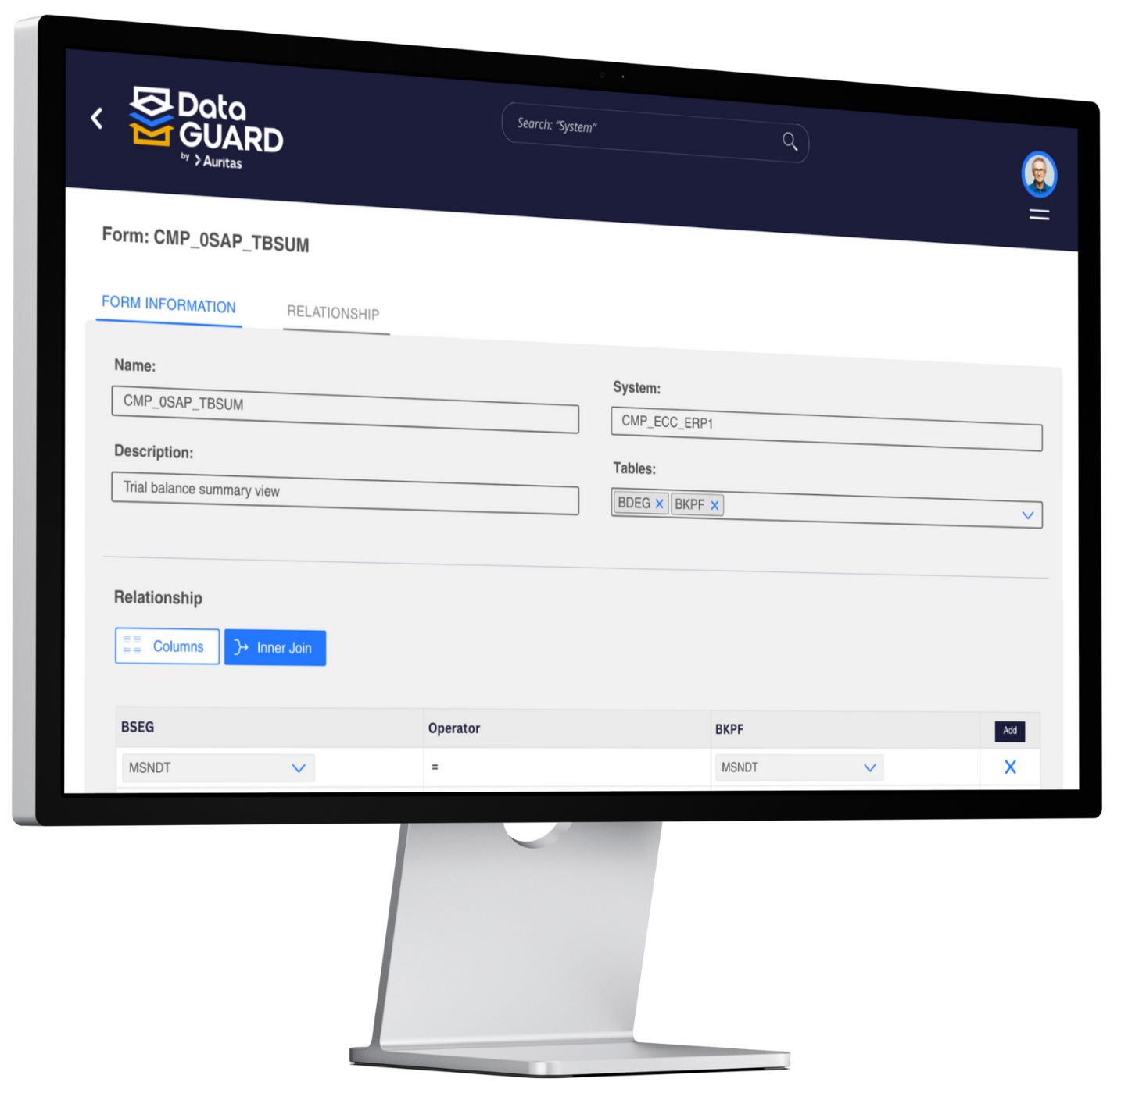
Data GUARD:
Reporting Capabilities
Data GUARD’s capabilities for reporting on the data, documents, and tables stored in the tool allow for organizations to get access and insights into all the information decommissioned systems.
Users can customize their reports, providing different layouts, views and filters tailored to the organization’s needs.
Data GUARD’ reporting methods:
Report Viewer
Document Viewer
Data Filter Viewer (Table View)
SQL Viewer
Notes:
For the messaging/title for each feature:
What feature are we talking about? (automated scheduling) – Advantage – What benefit/outcome it drives to the customers?
Visual rework

Slide 11
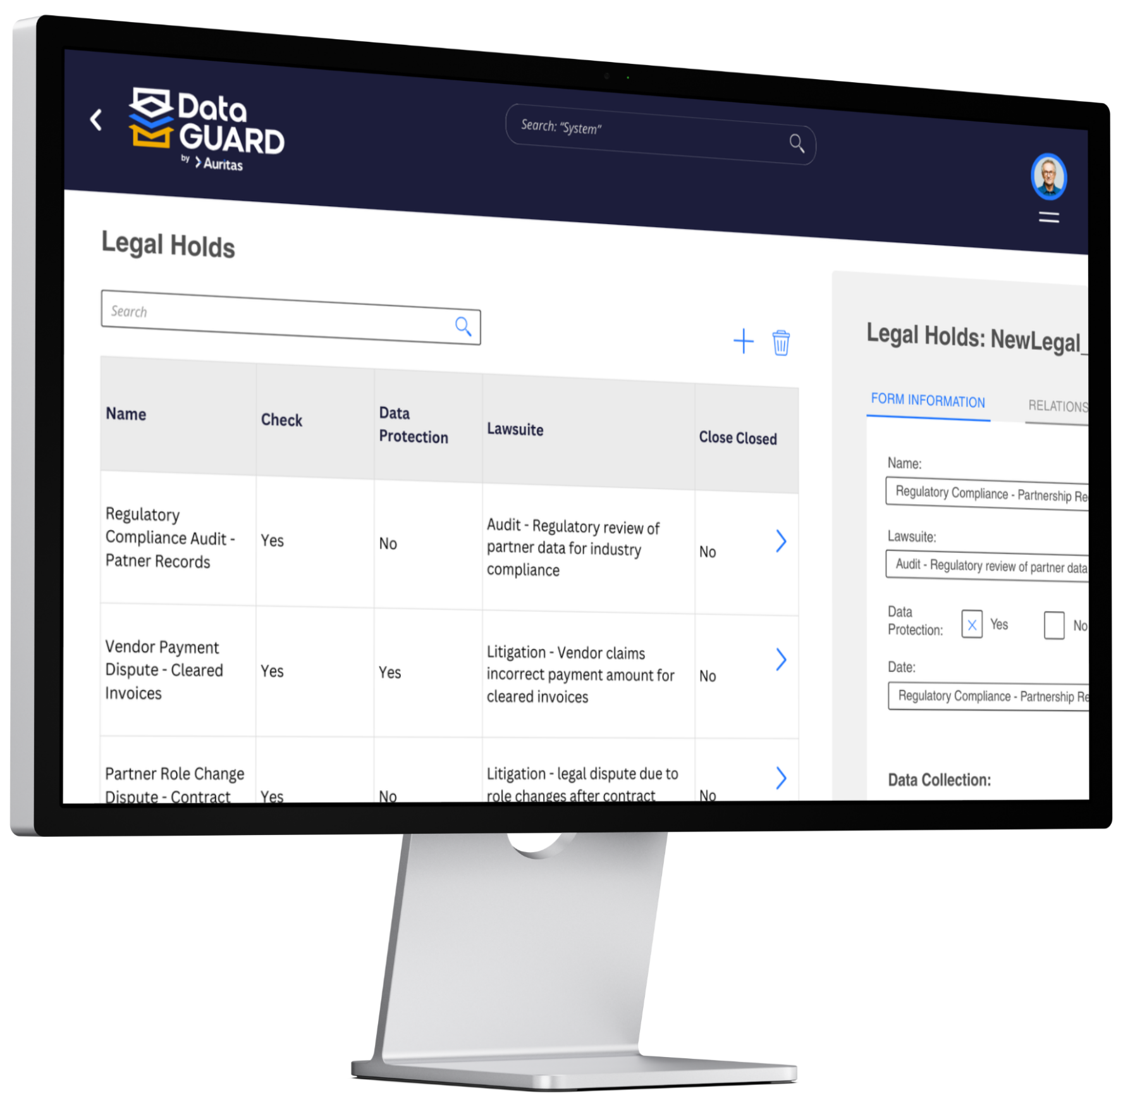
Data GUARD:
Compliance & Control
Apply retention compliance for retired data
Audit logs for overview on historical changes made to reports, access groups, documents, system, retention and more
Legal hold capability
Data GUARD allows for data disposition ensuring compliance and security
Access control for data security. Create user groups and define visibility limits.
  Audit-ready reports while ensuring security & privacy compliance
Notes:
For the messaging/title for each feature:
What feature are we talking about? (automated scheduling) – Advantage – What benefit/outcome it drives to the customers?
Visual rework

Slide 12
Auritas Legacy System
Retirement Tools
Extract
Database
File System
Transform
Table conversions
Store
Report
Business Objects
Document Viewer
Main Frames
BLOB
Formats
SAP BTP Cloud
DB (Prop., OpenSource)
Cloud (AWS, Azure)
Tableau
Excel

Slide 13
Data GUARD by Auritas
SAP BTP pre-requisite services:
Service Name | Role / Functionality | Plan | Metric | Small | Medium | Large | Extra Large
 |  |  |  | Qty. | Qty. | Qty. | Qty.
HANA Cloud | Data GUARD Application Database | HANA Service | CU | 500 | 1,000 | 1,500 | 2,000
Work Zone Standard Edition | Pre-requisite for BTP application | Standard | Users | Up to 100 | Up to 100 | Up to 500 | Up to 500
Job Scheduling | Pre-requisite for retention compliance | Standard | Block of 10K jobs | 5 | 10 | 25 | 50
Integration Suite | Required for migration of data from the source legacy system to the Data GUARD. | Standard | Tenant | 1 | 2 | 2 | 2
Cloud Foundry Runtime | Pre-requisite for BTP application | Standard | GB | 5 | 10 | 15 | 20
Application Logging | Pre-requisite for BTP application | Standard | Tenant | 1 | 2 | 3 | 4
Total

Slide 14
Data GUARD by Auritas
SAP BTP optional services:
Service Name | Details on the why this is required/optional | Plan | Metric | Small |  | Medium |  | Large |  | Extra Large
 |  |  |  | Qty. | ACV | Qty. | ACV | Qty. | ACV | Qty. | ACV
SAP Document Management service | Required if documents or archive files are to be stored in SAP BTP platform | Standard | Block of 50K API calls, 100 GB Blocks storage | 1, 5 | $4,428 | 2, 10 | $8,856 | 4, 20 | $17,712 | 10, 40 | $41,280
Data Retention Manager | Required when SAP Document Management Service is used | Standard | Tenant | 1 | $1,176 | 2 | $2,352 | 3 | $3,528 | 4 | $4,704
Analytics Cloud | Used as a Global reporting tool for all decommissioned systems in the customer Data GUARD instance | Standard | Hours | 200 | $5,976 | 400 | $11,952 | 800 | $23,904 | 1,200 | $35,856

Slide 15
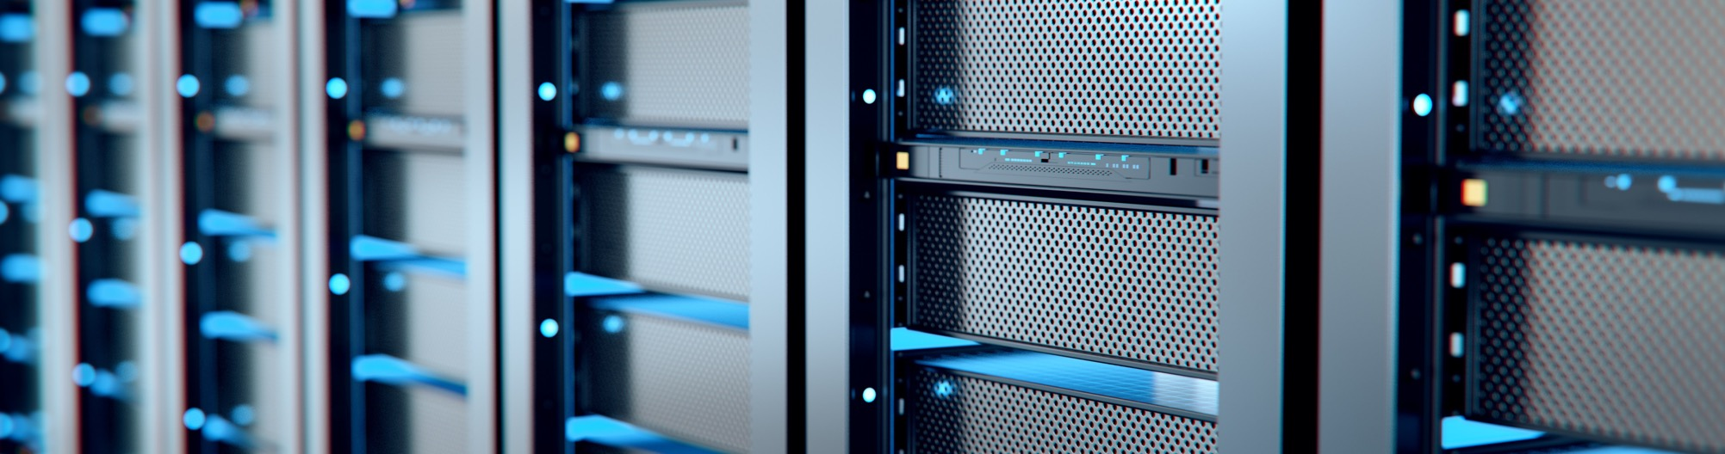
Demo

Slide 16

Key Features
System Selection​
SQL Analysis​
Report Manager​
Data Filter​
Data Filter Viewer​
File Systems​
Document Viewer​
Security & Governance​

Slide 17
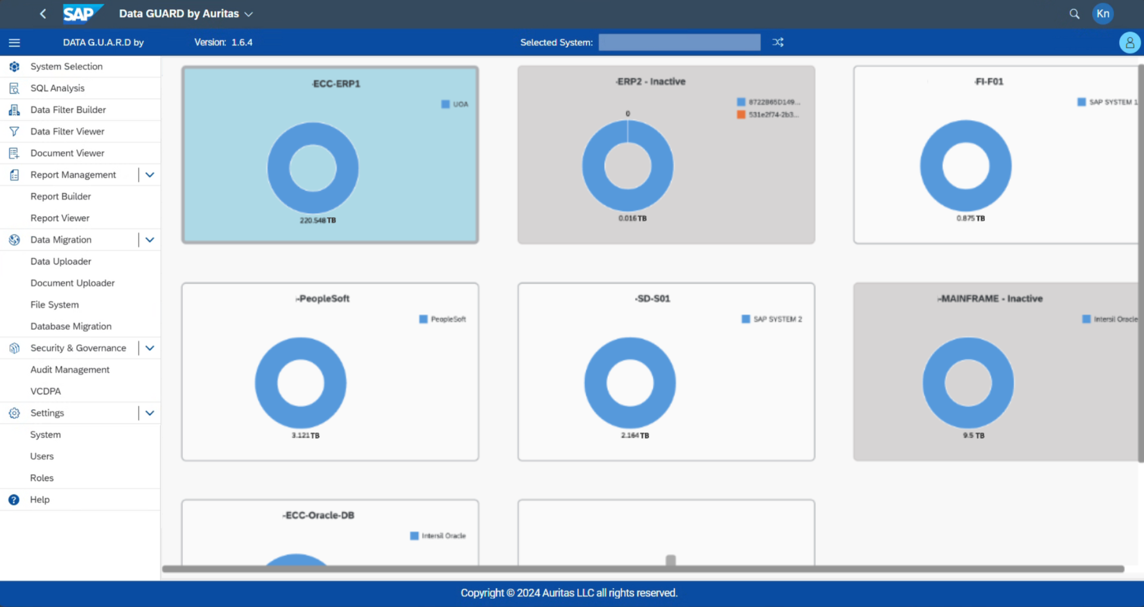
System Selection
1. Gain a comprehensive overview of system details and data sizes.
2. View all systems decommissioned into your Data GUARD instance.
3. Easily add new systems.

Slide 18
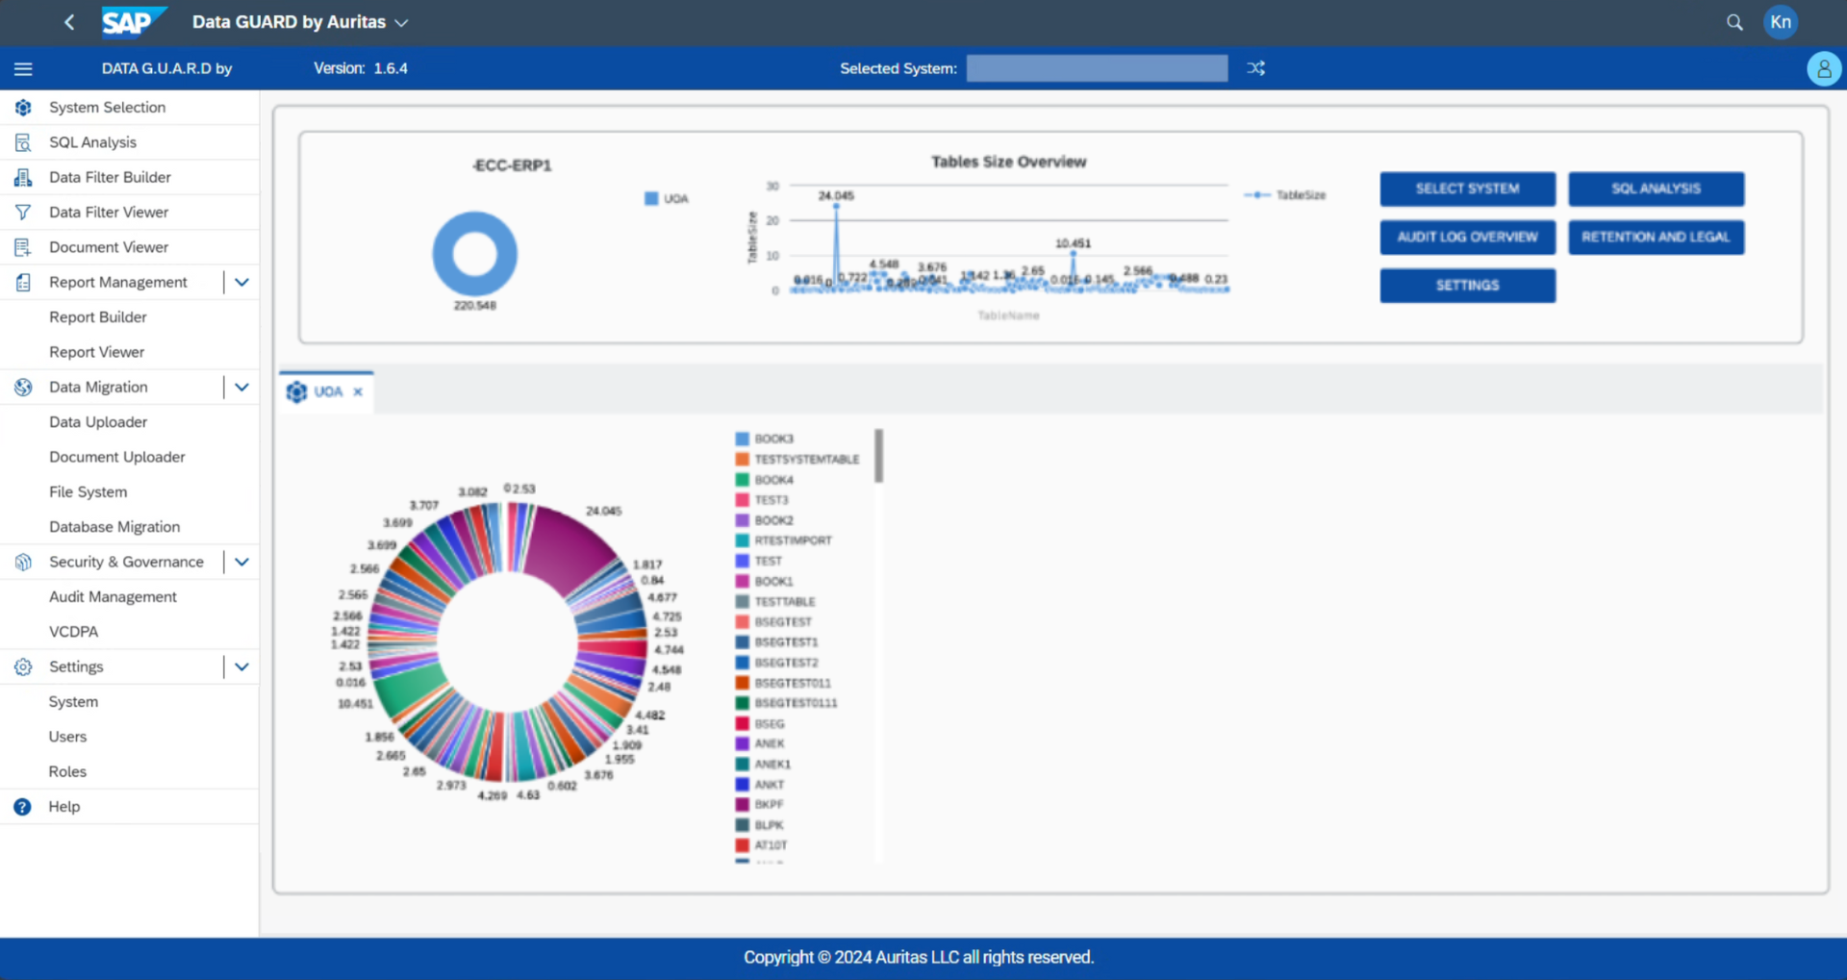
System Selection (2)
1. View detailed information about the selected system.
2. See insights into tables and their respective sizes.

Slide 19
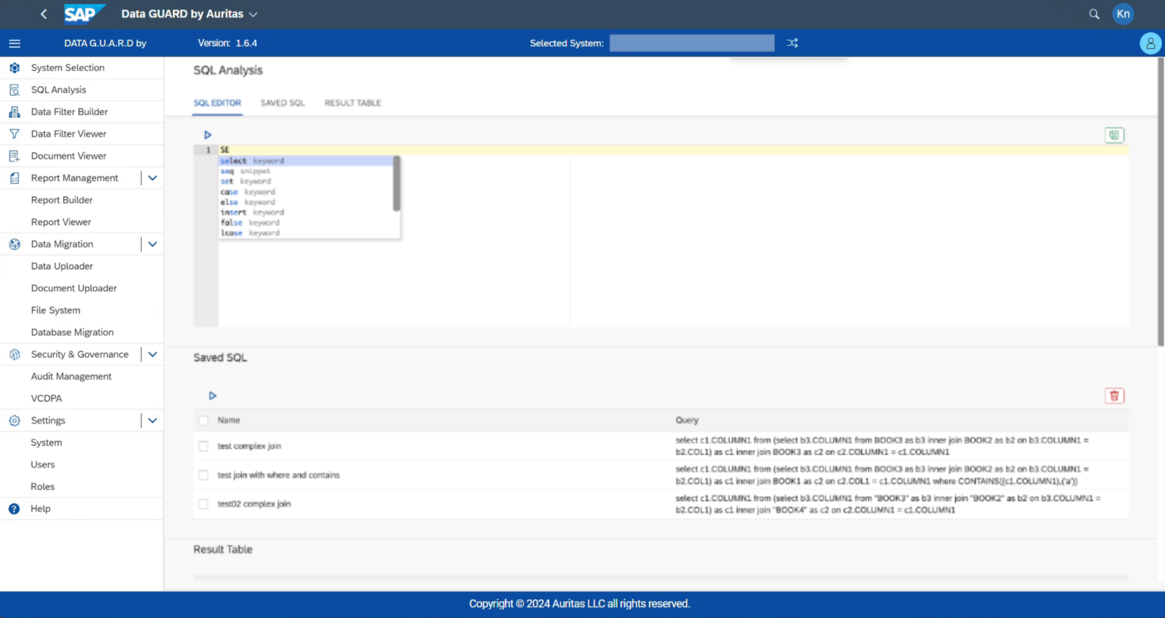
1. Create SQL analyses, simple or complex, aligned with SAP standards.
2. Download a copy of your analysis.
3. Save your queries and results for future use.
SQL Analysis
1. Create SQL analyses, simple or complex, aligned with SAP standards.
2. Download a copy of your analysis.
3. Save your queries and results for future use.

Slide 20
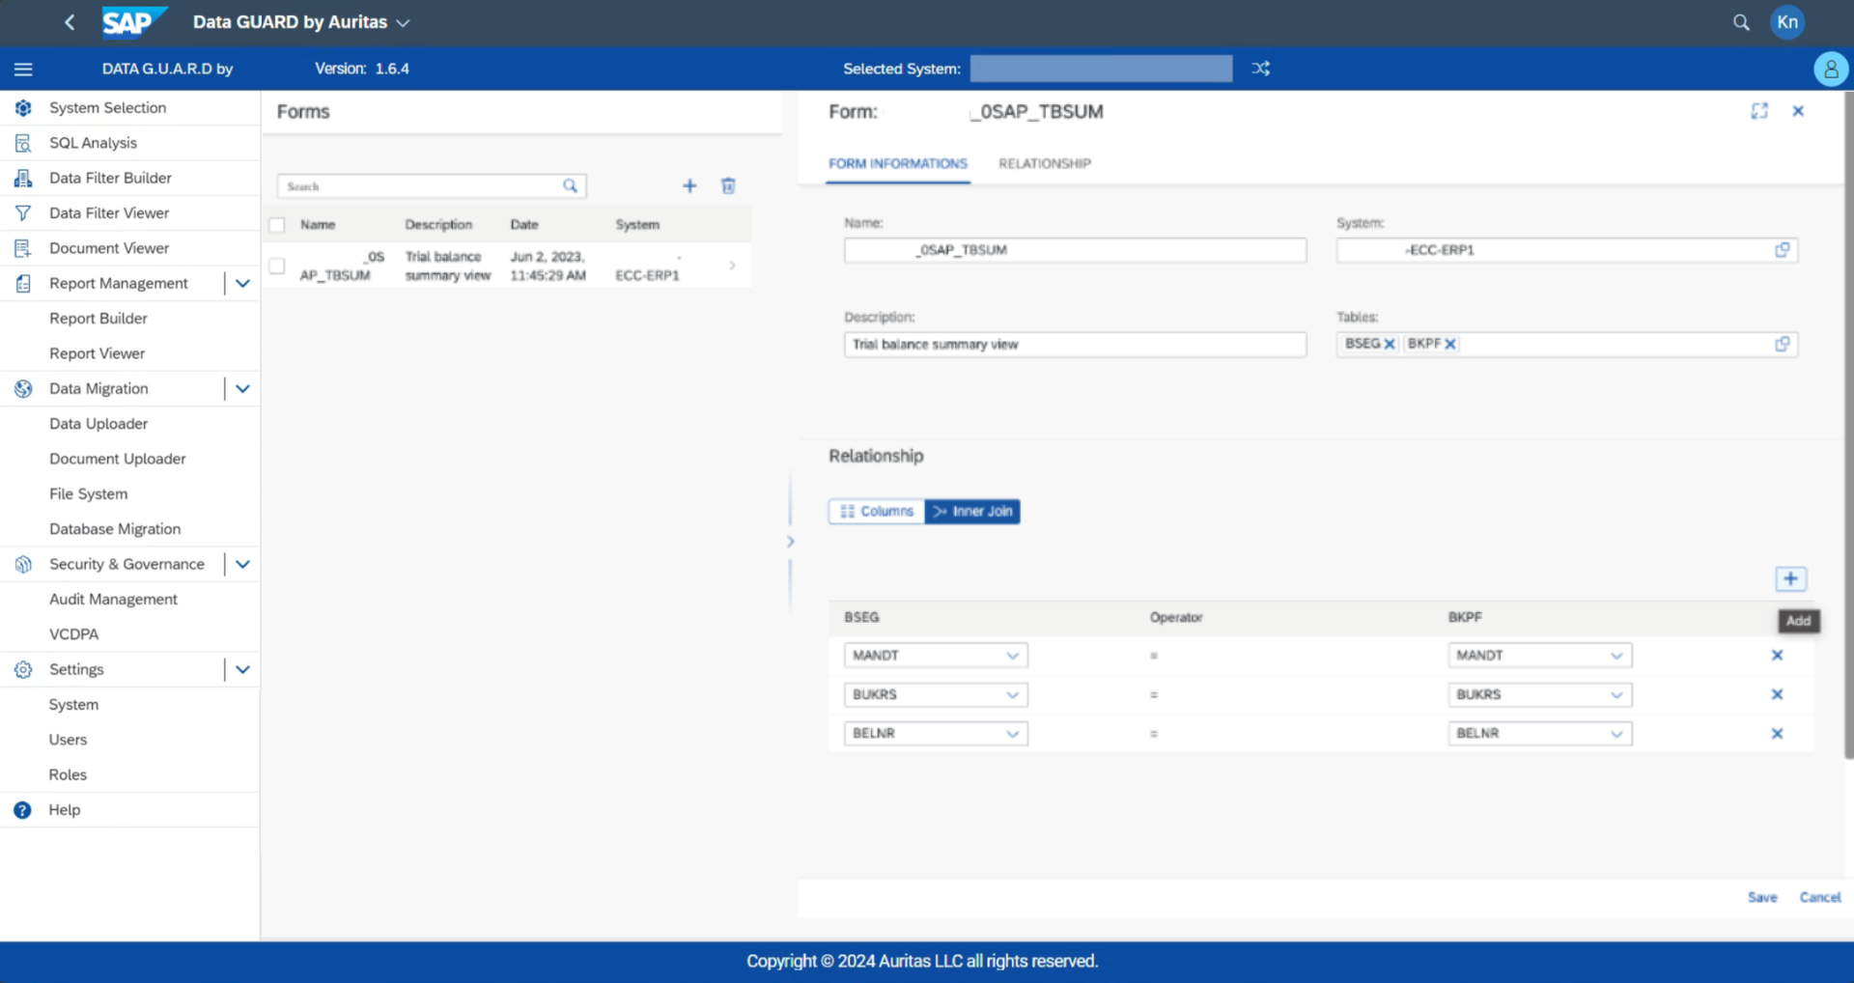
Report Manager
1. Build simple or advanced joins across multiple tables.
2. Get started quickly with pre-built reports for SAP and non-SAP systems.
3. Create new reports or forms with maximum flexibility.

Slide 21
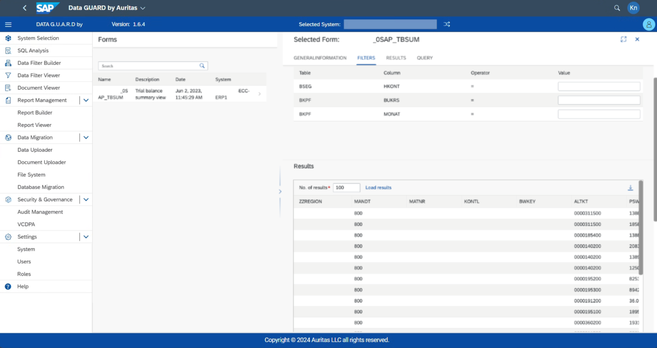
Report Manager (2)
1. See the query generated for each scenario and download or save the data for use in future reports.
2. View all created reports and explore results.
3. Easily switch column names between technical and functional terms.

Slide 22
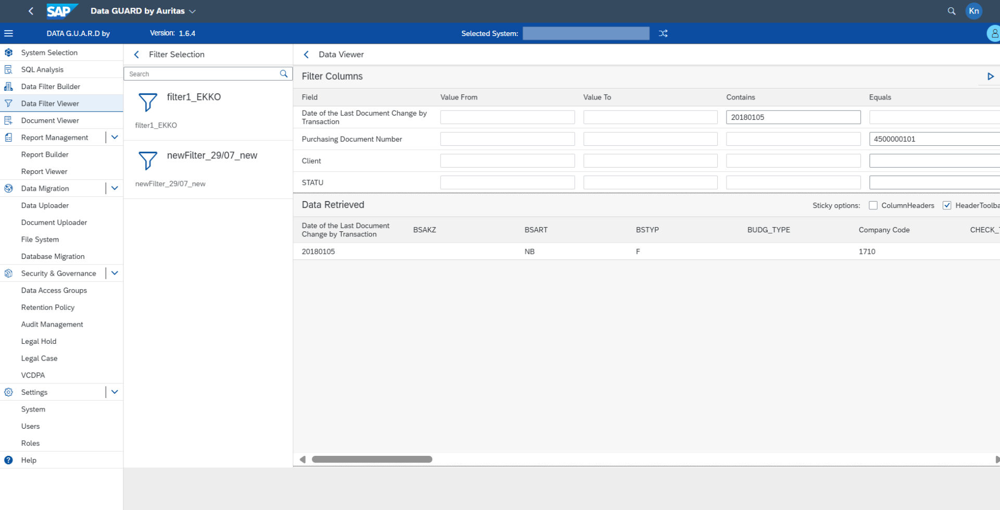
Data Filter Builder
1. Generate custom filters for reports and forms with ease.
2. The filter search can be linked to other applications to create new analytics.

Slide 23
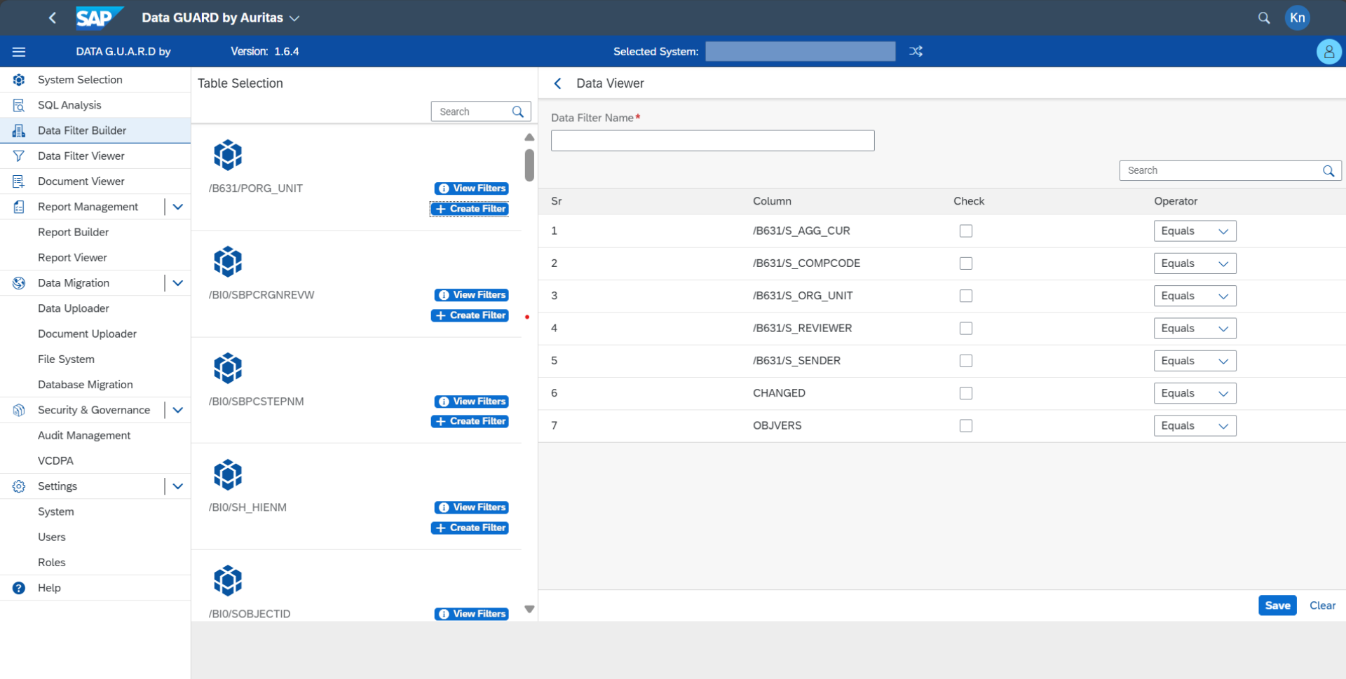
Data Filter Viewer
Data GUARD includes a set of pre-built filters ready for organizational use.

Slide 24
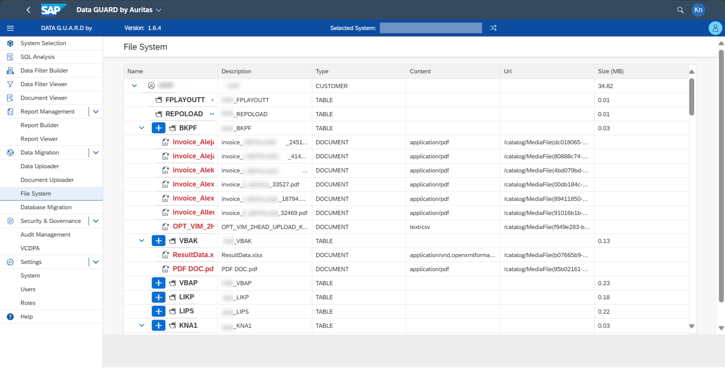
File System
Store and access your data, documents, and reports from decommissioned legacy systems.

Slide 25
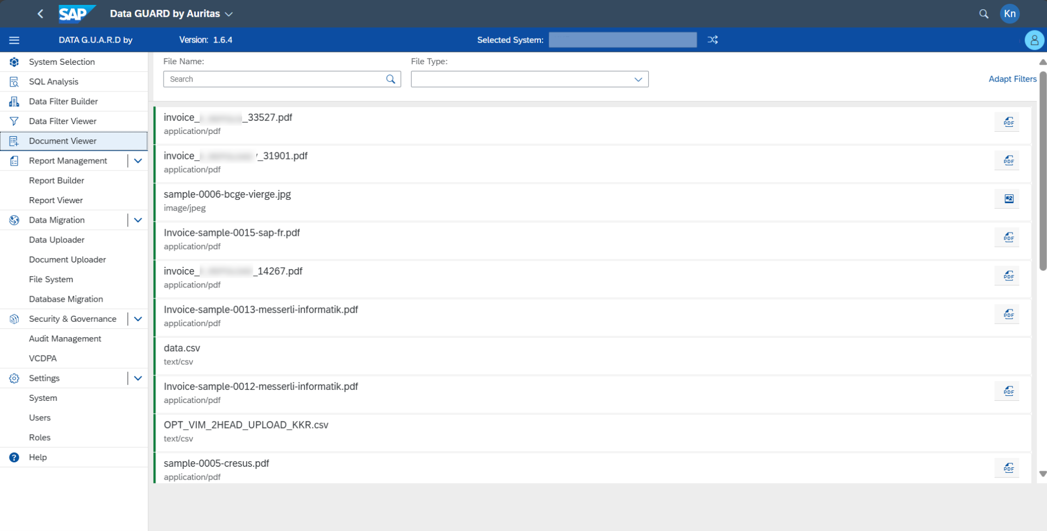
Document Viewer
1. Perform a standard search with a hitlist of documents, double-click any item to view full details.
2. Access documents from decommissioned legacy systems using standard search features as well as linked search criteria.

Slide 26
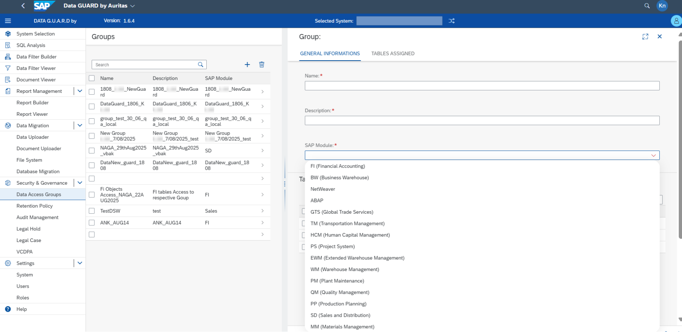
1. Assign different policies to users and owners to control what they can see and how they can interact with the system.
- For example, you can restrict access for external auditors, limiting what they can view and modify.
Security & Governance: Data Access
Assign different policies to users and owners to control what they can see and how they can interact with the system.
For example, you can restrict access for external auditors, limiting what they can view and modify.

Slide 27
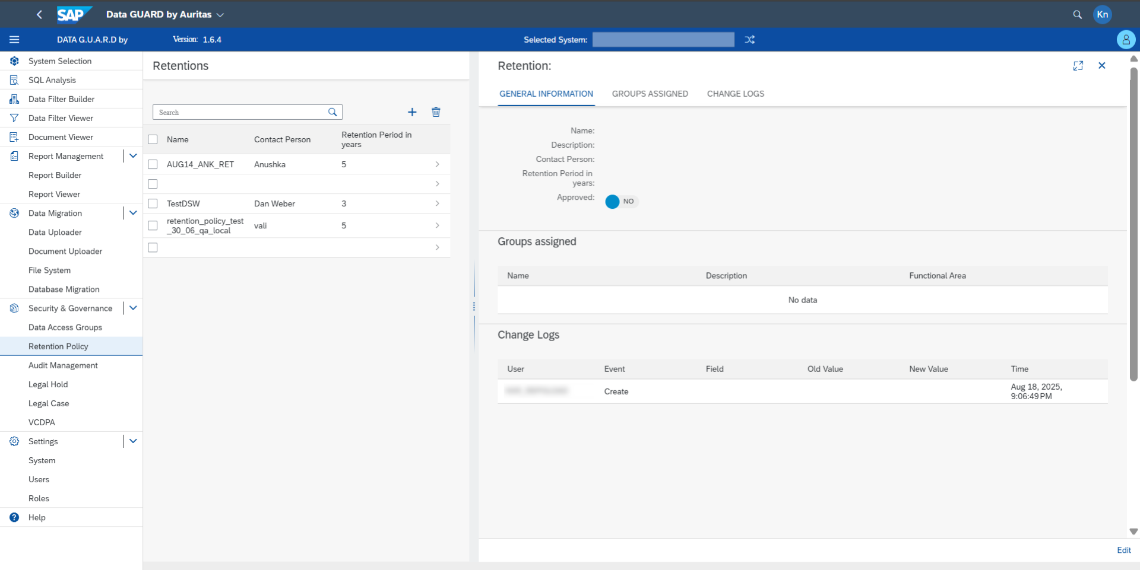
Retention Policy
Retention management: Implement retention policies and track all past actions, including who performed them, with the ability to reference and address them later.
Include e-discovery and any subsequent actions, such as obfuscation or deletion, with all results logged within your environment.

Slide 28
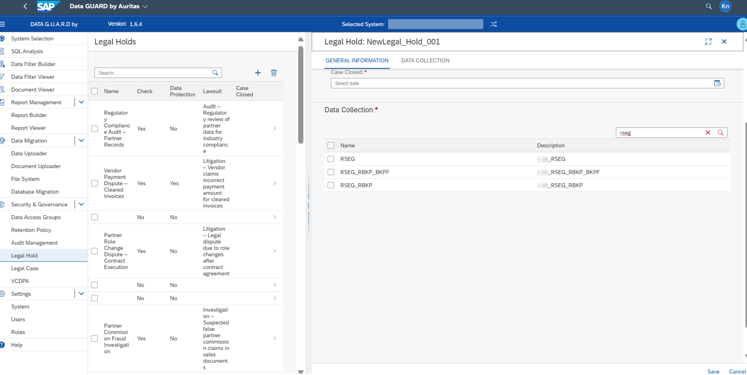
Legal Hold
Manage legal holds as needed and maintain a detailed log of all actions.

Slide 29
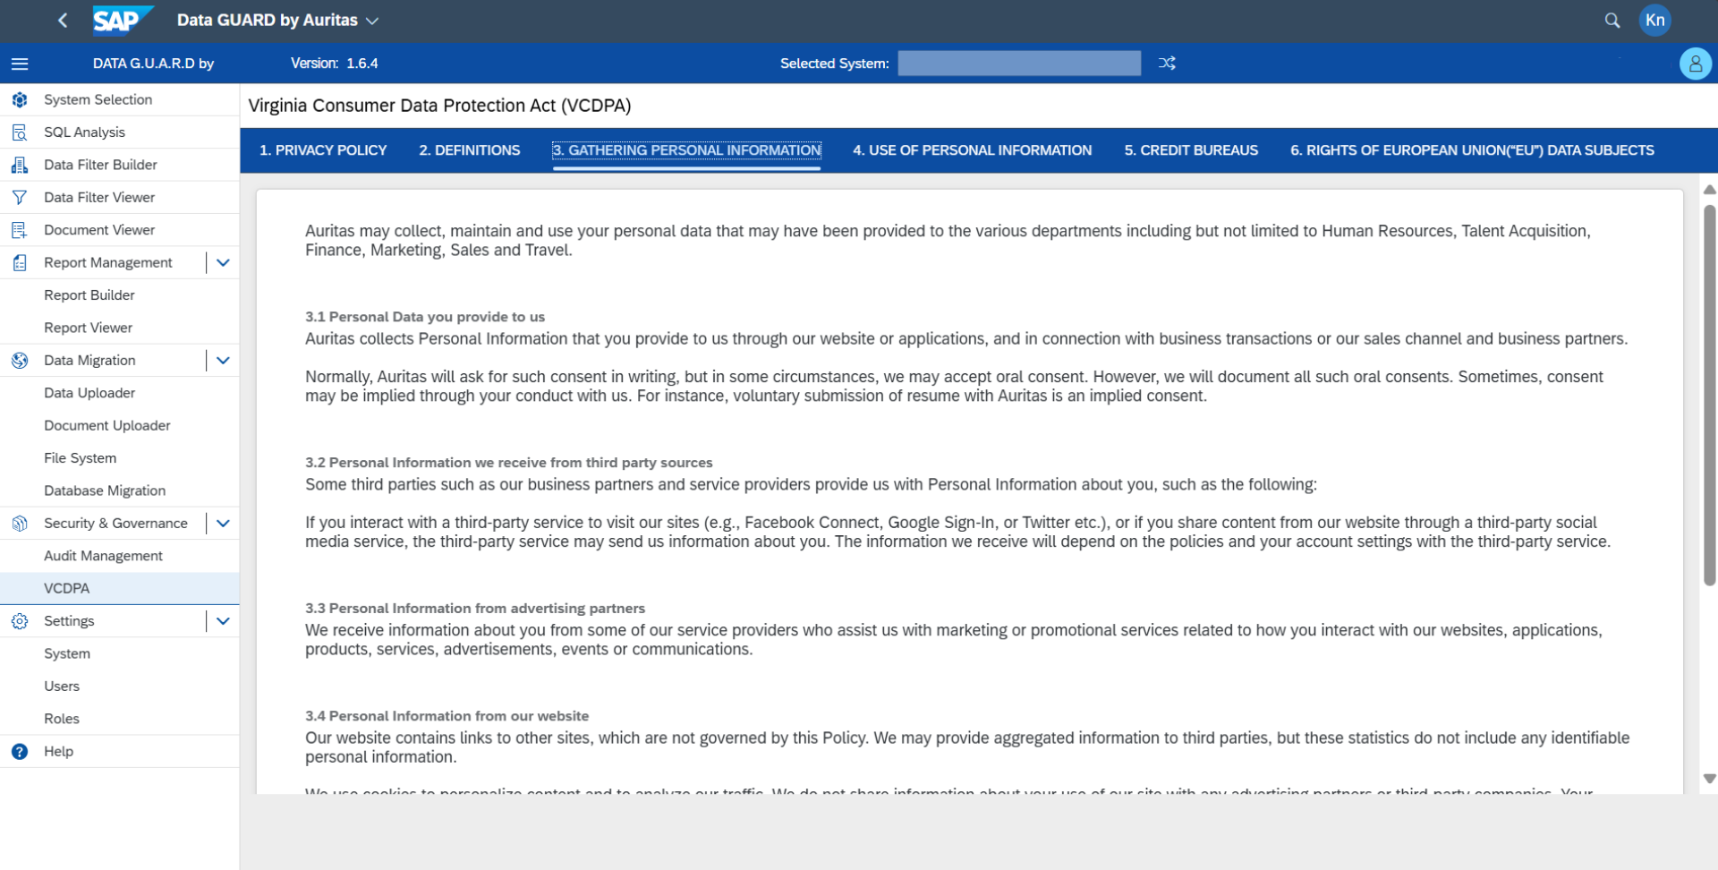
Legal Case
Auritas allows you to bring existing policies into your system and activate them easily whenever needed.

Slide 30

Success Stories

Slide 31


Legacy System Retirement
& Retention Management
Pain Points:
  Over 200 legacy applications needed decommissioning
  Had diverse set of legacy systems, including both SAP and non-SAP systems
  Extracted data needed to be retrieved in a cost-effective manner
  Data within these legacy applications had to remain readily available
Benefits:
  Successfully decommissioned legacy SAP and Non-SAP Applications.
  Easy access to the data held within legacy environments
  Established a Clean Lean and Compliant Data Strategy
  Compliance and reduction of operational and legal risk
  Secured long-term storage in durable, tamperproof form
ROI:
  Millions in savings from decommissioned systems' licensing/infrastructure costs
  Lower TCO of IT landscape
  Reduced administration & resource consumption of legacy applications
  Increased process efficiency to access SAP data & documents
  Leverage storage lifecycle for lower costs

