Slide 1

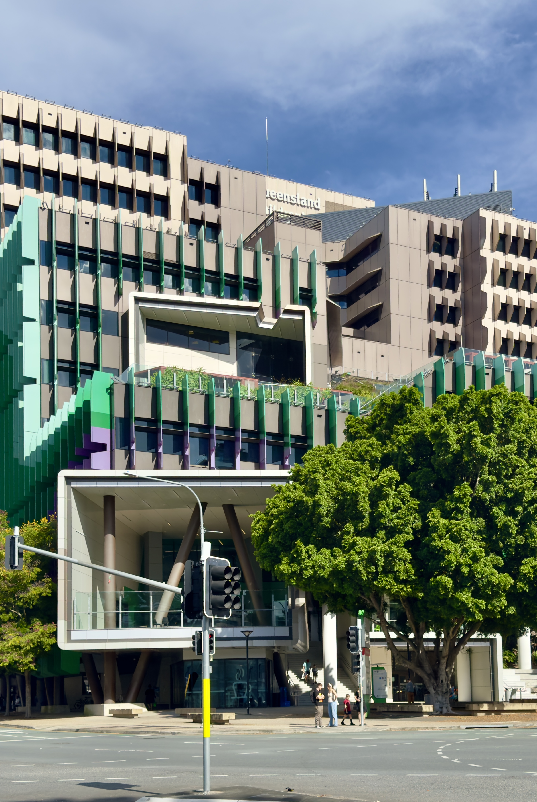
Healthcare
Success Story:
SAP MDG Implementation & Ongoing AMS Support
Background & Pain Points:
  The absence of a robust data governance framework poses business risks.
  Current processes are not optimized, hindering alignment with business objectives.
  Compliance with healthcare regulations and safeguarding sensitive data are at risk.
  Third-party content management increases landscape complexity.
Solution:
  Conducted data quality and governance maturity assessments to form a foundational basis for implementing SAP Master Data Governance (MDG).
  Queensland Health continued its collaboration with AuriCare, ensuring ongoing support post-implementation.
  The ongoing partnership aimed to address any issues arising from the implementation, both data-related concerns and the SAP MDG tool itself.
Results:
  Standardized processes throughout the entire organization.
  Clean and accurate data provide secure insights from precise data calculation.
  Centralized source that extends across a wide variety of heterogeneous systems.
  Ensured compliance with legal regulations pertaining to health care and public.
  Increased accuracy for planning & forecasting capabilities.
  One system of record for Master Data maintenance to minimize time & effort.

Slide 2


Life Sciences
Success Story:
Standardize Data Governance For Large-Scale Merger
Background & Pain Points:
  Lack of centralized source for master data.
  Underwent large merger of two big companies (Sorin & Cyberonics).
  Two different historical processes made it difficult to govern data efficiently.
  Constantly working on improving quality due to poor business analytics and insights.
Solution:
  Data quality and data governance maturity assessment.
  SAP Master Data Governance (MDG) implementation.
  Auritas accelerators for MDG
  Master data migration
Results:
  Standardized processes throughout entire organization.
  Centralized source that extends across a wide variety of heterogenous systems.
  Support consolidation for customer, supplier, and product databases.
  Higher accuracy on business transactions with Qualitative Master Data.
  Increased promo planning & forecasting capability for sales efficiency (Master Data).
  One system of record for Master Data maintenance to minimize time & effort for end users.

