Slide 1

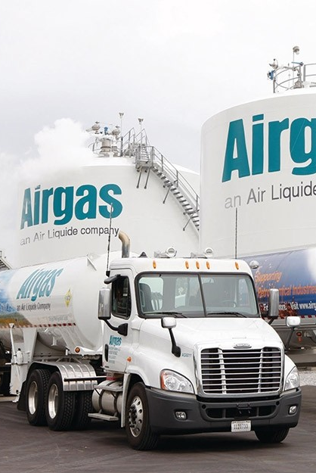
INTERNAL USE ONLY
Success Story:
Data Archiving for S/4HANA Migration Preparation
Pain Points:
  Data footprint increased by 6% annually, leading to a substantial production database size (11.8TB), complicating the migration process.
  Migrating vast amounts of data would be costly.
  Large database threatened to extend the migration timeline, causing potential delays.
  Risk of interrupting daily operations, risking business continuity during transition.
Solution:
  Implemented a phased data archiving approach.
  Archiving without any business interruptions.
  Leveraged AWS S3 as the archiving repository.
  Automation with Data ASSIST
    Gain insights into the database, identifying patterns & opportunities.
Results:
  Achieved an 79% size reduction:
    Archiving 8.7TB initially and further optimizing data for a total reduction of 9.3TB.
  Reduced the timeline for migration.
  Achieve NetZero database growth, ensure predictable costs for the S/4HANA migration.
  Annual savings from the project exceeded $600K. Cumulative savings surpassing $2M.

Slide 2



Tech
Success Story:
Streamlining Migration to S/4HANA with Database Size Reduction
Background & Pain Points:
  Large ECC database​ with high growth rate increases costs associated.
  Issues with GDPR compliance bring legal risks for an organization.​
  Eminent move to SAP S/4HANA:
    Need to prepare the database for the migration.
    Reduce database size for cost savings when migrating & operating on S/4.
Solution:
  Implement a comprehensive data archiving strategy, starting with database assessment for object recommendations.
  Launch a retention policy in accordance with privacy regulations, including GDPR.
  Implement OpenText Document Access/Extended ECM ​for enhanced performance, including search, access and retrieval of data.
Results:
  Extended life of ECC hardware investments​.
  Database size reduction with data archiving.
  Reduced S/4 HANA implementation costs​.
  Retention management implementation for reduced compliance risks.
  Better database performance:
    Reduction in database search and ​access times.​
    Reduction in backup times/increased system availability​.
  Streamlined migration journey to SAP S/4HANA.

Slide 3


Distribution
Success Story:
Fast Tracking S/4HANA Adoption
Background & Pain Points:
  Looking to prepare database for transition to S/4HANA.
    Minimize the risk of downtime during the cloud adoption.
    Save costs when transitioning to new system.
  Multiple tables over 10 billion rows.
  86 application servers required in production environment.
  Database was 30 terabytes and growing at .5 terabyte per month.
  Challenge is to reduce database space by half through optimizing existing archiving program and doing so quick.
Results & ROI:
  Grainger plans on moving to S/4 within a year.
  Avoiding archive index growth.
  Converted Clusters and LOB tables to manageable transparent tables.
  Growth reduced by 85%.
  Approaching NetZero HANA Migration down time.
  Reduced HANA sizing from estimated 21TB appliance to 7TB appliance.
  $1.5M annual savings from hardware costs alone.

Slide 4


INTERNAL USE ONLY
Success Story:
Archiving Accelerated Move to RISE with Size Reduction of 80%
Pain Points:
Economics of the deal didn’t support a move from on-prem to RISE/cloud
  Current system was 5TB requiring larger infrastructure to support compute and storage
  Non-prod systems added to cost structure
  Included growth calculations reduced the value proposition for a cloud migration
Solution:
  Reduce the DB size through an Archiving strategy:
    Reducing the source DB size results in a smaller target requirement
    Migration time is reduced with less data to transfer
    With fewer objects, there is less risk in the overall project
  Infrastructure costs are reduced as well as overall project services
Results:
  Peabody was able to reduce their source system from 5TB to 1TB
    80% size reduction
  $1M estimated cumulative savings from reducing data footprint.
  A smaller infrastructure footprint provided the needed value proposition for RISE
  Beyond the initial activity, by putting an archiving strategy in place, Peabody can manage their growth and focus investment on new technologies as opposed to infrastructure spend

Slide 5


Oil & Gas
Success Story:
80% System Reduction with Accessible & Compliant PRA Archive for SAP S/4HANA Prep
Solution
  Implement proprietary PRA archiving mechanism to preserve access to archived PRA transactions while maintaining compliance.
    Enabled PRA reversals or entries to be “linked” directly to a specific archived object.
    Within the journal entry, the archive link was referenced in the text field, allowing users to retrieve details seamlessly.
  Data ASSIST:
    Automated the archival process of historical data with dynamic scheduling.
    Defined retention requirements and implementing a compliance strategy.
Results & ROI:
  81% size reduction across the SAP landscape, achieving the initial requirement for transition.
  PRA archiving allowed for savings and size reduction while retaining access and ensuring compliance.
  Monetary savings when migrating a smaller database to SAP S/4HANA.
  Data ASSIST provided ongoing growth control, ensuring costs stayed low even in the new environment while providing insights into their database.

