Slide 1
Driving Innovation, Empowering Transformation.
S/4HANA Implementation

Slide 2

Auritas Introduction
Implementation Key Elements
Activate Methodology
The S/4HANA Digital Core
AMPD
Training & Workshops
Project Governance
Why Auritas

Slide 3




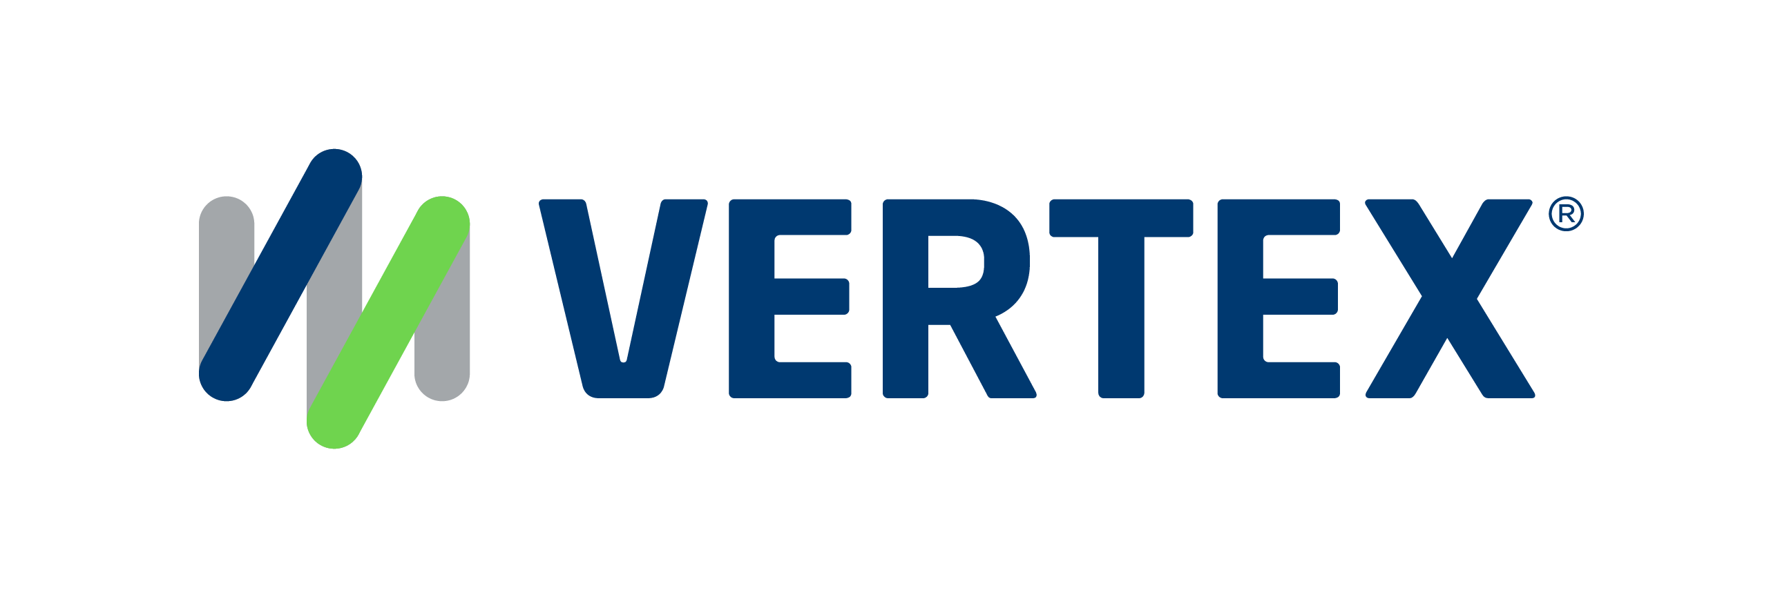
1,500
10,500+
25 Yrs
$1.5B
Successful Projects
TB of Data
Managed
Transforming Companies
Total Customer Savings
Driving Innovation, Empowering Transformations.
Data Management
Solution
Implementation
Product
& Innovations
Strategic
Partnerships
  Data Archiving & ILM
  Retention Management
  HANA Memory Optimization (NSE)
  Data Governance
  Data Migration
  Cloud Migrations
  Data Privacy and Security
  Legacy Decommissioning
  Data Volume Assessment
  Data Quality Assessment
SAP S/4HANA & RISE
SAP BTP Deployment
  SAP Integration Suite
AI Implementation
SAP OpenText
  Extended ECM (xECM)
  Vendor Invoice Management
  Document Presentment
SAP Ariba
SAP Vertex
SAP Vistex
Geospatial Intelligence (GIS)
  Data ASSIST by Auritas
  (Data Archiving Automation)
  Data GUARD by Auritas
  (Legacy Decommissioning)
  Auritas Intelligent Accrual
  (Financial Automation)
  DMS+ by Auritas
  (Enhanced Document Storage)
SAP Gold Partner
SAP PartnerEdge, Sell
CCFlex – Cloud Choice Flex
PartnerEdge®
  (AMS + Hypercare)
CCFlex

Slide 4













Customer Success
Services Across Multiple Industries – Verticals:

Slide 5
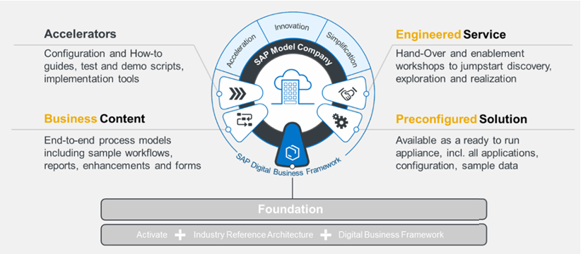
Implementation Approach - Key Elements:
SAP Best Practices offers a reference solution to support main processes with SAP S/4HANA as it is delivered with relevant business content and accelerators.
SAP Activate implementation methodology leverages the SAP Best Practice solution with its pre-configured business scenarios and pre-built documentation.
Value-add functionalities and services which complement the best practices and allow to leverage additional pre-configured functionalities, test scripts and other tools.
© 2024 Auritas LLC. All rights reserved.

Slide 6

Implementation Approach - Key Elements:
Senior staff of consultants and project leaders experienced in the SAP Best Practice template based Activate methodology.
Auritas conducts business process, functional and transactional hands-on workshops to the project core team.
SAP's Accelerator tool Data Migration Cockpit will leveraged to speed and monitor the data migration effort.
  Data migration plan to include data objects required to be migrated to SAP S/4 for the business scenarios.
SAP Best Practice’s pre-configured forms/outputs and reports.
  Identify process & configuration gaps between to make the necessary enhancements to the configuration to address unique company’s needs.
Notes:
Auritas’ design by exception allows the design of business processes and workflows for each business function to ensure unique company’s needs are being addresses.
Solution validation, we provide with the company’s scenarios. We explain sap best practices, if that does not work for the company, we need to make an enhancement/change to the configuration to address that. Go mainly with sap best practices, but change in configuration to reflect companies needs…

Slide 7
SAP Activate Methodology
An SAP implementation methodology, Activate, leverages the SAP Best Practice solution with its pre-configured business scenarios and pre-built documentation. It provides a clear adoption process of structured and solution-specific best practices.
Auritas implementation approach follows the SAP Activate methodology with few adjustments.
PREPARE
EXPLORE
REALIZE
DEPLOY
RUN
Validate SAP pre-configured Best Practices scenarios for all major business processes.
Configure the SAP system, adjusting business gaps, and performing initial user and integration testing.
Move from a pre-production environment to a live productive operation. Set up AuriCare.
Solution installation & initial planning and preparation for the migration project.
Complete the end-user training and final testing of system readiness.

Slide 8

SAP Activate Methodology: Prepare
Solution installation & initial planning and preparation for the migration project.
  Auritas to gather business process and data information
  Draft solution validation schedule based on the unique identified business scenarios/processes.
  Order and provision the SAP systems & connect them to the network.
  Work on master data structure, mapping and data cleansing to have a first set of legacy systems files to be uploaded
  Perform self-enablement training of the SAP pre-configured scenarios.
PREPARE
EXPLORE
REALIZE
DEPLOY
RUN
Notes:
Rework how it looks.

Slide 9
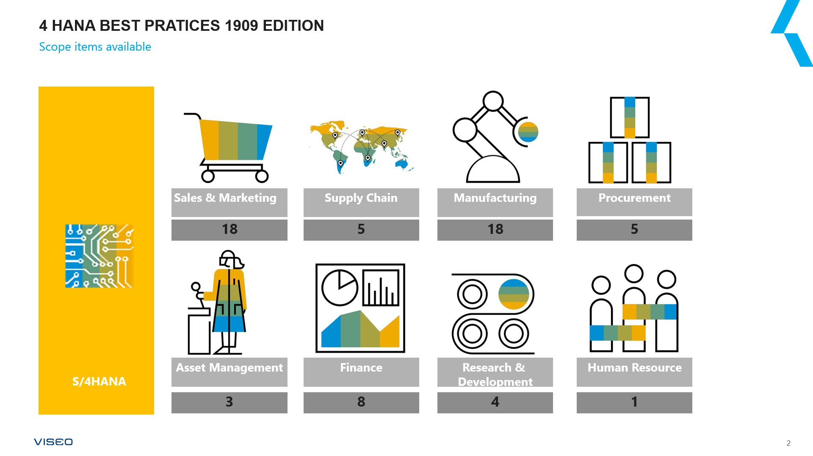
SAP Activate Methodology: Explore
Walk through & validate SAP pre-configured Best Practices scenarios for major business processes.
  Visualization of the SAP pre-configured business processes with the company’s own sample of data.
    Allow the functional design of the different interfaces, forms, workflows, reports and data conversion requirements.
  Identify process & configuration gaps.
    We make the necessary enhancements to the configuration to ensure unique company’s needs are being addresses.
  Identify process & configuration gaps and adjustments to the Best Practices.
PREPARE
EXPLORE
REALIZE
DEPLOY
RUN

Slide 10
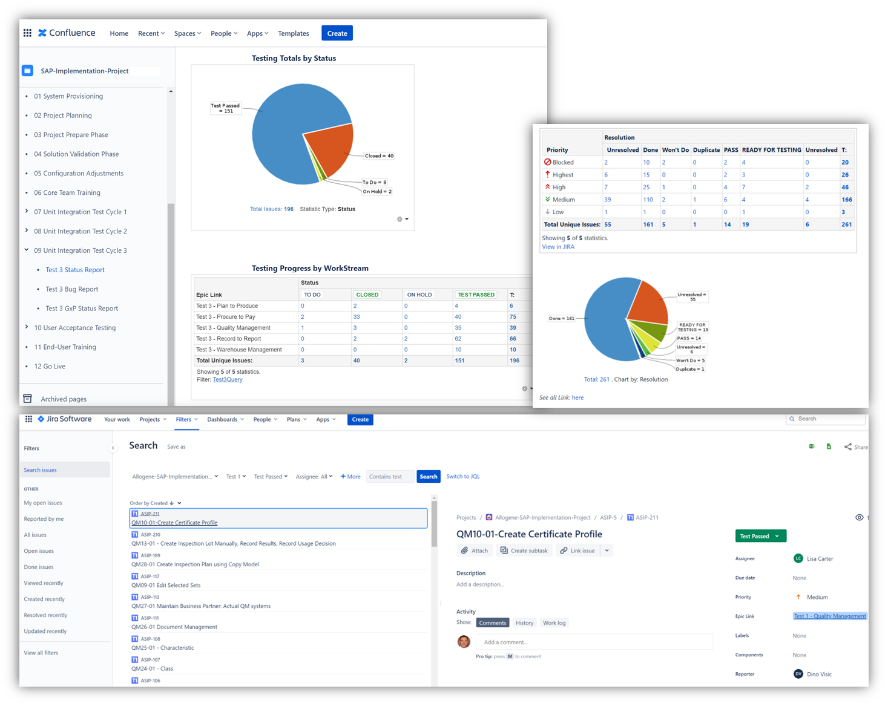
SAP Activate Methodology: Realize
Auritas configures the SAP system, adjusting business gaps and master data to meet specific requirements, and performing initial testing.
  Company’s core team is trained on SAP processes and transactions, enabling them to execute test scripts.
  Prepare and execute multiple test cycles, validating the system's readiness for production while tracking issues for fulfillment.
  End-user training materials are prepared using pre-built templates to streamline the process.
*Test cycle execution tracked in Jira.
PREPARE
EXPLORE
REALIZE
DEPLOY
RUN

Slide 11
SAP Activate Methodology: Realize
Step-by-Step Approach:
1
  Auritas complete SAP configuration, adjusting business gaps and master data.
  Initial process testing.
  The company’s core team receives training on SAP processes, functions, and transactions.
  Prepare test scripts covering all business scenarios, leveraging pre-built templates and adjusting for unique needs.
  Company’s team executes test scripts with migrated data, resolving issues between cycles, tracking progress and bugs.
  A detailed cut-over plan is refined throughout testing to ensure SAP production readiness.
  End-user training manuals are created from Auritas’ pre-built templates as test scripts are validated and signed off.
2
3
4
5
6
7
PREPARE
EXPLORE
REALIZE
DEPLOY
RUN

Slide 12

SAP Activate Methodology: Deploy
Complete the end-user training* and final testing of system readiness.
  Cut-over plan execution, including configuration transfer, data migration, initial manual settings.
  Selected system management and performance testing of the productive SAP system will be performed as a last validation of the SAP system readiness.
PREPARE
EXPLORE
REALIZE
DEPLOY
RUN

Slide 13

SAP Activate Methodology: Run
Move from a pre-production environment to a live productive operation.
  Setting up an internal support and communication structure for the end-users
  Initiating a long-term support infrastructure that will combines company's internal support team and AuriCare, the Auritas Managed Services team.
PREPARE
EXPLORE
REALIZE
DEPLOY
RUN

Slide 14
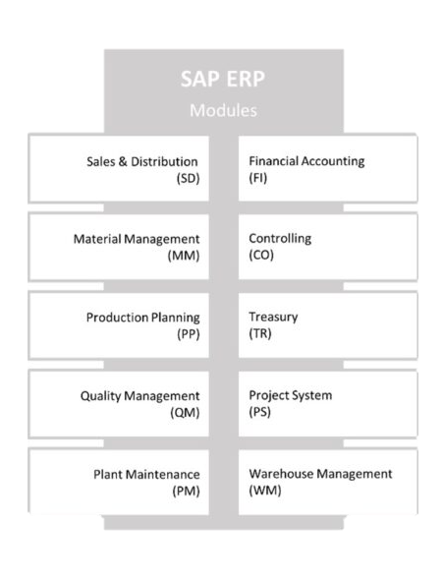
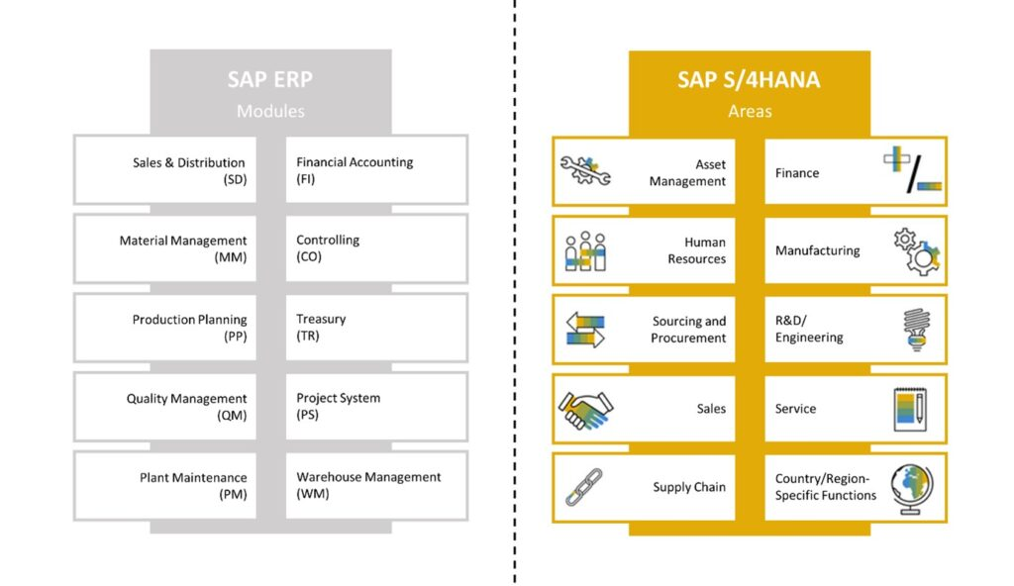

S/4HANA Digital Core
Asset Management
Source &Procurement
Finance
Supply Chain
Manufacturing
S/4HANA
Digital Core
R&D/Engineering
Service
Local Functions
Sales
Human Resources

Slide 15
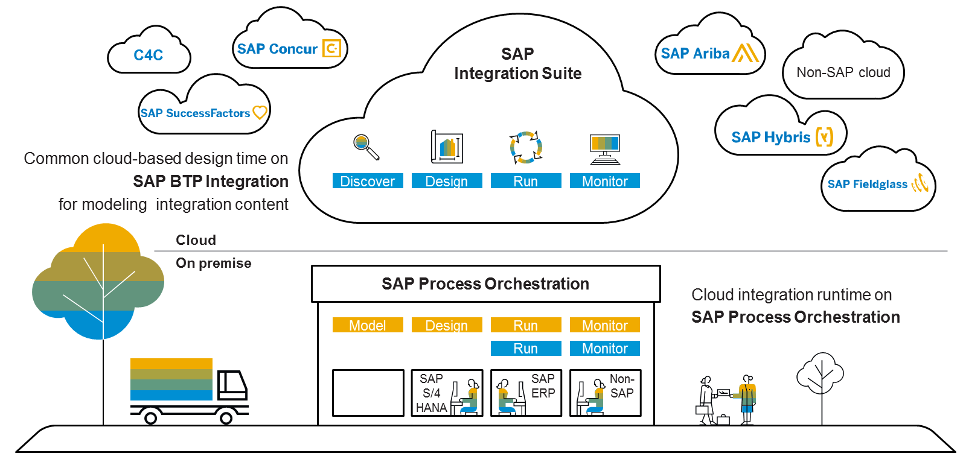
SAP BTP Integration Suite
Leverage the BTP Integration Suite to interconnect business processes from different departments and organizations, arranging for the technical communication between the components and the correct "translation" of data.

Slide 16

AMPD Methodology

Slide 17
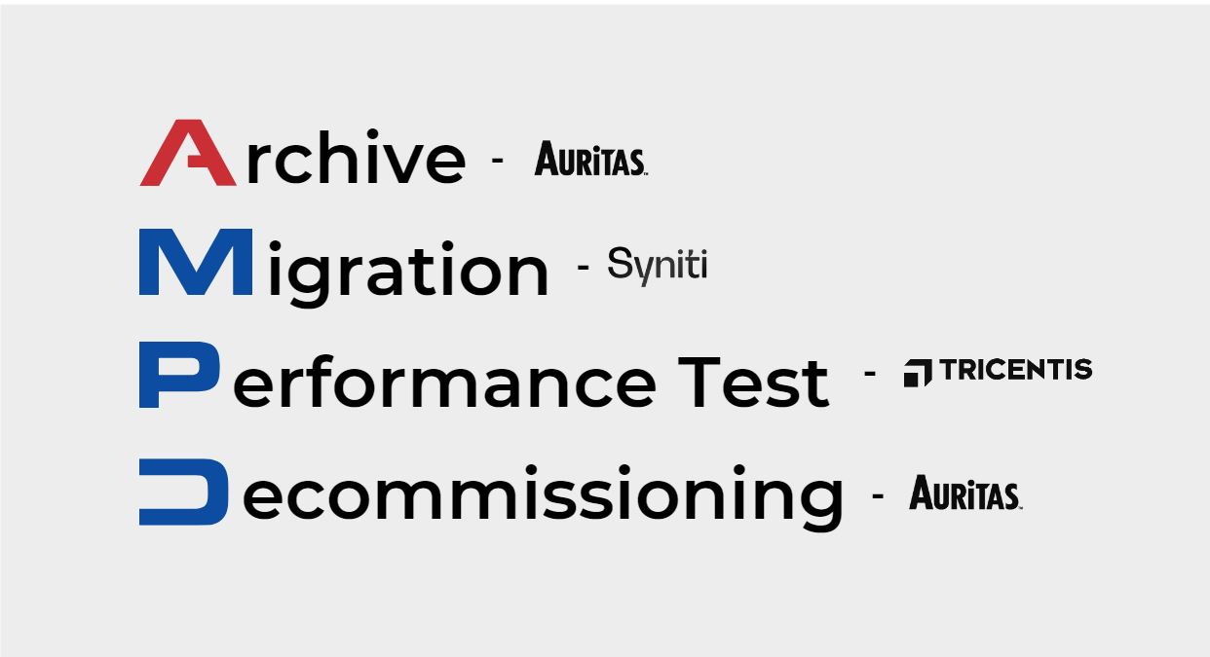
The Journey to S/4HANA: AMPD Methodology
Archiving: Focuses on managing data volume efficiently, reducing storage costs, and maintaining a streamlined data environment. Data ASSIST by Auritas ensures stored data remains accessible for historical insights while automating with Retention Management for compliance and data integrity.
Migration: SAP Advanced Data Migration and Management: Seamlessly transitions data to an Intelligent Enterprise with accurate tracking and insightful dashboards.
Performance Testing: Utilizes AI-driven, codeless automation to test IT landscapes, enhancing efficiency and reducing risks across SAP and non-SAP systems.
Decommissioning: Addresses outdated systems that hinder efficiency and incur high costs, offering tools like Data GUARD by Auritas to securely retire legacy hardware and preserve data access.

Slide 18






rchive
The Journey to S/4HANA:
igration
Methodology
erformance Test
ecommissioning
Start
1
2
Archive
Migration
Present Storage
Retention Management
Trash
& Repurpose
4
Decommissioning
Legacy Storage
3
Performance Testing

Slide 19
Training & Workshops
Additional consulting support may include the following: providing end-user training manuals, digital materials, end-user training sessions, etc.
SAP education training for relevant/selected job titles.
The project team will have the opportunity to learn the SAP application through the following project activities:
PREPARE
EXPLORE
REALIZE
DEPLOY
RUN
Training/Workshops:
Master data migration sessions
Training/Workshops:
Best Practices Bus. Processes
Data conversion
Training/Workshops:
Formal Functional Area & Transactional Training
Functional & Transactional through Test Cycles
Interface Methods
Reporting
Roles & Authorizations
Training/Workshops:
End-user Training Support
Training/Workshops:
SAP Configurations

Slide 20
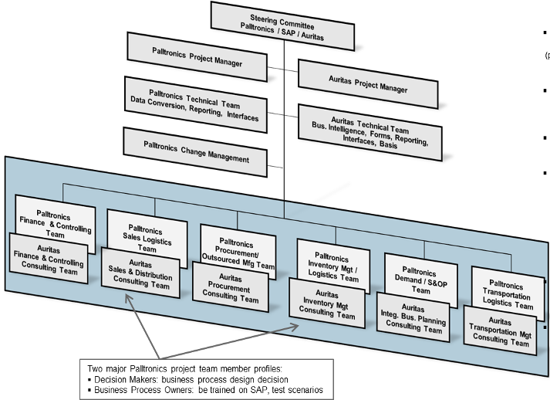
Project Governance & Team
Project governance consist in the combination of a Steering Committee (executive sponsors) and project managers from both Auritas and the company.
Company
Steering Committee Meeting: Bi-Monthly
  Strategic decisions (planning, budget, risks, resource issues, major objectives…)
Project Status Meeting: Weekly
  Day-to-day decisions (resources, tools, teams, actions)
Project Technical Team Meeting: 2x/Week
  Technical planning and decisions
Change Management Meeting: Monthly
  Change management planning & deliverables
Company
Company
Company
Company
Company
Company
Company
Company
Company
Extended Project Team Meeting: 2x/Week
  Functional and Technical decisions
Auritas Internal Team Meeting: Daily
  Functional and Technical planning & decisions
Company
*Sample of project team structure
Notes:
Rework!!! the the schedule for meetings on the right side of the slide.

Slide 21

Why Auritas?
Decades of knowledge and experience implementing SAP Best Practices and Activate methodology.
Holistic approach to S/4HANA implementation.
Prepare your team with hands-on workshops and training for comprehensive knowledge transfer.
SAP Accelerators for speedy and and smooth data migration efforts.
Complete Data Suite by Auritas to help with archiving efforts and legacy decommission needs.
Necessary enhancements to the configuration help ensure unique company’s needs are being addresses.
Close partnership with SAP, being a Gold Partner.

