Slide 1
Auritas + OpenText + SAP
Karly Sills, Sr. Sales Director – North America

Slide 2





1,500
10,500+
25 Yrs
$1.5B
Successful Projects
TB of Data
Managed
Transforming Companies
Total Customer Savings
Driving Innovation, Empowering Transformations.
Data Management
Solution
Implementation
Product
& Innovations
Strategic
Partnerships
  Data Archiving & ILM
  Retention Management
  HANA Memory Optimization (NSE)
  Data Governance
  Data Migration
  Cloud Migrations
  Data Privacy and Security
  Legacy Decommissioning
  Data Volume Assessment
  Data Quality Assessment
SAP S/4HANA & RISE
SAP BTP Deployment
  SAP Integration Suite
AI Implementation
SAP OpenText
  Extended ECM (xECM)
  Vendor Invoice Management
  Document Presentment
SAP Ariba
SAP Vertex
SAP Vistex
Geospatial Intelligence (GIS)
  Data ASSIST by Auritas
  (Data Archiving Automation)
  Data GUARD by Auritas
  (Legacy Decommissioning)
  Auritas Intelligent Accrual
  (Financial Automation)
  DMS+ by Auritas
  (Enhanced Document Storage)
SAP Gold Partner
SAP PartnerEdge, Sell
CCFlex – Cloud Choice Flex
PartnerEdge®
  (AMS + Hypercare)
CCFlex

Slide 3







Auritas Differentiation
Holistic expertise on BTP and solution extensions
Accelerated deal closure for hundreds of engagements
End-to-end support across the deal cycle (pre-sales, sales, demos, and services)
In-house solutions developed on BTP
  Data ASSIST & Data GUARD = BTP consumption
Expertise across multiple SAP LoBs (BTP, Finance & Spend Management, SFSF, PSO, and BDC)
SAP Certifications, including CCFlex, GROW, BTP, and Ariba
SUCCESS IN NUMBERS
3-6
months
$700k
reduction in
sales cycle
average customer lifetime value
8y
$3.5M
average relationship length with customers
in license-dependent deals closed
Absolute experts! Auritas helped us achieve a very lean footprint, reducing costs and built excitement for our future deployment of SAP S/4HANA
SAP gave us an excellent partner in Auritas, they made our transformation smooth and easy.
Thanks to Auritas, our database and retention management is better than it has ever been. Choosing to work with Auritas was the best decision we could have made.
Brandon Rowley,
SAP Program Architect, Allison Transmission Inc.
Robert Loreto
Director of IT, NVIDIA
Terry Chadwick
SAP Solution Architect, SaskPower

Slide 4

























Auritas Influenced Deals
Archive File Storage
Vendor Invoice Management (VIM)
Content Management – xECM + SFSF
Replacement
  AI based recommendation engine for DVM
  Data ASSIST connects with ArchiveCenter
  Win-win for SAP rep
  Potential to extend to xECM
  Sales order management
  Ariba integration
  AR cash application
  Messaging of integration across multiple system with xECM
  3rd party resume platform
  Automate all contract fetch/OCR/auto classification file storage, integration with MDG
  Asset manuals/images
  Doc Presentment extension/Exstream
  xECM
  VIM+ICC
  CoreSig
  Replaced Gimmal, Filenet, Saperion
CPEA/BTPEA + SAP Store
Value prop for CPEA/BTPEA
Acceleration of RISE
Alignment with Hyperscaler
Reduces the sales cycle

Slide 5
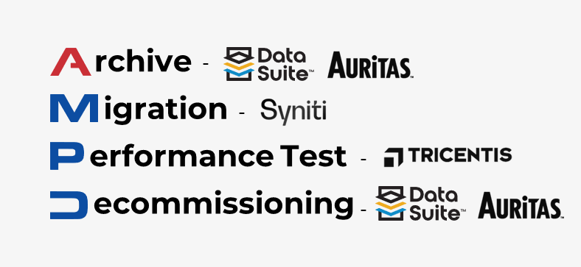



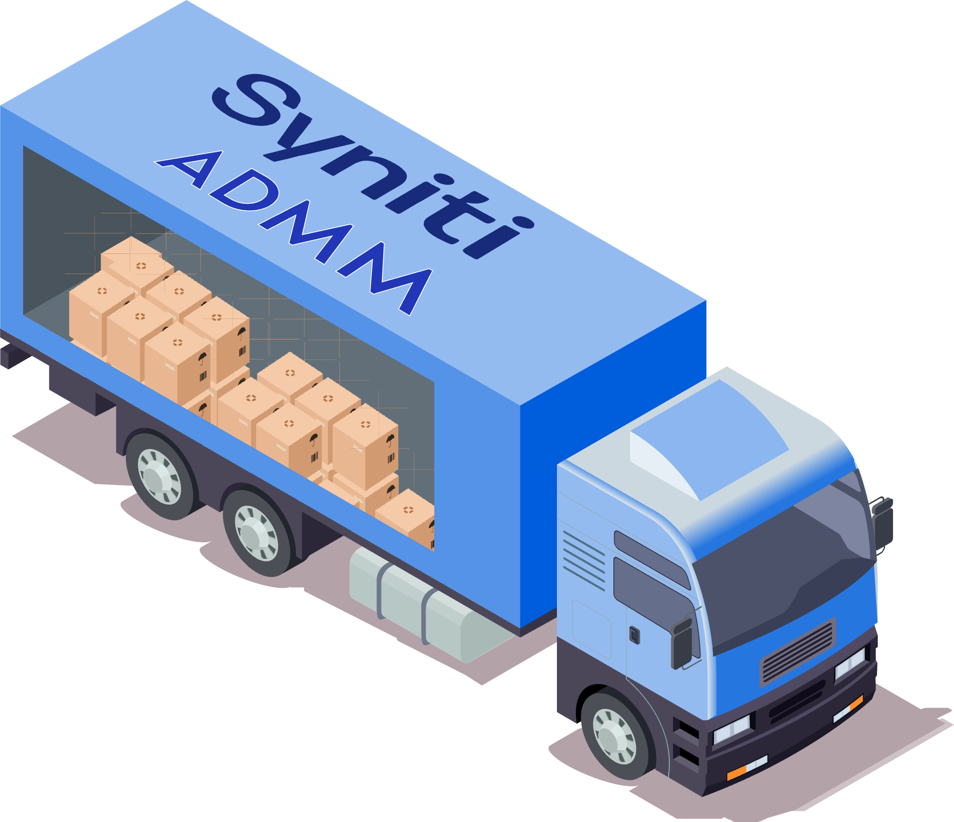















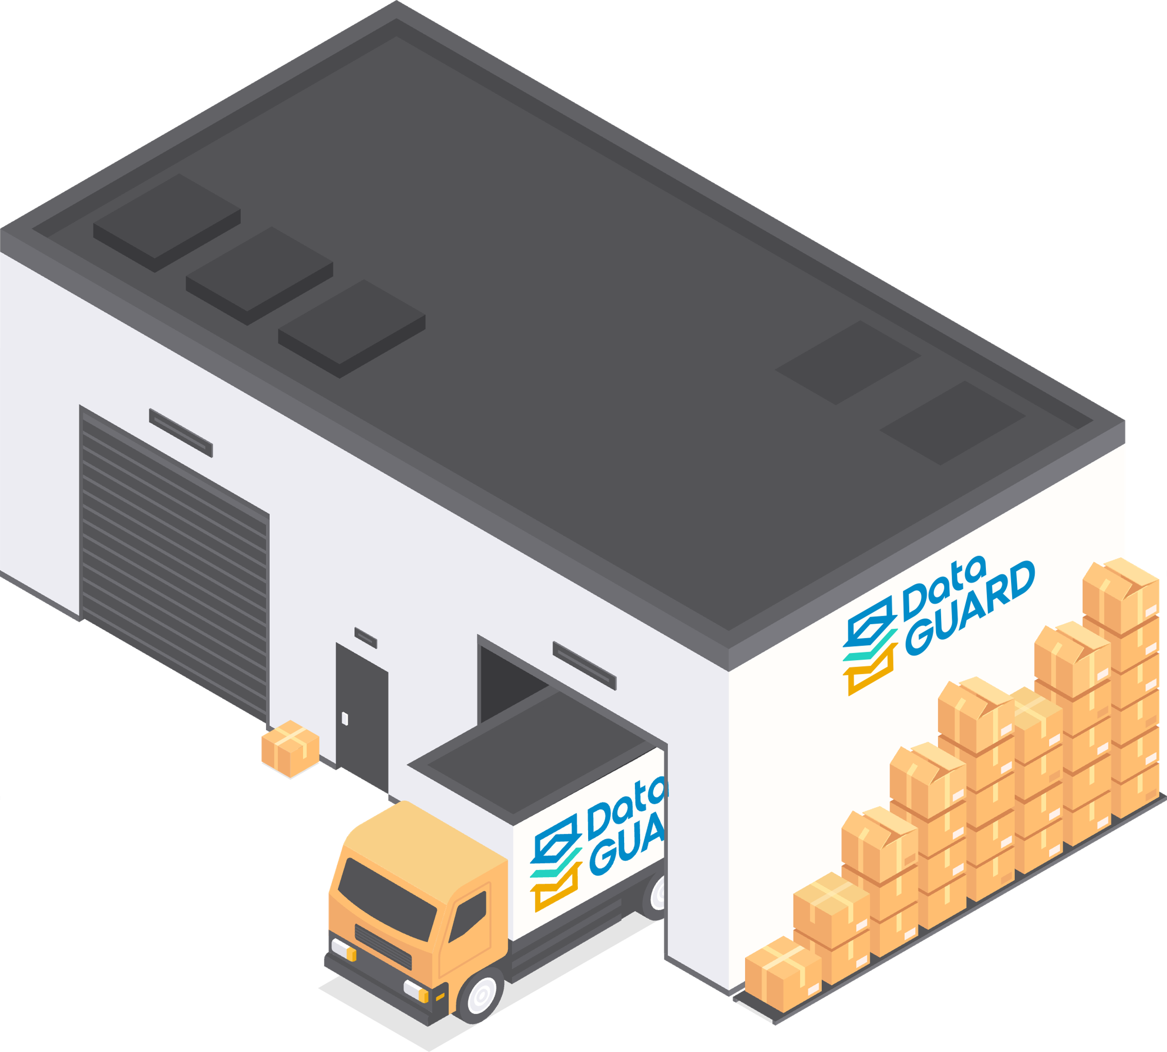





/ Automate
The Journey to S/4HANA:
Methodology
Start
1
2
1
Archive
Migration
IM
Present Storage
Retention Management
ADA, xECM
Trash
& Repurpose
4
Decommissioning
Legacy Storage
3
Performance Testing

Slide 6
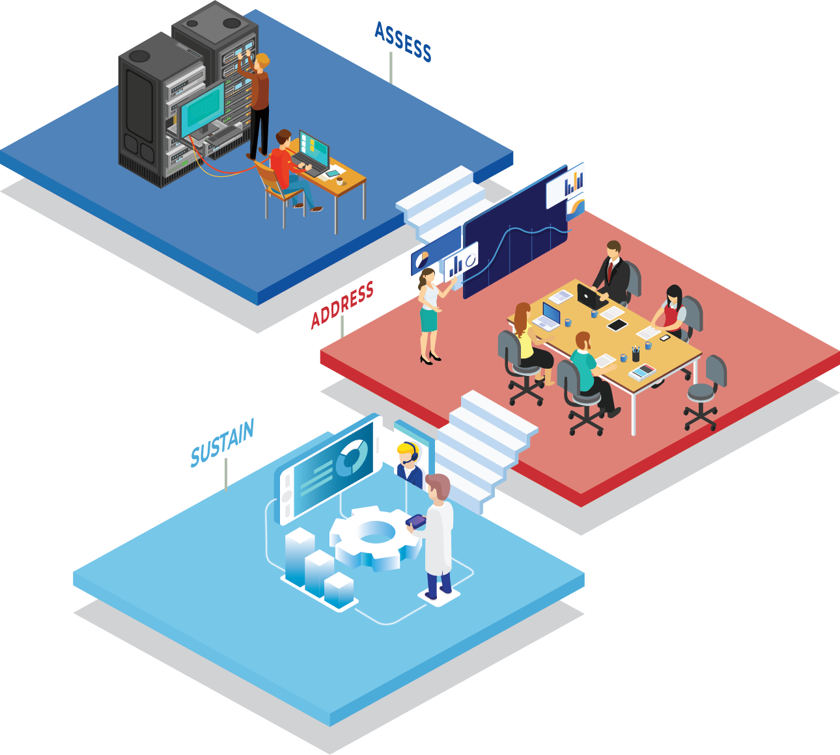
Complimentary Data Volume Assessment
Assessment Benefits:
  Report on existing enterprise data distribution.
  Knowledge of projected reduction in database size with archiving and deletion.
  Forecasted savings and database size reduction percentage.
  Recommendations on technical, functional, migration, and deletion objects.
  Readout of the results with Auritas’ experts.
  ROI predictions with DB volume management recommendations.
  HANA Migration- Ensure only the things that matter are moved over and that you don’t have to pay for unneeded infostructure.
  Get your results within 10 days.

Slide 7
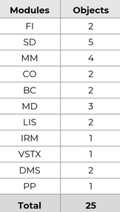



Complimentary Data Volume Assessment
Projected Data Addressed by Modules
Sample of Assessment Delivery
35,000,000
495,381
285,913
67,193
33,263,006
1,163,184
1,007,523
812,773
30,000,000
1,900,529
1,736,155
Assessment Details:
  Analysis of existing database tables.
  Identification of the largest tables in the database.
  Identification of potential archiving opportunities.
    Determine what can be deleted or archived and what cannot.
  Estimation of database size reduction.
25,000,000
7,315,054
20,000,000
8,579,507
15,000,000
10,000,000
9,899,824
5,000,000
FI
SD
MM
CO
BC
MD
LIS
IRM
VSTX
DMS
PP
Grand Total
Customer Success Stories
Industry: Manufacturing
Industry: Distribution
Industry: Utilities
84% database size
reduction with project payback within 10 months.
85% ongoing data growth reduction and database size cut by 50%.
Reduce data volume by a factor of 9 and 10% increase in customer satisfaction.

Slide 8
Continuous Review | Maximize AP (Internal) Output
Partner Solutions Revenue Plan
How can you recognize how far along you’ve come in reaching the key results?
Monthly & Quarterly reviews with your VPs & RVPs post AP session. Goal is to discuss progress, roadblocks, and update key results accordingly
New addition – Action item
Revenue Plan
Idea | Problem we are solving | SAP Solution | ACV $ | Risks & Challenges | Action Item (Activity Status (G/Y/R)
Data Archiving | Prep for S/4 HANA, data migrations, OnPrem to Cloud, Hyperscaler Growth/Cost, post Go-Live S/4 strategy for database growth Reduce Database Footprint for current storage license/hardware costs and future ROI for S4. Decreased timeline and cost-effective approach to S/4 HANA. Address compliance & legal holds for audits /data regulations via data archiving/retention management Enhances performance Sustain investment overtime by scheduling/automating archive process | STORAGE OPTIONS: SAP Archiving and Document Access by OpenText Or SAP BTP DMS Or SAP Extended Enterprise Content Management by OpenText Growth Sustainment Auritas Data ASSIST(certified app deployed on BTP) | $ (SAP to Provide) BTPEA or Consumption $ (SAP to Provide) BTPEA or Consumption (See Data ASSIST Services Slide) | Small footprint of data Requesting other third-party storage, i.e. hyperscaler Blob storage Lack of education as it pertains to end user access to archive files Note: archive files will be seamlessly accessible in ECC and S/4 | Auritas provides a complimentary DB02 assessment to client. Quick exercise for client, we review results within a week to highlight areas of opportunity to decrease pre S4. Instructions can be shared via email/quick discovery call Share the Applied Materials Strategy for DVM Prep for S4 (with archiving will save over 20 million over next 5 years) Once DB02 is completed, Auritas can provide sizing for OpenText SKUS or BTP DMS Auritas to provide Demos or architecture review, what others are doing in this space
Document Management | Content Silos Lack of Collaboration No single source of truth for structured data and unstructured documents/content Complaince/Regulatory Manual workflows / Poor search and retrieval | SAP Extended Enterprise Content Management by OpenText | $ (SAP to Provide) | Lacking business use case from LOBs Leveraging an alternative DMS solution currently Note: we can position xECM for data archiving and do a phased implementation if the current business driver is DB reduction. | Auritas can provide custom demos, develop use cases to identify business driven scenarios Offer flexible implementation roll outs
RENEWALS

Slide 9
Partner Solutions Revenue Plan
Idea | Problem we are solving | SAP Solution | ACV $ | Risks & Challenges | Action Item (Activity Status (G/Y/R)
Invoice to Pay Optimization | Manual processing and errors Lack of visibility and tracking Inconsistent approval processes Delayed payments and penalties Duplicate payments Compliance Lack of Reporting and Analytics | VIM ADD ON 1a. SAP Invoice Management by OpenText for ECC 1b. SAP Invoice Management by OpenText for S/4 PCE OCR 2. SAP Information Capture Core by OpenText Storage of Invoices Options 3. SAP Archiving and Document Access by OpenText Or 4. SAP Extended Enterprise Content Management by OpenText Or 5. SAP BTP DMS | $ (SAP to Provide) $ (SAP to Provide) $ (SAP to Provide) $ (SAP to Provide) BTPEA or Consumption | Finance Bandwidth to implement new solution Cost Change Management Point Solutions Less than 50,000 Invoices/year | Schedule session with Finance to review opportunity to reduce manual efforts to create a touchless invoice to pay process via VIM/OCR optimization Auritas can provide Demo, Architecture Review, Client Success stories (NVIDIA, Gilead, Seagate, Bourns, and more)
Legacy System Decommissioning | Cost savings Reduction of maintenance costs/perpetual licensing & hardware costs Reporting on historical data Decommission SAP and Non SAP Systems | Solution Auritas Data GUARD (DG is a Certified App) Pre Requisites to deploy DG BTPEA Services or Consumption Reporting SAC/Agnostic | BTPEA or Consumption $ (SAP to Provide) | Legacy systems are often ignored within companies and are not aware of an opportunity to decommission. Request to retain legacy data due to audits | Review architecture to understand if there are non SAP legacy systems to retire to free budget If Greenfield/Bluefield approach, we can discuss data strategy. Client Story, eBay: Data GUARD runs on BTP, can decommission SAP/Non SAP systems. Historical data will reside within Data GUARD on BTP. Reporting on historical data for future audits, can leverage SAC
RENEWALS

Slide 10
CCFlex
SAP CCFlex
We’ve influenced and executed SAP license deals end-to-end for decades, giving us unmatched insight into aligning licenses with long-term business goals.
Our experts provide hands-on demos, tailored architecture discussions, and actual ROI projections.
We do the work to show not just the process but introduce the right solution.
We focus on the art of the possible, helping customers envision & achieve business outcomes, not just delivering technical solutions.
We own the outcome: Because we implement the solutions ourselves, we ensure successful execution and adoption.
Land & Expand: We start with one service and strategically introduce additional offerings to maximize impact, supported by AuriCare (AMS Program).
18 license-dependent deals closed 2024 and 2025
$3.5M in license-dependent deals closed 2024 and 2025
11 customers closing license-dependent deals 2024 and 2025
Average customers maintain an 8-year relationship with Auritas
Auritas customers average 8 opportunities with Auritas
Notes:
Decades of experience influencing and owning license deals end-to-end)
Our experts provide provide demos (readily available demo environments), architecture conversations and provide customers with actual ROIs
We determine business outcomes because we are the ones implementing it.
We start with a single service, and make sure we introduce the other offers to expand services with customers.
---
Influence new logos (influence the license deals and take complete ownership – We own it from start to end.
(we provide demos, architecture conversations. We give them actual ROIs, whether it's, you know, from a data archiving standpoint. So showing them savings. Things for hardware perpetual licenses. It could be cost avoidance.)
So we're doing the work to show them not only the process, but the right solution to put in place.
Art of the possible as it pertains to business outcome, not just here's the solution.
We ensure adoption – successful implementation & adoption
Highlight AuriCare

Slide 11
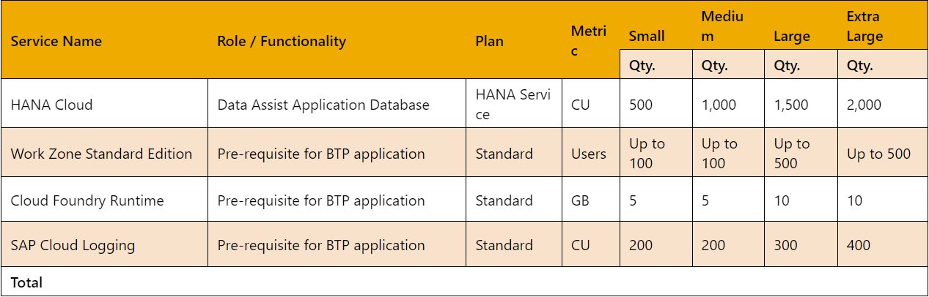
Data ASSIST by Auritas
SAP BTP pre-requisite services (yearly estimation):
*WorkZone is licensed per subaccount.
*All the services above need to be on the same subaccount.

Slide 12
Data GUARD by Auritas
SAP BTP pre-requisite services:
Service Name | Role / Functionality | Plan | Metric | Small | Medium | Large | Extra Large
 |  |  |  | Qty. | Qty. | Qty. | Qty.
HANA Cloud | Data GUARD Application Database | HANA Service | CU | 500 | 1,000 | 1,500 | 2,000
Work Zone Standard Edition | Pre-requisite for BTP application | Standard | Users | Up to 100 | Up to 100 | Up to 500 | Up to 500
Job Scheduling | Pre-requisite for retention compliance | Standard | Block of 10K jobs | 5 | 10 | 25 | 50
Integration Suite | Required for migration of data from the source legacy system to the Data GUARD. | Standard | Tenant | 1 | 2 | 2 | 2
Cloud Foundry Runtime | Pre-requisite for BTP application | Standard | GB | 5 | 10 | 15 | 20
Application Logging | Pre-requisite for BTP application | Standard | Tenant | 1 | 2 | 3 | 4
Total

Slide 13
Data GUARD by Auritas
SAP BTP optional services:
Service Name | Details on the why this is required/optional | Plan | Metric | Small |  | Medium |  | Large |  | Extra Large
 |  |  |  | Qty. | ACV | Qty. | ACV | Qty. | ACV | Qty. | ACV
SAP Document Management service | Required if documents or archive files are to be stored in SAP BTP platform | Standard | Block of 50K API calls, 100 GB Blocks storage | 1, 5 | $4,428 | 2, 10 | $8,856 | 4, 20 | $17,712 | 10, 40 | $41,280
Data Retention Manager | Required when SAP Document Management Service is used | Standard | Tenant | 1 | $1,176 | 2 | $2,352 | 3 | $3,528 | 4 | $4,704
Analytics Cloud | Used as a Global reporting tool for all decommissioned systems in the customer Data GUARD instance | Standard | Hours | 200 | $5,976 | 400 | $11,952 | 800 | $23,904 | 1,200 | $35,856

Slide 14





Your one-stop AMS program for your SAP & Solution Extensions needs.
Pay only for what you need without a compromise on quality.
What should I expect from AuriCare?
How is Auritas specialized for this service?
Global Application Support
Performance Advisory on Applications
System Health Check & Assessments
System Upgrade & Maintenance Advisory
Proven thought leadership in SAP & SolEx
Continued Support Post Implementation
300+ Implementations & Counting
Best Practice Solutions Beyond Software
Specialized & Global Talent Pool

Slide 15

















Differentiated AMS Service -
Design Thinking
200+ Certified Consultants
Global Team
Our Clients
25+ Customers
Customer Value
SAP Solex Expertise
Process Management
Data Management
Product Innovations
Our Key Partners

Slide 16


AuriCare Key Value
01
Methodology and Expertise
02
Optimized Cost
03
Geographical and Time Zone Coverage
04
Flexibility, Reliability and Scalability
Leverage Best Practice Methodologies
Benefit from broad experiences of team that has exposure to a broader set of scenarios
Deep expertise in improving in IT Processes, System Utilization and Solution Effectiveness
Reduce the cost of operation using a Hybrid delivery model and flexible support model
Lower consulting cost with a global delivery team
Offshore and Nearshore locations
Ability to support Americas, EMEA and Asia
Sustain operations at a lower cost with high Reliability and Quality
Framework for Flexible Engagement across Changing Business Needs
A perfect blend of experienced consultants with multiple skills
Breadth of Expertise
Depth of Skills and Experience
200+ technical and functional consultants experienced in ECC and S/4 HANA
On-Premise or Cloud Support
Multiple models of delivery ranging from completely offshore driven services to offshore-onsite services.
.
Current portfolio of customers are US based with global footprint
SLA based services
Centers of Excellence in niche modules
Certified support consultants

Slide 17

www.auritas.com/AMPD
https://micro.auritas.com/home
Karly Sills
Sr. Sales Director – North America
Phone: 714-566-5995
Email: ksills@auritas.com
Notes:
Add Karly here

Slide 18




Moving From PI/PO to Integration Suite
Enhanced Capabilities
and Features
Modern and Scalable
Architecture
SAP Integration Suite enhances data processing, automates integration flows, and adapts to your workflows—delivering greater speed, efficiency, and agility than traditional PI/PO tools.
Built on modern architecture, SAP Integration Suite scales effortlessly and adapts to your evolving business needs. Grows with your business without performance loss.
Improved User Experience
& Interface
Integration with Cloud
& Hybrid Landscapes
An intuitive interface simplifies complex tasks, enhances user experience, and boosts productivity. It allows users to manage integration tasks more efficiently, leading to better workflow.
Enables end-to-end process integration across various applications by facilitating message exchanges. This capability allows for the development and utilization of predefined integration content.

Slide 19
Unify Your Tech Stack: Integration Suite
Seamless Integration with Cloud Solutions
  Streamlined connectivity between various cloud services, improving operational efficiency.
  Scalability and cost-effectiveness through seamless integration.
  Enhanced flexibility, allowing organizations to adapt quickly to changing needs.
Advanced Security and Compliance Measures
  Features ensure the integrity of data across all systems, safeguarding against unauthorized alterations.
  Adheres to industry standards for data protection, ensuring compliance.
  Advanced security features to prevent breaches that can lead to significant consequences.
Comprehensive Monitoring and Analytics
  Robust monitoring tools for critical insights into their integration processes.
  Leverage real-time data to optimize processes and outcomes.

Slide 20




Auritas' Expertise in Integration Suite
With Auritas, we help from deployment to post-live support, ensuring no more juggling disconnected systems.
Solution deployment on SAP BTP
Auritas has successfully transitioned numerous organizations to the Integration Suite and have strong expertise in BTP.
Migration from legacy systems
Decades of experience working with data migration. Certified team members that work with SAP and non-SAP legacy systems.
Integration with multiple ERP solutions
Certified professionals who possess deep knowledge of Integration Suite and a number of SAP & non-SAP environments for connection.
Tailored solutions & support
We provide personalized support throughout the implementation process and partner for long-term success post-implementation.

Slide 21

Safe Implementation with Auritas
Robust security protocols for data protection, regulatory compliance and risk mitigation.
Tailored strategies to proactively identify potential risks and minimize disruption.
Post implementation support for smooth operations.
Expert guidance.

Slide 22
Integration Suite – Use Cases
Application Integration
Synchronize data across systems, such as integrating SAP S/4HANA with Salesforce to streamline quote-to-cash, or syncing SuccessFactors with ERP for aligned HR and finance data.
API Management
Expose, manage, and secure APIs to enable innovation and accelerate digital transformation, such as creating APIs for customer data to fuel mobile development or partner collaboration.
Finance Automation
Automate invoice approvals and journal postings by integrating your SAP ERP with OpenText VIM and external payment platforms.
Hybrid Cloud Integration
Bridge cloud and on-premise environments by connecting SAP ECC or S/4HANA with cloud-based apps to support end-to-end business processes across hybrid IT landscapes.
Sales & CRM
Connect Salesforce with SAP master and transactional data to give your sales team instant access to inventory, pricing, and order status.
Accelerate Procurement
Streamline purchase requisitions and PO workflows by syncing SAP Ariba with S/4HANA and third-party vendor systems in real time.

Slide 23
Net New H2 Deals In Flight
WEST
PACCAR – VIM, ADA
iHerb – ADA, Data ASSIST/BTPEA Consumption
Hensel Phelps – xECM, BTP
Monster – ADA, BTPEA, Auritas Data GUARD
Autodesk – BTP/Data ASSIST
AEI - VIM
Lam Research – BTP/Data ASSIST/Data GUARD
HPI – xECM/ BTP/Data ASSIST
Agilent – xECM
MIDWEST
Tropicana – ADA/BTP-Data ASSIST
Victoria Secret – ADA/BTP Data ASSIST
Gentex – VIM (AP/SOM)
Toro Company - xECM
STRYKER – BTP DMS

Slide 24







Current Deals in Flight H1 - West
CCFlex: XECM for DVM
Future: VIM, ICC, Data ASSIST, BTPEA
XECM for DVM & Content Management
Data ASSIST
VIM S/4, ICC, ADA
Data ASSIST
Data GUARD
BTPEA Consumption
Migrating OT to SAP BTP DMS
CCFlex: ICC
Future: Data GUARD & BTPEA
XECM for DVM
BTPEA Consumption
Data GUARD
Notes:
U-haul
HPI
Amgen
Agilent
Woodgrain
ebay
Aspire Bakeries
Box for each – leave 2 lines

