Slide 1
Driving Innovation, Empowering Transformation.
SimpleMDG Services
Fortifying Your Master Data Foundation

Slide 2


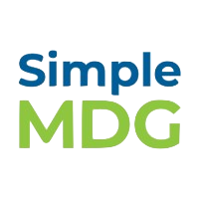

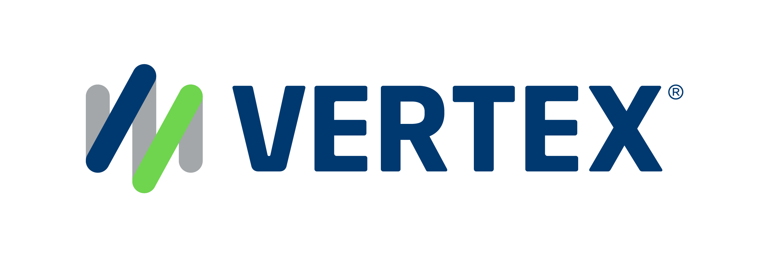
1,500
10,500+
25 Yrs
$1.5B
Successful Projects
TB of Data
Managed
Transforming Companies
Total Customer Savings
Driving Innovation, Empowering Transformations.
Data Management
Solution
Implementation
Product
& Innovations
Strategic
Partnerships
  Data Archiving & ILM
  Retention Management
  HANA Memory Optimization (NSE)
  Data Governance
  Data Migration
  Cloud Migrations
  Data Privacy and Security
  Legacy Decommissioning
  Data Volume Assessment
  Data Quality Assessment
SAP S/4HANA & RISE
SAP BTP Deployment
  SAP Integration Suite
AI Implementation
SAP OpenText
  Extended ECM (xECM)
  Vendor Invoice Management
  Document Presentment
SAP Ariba
SAP Vertex
SAP Vistex
Geospatial Intelligence (GIS)
  Data ASSIST by Auritas
  (Data Archiving Automation)
  Data GUARD by Auritas
  (Legacy Decommissioning)
  Auritas Intelligent Accrual
  (Financial Automation)
  DMS+ by Auritas
  (Enhanced Document Storage)
SAP Gold Partner
SAP PartnerEdge, Sell
CCFlex – Cloud Choice Flex
PartnerEdge®
  (AMS + Hypercare)
CCFlex

Slide 3




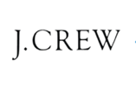

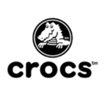


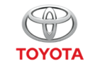



Customer Success
Services Across Multiple Industries – Verticals:

Slide 4
The Struggles with Master Data
42%
of SAP customers have issues with master data quality and governance
Pervasive lack of trust in data among business users
Hesitation in moving to S/4HANA due to data cleansing challenges
I want to implement new SAP module, but data issues are making it a risk
It takes too long to create and update master data
IT cannot keep up with requests and approvals fast enough
of SAP customers believe their master data is not ready to support migration to S/4HANA
45%
of SAP customers cite hurdles in managing master data in the cloud
38%
*ASUG Survey (2025)

Slide 5
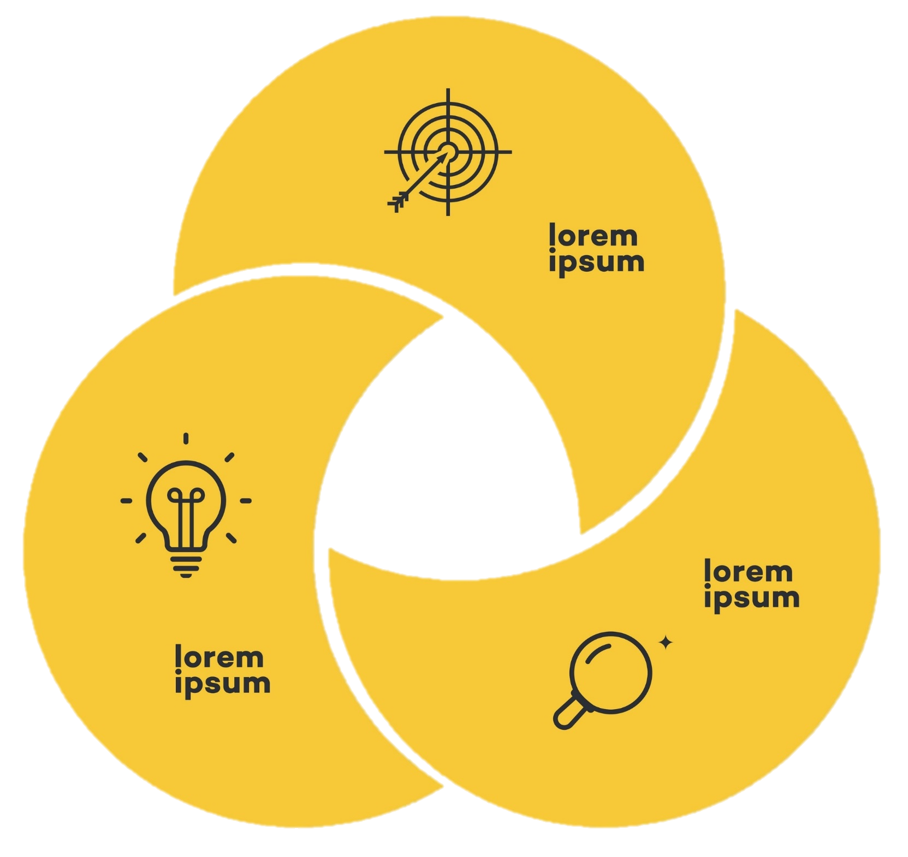

Holistic Approach to Data Quality
Master data governance is a discipline for assessing, managing, using, improving, monitoring, maintaining, and protecting the organization’s master data.
Auritas recognizes that true success in the pursuit of data quality lies in the seamless integration of People, Process, Technology and Data.
People
Process
Data
Technology

Slide 6
Advantages of SimpleMDG for Your Data Governance
Low Total Cost of Ownership
One-stop Shop for MDG
No Code Implementation
Rapid Time to Value
Saving enterprises costly and lengthy implementation and ongoing maintenance while delivering high data quality.
Over 90 standard master data types enables quick and reliable launch and maintenance.
Auritas handles the SimpleMDG implementation process to free up IT bandwidth and ensure expertise.
The solution design and methodology enables quick implementation in 2-3 months.

Slide 7
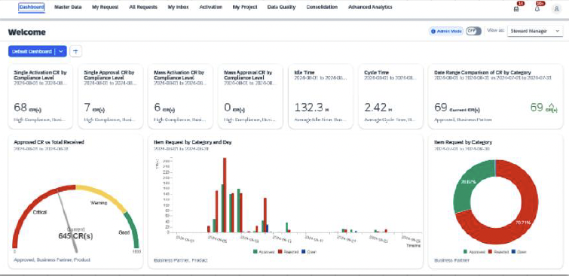
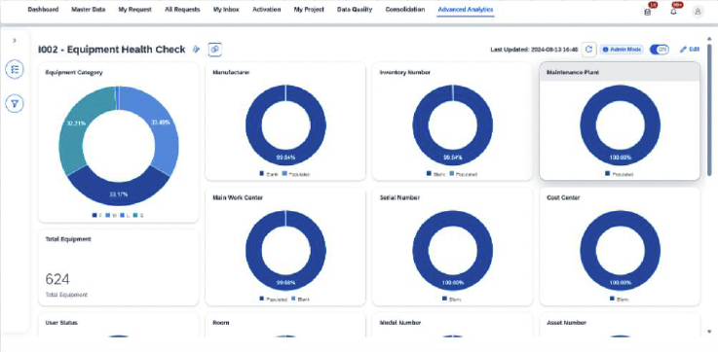
Real-time Insights Into Data Health
Dashboard Analytics: Analysis of change request and SLA progress and history
Advanced Analytics: Industry and object specific analytics

Slide 8
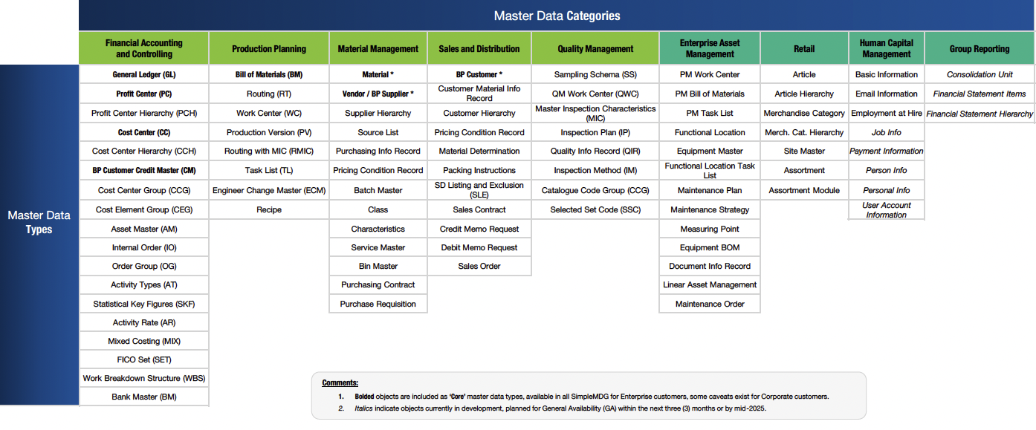
SimpleMDG’s Catalog of Master Data Types

