Slide 1
Driving Innovation, Empowering Transformation.
SAP BTP for
SAP SuccessFactors

Slide 2




1,500
10,500+
22+
$1,5B
Successful Projects
TB of Data
Managed
Years Evolving Companies
Total Customer Savings
Driving Innovation, Empowering Transformations.
Data Management
Solution
implementation
Product
& Innovations
Strategic
Partnerships
  SAP Data Archiving
  SAP DaRT
  Data Quality & Governance
  Data Migration
  System Decommissioning
  Data Privacy
S/4HANA Implementation
SAP Business Data Cloud (BDC)
SAP BTP Deployment
SAP OpenText
  Extended ECM
  Vendor Invoice Management
  Doc Presentment
SAP Spend Management
SAP Vistex
SAP Vertex
AI Implementation
Cloud Migrations
  Data ASSIST by Auritas
  (Data Archiving Automation)
  Data GUARD by Auritas
  (Legacy Decommissioning)
  Auritas Intelligent Accrual
  (Financial Automation)
SAP Gold Partner
SAP PartnerEdge, Sell
CCFlex – Cloud Choice Flex
  (AMS + Hypercare)
PartnerEdge®
CCFlex

Slide 3

























Customer Success
Services Across Multiple Industries – Verticals:

Slide 4

Solution Overview
Customer Challenges
Information Excellence Using SAP BTP
Integration of SAP SF and SAP BTP

Slide 5











SAP SuccessFactors: Cross-suite Operation Challenges
Disparate Processes
SAP SuccessFactors Employee Central
HR Partner
Support day-to-day business needs and employee administration
SAP SuccessFactors Recruiting
Time-consuming
Inefficient
Shared Services
Need to quickly find documents for an employee
SAP SuccessFactors Onboarding
Compliance
Meet security and compliance requirements
Other SAP SuccessFactors Talent solutions
High costs
Employees & Managers
Access and update employee documents
Worldwide data centers supporting SAP SuccessFactors

Slide 6













Operation Challenges
Disparate Processes
Recruiting
Candidates
Onboarding
TIME CONSUMING
Employees
Learning
Performance
HIGH COST
Managers /
HR Coordinators
UNPRODUCTIVE
Compensation
Retirement
Compensation/Benefits

Slide 7


Digital Personnel Files are Complex
Documents are spreading across disparate systems
Crucial to keep records for as long as necessary
Simply storing documents is not enough.
HR needs a centralized repository to fulfill all digital requirements
Capture
Manage
Recruiting
Onboarding
Learning
Performance
& Goals
Compensation
Separation / Retirement
Average employee file contains 30-50 documents
Output
Process
Notes:
Employee Lifecycle: Hire to Retire
Digital personnal file contains 30-50 documents
Recruiting/Onboarding: Offer letter, Job Description
Payroll and Compensation: Incentive Plan
Benefits: Beneficiaries, Dependents
Performance and Goals: Performance Review, Reference Letter
Learning & Development: Certifications, Trainings, Videos
Separation/ Retirement: Resignation Letter
Growing documents are spreading across disparate on-premise and cloud systems, applications, inboxes and both public and private storage devices. To prevent storage silos, documents need to be digitalized and stored centrally.
For HR documents in particular, it’s crucial to keep records for as long as necessary. Country-specific retention rules demand complex document lifecycles.
Simply storing documents is not enough. Documents need to be updated and fullfil data-security guidelines. To provide roles all over the company with employee documents they need for their day-by-day work, documents need to be integrated to HR workflows, autoamted and routed through different channels.
To fullfil the digital requirements, HR needs a centralized repository to capture, manage, process and deliver documents from anywhere in the world
Enterprise information continues to grow in volume and variety and that holds true for HR documents as well. Not only are the documents growing, they are spreading across disparate on-premise and cloud systems, applications, inboxes and both public and private storage devices.
For HR documents in particular, it’s crucial to keep records for as long as necessary – and no longer. Retaining information for too long is costly and risky, but so is destroying it too soon. Ensuring proper user authorization and access is
also crucial.
Optimized digital solutions for managing employee documents and records enable companies like yours to improve data compliance, increase efficiency, and prepare for potential litigation.
EXAMPLE:
Organizations manage on average 30-50 unique HR documents per employee
> 2 transactions per document per year
7-30 years document retention time
The volume of HR documents and related transactions is massive
For 50,000
1.5 – 2.5 million unique HR documents
3+ million annual document transactions
Source: HCI/OpenText 2012 Joint Research Study

Slide 8




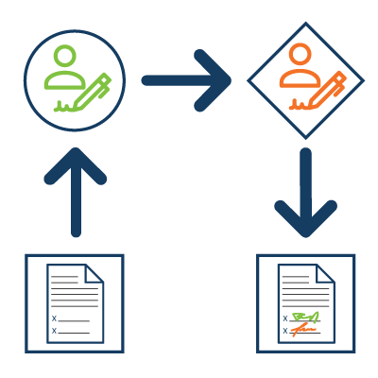


Day in the Life of the HR Professional
Recruitment &
Onboarding
Time Management & Approvals
Data protection and Retention Policies
Learning and Development
Hire
Retire
HR Professional Journey
Data & Content
Management
Modern process in Workflow and e-signatures
Separation & Retirements
Retaining Employee Data & Content
Payroll, Performance & Comp Data
Notes:
Mani
Day in the Life of HR Professional

Slide 9

Extending SAP
SuccessFactors
  Build Custom Interfaces in SAP SF Employee Central
  Connect to SAP Commerce Cloud, SAP Cloud for Customer, S/4 HANA
  Enhance management of HR Tasks with SAP SF using SAP BTP extension
  Use SF user roles to manage authorizations in the extension applicatio
  Intelligent Service to trigger custom events in SAP for business use cases.
  Using SF APIs, SAP BTP application can create automate applications for HR related activities.

Slide 10
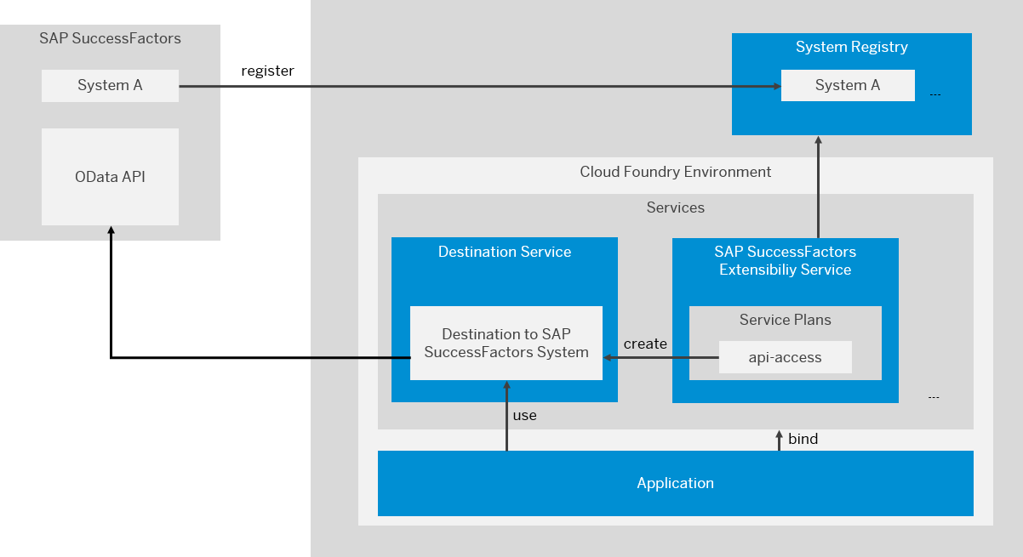
High-Level Overview
Integration of SAP SF & SAP BTP

Slide 11
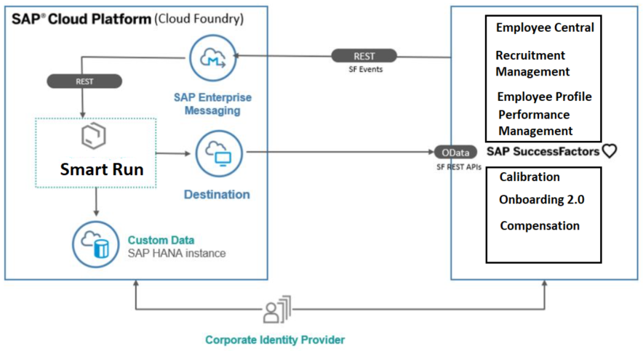
Architecture for Smart Run

Slide 12
Business Scenario
Smart Run Application runs on the SAP BTP.
It consumes platform services like Enterprise Messaging and SAP HANA. The smart run application makes calls to SF OData APIs and fetches metadata and documents from SF modules starting from OnBoarding 2.0 to Performance Management.
It will showcase all the employee related information through web application UI.
These information can be used for two different use cases:
HR can access all employee information in one place.
Rehire process becomes easy as we have information about the skillsets, projects assigned terminated employee.

Slide 13
OpenText vs BTP
No. | SAP BTP | OpenText xECM
1 | Integration with SAP Commerce Cloud, Cloud for Customer, SuccessFactors and many other SAP Cloud Platforms | Limited Integration to SAP C4C, SuccessFactors.
2 | Customizations are possible with Low code/no code development | Traditional Web Technologies are used for customizations
3 | Artificial Intelligence, IOT, Analytics are streamlined in SAP BTP | No support for IOT, AI and Analytics
4 | Full-fledged SaaS Model | Limited SaaS Model
5 | Open-Source Technologies are used development. Community Support and Forums are good. | Proprietary Technologies are used for development. Community Support is restricted only to partners
6 | Limited Document and Record Management Strategies | Strong Document and Record Management Strategies
7 | Easy Outbound and Inbound Integration with third -party applications through APIs and OAuth | Difficult to integrate with third -party applications
8 | Integration to both On-premises and Cloud-based Systems is easy | Integration depends on the system design
9 | Development required for standard document management applications | Standard document management applications are available within OpenText
10 | Maintenance and Support is carried out by the team | OpenText takes cares of support and maintenance.

