Slide 1
Driving Innovation, Empowering Transformation.
System & Cloud Migration

Slide 2




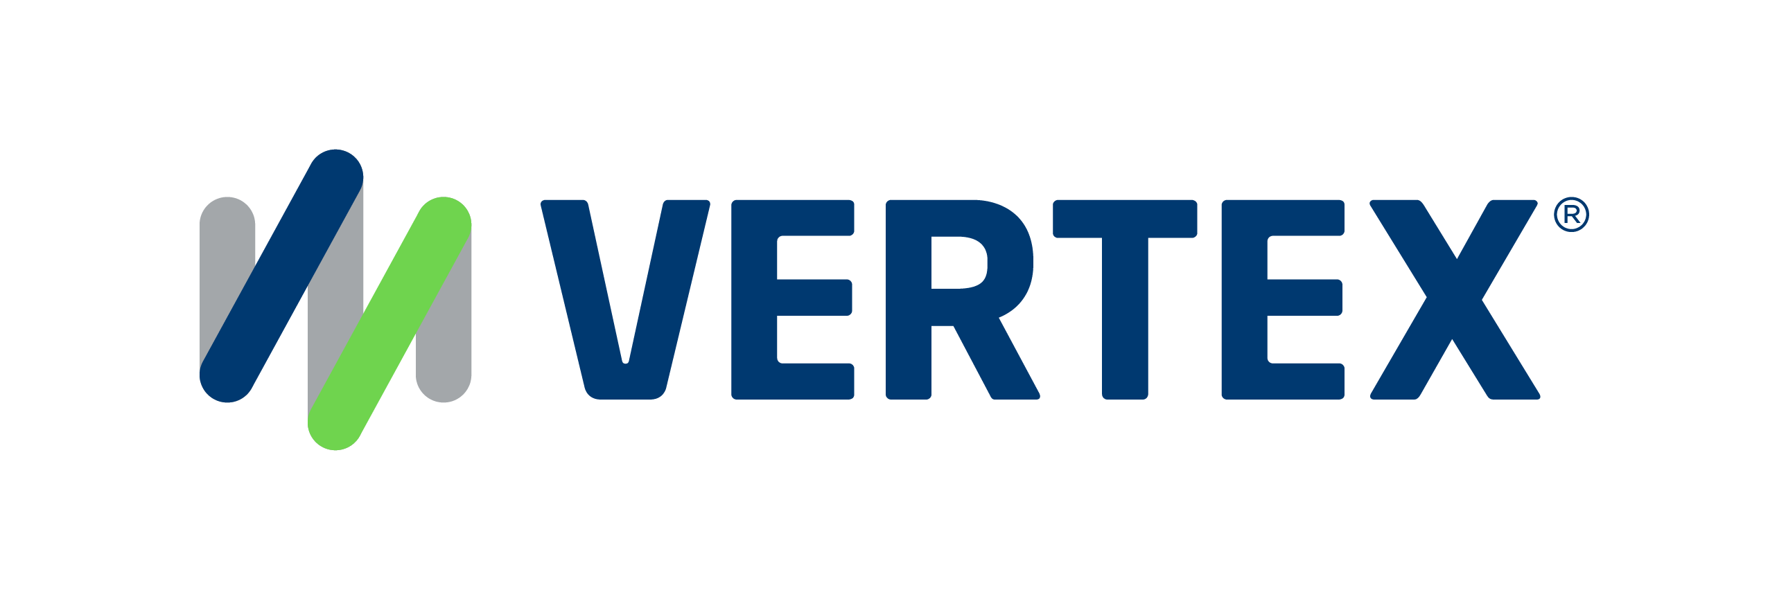
1,500
10,500+
25 Yrs
$1.5B
Successful Projects
TB of Data
Managed
Transforming Companies
Total Customer Savings
Driving Innovation, Empowering Transformations.
Data Management
Solution
Implementation
Product
& Innovations
Strategic
Partnerships
  Data Archiving & ILM
  Retention Management
  HANA Memory Optimization (NSE)
  Data Governance
  Data Migration
  Cloud Migrations
  Data Privacy and Security
  Legacy Decommissioning
  Data Volume Assessment
  Data Quality Assessment
SAP S/4HANA & RISE
SAP BTP Deployment
  SAP Integration Suite
AI Implementation
SAP OpenText
  Extended ECM (xECM)
  Vendor Invoice Management
  Document Presentment
SAP Ariba
SAP Vertex
SAP Vistex
Geospatial Intelligence (GIS)
  Data ASSIST by Auritas
  (Data Archiving Automation)
  Data GUARD by Auritas
  (Legacy Decommissioning)
  Auritas Intelligent Accrual
  (Financial Automation)
  DMS+ by Auritas
  (Enhanced Document Storage)
SAP Gold Partner
SAP PartnerEdge, Sell
CCFlex – Cloud Choice Flex
PartnerEdge®
  (AMS + Hypercare)
CCFlex

Slide 3













Customer Success
Services Across Multiple Industries – Verticals:

Slide 4

Data Management
System & Cloud Migration

Slide 5
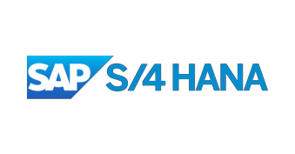








The Journey Starts Here.
Keep Core
Clean
Process
Excellence
Drive Innovation
Cloud Integration
ABAP / Fiori
Workflow / Business
Rules Management
Process Mining
Process Intelligence
Enterprise Architect Designer
S/4 HANA
Advanced Data Migration
Data Services
LaMa (Landscape
Management)
Conversational AI
Robotic Processing Automation
Leonardo
SAC Predictive
Jan. 2027
ADMA
MDG
Data Services
Information Steward (IS)
IS Accelerator
Information Lifecycle Management
Near-line storage
Document Access
Extended Content Management
BW4/HANA – Mixed Mode
HaaS
Cloud Datawarehouse
HANA Cloud Services
Enterprise Information Management
Information Lifecycle Management
LaMa (Landscape Management)
Active/Active Read Enabled
Today
Data Quality & Stewardship
Data & Content
Management
Modern Data
Platform
Landscape
Management
Ongoing
Post S4 Go live
Notes:
Deepak

Slide 6
Triggers to Data Migration
Greenfield Implementation
Brownfield Upgrade
Mergers & Acquisition
Cloud Migrations
Notes:
DECISION-MAKING
Incorrect decisions based on poor quality data negatively impact an organization’s revenue
Incorrect spend analytics leading to lost revenue
PROCESS BREAKDOWN
Data driven processes fail leading to business inefficiencies and lost revenue
Bad addresses lead to lost deliveries
LEGAL & REGULATORY ISSUES
Poor quality data leads to compliance issues resulting in fines & penalties
FINANCIAL IMPACT
Lost Revenue
Capital locked up in duplicate inventory
INCREASED PROCUREMENT SPEND
NOT OPTIMIZING INVENTORY LEVELS
INCREASED WAREHOUSE MANAGEMENT COSTS
POOR LEAD-TIME ACCURACY
DECREASE IN PRODUCTION EFFICIENCY
INEFFICIENT AND COSTLY FORECASTING AND PLANNING
LACK INFORMATION NEEDED TO MAKE CRITICAL DECISIONS
BUSINESS DECISIONS ARE CORRUPTED BY POOR DATA QUALITY
LACK OF CONSOLIDATED VIEW OF CUSTOMER DATA ACROSS ALL CHANNELS
CUSTOMER HIERARCHY AND GROUPING VISIBILITY/PROFITABILITY ANALYSIS

Slide 7


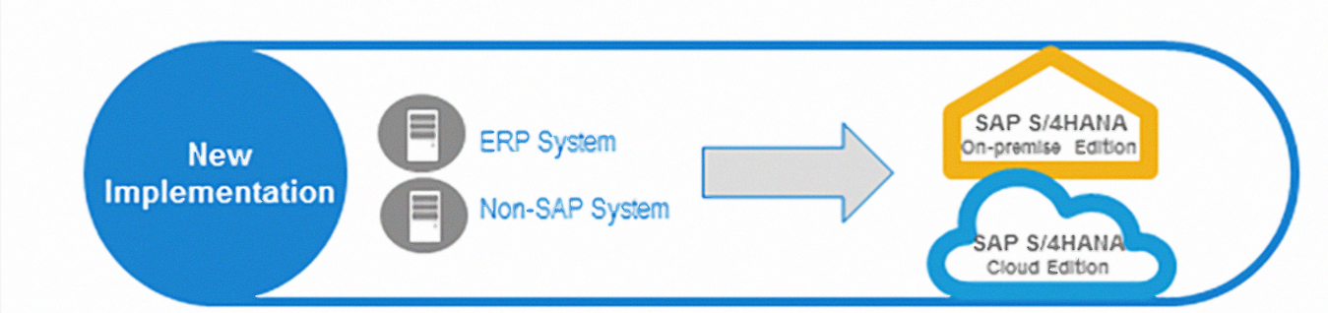


The Migration Journey Has Two Paths
Both paths present strategic concerns that require solving
Greenfield
Brownfield
Greenfield
Brownfield

Slide 8
The Migration Journey Has Two Paths
Both paths present strategic concerns that require solving
Greenfield
Brownfield
New Implementation
System Conversion
ERP System
Non-SAP System
ERP System
SAP S/4HANA
On-premise Edition
SAP S/4HANA
Cloud Edition
SAP S/4HANA
On-premise Edition

Slide 9
“It’s not as simple as I thought”
Strategic Importance (5 = High) | CIO Considerations | Greenfield | Brownfield
5 | Legacy Platform Overhead |  | ✓
5 | Downtime | ✓
4 | Data Pollution (MD + TD)*
4 | Bloated S/4 size on Day 1 | ✓
4 | Automated Retention Compliance
3 | Historical Business Rules Retained |  | ✓
3 | DVM for Future Growth
*Master Data & Transactional Data
Notes:
DECISION-MAKING
Incorrect decisions based on poor quality data negatively impact an organization’s revenue
Incorrect spend analytics leading to lost revenue
PROCESS BREAKDOWN
Data driven processes fail leading to business inefficiencies and lost revenue
Bad addresses lead to lost deliveries
LEGAL & REGULATORY ISSUES
Poor quality data leads to compliance issues resulting in fines & penalties
FINANCIAL IMPACT
Lost Revenue
Capital locked up in duplicate inventory
INCREASED PROCUREMENT SPEND
NOT OPTIMIZING INVENTORY LEVELS
INCREASED WAREHOUSE MANAGEMENT COSTS
POOR LEAD-TIME ACCURACY
DECREASE IN PRODUCTION EFFICIENCY
INEFFICIENT AND COSTLY FORECASTING AND PLANNING
LACK INFORMATION NEEDED TO MAKE CRITICAL DECISIONS
BUSINESS DECISIONS ARE CORRUPTED BY POOR DATA QUALITY
LACK OF CONSOLIDATED VIEW OF CUSTOMER DATA ACROSS ALL CHANNELS
CUSTOMER HIERARCHY AND GROUPING VISIBILITY/PROFITABILITY ANALYSIS

Slide 10



Auritas RDS for S/4 HANA
We can help no matter which route you take
Rapid Deployment Solution (RDS) by Auritas
is a purpose-built solution that:
Provides turnkey automation to ensure faster time-to-value and mitigate key data risks.
Orchestrates data migrations and empowers stakeholders to drive data value in MA&D transactions by streamlining transactions for any approach:
  New Systems
  System Consolidations / Transformations
  Carveouts / Spin-offs
  Clone & Delete
We LOWER implementation cost
We LOWER implementation risk
We INCREASE deployment speed

Slide 11
Greenfield Deployment Resolution
Strategic Importance (5 = High) | Issues | Auritas Solution
5 | Legacy Platform Overhead | Sunset legacy platforms & provide access to legacy information with SAP ILM
4 | Data Pollution (Master & Transactional Data) | Remove polluted information before migration with DVM & Auritas tools
4 | Historical Business Roles Retained | Access historical transactions & reports with same look and feel using Auritas Accelerators
4 | Automated Retention Compliance | Comply with California Consumer Protection Act & GDPR using SAP ILM
3 | DVM for Future Growth | Build data management strategy on HANA platform to intelligently manage future DB size & growth
Notes:
DECISION-MAKING
Incorrect decisions based on poor quality data negatively impact an organization’s revenue
Incorrect spend analytics leading to lost revenue
PROCESS BREAKDOWN
Data driven processes fail leading to business inefficiencies and lost revenue
Bad addresses lead to lost deliveries
LEGAL & REGULATORY ISSUES
Poor quality data leads to compliance issues resulting in fines & penalties
FINANCIAL IMPACT
Lost Revenue
Capital locked up in duplicate inventory
INCREASED PROCUREMENT SPEND
NOT OPTIMIZING INVENTORY LEVELS
INCREASED WAREHOUSE MANAGEMENT COSTS
POOR LEAD-TIME ACCURACY
DECREASE IN PRODUCTION EFFICIENCY
INEFFICIENT AND COSTLY FORECASTING AND PLANNING
LACK INFORMATION NEEDED TO MAKE CRITICAL DECISIONS
BUSINESS DECISIONS ARE CORRUPTED BY POOR DATA QUALITY
LACK OF CONSOLIDATED VIEW OF CUSTOMER DATA ACROSS ALL CHANNELS
CUSTOMER HIERARCHY AND GROUPING VISIBILITY/PROFITABILITY ANALYSIS

Slide 12
Brownfield Deployment Resolution
Strategic Importance (5 = High) | Issues | Auritas Solution
5 | Downtime | Reduce data to be migrated by aggressively archiving and reducing migration downtime
4 | Data Pollution (Master & Transactional Data) | Remove polluted information before migration with DVM & Auritas tools
4 | Bloated S/4 HANA platform size on Day 1 | Implement data management strategy
4 | Automated Retention Compliance | Comply with California Consumer Protection Act & GDPR using SAP ILM
3 | DVM for Future Growth | Build data management strategy on HANA platform to intelligently manage future DB size & growth
Notes:
DECISION-MAKING
Incorrect decisions based on poor quality data negatively impact an organization’s revenue
Incorrect spend analytics leading to lost revenue
PROCESS BREAKDOWN
Data driven processes fail leading to business inefficiencies and lost revenue
Bad addresses lead to lost deliveries
LEGAL & REGULATORY ISSUES
Poor quality data leads to compliance issues resulting in fines & penalties
FINANCIAL IMPACT
Lost Revenue
Capital locked up in duplicate inventory
INCREASED PROCUREMENT SPEND
NOT OPTIMIZING INVENTORY LEVELS
INCREASED WAREHOUSE MANAGEMENT COSTS
POOR LEAD-TIME ACCURACY
DECREASE IN PRODUCTION EFFICIENCY
INEFFICIENT AND COSTLY FORECASTING AND PLANNING
LACK INFORMATION NEEDED TO MAKE CRITICAL DECISIONS
BUSINESS DECISIONS ARE CORRUPTED BY POOR DATA QUALITY
LACK OF CONSOLIDATED VIEW OF CUSTOMER DATA ACROSS ALL CHANNELS
CUSTOMER HIERARCHY AND GROUPING VISIBILITY/PROFITABILITY ANALYSIS

Slide 13
Reusable Framework for M&A
Source A
Destination B
Remove new company data completely from existing system
Smart filtering to ensure only appropriate data is migrated/removed
Ensure Complete Data Removal
Governed
Data Deletion
Improve Visibility
Reduce Risk
Notes:
DECISION-MAKING
Incorrect decisions based on poor quality data negatively impact an organization’s revenue
Incorrect spend analytics leading to lost revenue
PROCESS BREAKDOWN
Data driven processes fail leading to business inefficiencies and lost revenue
Bad addresses lead to lost deliveries
LEGAL & REGULATORY ISSUES
Poor quality data leads to compliance issues resulting in fines & penalties
FINANCIAL IMPACT
Lost Revenue
Capital locked up in duplicate inventory
INCREASED PROCUREMENT SPEND
NOT OPTIMIZING INVENTORY LEVELS
INCREASED WAREHOUSE MANAGEMENT COSTS
POOR LEAD-TIME ACCURACY
DECREASE IN PRODUCTION EFFICIENCY
INEFFICIENT AND COSTLY FORECASTING AND PLANNING
LACK INFORMATION NEEDED TO MAKE CRITICAL DECISIONS
BUSINESS DECISIONS ARE CORRUPTED BY POOR DATA QUALITY
LACK OF CONSOLIDATED VIEW OF CUSTOMER DATA ACROSS ALL CHANNELS
CUSTOMER HIERARCHY AND GROUPING VISIBILITY/PROFITABILITY ANALYSIS

