Slide 1


High Tech
Success Story:
Global Invoice Management Transformation Within 9 months
Pain Points:
  Production failure and operational risks
  Current AP solution/business model not scalable
  Compliance risk - Heavy manual controls to mitigate failures
  Business continuity and growing-concern over vendor stability
Benefits:
  Intuitive and mobile enabled FIORI user experience
  Global standardization of indirect invoice end to end process
  Operational around the clock, providing history, visibility, security, and a single system of document control
  Enhanced compliance by meeting local regulations
Results:
  51% touchless global automation within three months post rollout
  Established a unified ECC platform for 49 entities
  Addressed 145 global requirements
  Scalable automation & standardized workflows

Slide 2


Manufacturing
Success Story:
Global Invoice Management Optimization
Pain Points:
  Heavy manual labor needs to complete tasks. Long cycle/processing time.
  Challenges to measure supplier performance.
  Large number of exceptions.
  Customizations were being used in the place of business rules.
Solution:
  Scale for growth with common, standard global processes; develop and track key performance metrics to trend progress.
  SAP validation, rejection, exception handling, workflow, approval and posting minimal SAP customizations.
  Architect future state supplier portal integration.
  Integrate EDI and auto ingest emailed invoices.
  Lead change with business process, not technology; build cross functional change coalition to root the cultural change.
Results:
  Over 700 thousand invoices processed – EDI 55% and email and paper 45%.
  Touchless process went from 0-20% to 85+% globally.
  Cycle time was reduced from 18 to 4.5 days.
  Implement and integrate a supplier portal. Improved supplier relations.
  Extend standard POs for Maintenance, Repair and Operations (MRO) expense.
  Grow digital invoicing, target paper reduction with new vendors and non-PO.

Slide 3


Oil & Gas
Success Story:
VIM Upgrade for Global Invoice Processing Automation
Pain Points:
  Missed early payment opportunities and processing delays
  Increased risk of human error due to manual data entry processes
  Slow workflows were impacting team productivity
  Dealing with over 250k invoices being both PO and non-PO, across 35 legal entities
Solution:
  Upgrade OpenText Vendor Invoice Management technology
  Implement Information Capture Core by OpenText with Machine Learning
  Integrated intelligent capture for SAP, enabling machine reading and learning capabilities
Results:
  Over 20 OCR profiles were onboarded, ensuring region-wise country groupings and improved accuracy across diverse invoice formats
  Monetary advantages with automated identification of early payment opportunities
  Reduced manual processes introducing auto-posting directly in SAP VIM by OpenText
  Global deployment across 44 countries, delivering consistent functionality while ensuring compliance with regional and global financial regulations

Slide 4
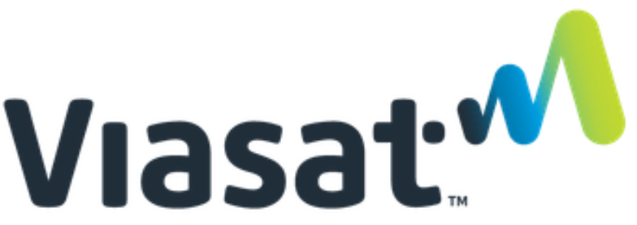

Telecommunications
Success Story:
Leveraging OpenText VIM OCR for Ariba BNI
Pain Points:
  Dual procurement channels (Direct vs Indirect) created fragmented invoice processes
  Separate reconciliation tools added complexity
  No unified invoice intake process, leading to inefficiencies & confusion for vendors
  OCR limited to direct invoices only
Solution:
One centralized invoice intake process via OpenText VIM
OpenText Intelligent Capture to machine-read both Direct and Indirect invoices
Indirect invoices are then interfaced into Ariba Invoicing for approvals before posting to S/4HANA
Direct invoices proceed through VIM for approvals and posting to S/4HANA
Results:
  A single, common invoice transmittal process for all vendors
  Improved operational efficiency by consolidating invoice intake and OCR processing
  Enhanced user experience across procurement/sourcing and finance teams
  Seamless integration with existing SAP systems while maintaining preferred platforms
  Sustainable long-term support through Auritas Hypercare services

Slide 5

Retail
Success Story:
A Smarter Way to Pay with OpenText VIM and SAP Taulia
Pain Points:
  Highly customized procurement processes with limited standardization and scalability
  Lack of end-to-end automation across procurement, invoicing, and AP processes
  Gaps in integration between procurement, finance, and invoice management tools reduced visibility and efficiency
  Homegrown procurement and invoicing processes for direct spend
Solutions Implemented:
Intelligent Capture for SAP for ML capabilities and increasing automation
SAP Invoice Management by OpenText (VIM) implementation
OpenText Archiving and Document Access implementation for system rightsizing
SAP Taulia Supply Chain Financing
Results:
  VIM currently processes 400,000 invoices annually, of which merchandise constitutes more than 75% of the volume
  Taulia generates a $2 million annuity YoY by way of dynamic discounting
  Automated down payment handling and invoice clearing
  Improved accuracy for complex, non-standard invoices

Slide 6
High Tech
Success Story:
SAP Invoice Management by OpenText for ESG/Sustainability Reporting
Challenges:
  Increasing pressure to meet sustainability regulations and reporting requirements
  Existing third-party solution provided only high-level, non-actionable insights
  Lack of granular, operational-level sustainability data for planning and forecasting
  Existing OpenText VIM lacked the capability to capture sustainability operational data
Benefits:
  Enhanced SAP Invoice Management (VIM) with Intelligent Capture for SAP (ICS)
  Extended VIM beyond invoicing to capture operational sustainability data (OD)
  Implemented line-item level data capture for energy, utilities, and consumption metrics
  Created standardized data structures and templates for global consistency
  Enabled multi-channel data ingestion (email, VIM extraction, drag-and-drop)
  Developed data enrichment capabilities (headers, rate slabs, attributes)
  Built a robust exception management framework with rule-based validations
Results:
  Significant improvement in sustainability data capture and reporting
  Enhanced visibility into utility consumption and operational performance
  Multi-dimensional data model enabling deeper analysis and forecasting
  Improved compliance, audit readiness, and financial planning

