Slide 1
Master Overview Deck
Invoice to Pay - Vendor Invoice Management (VIM)

Slide 2




1,500
10,500+
22+
$1,5B
Successful Projects
TB of Data
Managed
Years Evolving Companies
Total Customer Savings
Driving Innovation, Empowering Transformations.
Data Management
Solution
implementation
Product
& Innovations
Strategic
Partnerships
  SAP Data Archiving
  SAP DaRT
  Data Quality & Governance
  Data Migration
  System Decommissioning
  Data Privacy
S/4HANA Implementation
SAP Business Data Cloud (BDC)
SAP BTP Deployment
SAP OpenText
  Extended ECM
  Vendor Invoice Management
  Doc Presentment
SAP Ariba
SAP Vistex
SAP Vertex
AI Implementation
Cloud Migrations
  Data ASSIST by Auritas
  (Data Archiving Automation)
  Data GUARD by Auritas
  (Legacy Decommissioning)
  Auritas Intelligent Accrual
  (Financial Automation)
SAP Gold Partner
SAP PartnerEdge, Sell
CCFlex – Cloud Choice Flex
  (AMS + Hypercare)
PartnerEdge®
CCFlex

Slide 3

























Customer Success
Services Across Multiple Industries – Verticals:

Slide 4


High Tech
Success Story:
Global Invoice Management Transformation Within 9 months
Pain Points:
  Production failure and operational risks
  Current AP solution/business model not scalable
  Compliance risk - Heavy manual controls to mitigate failures
  Business continuity and growing-concern over vendor stability
Benefits:
  Intuitive and mobile enabled FIORI user experience
  Global standardization of indirect invoice end to end process
  Operational around the clock, providing history, visibility, security, and a single system of document control
  Enhanced compliance by meeting local regulations
Results:
  51% touchless global automation within three months post rollout
  Established a unified ECC platform for 49 entities
  Addressed 145 global requirements
  Scalable Automation & standardized workflows

Slide 5


Manufacturing
Success Story:
Global Invoice Management Optimization
Pain Points:
  Heavy manual labor needs to complete tasks. Long cycle/processing time.
  Challenges to measure supplier performance.
  Large number of exceptions.
  Customizations were being used in the place of business rules.
Solution:
  Scale for growth with common, standard global processes; develop and track key performance metrics to trend progress.
  SAP validation, rejection, exception handling, workflow, approval and posting minimal SAP customizations.
  Architect future state supplier portal integration.
  Integrate EDI and auto ingest emailed invoices.
  Lead change with business process, not technology; build cross functional change coalition to root the cultural change.
Results:
  Over 700 thousand invoices processed – EDI 55% and email and paper 45%.
  Touchless process went from 0-20% to 85+% globally.
  Cycle time was reduced from 18 to 4.5 days.
  Implement and integrate a supplier portal. Improved supplier relations.
  Extend standard POs for Maintenance, Repair and Operations (MRO) expense.
  Grow digital invoicing, target paper reduction with new vendors and non-PO.

Slide 6
Invoice-To-Pay Business Drivers
Streamline and digitize invoice processing
Use business rules instead of customizations
Reduce Labor
Root cause exceptions and track Straight Through Processing Measure supplier performance and drive accountability
Reduce Cycle Time
Optimize Cash Flow
Minimize exceptions to maximize DPO
Standardize and automate for Shared Service enablement Operational excellence balances people-process-technology
Create Scalability
Notes:
Operational, tactical and strategic objectives
Replace high labor and low efficiency with high automation and no touch
(STP) measures accuracy and efficiency is the key operational metric
(DPO) for working capital gains is the key strategic metric

Slide 7





Project Scope & Objectives
  Scale for growth with common, standard global processes
  Develop and track key performance metrics to trend progress
Global
  SAP validation, rejection, exception handling, workflow, approval and posting Minimal SAP customizations
Application
Systems
Integrate EDI and auto ingest emailed invoices
Manage digital invoices in a payables platform to enable business rules
Grow Digital
  Architect future state supplier portal integration
Change Management
Lead change with business process, not technology
Build cross functional change coalition to root the cultural change

Slide 8

Why SAP Invoice Management by OpenText?
  Global compliance for invoice mandates
  Open Platform
< />
XML
EDI
No invoices lost
in private mailboxes
Simple way
to forward to AP
No complex
supplier on-boarding
Simple solution
for any supplier
No need to print
Simple collaboration
with suppliers
Notes:
Toro chose to harness the power of SAP in our single instance, secure integrated environment.
As a completely pre-configured solution, VIM needs to accomplish many if not all different ways to receive invoices, to transform, validate and finally approve and post these. But Let’s start from the beginning and later elaborate on the specifics: VIM accepts invoices from any channel in the most common formats: traditional paper invoices that are scanned, PDF and XML invoices submitted electronically or invoices received directly from the supplier through EDI or a business network such as Ariba. While the invoices come in different formats they have something in common: They contain details about who needs to pay how much for what items to which recipient at which time.
VIM manages this information in SAP tables and then applies business rules to check data consistency and completeness. Since everything runs inside the ERP, it always uses real-time data and avoids costly replication and synchronization issues. Each rule has a role assigned that is responsible to look into the corresponding problem. In addition the solution also contains predefined actions that the user can take to resolve the problem. I’ll tell more about it later.
Depending on the detailed configuration, the invoice will be parked or posted and blocked throughout the process.
But once all exceptions are resolved and every necessary approval is received, the invoice is unblocked and free for payment. In between all actions a user takes are recorded in the audit trail and directly visible for all other stakeholders. This optimizes and accelerates the collaboration significantly. Once the process is terminated we also
<click>
Render the complete audit trail into a PDF document that is attached to the process plus the invoice document. That way auditors have complete insight into the process without relying on data in SAP tables.
<click>
Full transparency is really important for internal staff as well as the suppliers. This is why VIM also includes a very easy to use supplier self-service: Suppliers and internal staff simply see the invoice status by entering a few fields like invoice reference and amount. This eliminates calls and emails to the AP specialist who can solely focus on accounting activities.
VIM traces each and every step for two reasons: first of all for compliance purposes: You always need to know who decided what. But secondly it also allows detailed reporting and continuous process optimization: You know exactly which suppliers/plants/organizational units cause costs and delays in invoice processing. We’ll later discuss this important aspect in more detail.

Slide 9





Digital, Integrated, Automated Invoice Processing
Your Supplier
SAP Business Suite
Insight & Control
Ingestion
Invoice
Recognition
Invoice
Verification
Collaboration
& Monitoring
Invoice
Completion
Payment
Receive
Transform
Verify and
Complete
Exception
Handling
Approve
Pay
< />
XML
IDoc
Inquiry
Automated reconciliation and posting
Archiving
OCR
SAP Archiving
Invoice Capture
Center
Supplier
Self-Service
SAP Invoice Management
Notes:
As a completely pre-configured solution, SAP Invoice Management (IM) needs to accomplish many if not all different ways to receive invoices, to transform, SAP IM accepts invoices from any channel in the most common formats: traditional paper invoices that are scanned, PDF and XML invoices submitted electronically or invoices received directly from the supplier through EDI or a business network such as Ariba. While the invoices come in different formats they have something in common: They contain details about who needs to pay how much for what items to which recipient at which time.
SAP IM manages this information in SAP tables and then applies business rules to check data consistency and completeness. Since everything runs inside the ERP, it always uses real-time data and avoids costly replication and synchronization issues. Each rule has a role assigned that is responsible to look into the corresponding problem. In addition the solution also contains predefined actions that the user can take to resolve the problem. I’ll tell more about it later.
Depending on the detailed configuration, the invoice will be parked or posted and blocked throughout the process.
But once all exceptions are resolved and every necessary approval is received, the invoice is unblocked and free for payment. In between all actions a user takes are recorded in the audit trail and directly visible for all other stakeholders. This optimizes and accelerates the collaboration significantly. Once the process is terminated we also
<click>
Render the complete audit trail into a PDF document that is attached to the process plus the invoice document. That way auditors have complete insight into the process without relying on data in SAP tables.
<click>
Full transparency is really important for internal staff as well as the suppliers. This is why SAP IM also includes a very easy to use supplier self-service: Suppliers and internal staff simply see the invoice status by entering a few fields like invoice reference and amount. This eliminates calls and emails to the AP specialist who can solely focus on accounting activities.
SAP IM traces each and every step for two reasons: first of all for compliance purposes: You always need to know who decided what. But secondly it also allows detailed reporting and continuous process optimization: You know exactly which suppliers/plants/organizational units cause costs and delays in invoice processing. We’ll later discuss this important aspect in more detail.
Let me quickly touch an important topic: simplicity.
<click>
SAP IM has exactly two price items: First of all the solution itself including the supplier self-service and all web and mobile approval components.
<click>
Secondly the optional OCR that also include the scanning software.
<click>
The OCR is deeply integrated with your ERP: It stores all configuration within SAP, retrieves all documents that require OCR processing from SAP (and the attached Archive). So from an infrastructure perspective it is a really simple solution. The invoice process itself uses SAP Business Workflow with the huge advantage that you need not reinvent Org-models, substitutions and so much more: Everything that you have already is used. The same applies for reporting: It scales from ABAP reports, via WebDynpro to BW content.
Let me walk you through some additional details of the individual processing steps in the next minutes.

Slide 10



Invoice-to-pay Journey
Optimize
PO Driven
Line-item match acceleration
Minimum touch exception path
Robust business rules
Digitized workflows
Analytics
Operate
Actionable Improvements
Supplier Portal Integration
Continuous Improvement
Establish SSC
Measure performance
Benchmark
Vendor Adoption
Grow EDI invoices
Automate email
Paper reduction
Standardize process
Review & update Policy
Eliminate touch points
Accelerate
Digitize
Standardize

Slide 11
Our Success
  Vision Of Tomorrow
1.
700,000 Invoice in 12 Months:
EDI – 55%; Email and Paper – 45%
Supplier Portal implementation and integration
Volumes
2.
“Straight Through Process”
0-20% to 85+% globally
Extend standard POs for Maintenance, Repair and Operations (MRO) expense
No Touch
3.
Shrank cycle time from 18 to 4.25 Days (Average Days)
Grow digital invoicing, target paper reduction with new vendors and non-PO
Cycle
4.
Greatly Improved Suppliers Relationships
Root cause and resolve vendor exceptions via supplier performance meetings
Partner

Slide 12
Invoice to Pay: Assess Your Opportunity
Impact | Process Metrics | UOM | Best-in-class | Time to value
Efficiency | Total Cost-per-Invoice (AP) | $ | 1.00 to 2.50
Acceleration | AP Invoice Cycle (receipt to payment) | Days | 5
 | DPO (Days Payable Outstanding) | Days | 45-60
 | % of Invoices Paid on time | % | 92-96
 | Straight Through Pass % | % | 50-65
 | Early Payment Discount Capture | % | 70
 | Invoices Processed per FTE | Nos. | 30000-45000
Optimization | Electronic Invoicing | % | 60
 | Supply Chain Financing (Addressable Spend) | % | 50
 | Electronic Payments | % | 80
High
Medium
Low

Slide 13





Invoice to Pay:
Value Attainment Roadmap
Ingestion
Transform
Manage by Exception
Supplier Management
Financing
Simplify and Digitize
Introduce EDI early
Compliant - SAP eDocuments
Use a Vendor segmented approach
Machine Learning
Invoice Validation as a Service
Electronic Document mapping
Policy
Intelligent process
Auto Posting
Electronic Approvals
Audit Trails
Electronic Payments
Reporting Insight
Manage Supplier Onboarding
Supplier Self Service
Supplier Performance
E-invoicing
Supply Chain Financing
Dynamic Discounting

Slide 14
Differentiators for
Best-in-Class Invoice-to-Pay
Optimize
Touchless
Processing
Tried and tested methodology to maximize first pass
Balance process and solution capabilities
Approach scales for most industries and company size
  Simplify and streamline invoice to pay
  Automation to minimize reconciliation time & enhance worker productivity
  Improve cash flow and vendor relations
Minimum
Cycle Time
    Reduce cost and compliance risk
    Audit trail, compliance, quick close, & reporting
    Acceleration within invoice entry and processing for AP
Compliance
Control
Global Competence: Compliance and Localization
Solution Accelerators
Change Management
Orchestration
Vendor On-Boarding & Adoption

Slide 15

Solution Extensions
Vendor Invoice Management

Slide 16




Challenges To Optimal Accounts Payable Processes
Receipt & Capture
Inquiries & Exceptions
Matching & Approvals
Discounts & Payments
High cost of
paper invoices
Too many exceptions
Lack of
compliance
Lack of
control
“Nearly 80% of all incoming invoices are still paper-based.”
The Hackett Group
“25% of invoices have exceptions.”
TAPN
“$4.6 million avg. in contract leakage per billion in spend.”
The Hackett Group
“80% of early payment discount opportunities missed.”
Ariba
Notes:
According to a recent, in-depth study conducted by Harvard Business Review, an overwhelming 86% of the 746 business managers surveyed feel their business processes and related decision making has become so complex as to hinder their ability to grow in a digital economy.
Let’s look into the four basic steps of the invoice-to-pay process and their challenges: (Animation. Click per bullet)
Nearly 80% of all invoices are still paper-based: This is simple for the supplier (everybody can print and mail) but a huge challenge on your side: Managing the physical paper, entering the invoice details into SAP and finally filing/archiving the invoice at the right and secure location for the right period of time.
15% of invoices have exceptions: This has multiple reasons: Poor communication with the supplier so that price changes are not properly recorded in SAP or erroneously assumed to be agreed by the supplier; Wrong quantities entered on your side or sometimes even delayed entry; invoice is sent to the wrong legal entity and/or from the wrong supplier entity potentially in the wrong currency or with wrong tax …
It is not uncommon that contracts are in place but not used because nobody knows about the more favorable terms and conditions.
And last not least a significant percentage of early payment opportunities are missed.
All these challenges can be addressed but be aware that the change process takes a little bit more than selecting the right software.

Slide 17










Key Business Drivers for
Achieving Excellence in AP
Insight – Financial and operational
Collaboration – Share common information
Automation – Reduce manual processes
Control – Exception-based management
IT Simplification – One platform
Notes:
But beyond the key motivations there are five major business drivers that are an integral part of any invoice transformation consideration:
Financial information like budgeting, planning and reporting needs to be available in real time with always accurate data.
Collaboration and information sharing must become a fixed and organized part of processing.
Automate tedious manual steps. This not only eliminates potential errors but also allows the specialists to focus on value adding activities.
The right controls ensure that exceptions (problems) are detected and processed by the right people without violation of the segregation of duties.
Last not least: Simplifying IT rather than adding additional information silos is key for success. The easier it is to embed and implement the new solution, the better the probability of success.

Slide 18
Unoptimized / Optimized / Best Run
Best run companies process invoices more efficiently.
Best run companies process invoices faster.
Number of invoices processed per "process accounts payable" FTE
Cycle from receipt of invoice until approved and scheduled for payment
30,000 to 45,000
Top 25%
4 Days
9,375
Median
7 Days
5,600
Bottom 25%
14 Days
“Some Data provided by APQC. ©1992-2012 APQC. ALL RIGHTS RESERVED. www.apqc.org/osbc”
Notes:
There are two very important and easy to measure KPIs:
The number of invoice processed per accounts payable FTE reflects the personnel costs of the process. Topics like manual data entry, multiple data corrections, tedious collaboration and navigating through complex screens contribute to low efficiency. The difference between the Top 25% and Bottom 25% is significant.
The cycle time is strictly related to the process quality and the ability to ensure a predictive payment behavior including capturing all existing plus additional discounts. A short cycle time also ensures that books are closed as early as possible and that costly financial restatements are eliminated.

Slide 19
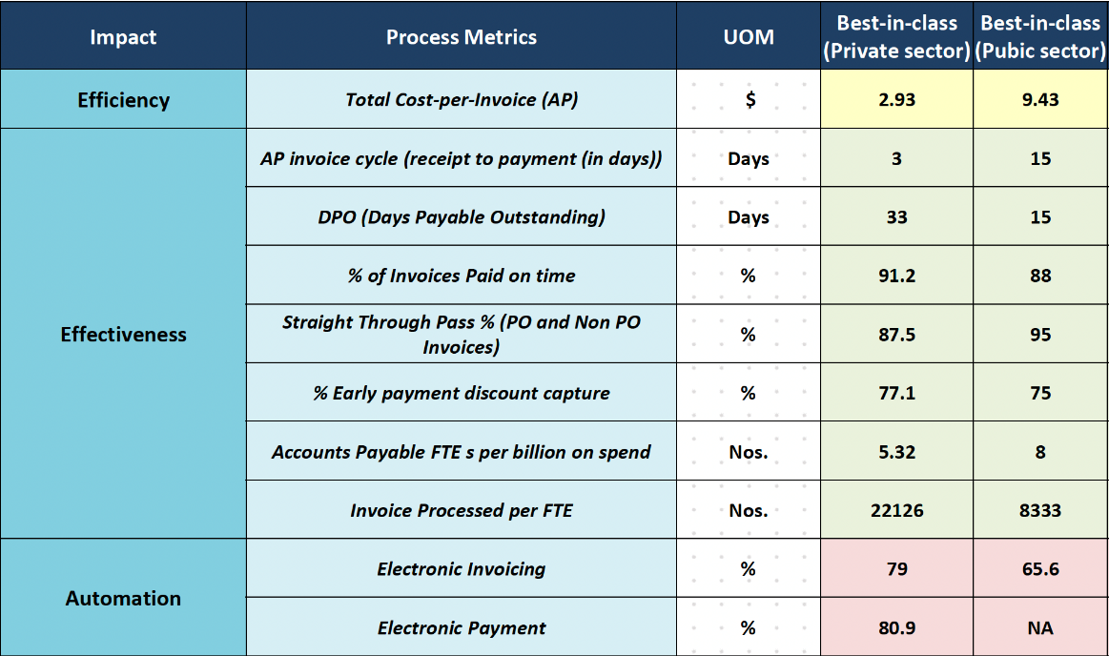
Invoice Management: Benchmark
Benchmark Source :-Best In Class Private Sector –Hackett ; Best in Class Public Sector -APQC

Slide 20
Invoice Management Potential Outcomes
(US Cost Model)
Impact | Process Metrics | Best-in-Class | Opportunity
Efficiency | Total Cost-per-Invoice (AP) | $.50 - $1.50
Acceleration | AP Invoice Cycle (minimum time to payment) | 5 days
 | DPO (Days Payable Outstanding) | 45 - 60 days
 | % of Invoices paid on time | 92% - 96%
 | Straight Through Pass % (PO Based volume) | 50%-65%
 | Early Payment Discount Capture | 70%
 | Invoices Processed per FTE | 30,000-45,000 annually
Optimization | Electronic Invoicing | 40-60%
 | Supply Chain Financing (Addressable) | 50%
 | Electronic Payments | 80%
Short Term
Medium Term
Long Term
Best-in-class and Opportunity Suggestion is based on supplier maturity, spend type and available infrastructure

Slide 21
Solution Extension Program vs. Open Ecosystem
What is the difference?
Partner & Solution Selection
    By SAP invitation Only
    SAP branded
    Open and partner certified
Product Support
    SAP is single point of contact for customer across all phases of the technology lifecycle including Training, Maintenance and Support
    Available from the partner
Product Roadmap
    SAP owns integration of solution into SAP roadmap
    Available from the partner
SAP Solution
Extensions
(30 partners)
Customer Route to Acquiring Solution
    Sold by SAP
    PSLE applicable
    SAP EULA
    Sold by the partner
    Partner EULA
Open Ecosystem
(Thousands of Partners)
Product Testing & Validation
    Meets SAP product standards with broader testing requirements
    “Premium Qualification” (16 standards)
    Platform interoperability certification

Slide 22
Digital, Integrated, Automated Invoice Processing
Your Supplier
Invoices
Insight & Control
Ingestion
Invoice
Recognition
Invoice
Verification
Collaboration
& Monitoring
Invoice
Completion
Payment
< />
XML
Robot
Built in
ML / AI
Verify and
Complete
Exception
Handling
Robot
Pay
IDoc
Electronic
Data Mapping
Validate Data
Comment
Finalize for posting
Scanning
Trigger Workflows
Return to Vendor
Archive
Audit Trail
Archiving
Machine Read & Learning
Approval
Inquiry
SAP S/4HANA
SAP Business Suite
Supplier
Self-Service
SAP Archiving*
SAP Information Capture
SAP Invoice Management
Notes:
As a completely pre-configured solution, SAP Invoice Management (IM) needs to accomplish many if not all different ways to receive invoices, to transform, SAP IM accepts invoices from any channel in the most common formats: traditional paper invoices that are scanned, PDF and XML invoices submitted electronically or invoices received directly from the supplier through EDI or a business network such as Ariba. While the invoices come in different formats they have something in common: They contain details about who needs to pay how much for what items to which recipient at which time.
SAP IM manages this information in SAP tables and then applies business rules to check data consistency and completeness. Since everything runs inside the ERP, it always uses real-time data and avoids costly replication and synchronization issues. Each rule has a role assigned that is responsible to look into the corresponding problem. In addition the solution also contains predefined actions that the user can take to resolve the problem. I’ll tell more about it later.
Depending on the detailed configuration, the invoice will be parked or posted and blocked throughout the process.
But once all exceptions are resolved and every necessary approval is received, the invoice is unblocked and free for payment. In between all actions a user takes are recorded in the audit trail and directly visible for all other stakeholders. This optimizes and accelerates the collaboration significantly. Once the process is terminated we also
<click>
Render the complete audit trail into a PDF document that is attached to the process plus the invoice document. That way auditors have complete insight into the process without relying on data in SAP tables.
<click>
Full transparency is really important for internal staff as well as the suppliers. This is why SAP IM also includes a very easy to use supplier self-service: Suppliers and internal staff simply see the invoice status by entering a few fields like invoice reference and amount. This eliminates calls and emails to the AP specialist who can solely focus on accounting activities.
SAP IM traces each and every step for two reasons: first of all for compliance purposes: You always need to know who decided what. But secondly it also allows detailed reporting and continuous process optimization: You know exactly which suppliers/plants/organizational units cause costs and delays in invoice processing. We’ll later discuss this important aspect in more detail.
Let me quickly touch an important topic: simplicity.
<click>
SAP IM has exactly two price items: First of all the solution itself including the supplier self-service and all web and mobile approval components.
<click>
Secondly the optional OCR that also include the scanning software.
<click>
The OCR is deeply integrated with your ERP: It stores all configuration within SAP, retrieves all documents that require OCR processing from SAP (and the attached Archive). So from an infrastructure perspective it is a really simple solution. The invoice process itself uses SAP Business Workflow with the huge advantage that you need not reinvent Org-models, substitutions and so much more: Everything that you have already is used. The same applies for reporting: It scales from ABAP reports, via WebDynpro to BW content.
Let me walk you through some additional details of the individual processing steps in the next minutes.

Slide 23
Information Capture Has a Global Scope
Australia | Korea*
Austria | Mexico
Belgium | Netherlands
Brazil* | New Zealand
Canada | Norway
China (Mainland) | Poland
China (Traditional)* | Portugal
Czech Republic | Russia
Denmark | Singapore
Finland | Slovakia
France | Spain
Germany | Sweden
Hungary | Switzerland
India | Taiwan
Italy | Turkey
Ireland | United Kingdom
Japan* | United States
Additional countries with “Basic Support”
Andorra, Angola (Portuguese), Argentina, Azerbaijan, Bahamas, Barbados, Belarus, Benin (French), Bolivia (Spanish), Bosnia, Bulgaria, Burkina Faso, Cap Verde, Central African Republic (French), Chile, Columbia, Costa Rica, Cote d‘Ivoire, Croatia, Cuba, Cyprus, Dominican Republic (Spanish), East Timor (Portuguese), Ecuador, El Salvador, Equatorial Guinea, Estonia, Greece, Grenada, Guatemala, Guinea, Haiti, Honduras, Iceland, Ireland, Jamaica, Kazakhstan (Russian), Kenya (English), Latvia, Liechtenstein, Lithuania, Luxemburg, Malaysia (English), Mali, Malta (English), Mauritius, Moldova, Monaco, Mozambique, Namibia, Nicaragua, Niger, Nigeria (English), Panama, Paraguay (Spanish), Peru, Philippines (English, Spanish), Republic of the Congo, Romania, San Marino, Senegal, Serbia, Seychelles, Slovenia, South Africa (English, Afrikaans), Suriname, Togo, Ukraine, Uruguay, Venezuela.
With machine learning support
*Restrictions apply
Additional languages and countries are added frequently
Notes:
Standard support means that ICC is preconfigured to extract invoice data for typical vendor invoices for these countries: ICC „understands“ the languages of the listed countries and considers specific invoice characteristics, e.g. country specific date and amount writing styles, taxes (VAT in most countries, but also GST (e.g. Australia, Canada), sales tax (e.g. USA), and country specific fields (e.g. KID payment reference for Scandinavian countries, ESR payment reference for Switzerland, SIRET for France, CIF for Spain).
ICC Validation client UI is available in languages used in these countries – language can be selected user specific.
Special Notes for countries with *:
Brazil: in Brazil e-invoicing is used for goods, but service invoices are still paper based. ICC supports just invoices type „Nota Fiscal de Servicos Electronica – NFS-e
China Mainland: In China Mainland (People‘s republic of China) language is Simplified Chinese, national and provincial invoice forms are in use. ICC supports the three most widely used national invoice forms and extracts invoice data automatically: VAT Special Invoice, VAT Common Invoice and Transportation Invoice. Support for more forms on request.
China Traditional: Traditional Chinese is the language used in Taiwan and Hongkong. Various invoice formats are in use – ICC is not preconfigured for specific invoice forms but recognizes the complete invoice text and makes it available for Single Click Entry. Vendor and Company Code will be determined automatically based on master data download from SAP, other invoice fields will require training with ART.
Japan: Various invoice formats are in use – ICC is not preconfigured for specific invoice forms but recognizes the complete invoice text and makes it available for Single Click Entry. Vendor and Company Code will be determined automatically based on master data download from SAP, other invoice fields will require training with ART.
Korea: Various invoice formats are in use – ICC is not preconfigured for specific invoice forms but recognizes the complete invoice text and makes it available for Single Click Entry. Vendor and Company Code will be determined automatically based on master data download from SAP, other invoice fields will require training with ART.
Thailand: Various invoice formats are in use – ICC is not preconfigured for specific invoice forms but recognizes the complete invoice text and makes it available for Single Click Entry. Vendor and Company Code will be determined automatically based on master data download from SAP, other invoice fields will require training with ART.
Basis Support means: For these countries the application is preconfigured with regard to character recognition, culture settings controlling data conversion and formatting, and VAT rates are specified. For some of these countries, data extraction will also yield good results if the respective country uses the same keywords and phrases as one of the countries of the above list. For these countries, additional customizing will be needed to achieve high recognition rates
Traditional Chinese is used in Taiwan, Hongkong, Macau
Taiwan: Various invoice layouts exist
National used GUI invoice form exists - GUI stands for Government Unified Invoices. In Taiwan, all VAT registered vendors must apply to purchase preprinted invoice books from the Government. It is possible to apply for self printed invoices. These must bear serial numbers issued by government.
Forms also show handwritten characters
International style invoices also exist (bilingual Chinese/English)
ICC supports Traditional Chinese character set
Complete invoice text is recognized and available for SCE.
No preconfigured recognition for invoice fields, data extraction for invoice fields needs to be trained with ART – for invoice header and invoice item fields.
Training with ART is easy to use, can be performed by the customer, needs to be done once for every vendor
Invoice Vendor and Company Code will be recognized without training, based on master data extract download from SAP like for other ICC standard countries.
To be checked if specific requirements for Hongkong exist
Further enhancements in upcoming ICC 7.5 SPs upon availabilitiy of more invoice samples. Provide more preconfigured functionality for GUI invoice forms.

Slide 24



How RPA is Used
Document Classification, Invoice Intake and Rejections
Enrich missing information
Match in real-time
Apply the right set of business rules
React to business events: PO Change, GR Creation

Slide 25

How Machine Learning is Used
Machine Reading +
Machine Learning

Slide 26



Add Intelligence to Invoice Processing
  Pre-processing & text recognition
  Split an image into invoice and attachment
“Invoice”
“Credit Note“
“Down payment“
Other
Classification
Identify document type
  Extraction
  Search for relevant information on the document
Date: Jan 21, 2019
Amount: $332.29
Order-Nr: X-44277
Supplier: Mueller & Friends
Date: Jan 21. 2019
Amount: 332,29 $
Order-Nr: X-44277
Supplier: Mueller & Friends
21012019
332.29 USD
X-44277
K441258-3
Notes:
Keeping all the advantages of e-invoicing in mind still a significant fraction of invoices is not fully electronically (structured like XML or IDoc) but either scanned or PDF. These types of invoices are instantly archived and then process by the OCR engine under full control of SAP IM.
What SAP Information Capture does after loading the files from the archive server:
Identify the begin of invoice attachments to reduce extraction time
<click>
Classify the document type to distinguish between invoice, credit note, down payments or others.
<click>
Extract the full text (whether used for fields or not)
Please note: For searchable PDF the “etext” is used! This eliminates any character recognition problems (ambiguities like “I”, “l” or “1”, hidden text, etc.)
Normalize data; Example: Understand different currency symbols, units of measure, number formats and date formats
Enhance data quality based on master data that exists in ERP
<click>
Recognize invoices from multiple countries: The knowledge base contains all typical keywords for 30+ countries
Recognize complex invoice item tables spanning multiple pages including line item qualification for surcharges, freight, etc …
Learning for invoices not recognized the first pass
SAP Information Capture stores all configuration in SAP; The list of invoices that need extraction is loaded from SAP; the images are loaded via ArchiveLink from the correct content repository and the full text extraction details are stored back in an archive using ArchiveLink. But most importantly the extraction results including their geometry (where was it found) is directly updated in SAP. Everybody has instant access to the invoice, the header and line item data and the full audit trail who corrected individual fields.

Slide 27







Invoice Knowledge Base + ML
Boosts Recognition Rate (Built in RPA)
Invoice knowledge base*
Supplier invoice
Voter
User Interaction or business rule (Feedback)
Machine Learning
*out-of-the-box field recognition rate of about 75%
Notes:
In this simplified graphic, you can see key components of an intelligent automation solution.

Slide 28
Continuous Self-adapted Learning
The art of the possible
Processing 20 invoices for 80 different suppliers:
The machine learning algorithm just needs a few invoices from the same supplier to cross the 90% field recognition mark
Knowledge Base

Slide 29
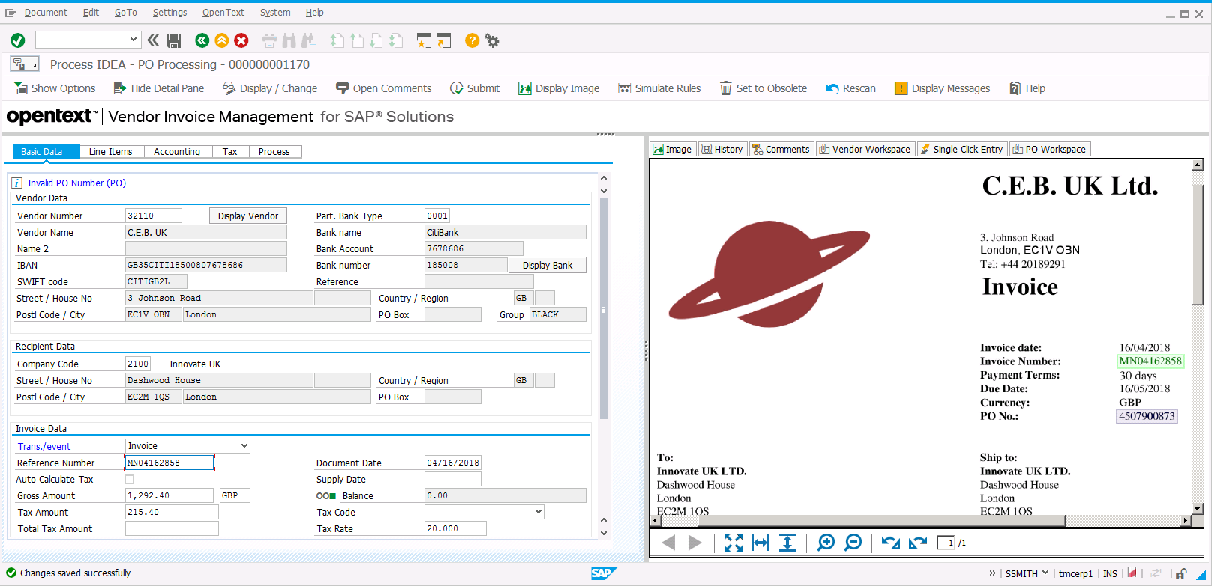
Information Capture Simplifies Navigation & Data Entry
The viewer navigates to
the correct location
Users simply click to enter data

Slide 30
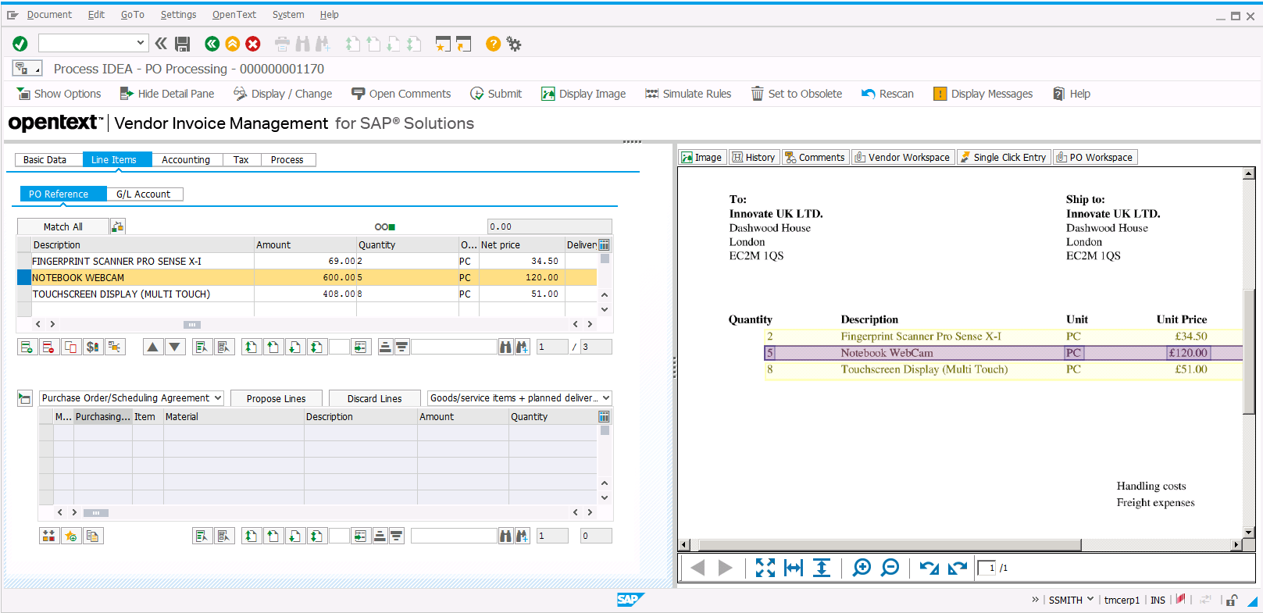
SAP Information Capture
Simplifies Navigation & Data Entry
The viewer navigates to the right location
Users simply click to enter data

Slide 31
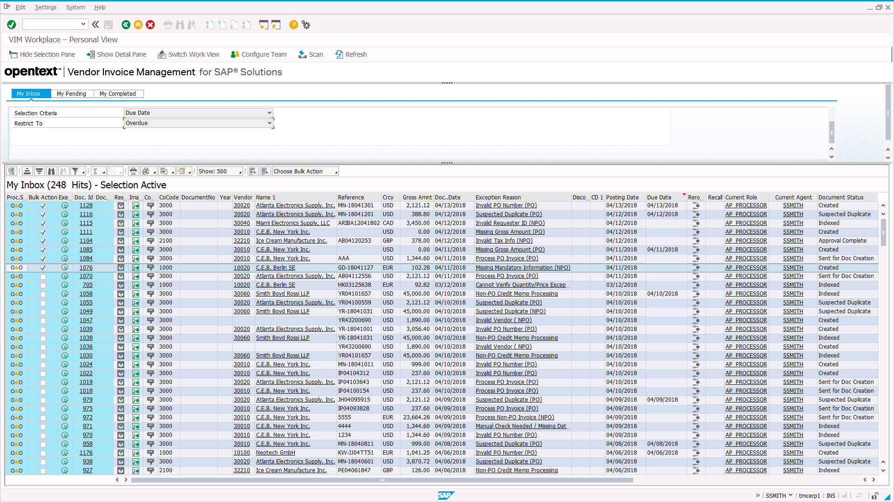
Efficient Collaboration
Personal, Team & Global Inbox
Invoice exceptions are automatically prioritized
Apply the same action to multiple items
Access details without opening
Personal workplace and team inbox
Advanced process control:
Recall approvals, restart processing
Scan and track invoices from one screen

Slide 32

Verification & Exception Handling

Slide 33
SAP Invoice Management Includes an Extensive Set Of Pre-configured Rules
Exception Handling
Validate data
Invalid PO Number (PO) |  | Payment Method Mismatch (PO) |  | Invalid Vendor Invoice Number (PO) |  | Service Entry Required (PO) - Enhanced Check
Invalid Vendor (PO) |  | Missing/Invalid Tax Exempt Text (PO) |  | Invalid Common Ordinary Invoice (VAT Exists) |  | Brazil - Missing NF Data (PO)
Invalid UOM (PO) |  | Missing Import Special Text (PO) |  | Check Hand Written (PO) |  | Brazil - Missing NF Customizing (PO)
Invalid Currency (PO) |  | Missing Item Description (PO) |  | Verification Required (PO) |  | Brazil - NF Validation Check Failed (PO)
Suspected Duplicate (PO) |  | Missing Mandatory Information (PO) |  | Validate Bank Details (PO) |  | Brazil - Wait for GR - Simple Check (PO)
PO Not Released or Incomplete |  | Missing/Invalid Triangulation Text (PO) |  | Invalid/Missing Vendor ABN Number (PO) |  | Brazil - Wait for GR - Enhanced Check
Unable to Match PO Lines (PO) |  | Invalid Sales Tax for the Region (PO) |  | Invalid/Missing Recipient ABN Number |  | Russia - Wait for TORG-12/ACT - Simple Check
Manual Check Needed / Missing Data for Indexing Lines (PO) |  | Vendor Audit Required (PO) |  | Missing Vendor Name (PO) |  | Russia - Wait for TORG-12/ACT - Enhanced Check (PO)
Unable to Determine PO Line Number (PO) |  | Vendor Maintenance (PO) |  | Missing Recipient Name (PO) |  | Russia - Original Invoice Mismatch (PO)
Manual Check Needed for Indexing Lines (PO) |  | Vendor Mismatch (PO) |  | Invalid Tax Description (PO) |  | Invalid Withholding Tax Code / Type (PO)
Invalid PO Item Number (PO) |  | Service Entry Required (PO) |  | GR Not Done - Simple Check |  | Withholding Tax Base Amount Bigger than Total Net Amount (PO)
Invalid Vendor VAT Number (PO) |  | Currency Mismatch (PO) |  | Missing Vendor ECC Number (PO) |  | Check BPF Added Data (PO)
Incomplete Credit Memo (PO) |  | Unit of Measure Mismatch (PO) |  | Mismatch Vendor ECC Number (PO) |  | Tolerance Exceeded (PO)
Vendor Address Mismatch (PO) |  | Approval Required (PO) |  | Missing Vendor CST Number (PO) |  | Missing VAT Date (PO)
Missing Item Quantity (PO) |  | Freight on Invoice (PO) |  | Mismatch Vendor CST Number (PO) |  | Check Withholding Tax Data (PO)
Missing Item Unit Price (PO) |  | Tax Audit Required (PO) |  | Missing Vendor TIN/TOT Number (PO) |  | Down Payment Clearing (PO)
Missing Invoice Date (PO) |  | Invalid Requisitioner (PO) |  | Mismatch Vendor TIN/TOT Number (PO) |  | Missing/Invalid GST Partner (PO)
Invalid Tax Info (PO) |  | PO Credit Memo Processing (PO) |  | Missing Vendor LST Number (PO) |  | Missing/Invalid Vendor GST Reg. No (PO)
Missing Date of Supply (PO) |  | Company Code Mismatch (PO) |  | Mismatch Vendor LST Number (PO) |  | Missing/Invalid HSN/SAC code (PO)
ISR Number Mismatch (PO) |  | Confirmation Required from SRM (PO) |  | Missing Vendor PAN Number (PO) |  | Cannot Verify Quantity/Price Exceptions (PO)
Invalid Recipient VAT Number (PO) |  | Invalid Payment Reference (PO) |  | Mismatch Vendor PAN Number (PO) |  | Quantity/Price Mismatch (PO)
Payment Terms Mismatch (PO) |  | Missing Invoice Code (PO) |  | Missing Vendor STC Number (PO) |  | Quantity/Price Confirmation Required (PO)
Invalid Siret Number (PO) (France) |  | Invalid Invoice Code Format (PO) |  | Mismatch Vendor STC Number (PO) |  | Missing Company Code (PO)
Invalid Company Address (PO) |  | Invalid Characters in Secret Code (PO) |  | Wait for GR - Simple Check (PO) |  | Missing Gross Amount (PO)
Vendor Invoice Reference Missing (PO) |  | Invoice Older than Allowed (PO) |  | Wait for GR - Enhanced Check (PO) |  | Check Vendor/Company Address (PO/NPO)
Rules cover country specifics
You select the relevant business rules
It is simple to add rules
Notes:
For purchase order related invoices even more rules apply. You can rest assured that we cater for most simple and complex scenarios and that the flexibility of the rule framework allows a fully automated and compliant check of incoming information against the data in SAP in real-time.
In that context we should also mention that so called “logic modules” can first “enhance” the data prior to applying all these rules. This contributes to the high levels of automation.
<click>It’s again up to you to decide, which rules to deactivate or even to add.

Slide 34


Support Large and/or Distributed
Organizations with Transparent Routing
Invoice received in London, UK
  Is scanned
  Workflow in SSC in Asia started
Shared Service Center
AP clerk in Asia
  Routes to buyer in US
  Requires approval in Argentina
Buyer in U.S.
solves exception
1
2
3
Approver in
Argentina gives OK
Notes:
One proven way to improve A/P efficiency is by implementing a shared service center. However., doing so is not without some challenges, for instance, high transaction volume and distribution or invoice origination, reconciliation, and approval. For organizations that do not have centralized or shared services, SAP Invoice Management provides the means to put these operations in place without extensive overhaul or retrofitting. With the virtual consolidation of documents, you can control all transactions centrally, even when elements of the transaction occur in different geographic locations.
Shared services can gain significant benefits from implementing SAP Invoice Management). You can post large volumes of invoices without human intervention, using SAP Information Capture. Exception-handling intelligence, paperless documents, and distributed access all enhance a shared-services center by creating a virtual, centralized monitoring and tracking solution that is accessible by any authorized party from any location.
For shared- services centers that post invoices to multiple back- end production instances, the solution provides a single consolidated view for your AP department to process invoices. From process control through reporting, your personnel work from a centralized instance
As a result, all information relevant to a transaction is visible on one screen. Scanned images, links to transactions (POs, goods receipts, invoices, and so on), comments, history, and other communications are consolidated in one location with links to more details. With increased visibility and accessibility comes reduction in cost, decreased risk and improved quality across all process steps.
Cost
Cost of manual data entry virtually eliminated
Costly focus and follow-up on numerous status calls and complaints from suppliers avoided
Need to install more instances when
adding countries avoided through localization
Risk
One place to monitor all invoices
Platform for central service delivery, enabling selective process harmonization
Transparent routing of invoices to process constituents across the corporation
Data entry errors and the associated risk and cost drastically reduced
Quality
Processing capacity grows with volume, without need to grow headcount proportionally
Consistent service provision adhering to KPIs and SLAs

Slide 35

Invoice Approval
Invoice Management Details

Slide 36
Simplify And Automate Invoice Coding & Approval
Auto determination
of initial routing
Coding – manual or automatic based on template
Parallel approval of line items with full view of history and invoice image
Rule-based approval chain and automatic escalation
One logic: many user-specific interfaces
Notes:
Processing invoices not related to a purchase order is one of the time consuming and challenging tasks in Finance. In the past, such invoices typically directly arrived at the requisitioner, who confirmed receipt of goods or services and added the accounting information. Afterwards the invoice was forwarded to the financial approvers requiring a lot of knowledge about the organization and responsibilities.
In a centralized, digital world, life is more complex but also more efficient an always following latest guidelines if properly optimized: Based on details about the supplier and requisitioner, the system determines the initial responsibilities: Who requested the goods/service and needs to confirm their delivery; which is the right cost element (for some suppliers this can be fully automatic if it is always the same – for others the corresponding user can select from a set of coding templates or even add coding details for part of the invoice and delegate the remainder to colleagues). And who is authorized to approve the cost allocation. The approval process and management of the chart of authority is one of the most discussed topics during invoice management projects. The proper design of approval limits and the use of the best parallelization is key to success. All approvers also need to be notified about new and pending approvals in a timely fashion. In the era of SAP Fiori they will for example directly see notifications and then can quickly process the pending approvals.
Sap Invoice Management really optimizes the process in a highly configurable way: Approvals can be firstly configured for different expense types (IT purchases can follow different approvals compared to marketing expenses for example); Coding can be delegated to multiple people; approval is driven by approval limits and levels and all approvals on one level are running in parallel. Any user in the process can refer to anybody else for questions or clarifications at any time. This results I a fully documented process flow completed in the shortest cycle time.
Role Action Problems Results
Accounts Payable Professional Ensure proper approval of invoices Varying approval paths, not knowing who is authorized to approve and at what limits, valid of signature, potential for fraud Late payments, incorrect payments, negative audits, fraud
Approver Ensure goods or services have been received and should be paid as billed Incomplete documentation, approval without authority, lack of knowledge if already approved, understanding of what must be done and when Late payments, incorrect payments, negative audits, fraud
Coder Code non PO invoices Lack of authority, incorrect cost object or general ledger account Late payments, incorrect payments, negative audits, fraud

Slide 37
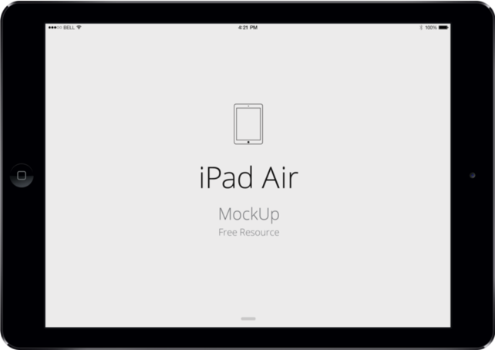

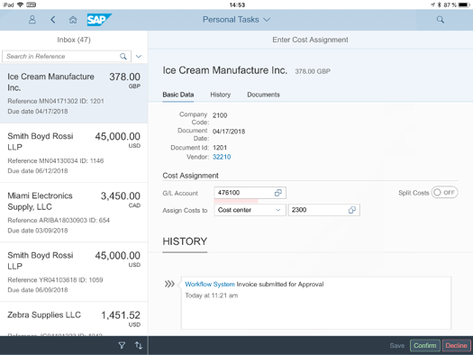
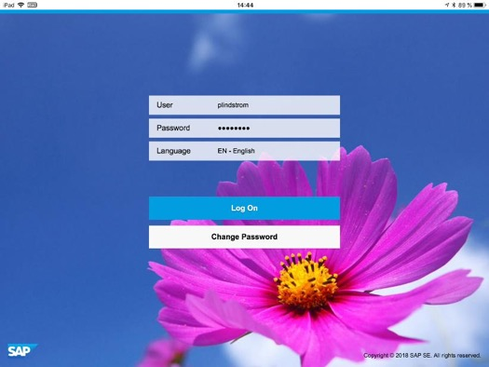
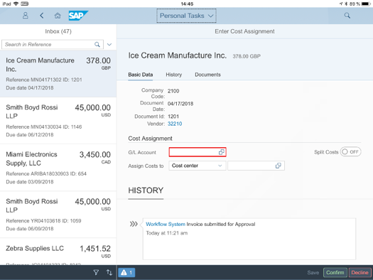
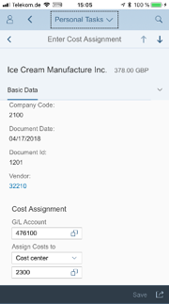
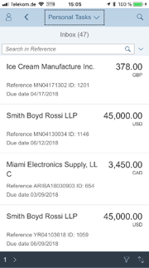
One Approval Logic
Always The Right User Interfacehe

Slide 38
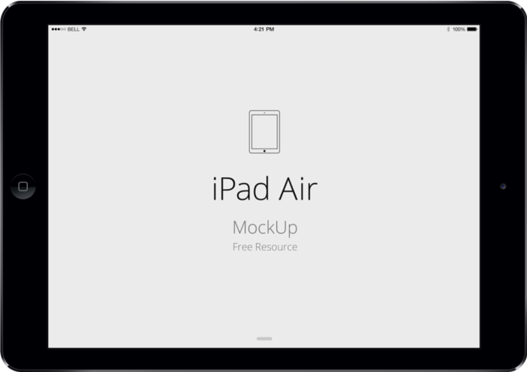

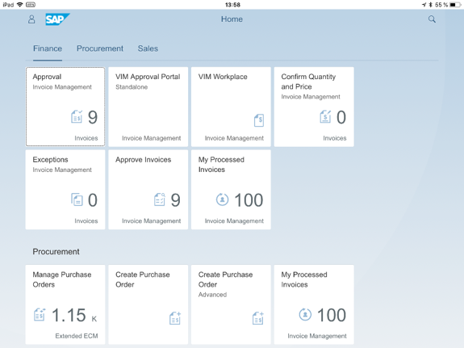
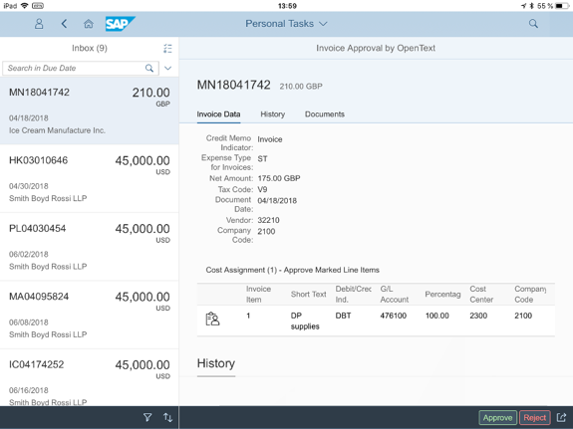
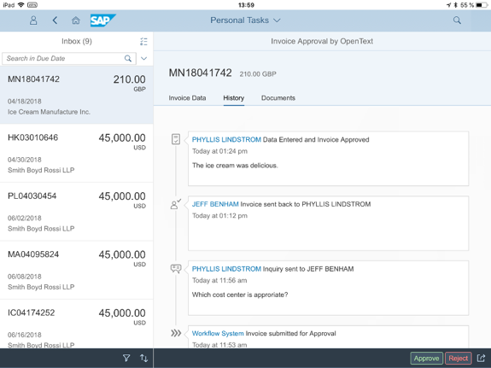
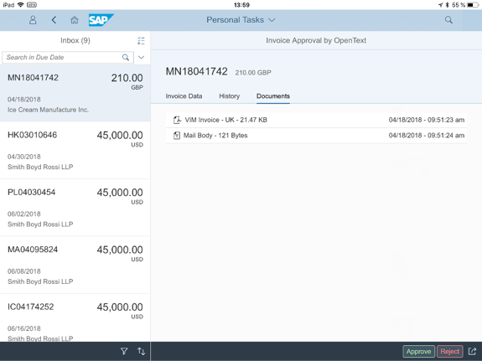

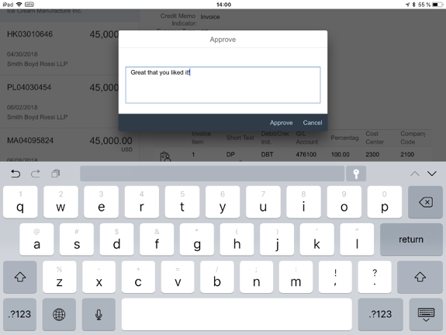
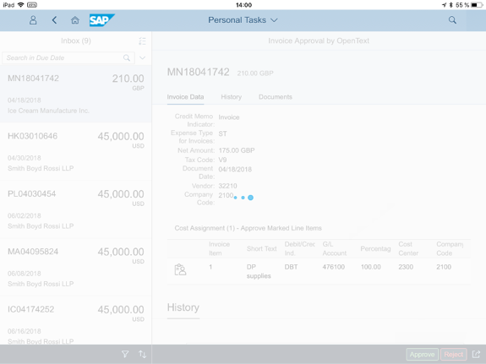
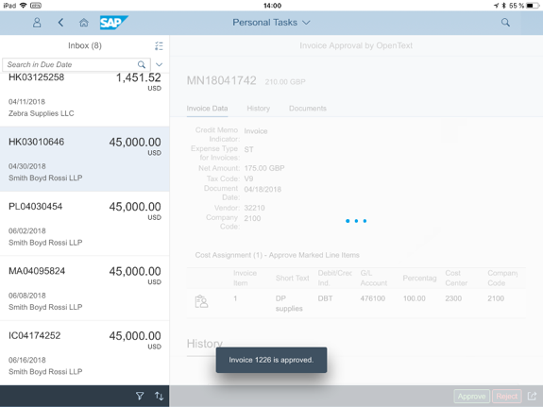
… or any tablet.
Invoice list
Invoice attachments
and image
Invoice details
Approve and confirm
Invoice approval history

Slide 39

Analytics & Reporting
Invoice Management Details

Slide 40
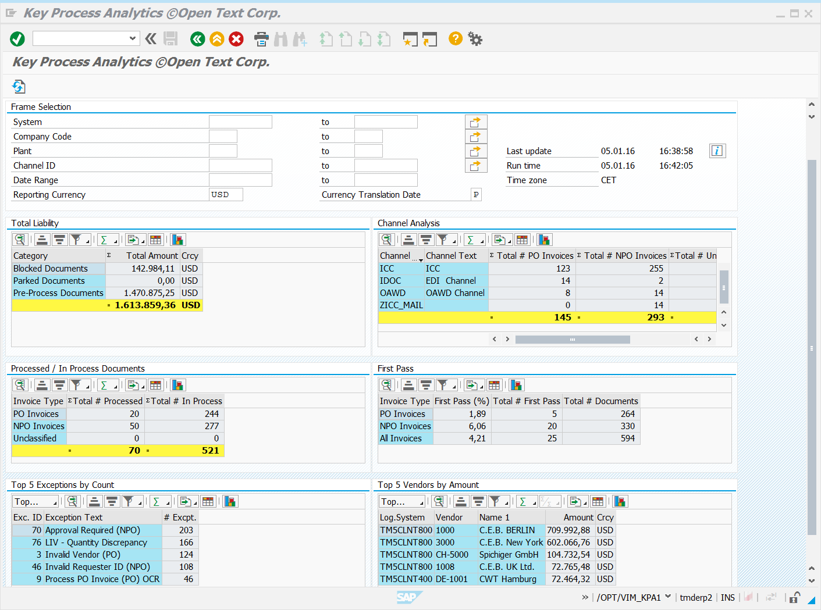
Aging report
Automation and OCR report
Current liability report
Exception analysis report
Key process Analytics
KPI web dashboard
Productivity report
SAP BW extractors & info cubes
Summary report
Planned: SAP Fiori-based analytics
A Complete List Of Reports

Slide 41
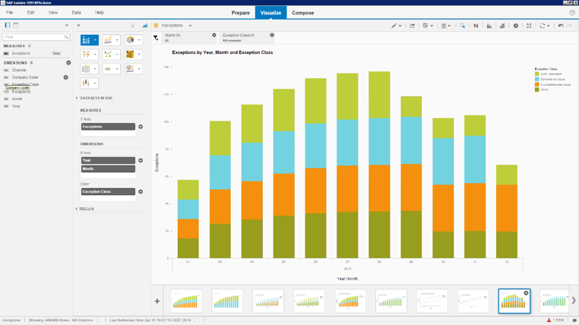
Trend Analysis is Key for Continuous Process Optimization

Slide 42
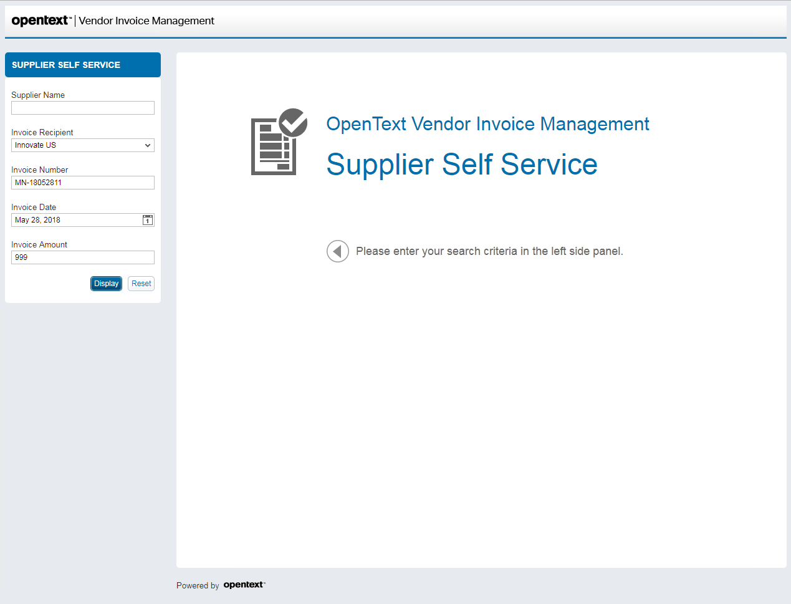
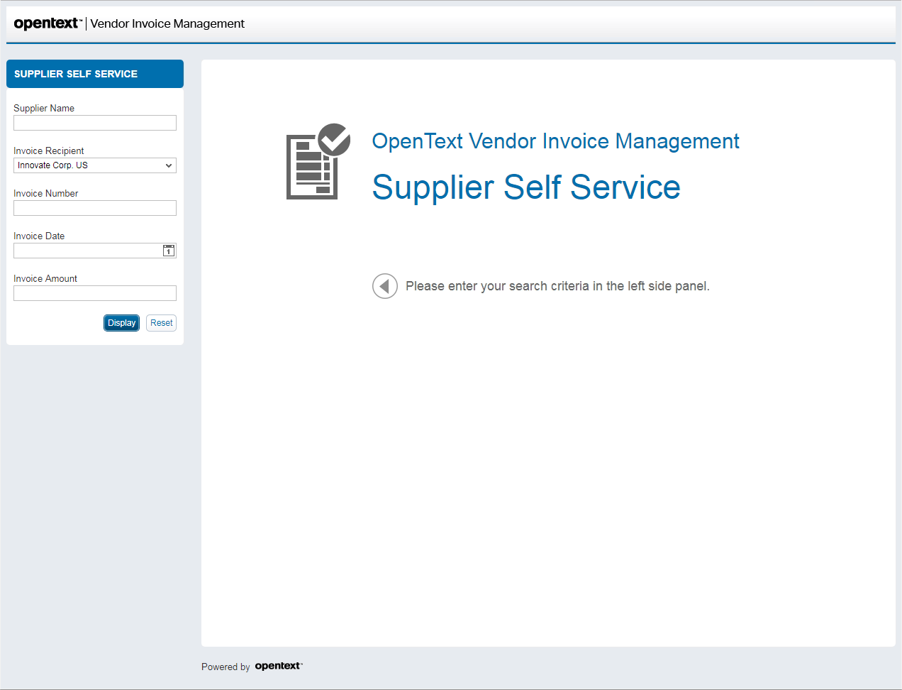
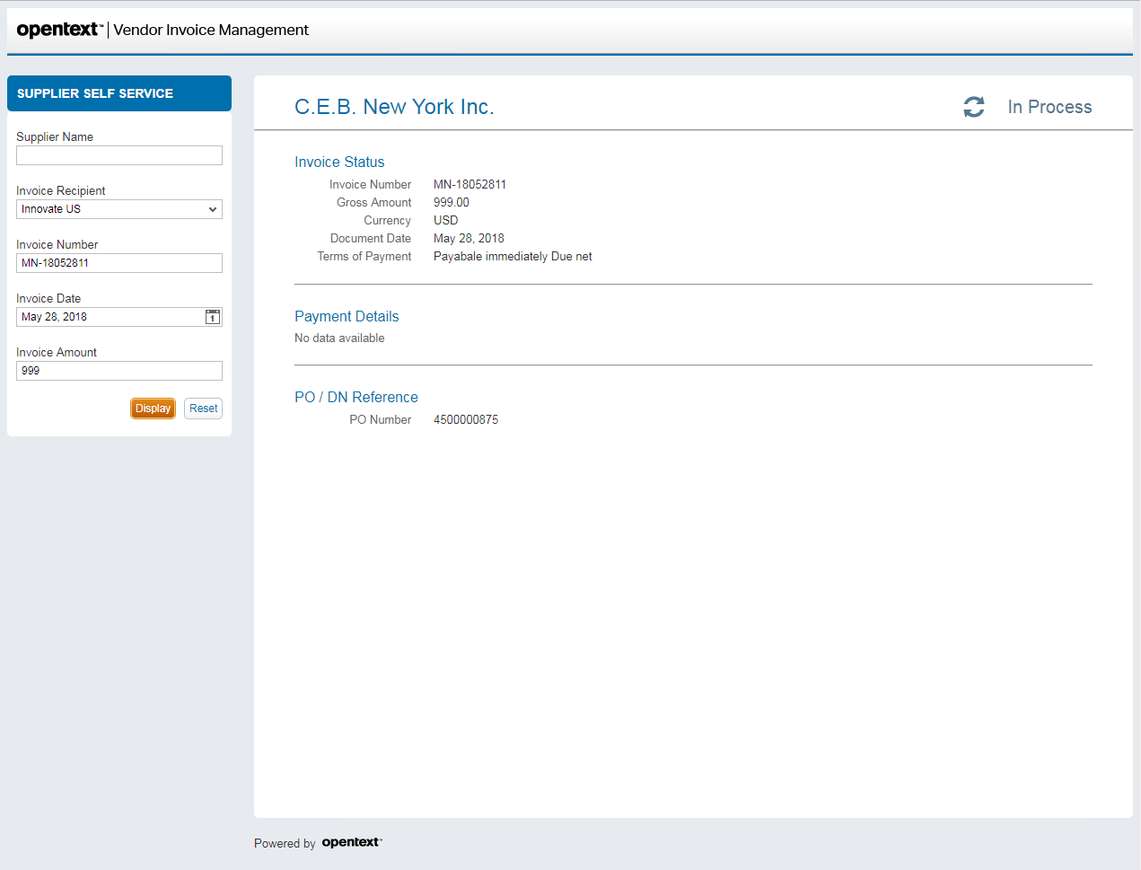
Supplier Self-service:
Keep Suppliers & Internal Staff Informed
Simple and secure user experience
Displays exactly what you intend to share
Eliminates calls and distractions
Improves supplier relationship

Slide 43

Aligned to SAP Source to Pay Roadmap
Leverage The Supplier Network To Achieve Higher Margins

Slide 44


















S/4 HANA Procurement – Reference Architecture
SAP Ariba Sourcing
SAP Ariba
Guided Buying
SAP Analytics Cloud
SAP Ariba Catalog
SAP Ariba Contract Management
§
SAP Ariba Spot Buy
SAP Ariba Supplier Lifecycle & Performance
SAP Cloud
Integration Gateway
Trading Partners
SAP Ariba Supplier Risk Management
SAP S/4HANA
Ariba Network
SAP Master Data
Governance for
Suppliers (optional)
SAP S/4HANA
Enterprise Management
SAP S/4HANA for
extended procurement
Financial Institutions
Dynamic Discounting
Supply Chain Finance
SAP ERP
SAP ERP
SAP S/4HANA
Notes:
[‎3/‎9/‎2018 10:11 AM] Matthias Niessen:
SAP S/4HANA not only serves as the system of record, but also offers transaction and analytics in the same system.
To manage processes in, sometimes called the Digital Edge, and to participate in Value Chains which span companies, the Cloud Integration Gateway, that is part of Cloud Platform helps SAP S/4HANA
participate in a variety of Core to Edge scenarios. Connecting to customers, employees and suppliers.
The way we do this is to connect the Ariba Network, and its 3m suppliers to S4 via the CIG. Along with this comes enablement capability, so new suppliers can be onboarded efficiently.
[More network stuff?]
Note we actually say Trading partners, as later we’ll see that Trading Partners can include people such as subcontractors or logistics providers.
If we look at the operational procurement inside SAP S/4HANA I might be in the middle of an Asset Maintenance Screen, and need to buy a spare part or a piece of tooling and book it to the asset. I want to remain in SAP S/4HANA and just buy it from a nice catalogue, transmit the order digitally to the supplier, and make sure the accounting is correct.
A slightly different use case is for long tail spend, where I don’t even have it in the catalogue and want to go to a spot market and just buy it.
So lets recap where we are. We have Operational procurement being done as part of SAP S/4HANA Enterprise Management: MRP runs throwing off Purchase Orders, maybe even scenarios coming through from Leonardo from sensors which is also producing Orders.
But there is another large use case, and this is for the casual user, who want to buy something now and again. Ease of use is paramount, and the have no idea of the right process. They need guidance, which is why we have an Awesome user interface, which takes care of the front end, but SAP S/4HANA still manages the back-end such as budget checks, Chart of Accounts and the PO itself.
So in addition to the core buying covered by SAP S/4HANA and Guided Buying, we will need other Ariba Cloud Apps as well, lets take a look at those.
So what else does Ariba do? SAP S/4HANA is chock full of things like Outline Agreements and Info records, which define which products are bought from whom? But how are those records created? Well that requires collaboration with suppliers, so it is the kind of thing Ariba does well. The Sourcing Product allows you to collaborate with suppliers to evaluate the best, and creates a PO in SAP S/4HANA.
And when you want to create an Outline Agreement in S4, you can use Ariba Contracts to handle the Contract Negotiation and publish it to SAP S/4HANA for subsequent procurement activity.
For your Analytics needs, you’ll probably be choosing one of the SAP Analytics Cloud products of Business Objects Cloud, Digital Boardroom or Roambi.
But lets look at this Digital core again, why did I draw this box so big? Because most companies have more than one copy of SAP, some have 20, some have 200. For many years these are likely to be a mix of ECC and Sap S/4HANA systems,

Slide 45








Out-of-the-box Connection With Millions Of Suppliers
SAP Business Suite
< cXML/>
Invoice Management
FI
Automated reconciliation and posting
Role-based collaboration
Pay
  Purchase order, invoice and content integration
  Improved supplier collaboration
  Enhanced exception processing and
  discount leverage
SAP Extended ECM / SAP Archiving and Document Access
Receive, manage and access
content in the right context
Notes:
With the on-premise solution you are tightly integrated with SAP Business Suite and S/4HANA and that allows you to manage the end to end solution while leveraging the Ariba Network.
You can work with incoming invoices in many different forms including paper, email, EDI, etc.. SAP Invoice Management resides entirely inside the SAP software environment and works with SAP Business Workflow. The application was developed in the ABAP™ programming language with native SAP technology, including a development workbench, dialog programs, function groups, business objects, workflow definitions, roles, customizing tables, reports, and so on. Invoice metadata is validated to help ensure that it is complete and applicable. After validation, the data is processed according to a series of client-specific configured business rules. After validation and execution of the business rules, an attempt should be made to post the invoice automatically. The application includes 47 configurable rules for validation and process-exception handling. The rules include requirements for processing invoices in selected countries. Metadata can be revised, if required, during validation. If the implementation of a selected business rule fails – for example, if the PO shown on the invoice is not released for posting – then the metadata resolution screen is created and routed for review.
When resolution is accomplished by the proper person, the invoice is posted. If it had been posted and blocked, appropriate action can be taken to change the transactional data, such as the PO or goods receipt. You can cancel the invoice, short pay the invoice, or pay the invoice as is. Comments are noted and a comprehensive record of activities is attached, including pertinent information such as who worked on it, when that work took place, and all of the supporting details. All individuals working on the transaction have a dashboard of information available with the header line item and full detail accessible with one click.

Slide 46


Why a Hybrid Solution for Procure to Pay
    Optimized collaboration with business partners
    Instant insight in one central procurement platform
    Intuitive user experience
    Real-time and on-the-fly analysis
+
SAP Invoice Management
    Simplify routing of invoices and related documents
    Shorter invoice approval time due to real-time information
    Increased productivity and reduced manual processing costs
+
    Fast pre-validation of invoices
    Reduced manual re-entry of documents minimizes errors
    Improved working capital management

Slide 47
Overview: Partner Capability and Success
200+ VIM Implementations
Specialized and global talent pool
Sales Capabilities – Dedicated Sales, Inside Sales, Sales Consultants
  Demand Generation
  Value Positioning and Road Mapping
  Solution Demonstrations
  POCs & RFPs
  Upsell and Cross Sell
Sales Influence and Customer References
  Published Case Studies
  Roundtables – SAPPHIRE, SAP Insider, webinars
Recent sales activity with ISBN
  Huntsman (500K)
  Viatras (Ariba, VIM, Payment Hub)
+
SAP Invoice Management
+

Slide 48





Finance Alignment
SAP S/4HANA RISE
Group Close
Recurring Revenue
& Royalties
Tax & Regulatory
Compliance
Final Close Management
Balance Sheet Substantiation
Receivables, Credit
& Collections
Treasury & Risk Management
Working Capital
Local Close
Payables & Invoice
Management
Universal Journal
Risk, Compliance
& Cybersecurity
Fixed Assets • General Ledger • Material Ledger
Controlling• Profitability Analysis
Invoice Management
Achieve SAP finance excellence like never before
Automate your Financial Close Process
Vertex Enabled Commerce
Modernize payables operations and drive down costs
Clean GR-IR
AI Powered
Best Automation Outcomes
Gain operational insight & guide performance of business teams
Unlock Supply Chain Finance
Reduce manual accrual effort by 80% or more
Streamline month end closing
Flexible Criteria & rule based
Accurate & ready reporting
Compliance Driven
Automated, real time tax calculation
Global Tax Compliance
Simplified returns filing
Master Data Monitoring
Easy maintenance & scale
Cost and Process efficiencies
Value

Slide 49












SAP Invoice Management By OpenText
One Foundation for Multiple Invoicing Channels & Document Types
Capture
Invoice Processing
Process Vendor Invoices
Accounts Payable
EDI
1101
10101
010
Sales Order Processing
Create
Sales
Order
Order
Fulfillment
1101
10101
010
Paper
1101
10101
010
1101
10101
Delivery Notes
Create
Goods
Receipt
Warehouse
Email
1101
10101
010
1101
10101
010
Order Confirmations
Confirm Order
Purchasing
Fax
1101
10101
010
1101
10101
010
Business Process
Complete Process
Step
Enterprise
Notes:
SAP Information Capture provides a single ingestion point for capturing data from nearly any source. Current scenarios supported include:
• Invoices, order confirmations, delivery notes, quotations to help A/P and Procurement streamline invoice management
• Sales order entry – to streamline and accelerate handling of incoming customer orders
SAP Information and SAP Invoice Management enable you to move from manual, document-centric processes to fully automated, simplified intelligent processes. Using leading-edge technology, it captures information from document images, validates it for accuracy and completeness, and transfers relevant metadata to the appropriate SAP application for next steps. Automatic data verification catches discrepancies and errors so you can have confidence in the scenarios that SAP Invoice Management supports.

Slide 50






SAP Information Capture & SAP Invoice Management
SAP Information Capture by OpenText
Capture / extraction solution
for all SAP documents
SAP Invoice Management by OpenText
Processing and workflow engine
Invoices
Machine Learning
Delivery Notes
Order Confirmations
Capture
Identify
Learn
Optimize
Remittance
Sales Orders
Other Documents
Notes:
Most of the corporate processes start, when a document enters an organization. Before anything else happens, the information contained on this document has to be captured (made readable for the computer). This process is also know as Optical Character recognition (OCR). SAP Information Capture is the product, that can help take care of this particular process.
After information from the document is captured by SAP Information Capture, it has to be passed to the leading application for further processing. In our case it is passed to SAP. Inside SAP it has to be processed to achieve a specific business outcome: dispatch goods ordered by a customer, process a quotation and send a response, or reconcile a remittance advice. Usually processing such information is done by hand, manually, and it is a highly labor intensive process, which is slow, error prone and costly. SAP Information Capture helps to fully automate processing of incoming information.

Slide 51
Auritas Differentiators for
Best-in-Class Invoice-to-Pay
Global Procure-to-pay Competence
Solution
Accelerators
Change Management
Orchestration
Supplier
Focus
Methodology
Process & Solution experts
Optimize Touchless
Minimize Cycle Time
Global:
Compliance risk & Controls
Cross industry experience
Analytics:
Terms & Discount Capture
Reporting Definition
Payment Consolidation
Automation:
Process Automation
Global Tax Automation
Approval Automation
Auto Accruals
AP Reporting Package:
Trend analysis
Key Metrics Dashboard
Approval Automation
AMS:
Managed services
Run the business support
Supplier Portal:
Vendor Self Service
Vendor Master Governance
Supply Chain Finance
Vendor Communication
Vendor On-Boarding & Adoption:
Vendor Communication
Vendor Onboarding
Master Data:
Vendor Master Campaign
Vendor Master Diagnostics
Impact Assessment:
People, Policy, System
Training Plan
Training Package:
Desktop Procedures
Job Aids
Training Delivery

