Slide 1
Extended ECM
by OpenText
Improve Productivity and Mitigate Risk

Slide 2





1,500
10,500+
25 Yrs
$1.5B
Successful Projects
TB of Data
Managed
Transforming Companies
Total Customer Savings
Driving Innovation, Empowering Transformations.
Data Management
Solution
Implementation
Product
& Innovations
Strategic
Partnerships
  Data Archiving & ILM
  Retention Management
  HANA Memory Optimization (NSE)
  Data Governance
  Data Migration
  Cloud Migrations
  Data Privacy and Security
  Legacy Decommissioning
  Data Volume Assessment
  Data Quality Assessment
SAP S/4HANA & RISE
SAP BTP Deployment
  SAP Integration Suite
AI Implementation
SAP OpenText
  Extended ECM (xECM)
  Vendor Invoice Management
  Document Presentment
SAP Ariba
SAP Vertex
SAP Vistex
Geospatial Intelligence (GIS)
  Data ASSIST by Auritas
  (Data Archiving Automation)
  Data GUARD by Auritas
  (Legacy Decommissioning)
  Auritas Intelligent Accrual
  (Financial Automation)
  DMS+ by Auritas
  (Enhanced Document Storage)
SAP Gold Partner
SAP PartnerEdge, Sell
CCFlex – Cloud Choice Flex
PartnerEdge®
  (AMS + Hypercare)
CCFlex

Slide 3

Introduction to xECM
Ideal customer profile
Selling xECM
Value Proposition
Competitive Differentiation
Common Objections
Benefits to customer & Case Studies

Slide 4









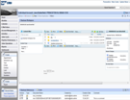







Enterprise Content Assimilation
MS SharePoint
SAP S/4
MS Windows
The Siloed
Enterprise
Process Centric Collaboration
Auritas ECM Solutions
SAP CRM / SRM
E-mail & MS Office
SAP Portal
Mobile Devices
ECM Web
Notes:
4
The principle of Extended ECM for SAP is to give users access to the information in the context of their day-to-day business activity. Tight integration into different systems make business workspaces accessible from SAP, the desktop, Office clients (including Outlook), SharePoint, mobile devices and the OpenText ECM web user interface.
To bring all these together OpenText created ECM suite 16 and above. ECM is considered as Destination for many of us. And it’s a centralized platform when we can put stuff where you may already have worked on, or completed or declare as record . Single truth of Content that can be accessed across the enterprise.

Slide 5
Extended ECM Value
Content
+
=
Context
Value
Documents
Financial documents
Quotations, Contracts
Invoices, etc.
Digital Media
Product Collaterals
How to use videos…
Business Data
CRM (Sales, Marketing, Srv.)
ERP (Logistics, Finance)
Supply Chain (Procurement)
Business Relationships
Related Documents
Related Business Objects
Increased Productivity
Improved Customer Service
Better / Faster Decisions
Compliance
Consistent – Relevant – Personal – Connected
Notes:
SPEAKER NOTES
Extended ECM takes care of the content – the whole lifecycle of the content. And Content comes in many forms: document, email and more and more digital media such as images and videos
But we don’t stop there – content needs context to be relevant, actionable and personal – so it needs to be integrated with the leading business processes and be exposed in the context of the task a user is working on. Access to content anywhere and anytime in commonplace in our personal lives, so its time to transcend traditional boundaries and deliver this in the enterprise as well.
This produces value on a new level – increasing productivity, improve customer service, foster better and faster decisions and last but not least provide a stable framework for compliance.

Slide 6

Ideal customer profile

Slide 7











The Journey Starts Here.
All Transformations Should Start With an Auritas Data Management Assessment (ADMA)
Keep Core
Clean
Process
Excellence
Drive Innovation
Cloud Integration
ABAP / Fiori
Workflow / Business
Rules Management
Process Mining
Process Intelligence
Enterprise Architect Designer
S/4 HANA
Advanced Data Migration
Data Services
LaMa (Landscape
Management)
Conversational AI
Robotic Processing Automation
SAC Predictive
Jan. 2027
ADMA
MDG
Data Services
Information Steward (IS)
IS Accelerator
Information Lifecycle Management
Document Access
Extended Content Management
BW4/HANA – Mixed Mode
HaaS
Cloud Datawarehouse
HANA Cloud Services
Enterprise Information Management
Information Lifecycle Management
LaMa (Landscape Management)
Active/Active Read Enabled
Today
Data Quality & Stewardship
Data & Content
Management
Modern Data
Platform
Landscape
Management
Ongoing
Post S4 Go live
ADMA
Auritas Data
Management Assessment
Notes:
Deepak

Slide 8
The S/4HANA Journey
with RISE – Customer Objectives
Prepare
Move
Run
Validate Readiness
RISE Readiness report
Maintenance Planner
Analyze Business Processes
Discovery reports
SAP Business Process Intelligence
Assess Data Quality
SAP Data Services
SAP Information Steward
SAP Master Data Governance
Industry-specific MDG solutions by Utopia
Optimize Data Footprint
Data ASSIST by Auritas
SAP Information Lifecycle Management
SAP Archiving & Document Access Core by OpenText
Get to Standard
BTP Custom Code
Analyzer
BTP Extension Suite
Establish Quality
Assurance Strategy
*SAP Application Testing Solutions by Tricentis
Simplify, Size Landscapes
S/4HANA
BTP Integration Suite
BTP Extension Suite
PCE options for BTP
Migrate
S/4HANA Migration Cockpit
SAP Data Services
SAP Information Steward
SAP Advanced Data Migration by Syniti
Modernize Integrations
BTP Integration Suite
SAP Process Orchestration
BTP Application Integration Framework
SAP Data Intelligence
Define Information Management Strategy
SAP Extended ECM by OpenText
Execute Quality
Assurance Strategy
Solution Manger
SAP Application Lifecycle Management Cloud
*SAP Application Testing Solutions by Tricentis
Automate Processes
BTP Extension Suite
BTP iRPA
BTP Conversational AI
SAP Information Capture Core and SAP Invoice Management by OpenText
Data & Analytics Strategy
S/4HANA embedded analytics
SAP Analytics Cloud
Data Warehouse Cloud
BW/4HANA
HANA Cloud
System Landscape Transformation
Data Intelligence
Monitor
Solution Manger
SAP Application Lifecycle Management Cloud
Optimize IT Processes
SAP Landscape Management
SAP Information Lifecycle Management
Solution Manager
Sustain Quality
*SAP Application Testing Solutions by Tricentis
Streamline Business Processes
BTP Extension Suite
SAP Business Process Intelligence
SAP Extended ECM by OpenText
SAP Document Presentment by OpenText
Innovate
BTP Extension Suite
BTP Conversational AI
BTP iRPA
SAP Data Intelligence
BTP Work Zone
Auritas areas of expertise

Slide 9
xECM Customer Profile
Companies looking for efficiency by reducing time on document handling, retrieval, & approval
Companies with global footprint requiring seamless content mgmt & collaboration across geographies
Companies with multiple content management platforms like Documentum, FileNet, Easy Software etc.
Organizations facing challenges in meeting regulatory compliance
Businesses struggling with silos and need to integrate content with SAP
Looking for Seamless integration with SAP and other enterprise systems for unified IT landscape.
Reducing costs in storage, retrieval, & management through automation & better resource utilization.

Slide 10






Building ECM Solutions on the SAP Business Model
Vendor
(LFA1)
EQUI
Procurement
Asset Management
Plant Maintenance
Goods Receipt
(MKPF)
MATERIAL WORK
SPACE
Material/
Product
(BUS1001)
Delivery
(LKIP)
PRODUCT
WORK
SPACE
Project
(BUS2172)
Sales
Customer
(KNA1)
Notes:
Another excellent example for business relationships resides inside plant maintenance. In plant maintenance we have the technical objects ‚Functional Locations‘ and ‚Equipment‘. A plant is modeled in SAP PM in a hierarchical way by using these technical objects.
Obviously, each functional location and each equipment has its own business workspace. The hierarchy, however, is a relationship that is used very often for understanding the setup of the plant and in the Extended ECM UI or in MS Outlook for navigation to the equipment and functional locations of interest.
Looking at scheduled and unscheduled maintenance the related business objects maintenance notification and maintenance order get of interest. Especially in the case of failure analysis in the sense of root cause analysis many collaboration happens between different users, e.g. a control panel operator, a plant operator, a technician and a reliability engineer. In this situation a collaborative workspace connected to a maintenance order issued for the failure analysis is a tremendous support for the failure analysis business process.

Slide 11
Best Practice Extended ECM Use Cases
Engineering Document Management
Plant Maintenance / EAM
Customer Case Management
Supplier Information Management
Customer Information Management with CRM
Internal and External
Collaboration in R&D
Purchase Contracts Management
Transportation & Logistics
Product Information Management
Installed Equipment History and Maintenance
Project and Portfolio Management
RFX Management
Quality Control & Quality Management Records
Service Project Management
Quotation and Bid Management
Research Records and Regulatory Submissions
Business Development
R&D
Supply Chain
Operations
Sales & Marketing
Customer Service
Human Resources
Finance
Legal
IT
Employee File Management
Legal Services & Contracts Management
Internal Investment Monitoring
Corporate Data and Content Archiving Service
HR Project Documentation
e-Discovery & Litigation Services
Secure Data Room for Mergers & Acquisitions
Legacy Decommissioning
…
Corporate Legal Records Management
Periodic Report
IT Project Documentation & System Validation
Notes:
When we look at the typical value chain of an organization we find processes with ECM demands all over the place.
Whether it is planning, production development where you may have 3rd party collaboration, project document management in Engineering and Construction, Research and Development and so on.
When we look at procurement with all the vendor collaboration, vendor documentation, documentation inside the procurement processes, the contract management inside the supply chain and so on.
Also in the production and operation area is a very interesting part of the business, typically it is at the heart of the value generating processes where you have the production capabilities, where you have maintenance, asset management, where we can nicely show how to apply document management, records management to support the processes around the operation and maintenance of assets.
In sales and marketing are a lot of unstructured content as well: think about the complete bid to cash documentation, collaterals, marketing research and so on. There we can nicely show how we can integrate into the SAP driven Customer Relationship Management.
And last but not least on the customer service–multi-channel customer service and interaction produces a lot of records that needs to be stored and properly preserved.
wherein Services you have also case management-like applications around incident, claims, fraud protection, huge service requests and things like that where Extended ECM can play an important role.
But also the line of business processes: In Human Resource you have policy management and knowledge management, and case management.
In Finance where you have strategic contract management, dispute management and so on.
In IT people may be interested in the consolidation between ECM and ERP itself. They may be interested to hear that we can help with Legacy Decommissioning, so getting rid of old file servers, archives and document management systems.
In addition to that Extended ECM includes data archiving and content archiving; content archiving can be applied to SAP documents and also for non-SAP documents.
And last but not least really important message here: we can leverage the SAP standards: So if the organization has already built its IT infrastructure on top of SAP, Extended ECM is really a perfect fit here.
The legal department, may be interested in topics like eDiscovery, contract management, global retention policies, automated compliance just to name a few.
The important thing when we look at the value chain is really that you ask for the processes. If you want to explain what value Extended ECM can bring to an organization you have to relate it to the business processes
Ask: “What are the processes? What have you already standardized in SAP?” to find out where Extended ECM delivers the most value.

Slide 12

Example types of unstructured content
    Work orders
    Contracts
    Order/shipment documents
    Failure report
    Incident report
    Inspection notes
    Technical documentation
Assets and
Internet of Things
    Incoming delivery notes
    Order confirmation
    Supplier statements
    PR and PO monitor
    Approval change of
    master data
    Service entry sheet
Supplier Collaboration
Business Networks
SAP®
S/4HANA
Workforce
Engagement
Customer Experience
Omnichannel
    Mailroom for HR forms
    (combined with EFM)
      Sick notes
      I-9
      Certificates
      Driver Licenses
    Incoming sales order
    Incoming customer
    statements
    Contracts
Notes:
Most data is generated by processes that start outside of the enterprise – often manually in forms. Here are some examples of incoming data via mail, telephone, e-mail, fax, or electronic data interchange and in various formats for each of the digital pillars. For instance:
Supplier Collaboration:
Incoming delivery notes
Order confirmation
Supplier statements
PR and PO monitor
Approval change of
master data
Service entry sheet
Customer Experience:
Incoming sales order
Incoming customer
statements
Contracts
Workforce Engagement
Sick notes
I-9
Certificates
Driver License
Asset Management
Work orders
Contracts
Order/shipment documents
Failure report
Incident report
Inspection notes
Technical documentation

Slide 13

Selling xECM

Slide 14






Key challenges facing business executives
CIO
Supporting
multiple systems
is overwhelming
my staff.
CFO
Achieve full transparency and close out key
financial reports.
COO
Improve reliability
and accuracy of document-intensive business processes.
CCO
Respond quickly
to changes in
market and
regulatory demands.
CMO
Manage brand and communicate in a consistent and differentiated way.
Sales & Services
Content is key to fully understanding each customer’s situation and our opportunity.
Notes:
We know from talking to our customers that most executives whether Chief Marketing Officer, Chief Operating Officer, Chief Financial Officer, or Chief Compliance Officer are inone way or another engaged in managing information and leveraging it to some degree to meet their KPIs,
For instance, CMO is very interestred in managing and increasing their brand value and one of the ways that accomplish that is by managing their digital assets in a consistent way. Keep their message differentiated is also critical in winning more business so it‘s important for them to utilize targeted and personlized messages.
For a CIO – costs of manging a complex IT infrastructure and the staff supporting these systems could be in the way of leveraging the latest technologies to support a changing business environment.
For COO – cost of operations is critical and making sure business processes are optimized with all relevant information available to employees in the most efficient fashion.
CFOs are always interested in producing timely and accurate financial statements. Liabilties report are just one example where having an up-to-date accounts payable data is very important.
Finally,most orgaizations now have a Chief Compliance Officer to make sure that all internal and external complinace requirements and policies are met. Having desparate systems and incomplete information may result in millions of dollars.

Slide 15





Key Value to Roles by Integrating ECM and ERP
CIO
Leverage the investment done for standardizing processes around SAP and extended it to ECM
ECM User
SAP User
IT Manager
Compliance
Manager
Increase Process Efficiency
Extend Functionality
Reduce Cost
Mitigate Risk
Web-based access to SAP content
All relevant information in one view
Quick Search
MS Office integration
Offline access to content
Rich ECM capabilities within SAP
Access to non-SAP content
Leverage existing SAP structures and data
Collaboration with non-SAP and external users
One Platform Strategy
Reduction of training and administration costs
Consolidation of IT systems and reduction of interfaces
Reduction of storage costs
Enterprise-wide Records Management for SAP and non-SAP content
Single set of retention policies to management content lifecycle
Reduced corporate exposure to litigation and regulations
Notes:
15

Slide 16
Value Proposition

Slide 17
Why OpenText Extended ECM for SAP Solutions?
Increase Efficiency
Reduce TCO
Reduce Risk
OpenText™ Extended ECM for SAP® Solutions extends SAP business applications with comprehensive ECM capabilities, including document management, records management and collaboration
Increase process efficiency by making unstructured content easily accessible within the context of SAP business processes
Low implementation risk, lower upgrade efforts and TCO
Due to its seamless integration in each users preferred application & UI, xECM secures high user adoption, avoiding significant training costs
Free Solution Accelerators including corresponding configurations for SAP and OpenText reduce implementation cost and risk
Achieve an unprecedented level of consistency and control by leveraging SAP data, structures and authorizations for organizing and categorizing unstructured content
Minimize the risk associated with unstructured content by controlling its complete lifecycle
Only ECM solution in the market premium-qualified, supported, maintained, and sold by SAP itself

Slide 18
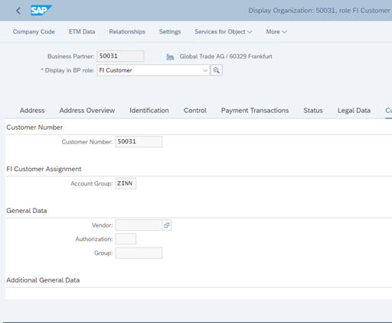

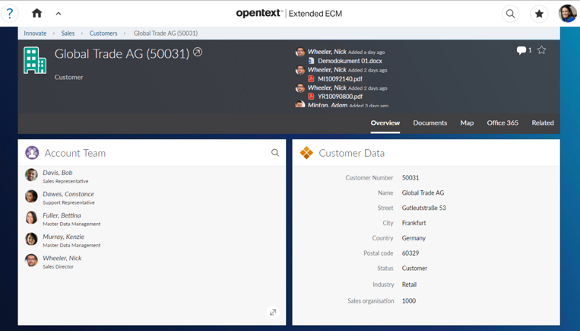
Seamless User Experience from Content to Business Application

Slide 19
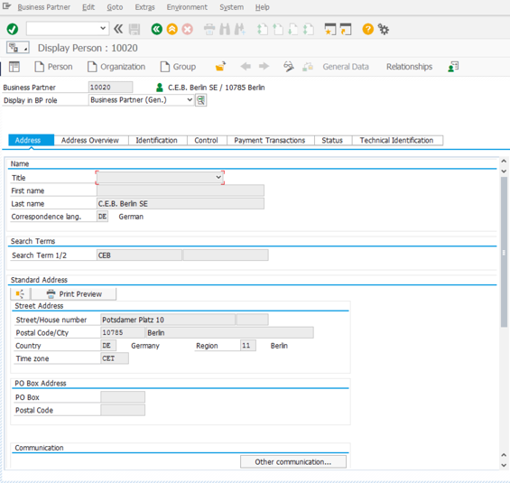
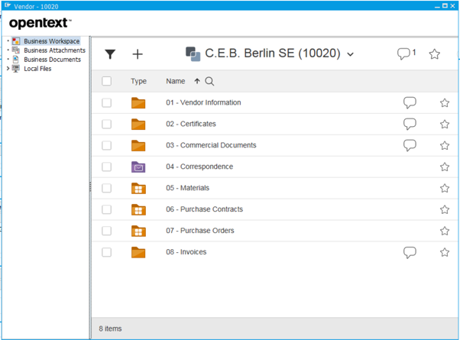

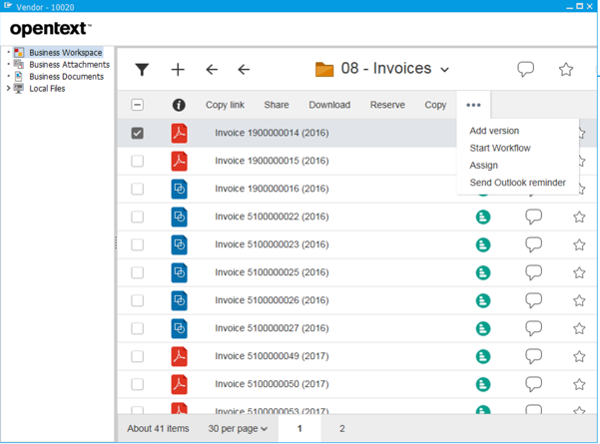
OpenText Extended ECM Workspaces – SAP User Experience
Doc Mgmt activities directly available in the SAP UI
Records Mgmt Information, available in the SAP UI
Collaboration features, available in the SAP UI

Slide 20
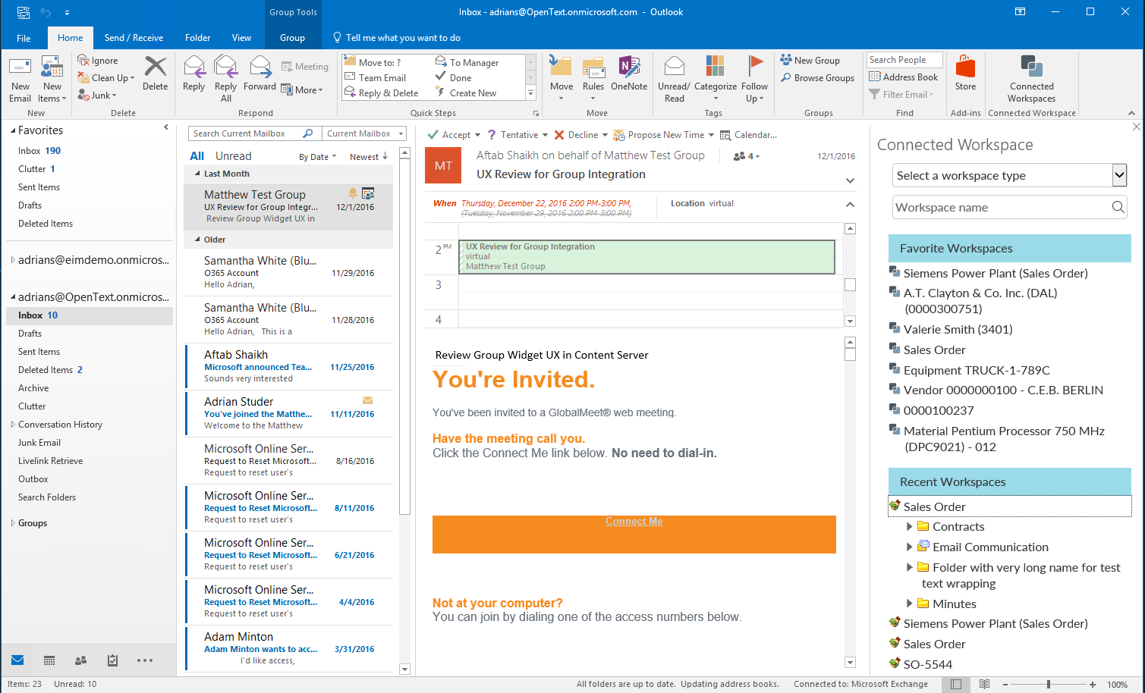

OpenText Extended ECM
Outlook / Office 365 Integration – Side Panel
Easily store emails into Business Workspaces

Slide 21
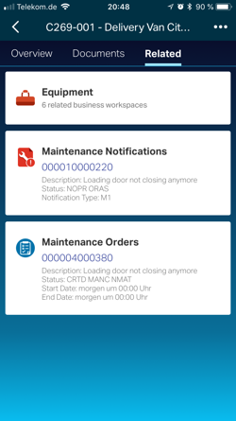
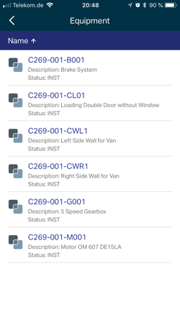
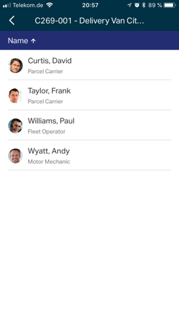

EP5NEW
OpenText Extended ECM
Empower the Mobile Workforce*
Extended ECM goes mobile: Workspace on mobile devices
Gain insight in business process related content at any place
Browse through workspace network
*feature licensed as OpenText ECM Anywhere
Notes:
Theme: Modernization & usability
Audience: Mobile workforce
The challenge to be solved: Bring workspace to mobile world
What we’ve done to solve it:
What’s New in EP5: CS mobile app supports now the workspace concept and introduce a scanning functionality
Value to the customer:
Add info on any pricing/naming proposals whether not started, in progress or approved:
Important to (install base/the market as a whole):

Slide 22


OpenText Extended ECM
Accelerate Extended ECM Rollouts with SAP S/4HANA Customer Vendor Integration
The accelerator provides integration into the new SAP S/4HANA Business Partner master data structuring
It generates the Customer, Vendor and Business Partner related Workspaces
It provides users with a 360° view on documents of a Business Partner, whether in it’s Customer or Vendor role
It allows a quick setup through transport package
Vendor
Vendor
UPGRADE
Business Partner
Customer
Customer

Slide 23
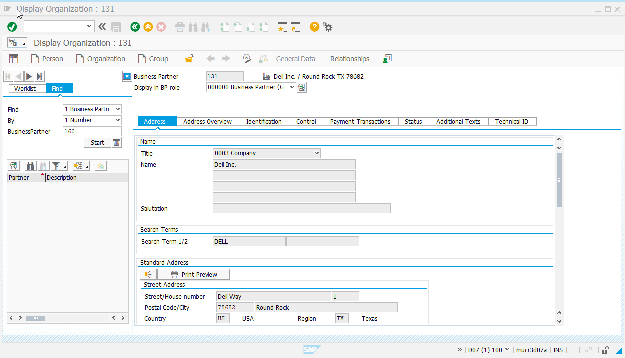
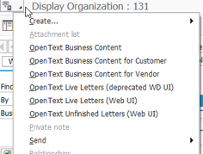
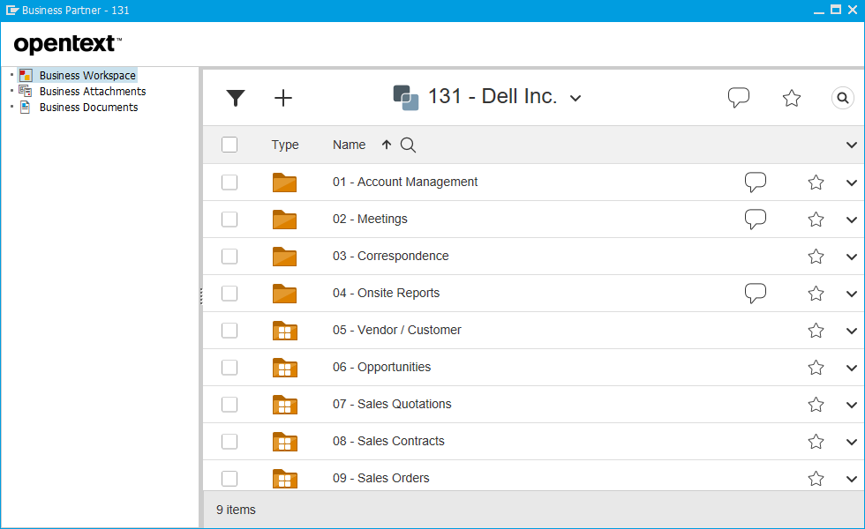

OpenText Extended ECM
Accelerate Extended ECM Rollouts with SAP S/4HANA Customer Vendor Integration
Access documentation of vendors and customers in S/4HANA On-premise
EP5NEW

Slide 24
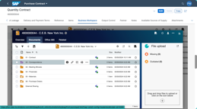
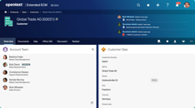
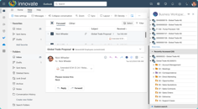
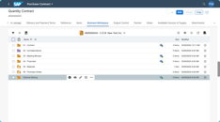
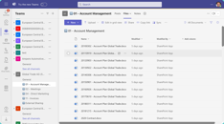
Integrated ECM and application system(s)
ECM System | SAP S/4HANA
Data Referencing
Data Synchronization
User and Access Control
Synchronization (SSO)
Extended ECM Web UI
Microsoft Outlook
Transaction (FIORI)
Microsoft Teams

Slide 25
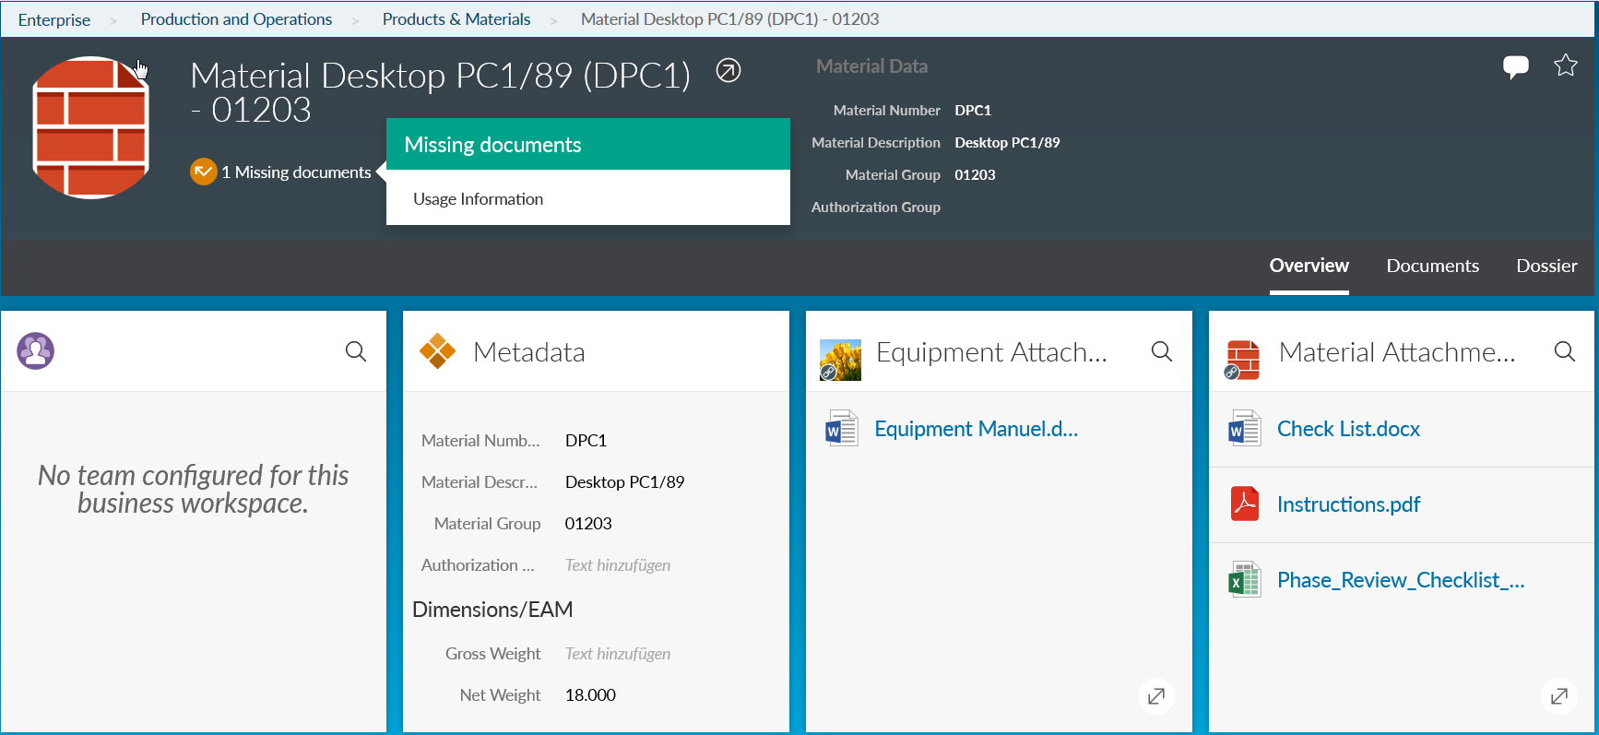
OpenText Extended ECM
Document Completeness Check
Completeness Check: Message in Workspace Header
Business Attachments

Slide 26

Competitive Differentiation

Slide 27
Competitive Differentiation
Unified User Experience across platforms
Seamless SAP Integration
Innovative Features
Advanced Workflow Automation
Superior Customer Support and Services

Slide 28
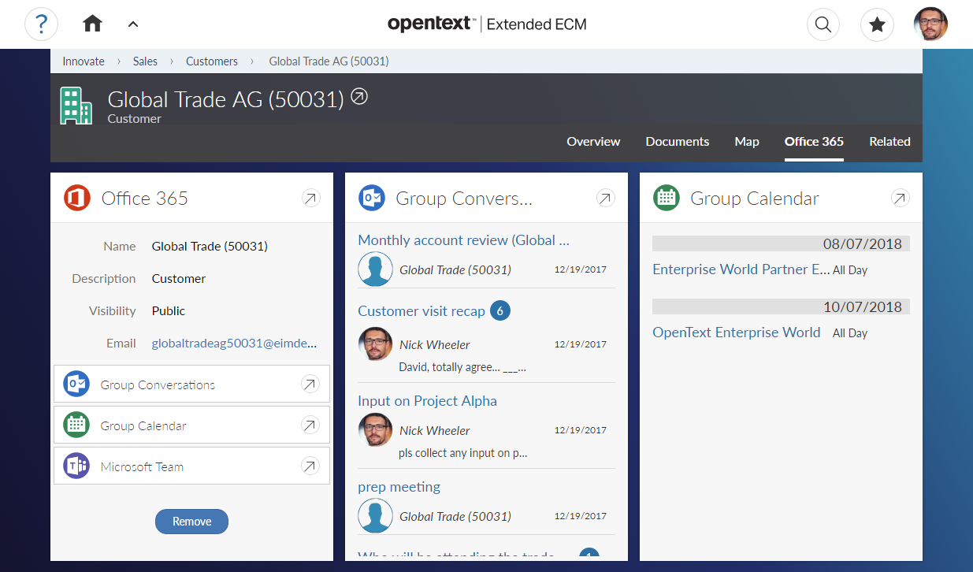
Seamless Integration with Microsoft Teams
Open Microsoft Team connected to Workspace
Notes:
This is the view of a businesses workspace in the user interface of SAP Extended ECM. From the workspace, users can with one click reach the artefacts in Office 365 that are linked to this workspace, in this case the customer Global Trade AG. By clicking on the Microsoft Team link, users can jump to the Microsoft Team web site or app.
On this screen, you can also see links and embedded content for Office 365 group conversations and a Office 365 group calendar linked to the customer.

Slide 29

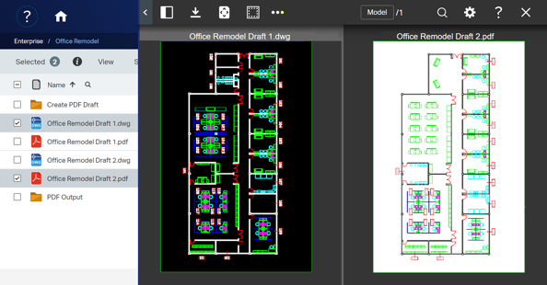
Intelligent Viewing
What’s included?
Secure content with banners and watermarks
Protect sensitive content such as PII or trade secrets with redaction capabilities
Convert documents to PDF and extract valuable text from images using Optical Character Recognition
View multiple documents in a single viewing session with Multi-File Viewing
View a variety of technical drawings
Quickly identify differences in text or images with compare
Notes:
[X1] (Basic) Complimentary Features
Documents: PDF, XLSX, XLSM, PPT, PPTX, PPTM, DOC, DOCX, DOCM, MSG
Images: JPG, JP2, PCX, PNG, TIF, TIFF, BMP, GIF, PS/EPS
In-Place Viewing
Basic Annotation
Download and Print
Annotation Access Roles
Annotation
Threaded Comments
Download and Print
Search
In-Place Viewing
Zoom In / Zoom Out / Zoom Region
Annotation Access Roles
Fit Extents / Fit Width
Page Select
Rotate
Pan Mode
Color Mode Select
Side Panel - Thumbnail Navigation
Side Panel - Bookmark Navigation
Side Panel - Search Result Navigation
Accessible User Interface
[X2/X3] (Premium) Premium Features X1 plus the below...
2D CAD: DGN, DWF, DWG
Redaction
Publishing
Multi-File Viewing
Graphical and Text Compare
Transformations
Publish PDF/TIFF
Redaction / Redaction Reasons
Multi-File Viewing
Graphical and Text Compare
Transformations
Stamps
Dynamic Token Replacement
Publish PDF/TIFF
Redaction / Redaction Reasons
Multi-File Viewing
Graphical and Text Compare
Stamps
Dynamic Token Replacement
Transformations

Slide 30
SAP Extended Enterprise Content Management
provides process-centric collaboration and compliance
  Line of Business Integration
  (retention policies, legal hold, audit trail, physical records mgmt)
Compliance
  Document Management
  (check in/out, version control, access controls, approvals, audit)
  Intelligent Viewing
  Flexible, scalable, and collaborative document viewing
  Records Management
  (retention policies, legal hold, audit trail, physical records mgmt)
  Office365 integration
  (integration with MS Teams spaces and Office applications)
  Capture
  (scanning, batch/single, fax, e-mail, bulk import)
  Collaboration
  (team sharing, threaded discussion, wiki, blog, workspace)
  Archive
  (storage of content and data, security, compression, access rights, hardware, management)
  Content-centric Workflow
  (review workflows, authorization, commentary)
  Document Generation
  (output management, ad-hoc document creation and automation)
  Content Access
  (access rights, publication,
  presentation, controlled external access for suppliers and partners)
Notes:
That’s where our integrated content management solution can help.
What’s unique about our solution is that both collaboration and compliance are achieved within the same solution. You don’t need separate collaboration, content management and record management systems operating in disparate environments to manage your information. It is all integrated within SAP S/4HANA.
Our approach is defined by the notion that our customers should have access to the information in the context of the business activity. So how do we accomplish this?
SAP Extended ECM provides process centric collaboration and compliance by tightly integrating unstructured content emails, documents (Word, PDF, PPT etc.) and video and audio files and so on with the transactional SAP S/4HANA business objects and data. By doing so internal and external stakeholders can join collaborative workspace where they can easily share and develop content, invite new team members, and place critical content under records management. The workspace, and all project content is accessible via SAP, desktop and web UIs making it very easy for the end user. Participants can use features such as personalized project pages, discussion forums, approval workflows, follow-ups, notifications, and polls to carry out required activities.
Through the lifecycle, all information is perpetually linked to the appropriate SAP references improving traceability of information and compliance.

Slide 31

Benefits to Customer & Case Studies

Slide 32
Business Value of SAP ECM Solutions by OpenText
Key Results
288%
$1.5M
10
3-year ROI
reduced invoice-related costs
months to payback on investment
Customer Quote:
“
Single pane of glass across the enterprise is the biggest benefit. We have the ability to see content now whereas the older way we had to search. We can now look at transactional records, so compliance is handled on the schedule.
”
Source: the IDC White Paper, “The Business Value of SAP Enterprise Content Management Solutions by OpenText in the Digital-First World,” commissioned by SAP and OpenText, Doc. #US48617021, January 2022.
Notes:
SAP ECM Solutions by OpenText Is Helping Organizations Digitize Their Operations
SAP customers are realizing significant value by leveraging SAP Enterprise Content Management Solutions by OpenText to optimize their document and vendor invoice management related operations. This is worth annual benefits of $6.33 million per organization ($1.33 million per 1 million documents) and would result in a three-year return on investment (ROI) of 288%.
Read the full report (gated): https://www.sap.com/documents/2022/01/629d79f0-127e-0010-bca6-c68f7e60039b.html

Slide 33
SAP Extended ECM by OpenText
Deployment options – Cloud
SAP xECM by OpenText, cloud edition
OpenText cloud
Microsoft Office 365 Cloud
SAP xECM by OpenText
Microsoft Office 365 integration module
Microsoft Teams Integration
Office 365 File Upload
Office Online Editing
Outlook Add-in
SharePoint Online Add-in
SharePoint Online Archiving
Office 365 Groups Integration
OneDrive for Business Archiving
Teams
Skype for Business
SharePoint
OneDrive
Outlook
Integration
Extended ECM for
Office 365 module
Blue arrows
show xECM, add-on for O365 functionality
Notes:
In this scenario, the customer has xECM, cloud edition. There are no integration components needed from the download center, as xECM, cloud edition and the add-on for O365 are both hosted in the OpenText cloud.

Slide 34

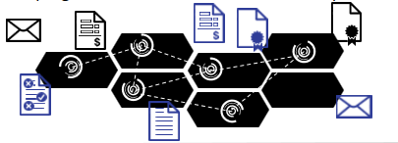
Put ECM in Business Context
Enterprise Content Management
Deep Integration with Business Application
Business Processes specific ECM
SAP
Business Suite
+
=
ECM Landscape
Save, Search, View
Edit, Share, Collaborate
Templates & Permissions
Outlook, Offline, Mobile
Scan, OCR, Workflow
Archiving & Records Mgmt
Annotate, Redline, Social
…
Workspaces natively extend SAP processes with ECM
Deep integration with SAP data, roles, permissions and logic
Seamless integration with various SAP UIs
SAP & ECM always “in-sync”
ECM for CRM
ECM for Procurement
ECM for Plant Maintenance
ECM for Quality Management
ECM for PLM and PDM
ECM for Transport & Logistics
ECM for Project Management
ECM for …
Notes:
What Extended ECM provides to a customer is first and foremost a complete Enterprise Content Management platform. The core components of the OpenText suite are part of Extended ECM. The product comes with Document Management, Collaboration, Social Media, capturing, imaging, and workflow.
It has a component that we call Content Access and that provides access to content inside Extended ECM from all the major user interfaces whether it is SAP or non SAP.
In the backend it comes with a complete DoD-certified Records Management and Archiving.
So technically spoken it is OpenText Content Server, Archive Server, Enterprise Library, Content Lifecycle Management that is all part of Extended ECM.
What is very special about Extended ECM is the way how it integrates in SAP. The main idea here is: we provide the content to the process in form of so called workspaces.
Workspaces are the key concept to explain the value of Extended ECM. A workspace natively extends SAP processes with ECM content and ECM capabilities.
And it really integrates nicely and deeply into the SAP landscape: it can reuse everything that is already standardized in SAP. That could be SAP data, structures, roles and permissions.
Where customers have really already invested a lot of effort to make it right inside SAP we don’t need to do it again for ECM - we simply reuse what is already there.
The 2nd important aspect is that of the User Interface integration.
Extended ECM integrates into all major SAP user interfaces. We will talk about this in a minute.
So bottom line: SAP and ECM worlds are always in sync with Extended ECM.
And the outcome of that equation is that we no longer talk about pure ECM.
We can really now articulate value on a completely different level.
We can really talk about business information management where we have a complete management of a process and ECM is basically part of that complete process management.
And it can be applied to all the processes that are running on SAP – but also you can apply it to processes outside SAP because it is still an Enterprise Content Management system, right?
But the SAP context makes it much easier to articulate the value.
Some examples are project management, enterprise asset management, product lifecycle management, procurement, quality management and so on.
Many customers have standardized these processes in SAP and we can make Enterprise Content Management part of that with Extended ECM.
The key benefit is really about process efficiency - that we connect content to processes to make life easier for both - the transactional and the information worker.
And we improve regulatory compliance by managing the content throughout its lifecycle independent if the content comes from SAP or from outside SAP.

Slide 35
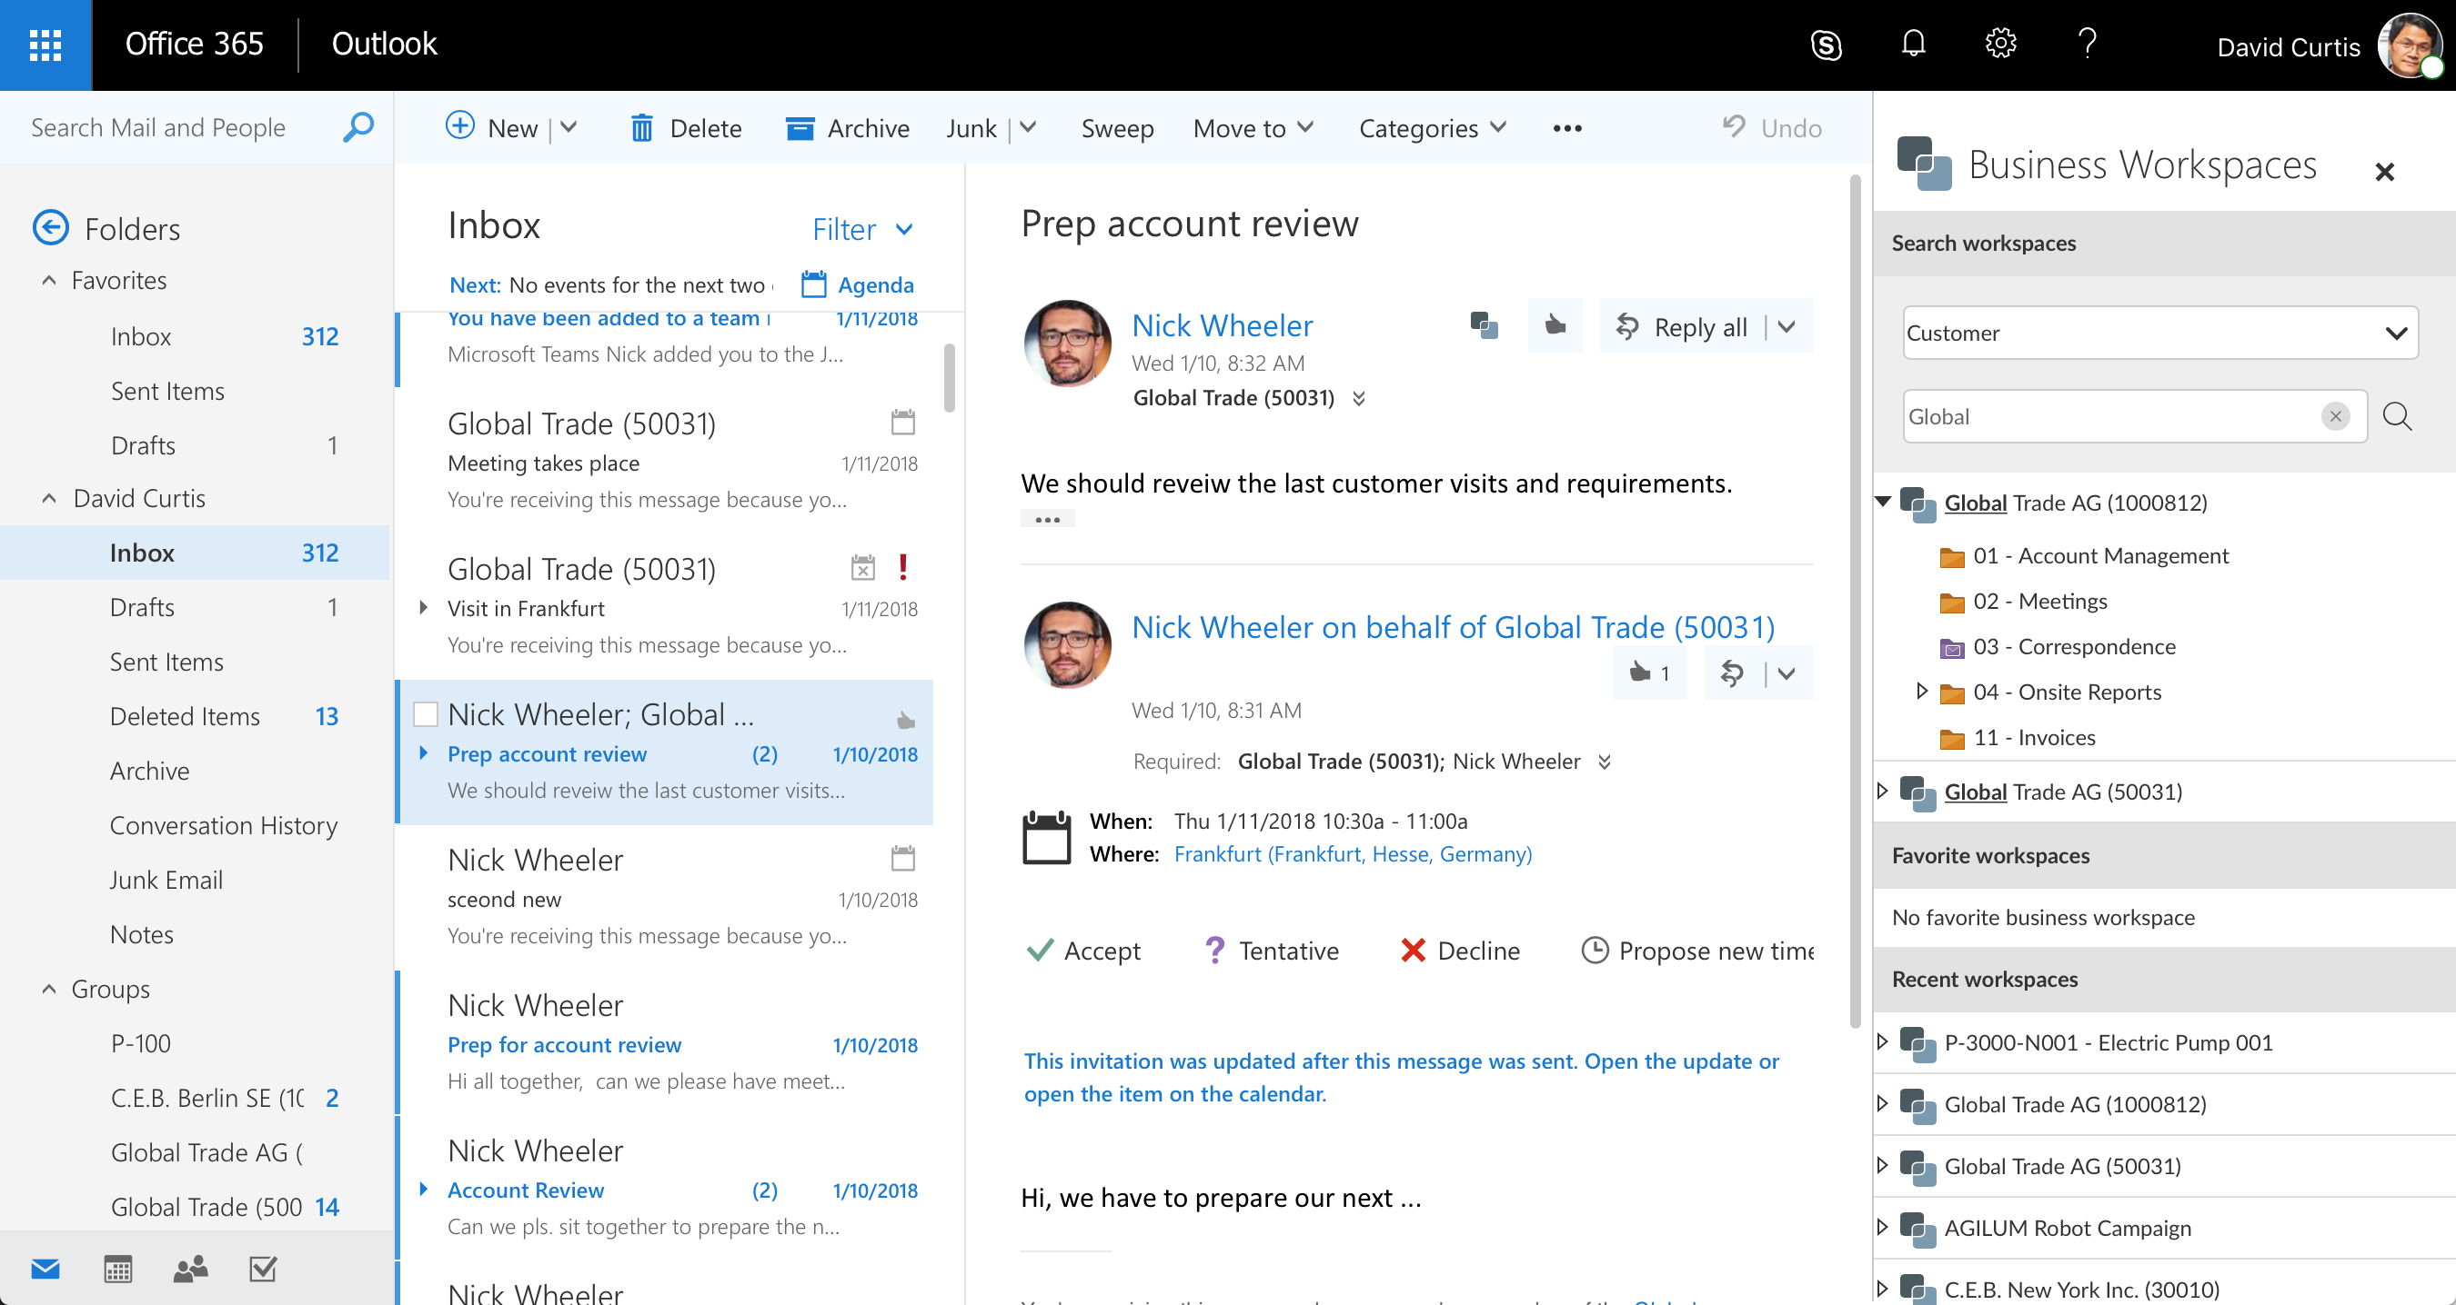
Office 365 Outlook: Access to Customer Workspaces
Quickly find a business workspace from within Outlook
Store emails in
Business Workspaces
easily and efficiently
Open business workspace
Notes:
SAP Extended Enterprise Content Management by OpenText, add-on for Microsoft Office 365 integrates with Microsoft Outlook. The integration gives users quick access to SAP Extended ECM business workspaces, and allows them to store emails into a business workspace directly from within Outlook.
This integration doesn’t require any local installation on the user’s PC and is supported with Outlook on Windows desktops, Outlook for Mac, and Outlook Online running a browser.

Slide 36

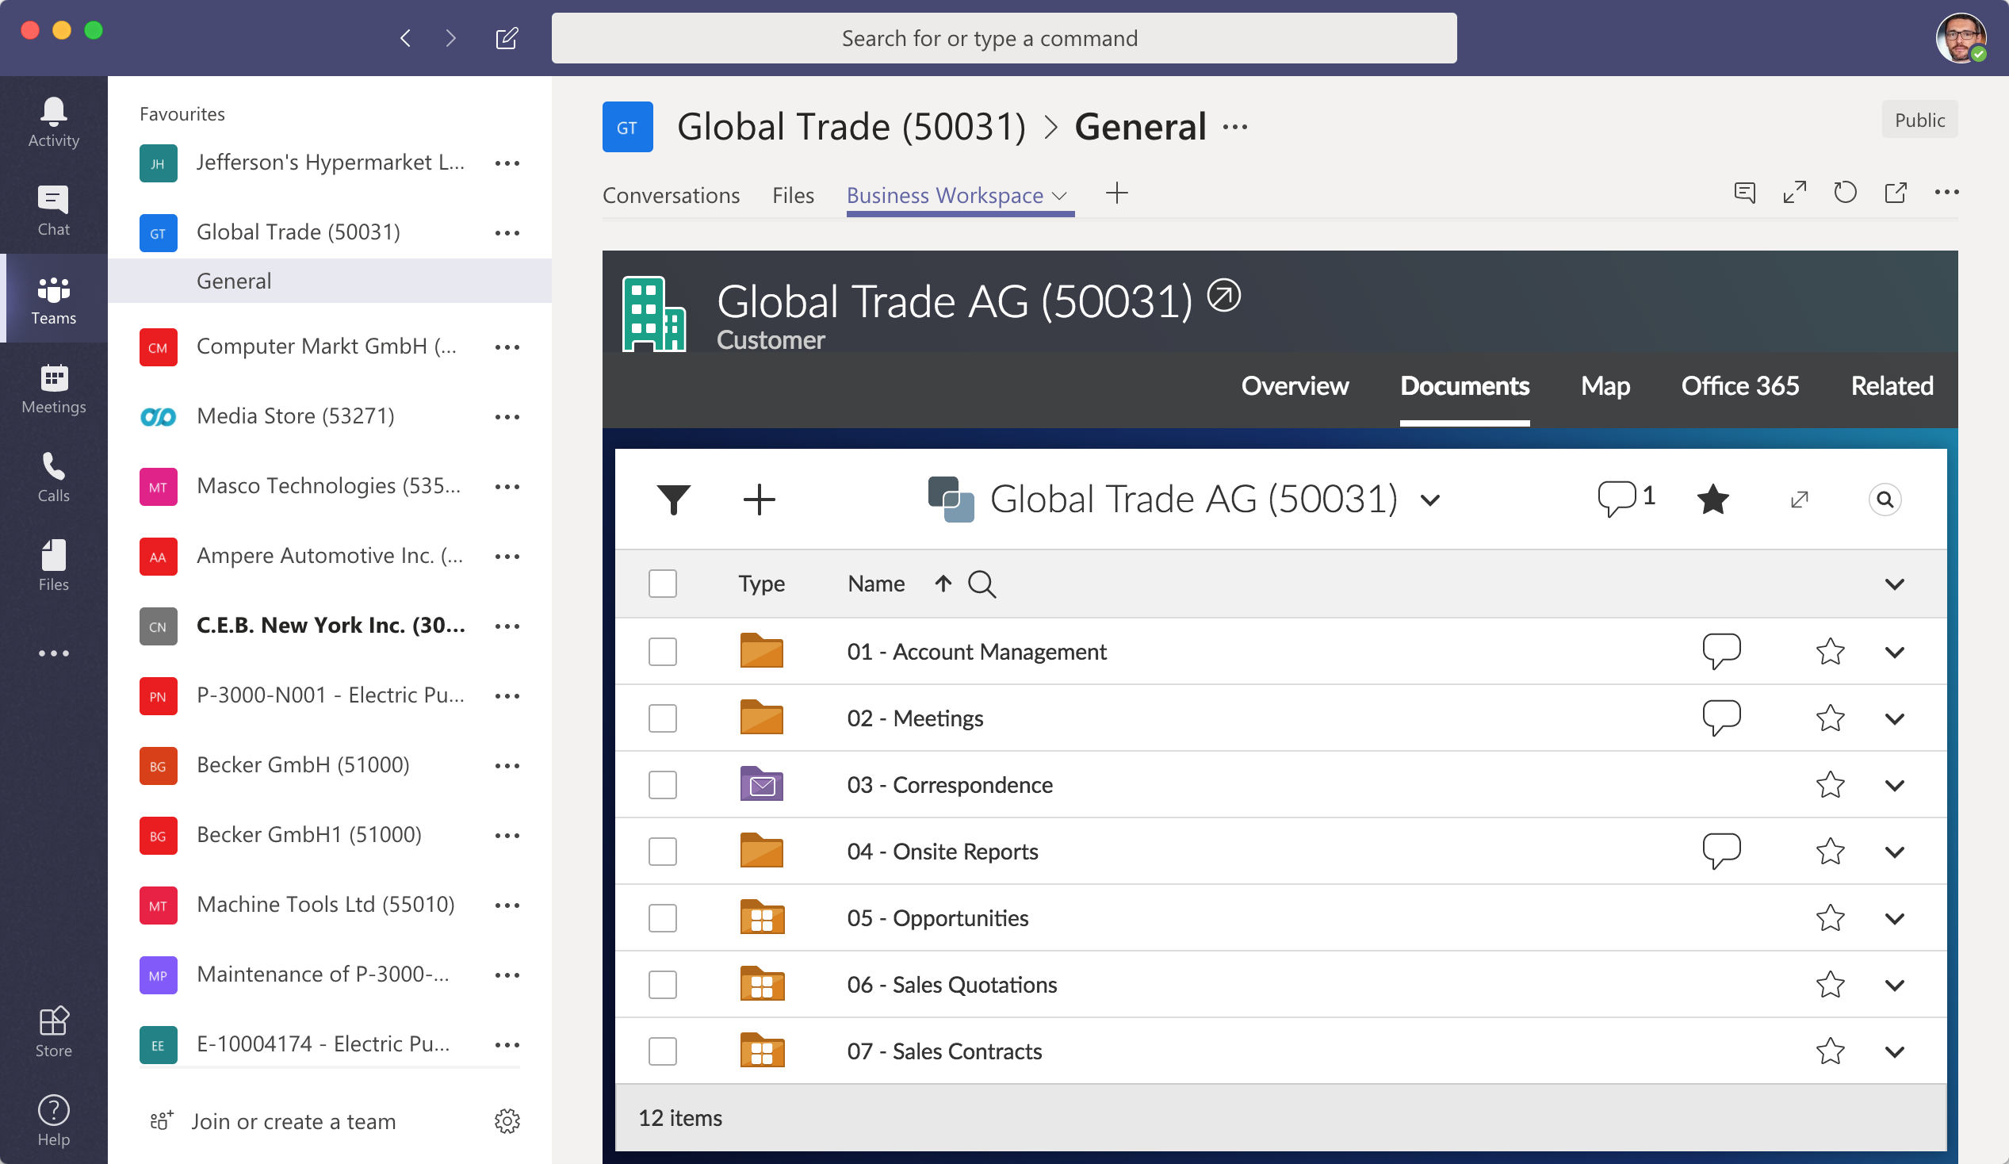
Integration with Microsoft 365
Seamless collaboration with integration of Microsoft Teams
What’s included?
Introduce structured content management to Teams
Extended ECM synchronizes content and members with Microsoft Teams
Create and retire teams in lock-step with business workspaces
Enterprise security and governance
Notes:
[X1] (Basic) Complimentary Features
Documents: PDF, XLSX, XLSM, PPT, PPTX, PPTM, DOC, DOCX, DOCM, MSG
Images: JPG, JP2, PCX, PNG, TIF, TIFF, BMP, GIF, PS/EPS
In-Place Viewing
Basic Annotation
Download and Print
Annotation Access Roles
Annotation
Threaded Comments
Download and Print
Search
In-Place Viewing
Zoom In / Zoom Out / Zoom Region
Annotation Access Roles
Fit Extents / Fit Width
Page Select
Rotate
Pan Mode
Color Mode Select
Side Panel - Thumbnail Navigation
Side Panel - Bookmark Navigation
Side Panel - Search Result Navigation
Accessible User Interface
[X2/X3] (Premium) Premium Features X1 plus the below...
2D CAD: DGN, DWF, DWG
Redaction
Publishing
Multi-File Viewing
Graphical and Text Compare
Transformations
Publish PDF/TIFF
Redaction / Redaction Reasons
Multi-File Viewing
Graphical and Text Compare
Transformations
Stamps
Dynamic Token Replacement
Publish PDF/TIFF
Redaction / Redaction Reasons
Multi-File Viewing
Graphical and Text Compare
Stamps
Dynamic Token Replacement
Transformations

Slide 37
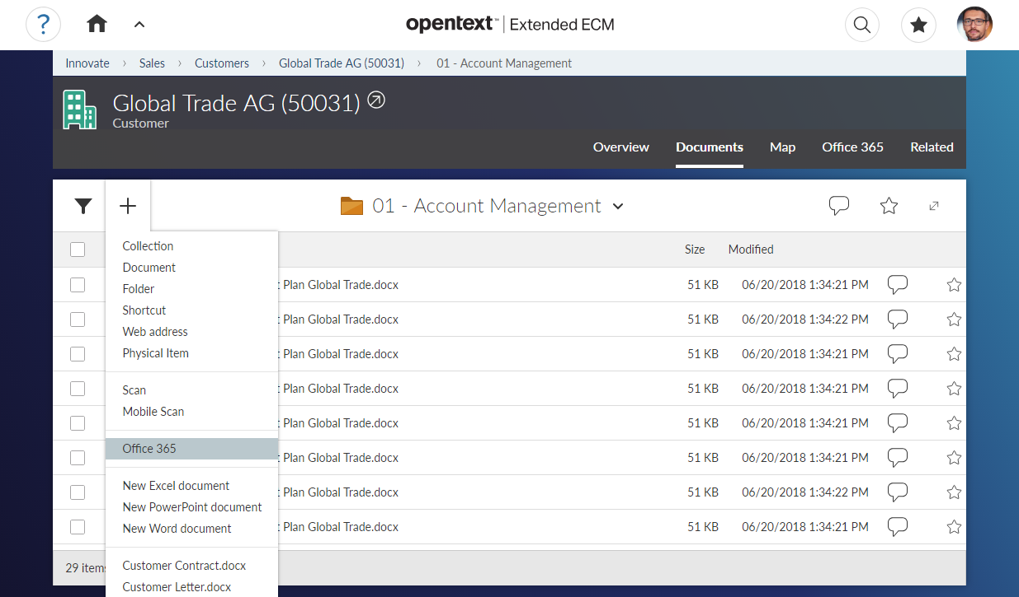
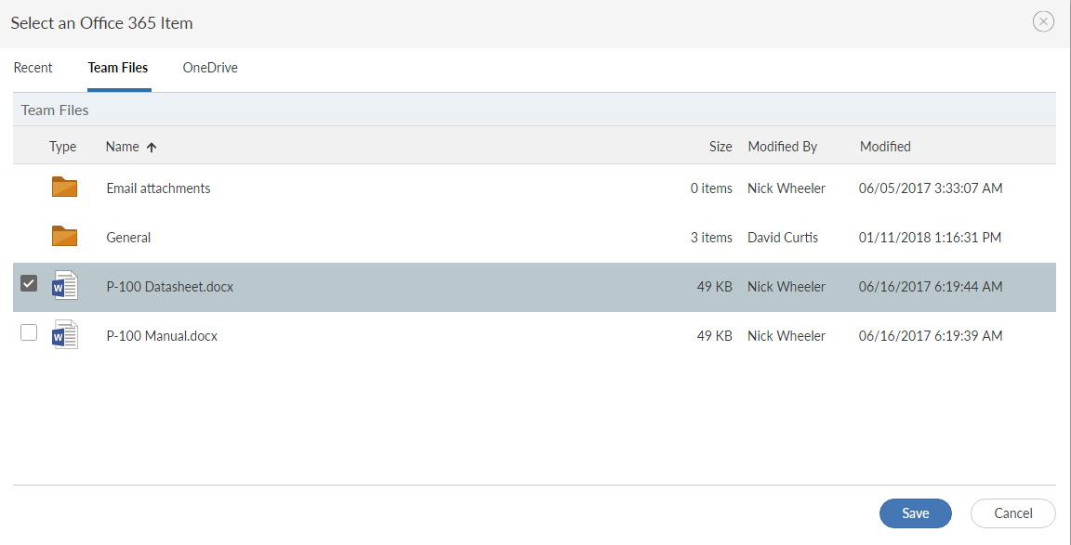
Seamless Integration with Microsoft Teams
Choose from recent files, files in connected Team, or personal OneDrive
Add files from
Office 365
Select files to add to this business workspace
Notes:
SAP Extended Enterprise Content Management by OpenText, add-on for Microsoft Office 365 includes functionality to upload Office 365 files right from with SAP Extended ECM. Users can select files from the Team that’s linked to the current workspace, their personal OneDrive for Business, and recent files they accessed across all of Office 365.
This functionality is also available in other user interfaces that integrate with SAP Extended ECM business workspaces, like for example SAP Fiori.

Slide 38
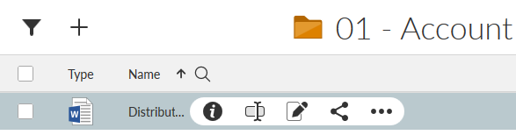
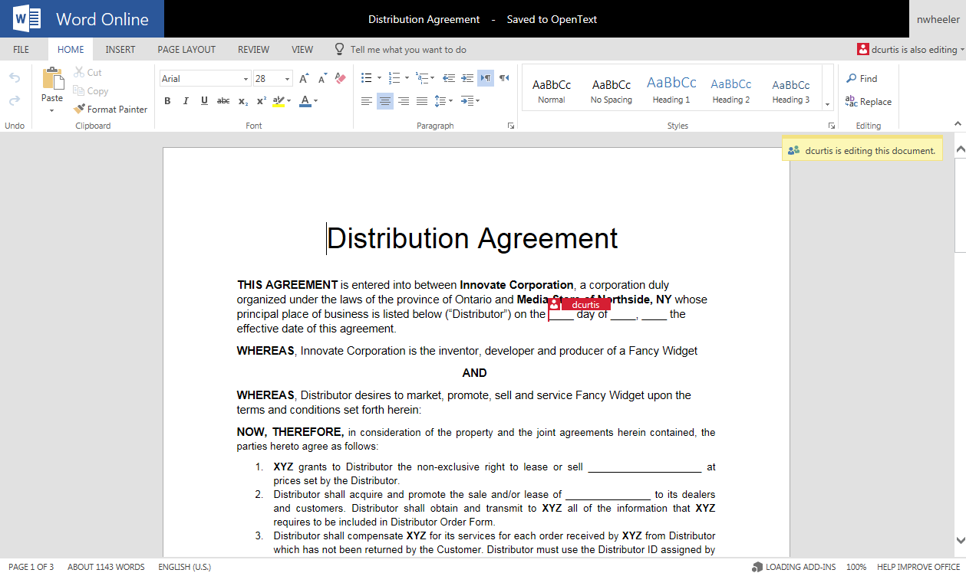
Co-authoring and editing with Microsoft Office Online productivity tools
Word, Excel, PowerPoint in the browser
Works cross-platform (Windows, Mac, mobile, etc.)
View and edit, co-authoring (multiple people working on the same document in real-time)
No installation on client machine
Notes:
Microsoft Office 365 includes Office Online clients, which are browser-based versions of the traditional Office clients like Word, Excel and PowerPoint. Because they run a browser, no installation on the client machine is needed, greatly reducing the cost of deployment. The Office Online clients are available with lower-tiers of Office 365 subscriptions (like E1) and very interesting for customers with a desk-less workforce. And last but not least, Office Online clients allow multiple users to simultaneously work on the same document (also called “co-authoring”).
SAP Extended Enterprise Content Management by OpenText, add-on for Microsoft Office 365 enables users to edit SAP Extended ECM documents with Office Online clients, bringing all the benefits above to the SAP Extended ECM user base.

Slide 39
Integrated information drives Innovation
Idea to Offering
Market to Contract
Demand to Deliver
Make to Order
Order to Cash
Procure to Pay
Asset Mgmt.
Record to Report
Hire to Retire
Enterprise Mega-Processes
Integrating ERP, PLM, Plant Maintenance, Finance, CRM and more - in one collaboration, workflow, and information management platform
Repository Integration
Documents created in the business application are automatically transferred into SAP Extended ECM repository. These documents must remain accessible in the business application. These documents can be put automatically under Records Management control.
Data & Relationships Integration
Relevant data of business objects (such as employee, customer, sales order) is automatically replicated to corresponding SAP Extended ECM Business Workspaces. This data can then be leveraged for classification and searching of documents & workspaces.
UI Integration
User Interface integration allows users to interact directly with content and ECM capabilities from within the business application. It is crucial for user adoption to keep users working in the work context they are familiar with.
Roles Integration
Business applications have a very detailed and powerful role concept to define access to crucial business data. SAP Extended ECM leverages these roles to assign role-based access to Business Workspaces and documents accordingly.
Process Integration
Business applications accomplish the work by executing processes (transactions, workflows). SAP Extended ECM capabilities need to be accessible during the execution of these processes as ECM is an essential part of many processes.
Repository
Data & Relationships
User Interface
Roles
Processes

Slide 40

David Boeckle
CSO
Office: +1.407.834.8324 x284
Mobile: +1.813.545.2381
Email: DBoeckle@Auritas.com

