Slide 1
Driving Innovation, Empowering Transformation.
SAP SuccessFactors – Content Management by OpenText

Slide 2





1,500
10,500+
25 Yrs
$1.5B
Successful Projects
TB of Data
Managed
Transforming Companies
Total Customer Savings
Driving Innovation, Empowering Transformations.
Data Management
Solution
Implementation
Product
& Innovations
Strategic
Partnerships
  Data Archiving & ILM
  Retention Management
  HANA Memory Optimization (NSE)
  Data Governance
  Data Migration
  Cloud Migrations
  Data Privacy and Security
  Legacy Decommissioning
  Data Volume Assessment
  Data Quality Assessment
SAP S/4HANA & RISE
SAP BTP Deployment
  SAP Integration Suite
AI Implementation
SAP OpenText
  Extended ECM (xECM)
  Vendor Invoice Management
  Document Presentment
SAP Ariba
SAP Vertex
SAP Vistex
Geospatial Intelligence (GIS)
  Data ASSIST by Auritas
  (Data Archiving Automation)
  Data GUARD by Auritas
  (Legacy Decommissioning)
  Auritas Intelligent Accrual
  (Financial Automation)
  DMS+ by Auritas
  (Enhanced Document Storage)
SAP Gold Partner
SAP PartnerEdge, Sell
CCFlex – Cloud Choice Flex
PartnerEdge®
  (AMS + Hypercare)
CCFlex

Slide 3

Breaking down xECM
  Platform for the Enterprise
  xECM - Anatomy
Business Need
  HR Priorities
  Content Management Challenges
xECM for SuccessFactors
Use Cases
Key Benefits

Slide 4





Information Flows
Content Services for the Digital Enterprise
Digitize
Utilize
Deliver
Business Center for SAP
Vendor Invoice Management
for SAP
Capture & Information Extraction
Validation & Dispatching
Approvals
Inbox Management
Triggering Processes
Omni-channel real-time information delivery
Ad-hoc and rule-based document assembly
Media Management
SAP
SAP
SAP
SAP Hybris
SAP Hybris
Salesforce
Salesforce
Oracle
Microsoft
Government
SuccessFactors
Engineering
Core
(external sharing)
Intelligent Capture
Extended ECM
Document Presentment
(Exstream)
Digital Asset
Management
Control
Information
Governance
Content Suite Platform
Archiving
Records Management
Data Protection
Archiving &
Document Access for SAP
Control
Notes:
SPEAKER NOTES
Open Text SAP Solutions deliver a full set of capabilities to support these information flows in the Digital Enterprise:
Information Processing:
Vendor Invoice Management is a poster child for information processing – it takes and processes invoices coming from suppliers in different formats and different channels – may it be paper, EDI, eMail or data from business networks (Ariba or GXS)
And we have extended this to a whole new level with a new product called “OpenText Business Center for SAP Solutions”. It can apply the same idea of reading, understanding and processing an incoming information to many more business scenarios such as Sales Order processing, Delivery Notes processing or HR document processing. Any unstructured or semi-structured information that comes into your organization and needs any kind of processing is covered by this SAP-based OpenText product.
Information Management:
Here we find the flagship product of the OpenText Enterprise Applications: Extended ECM for SAP. It allows to manage any kind of unstructured information in so called business workspaces that are tightly connected and integrated into leading business applications in SAP and SAP S/4HANA
In many cases users are working in collaborative environment. Here MS SharePoint is a dominant player. Extended ECM for MS SharePoint makes all information that is stored in OT available for SharePoint users and let them contribute new information assets such as documents or emails.
Extended ECM for Government is a public sector case management solution building on the Extended ECM platform.
Extended ECM for Engineering (aka Engineering Document Management) is another example of an Enterprise Application that applies information management to specific business processes such as capital project management or managing of technical documents or CAD drawings
<Information Processing and Information Management need to be tightly connected. Incoming information to is processed by VIM or Business Center needs to be stored in Extended ECM in many cases. Vice versa information processing may need additional context information that is already stored in Extended ECM to make decisions how to process new information>
Information Delivery:
Aggregating the right information for the right target group in a hyper-personalized way – omni-channel. Document Presentment does exactly that.
Digital Documents is an extended version of Document Presentment that provides an integration into Hybris Commerce and Hybris Billing.
Digital Asset Management: many business processes are not just (or no longer) based on traditional document formats but more and more using images and videos. DAM is also tightly integrated into leading applications such as SAP ERP, CRM or the Hybris Commerce and Hybris Marketing (e.g. for campaigns).
Information Processing – Information Management and Information Delivery is underpinned with OpenText’s well known Archiving and DocumentAccess technology – making sure that compliance requirements are properly covered.
On top of this – OpenText’s Enterprise Applications come with a productized integration into key business eco-systems such as SAP, SuccessFactors, Microsoft, Oracle, and Salesforce. But also specific business applications such as SAP’s Ariba network, SuccessFactors or hybris.

Slide 5
Extended ECM Platform: What is a Workspace?
A workspace represents a meaningful entity in an organization, e.g. a customer, a sales opportunity, a project, or even a community of people with common interests. A workspace provides insight from the data, the content, the people, and the task perspective.
TASKS
CONTENT
PEOPLE
Business data provides context to content and thus makes it relevant, searchable and actionable. Data can be synchronized with a leading business application.
DATA
Call it teams, communities or groups, it’s about people working together to achieve a common goal. In doing so people can have different roles and responsibilities.
Organize and store your organization's documents, and other content, that relate to organization's processes.
BUSINESS
WORKSPACE
Workspaces are actionable through tasks, follow-ups, milestones, and phases. They can be predefined, ad-hoc or synchronized with ERP, CRM or HCM systems.

Slide 6




Extended ECM Platform
Open, Versatile Content Management Platform
TASKS
TASKS
TASKS
CONTENT
CONTENT
CONTENT
PEOPLE
DATA
PEOPLE
DATA
PEOPLE
DATA
CUSTOMER
WORKSPACE
SALES ORDER
WORKSPACE
PRODUCT
WORKSPACE
Notes:
SPEAKER NOTES
For business processes with a higher level of collaboration, where information sharing and managing larger volumes of content is a key requirement OpenText’s versatile platform solution is Extended ECM. It integrates perfectly into SAP, Microsoft, Oracle, Salesforce and other leading applications.
Extended ECM Platform fuels Business Processes with Information
It provides Business Workspaces to manage all information required for a process while giving users working in different applications and Uis seamless access to the information the need.
Extended ECM also provides an open interfaces for partners and customers (UI + Backend) to integrate into additional eco systems

Slide 7




Extended ECM Platform
Network of Business Workspaces
TASKS
CONTENT
PEOPLE
DATA
PROJECT
WORKSPACE
TASKS
CONTENT
PEOPLE
DATA
TASKS
CONTENT
PEOPLE
DATA
TASKS
TASKS
CONTENT
CONTENT
PEOPLE
CUSTOMER
WORKSPACE
PEOPLE
DATA
DATA
OPPORTUNITY
WORKSPACE
SUPPLIER WORKSPACE
MATERIAL

Slide 8
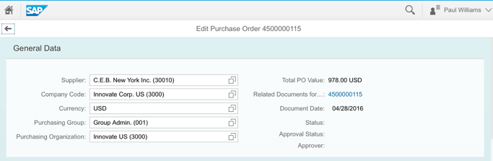
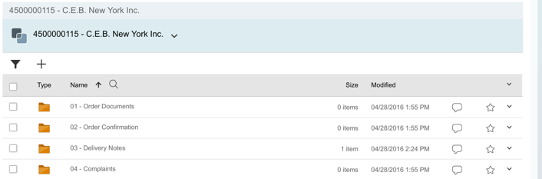
Extended ECM
Anatomy of the Integration
Business Object
Embedded Workspace User Interface
Lead Application
Trigger Event
Data,
Roles,
Structure,
Relations,
Classifications
Content
in Context
TASKS
CONTENT
PEOPLE
TASKS
DATA
CONTENT
PEOPLE
DATA
WORKSPACE
TEMPLATE
Business Workspace
Template based Creation
Extended ECM Platform
Notes:
For business processes with a higher level of collaboration, where information sharing and managing larger volumes of content is a key requirement OpenText’s versatile platform solution is Extended ECM. It integrates perfectly into SAP, Microsoft, Oracle and other leading applications. It provides Business Workspaces to manage all information required for a process while giving users working in different applications and Uis seamless access to the information the need.
Extended ECM Platform fuels Business Processes with Information
We ship Predefined business scenarios with Extended ECM to reduce time to value
Extended ECM also provides an open interfaces for partners and customers (UI + Backend) to integrate into additional eco systems
The new Business Center for SAP and Extended ECM are working perfectly together. Business Center can trigger the workspaces or file documents in Extended ECM. Vice versa Extended ECM workspaces can be embedded into Business Center.

Slide 9

HR Business Challenges & Need

Slide 10
Customer Priorities for Change
Efficient, agile & responsive HR services
Security, privacy & compliance
How can we…
Support a virtual HR service center?
Manage my digital employee files?
Reduce paper consumption?
Better support the recruitment process?
Provide increased HR automation?
How can we…
Support GDPR regulatory requirements?
Help support vaccination tracking?
Support subject access requests?
Meet external legal audit requests?
Priorities
What priorities are top of mind for our customers?
What forces are driving change?
First-class employee experience
Scalability, growth & automation
How can we…
Prepare for remote or hybrid working?
Attract and retain talent?
Improve the employee experience?
Reduce paper, photocopying, printing and postage?
How can we…
Keep up with our growing volume of employee records?
Improve HR service despite “leaner teams” and “leaner budgets”?
Make hiring faster as vacant positions cost money?

Slide 11





HR document management challenges don’t stay in HR—they impact stakeholders across the organization
Employees / Managers
HR shared services
Why is it so hard to access documents quickly?
Why does onboarding feel so manual and disjointed?
Can I track missing onboarding documents without HR?
Can we retrieve any employee document quickly and securely?
How much time is spent chasing down missing documents?
Is our process fast enough to meet internal SLAs?
HR leaders
Is manual work taking time away from strategic priorities?
How much time is spent filing, searching, or chasing documents?
Are onboarding and offboarding still relying on paper or email?
HR IT
Compliance officer
Is our current system integrated with our HRIS or ERP platforms?
Are we maintaining secure, access to employee documents?
Is our document storage scalable, centralized, and compliant?
How quickly can we respond to security or compliance audits?
How do we enforce data retention and destruction policies?
Do we have audit trails and version control for every document?
Notes:
Standard SAP SFSF AE question is “why do they need xECM if they can store documents in SFSF already”. SAP SuccessFactors Document Management Core by OpenText provides a centralized and secure location for the storage and management of employee files.
The point of differentiation is that SAP SuccessFactors DMS is only for HRBP and System Admin, the OpenText solution extensions are for users across the business.
Let’s take a closer look…
HR teams today are juggling a complex set of challenges—compliance, access, efficiency—all while supporting a hybrid workforce. As your business evolves, managing employee documents manually or across disconnected systems becomes a liability – not only for HR, but for stakeholders across the organization – as they are all engaged in one way or another in accessing or managing HR documents.
Let’s take a step back and ask the questions HR and business leaders are increasingly asking themselves…
If you were audited today, could you confidently and quickly retrieve all required employee documents?
How do you know those documents are actually stored in compliance with regulations like GDPR?
And what about documents that are missing, expired, or incomplete—would you even know?
Without a clear compliance process, the risk of fines and reputational damage grows.
How do you ensure document storage is consistent across locations, teams, or subsidiaries?
Can your HR team securely access what they need—when they need it—especially in today’s remote and hybrid environments?
And is there a central, organized view of each employee’s complete file, or are records scattered across inboxes, desktops, and shared drives?
Disorganization isn’t just inconvenient—it’s risky, especially when employee data is involved.
Think about how much time your HR team is spending manually uploading, filing, or searching for documents.
Are reminders for expiring certifications or documents automated—or falling through the cracks?”
And during onboarding or offboarding, are you still using paper or email to chase down forms and signatures?
Manual work eats into strategic time and increases the chance of costly errors.
What if…
You had a secure, centralized solution that gave your HR team instant access to the right documents—anytime, anywhere?
What if compliance was built in, with automated tracking and alerts for missing or expired records?
And what if you could reduce manual work by digitizing and automating document flows from hire to retire?
That’s the power of a modern HR document management solution—and we’re here to help you get there.”

Slide 12


How SAP & OpenText can help

Slide 13

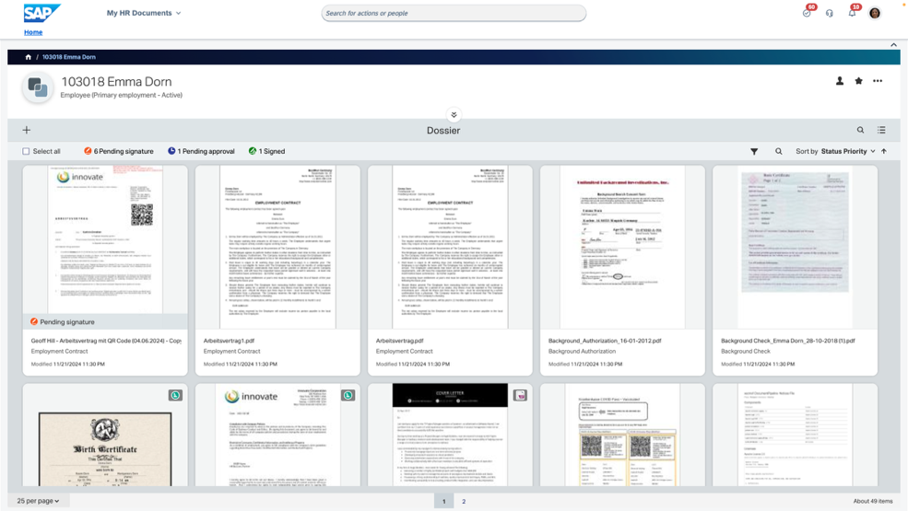


Digitalize and streamline processes with HR document management solutions from SA
Drive efficient document lifecycle management
Store, manage, and create employee documents from within your HR platform for improved operational efficiency
Streamline HR document generation
Improve HR communications with accurate and personalized employee documents
Personalize people experiences
Boost employee engagement and productivity with personalized experiences for document-related transactions and services
Enable agile and compliant HR
Meet data privacy requirements while ensuring complete employee files
Notes:
HR document management solutions from SAP enable you to centralize the creation, storage, and management of employee files, with convenient and secure access from within your HR system. By connecting HR processes and employee data with document management capabilities, you can improve operational efficiency and document accuracy while reducing security and compliance risk.
This is done in 4 ways:
Drive efficient document lifecycle management – Store, manage and create employee documents from within your HR platform for improved operational efficiency.
Streamline HR document generation – Create accurate and personalized employee documents.
Improve people experiences – Boost engagement and productivity with individualized experiences for document-related transactions and services.
Enable agile and compliant HR – Meet data privacy requirements while ensuring complete employee files.

Slide 14



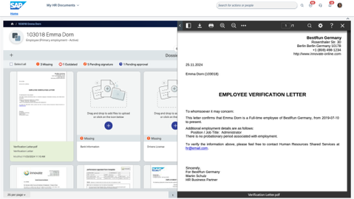
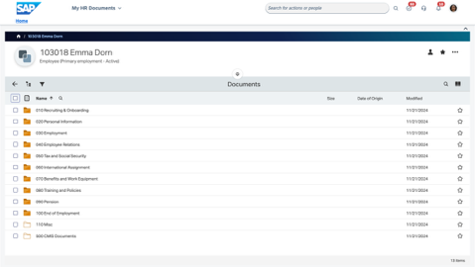
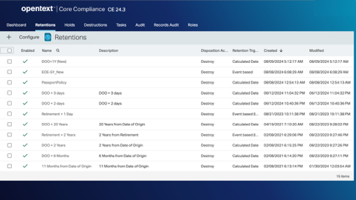
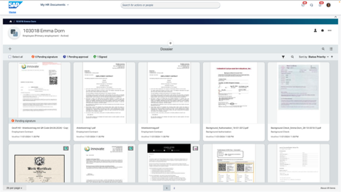
How we deliver HR document management
From creation to disposition, a comprehensive enterprise solution
Document
Generation
Document
Management
Records Management
  Create engaging employee communications with:
  Predefined templates with conditional formatting and editable fields
  Employee self-service
  Integrated eSignature
  Bulk document generation
  Event-based document generation*
  Create document workflows
  Increase productivity with:
  Centralized document storage with metadata
  Document version control
  Folder structure and taxonomy
  Full-text search
  Role-based permissions for security and access control
  Upload and approve documents
Enable HR document compliance with:
Support regulatory requirements such as GDPR
File completeness check
Legal holds
Audit trail
Document disposition
Retention policies
Redaction*
*Functionality only available with SAP SuccessFactors Extended ECM by OpenText
Notes:
We deliver HR document management across 3 pillars:
1. Document Generation to create personalized documents to facilitate communication between HR and your employees. Our robust document-generation platform supports any HR document creation requirements.
2. Document Management to store, and manage employee documents from within your HR platform. This approach helps to simplify the processing, managing and securing of large volumes of employee, retiree, contractor and job applicant documents from one location.
3. Records Management to enable effective adherence to data protection and privacy requirements. Document-level rules for access, retention, deletion and legal compliance support regulatory compliance, and help minimize the risks associated with audit and litigation.

Slide 15

Solution Differentiators

Slide 16
Unique selling points for SAP SuccessFactors Document Management Core
The value of a Solution Extension from SAP
An SAP solution
SAP premium qualified solution is tested, validated and approved to meet SAP product standards
Current and future-state architecture with SAP core products is ensured
One vendor
Single contract
One cloud service level agreement (SLA)
SAP is the single point of contact during all phases of the technology lifecycle (training, maintenance, support)
Broader functionality from a single vendor
Best of breed
Designed by the content management experts at OpenText
OpenText is a leader in the IDC MarketScape: Worldwide Intelligent Content Services 2024 Vendor Assessment
Compliance and governance
Robust records management capabilities meets the requirements of many compliance standards and certifications including FEDRamp, U.S. DoD 5015.02-STD v3,, SOC compliance, ISO 15489, Australian VERS, and more.
Predefined integrations
Technical and process integration, including:
User interface
Role-based permission sync
Document integration without duplication
Workflow integration
Document generation capabilities
Interactive content editing
Template designer
Bulk letter generation

Slide 17
Side-By-Side Functional Comparison Matrix
(OpenText 25.2 release)
Feature | SAP SuccessFactors Document Management Core | SAP SuccessFactors Extended ECM
Records Management | Ability to set retention rules and legal holds Audit trail captures list of events including create, upload, download, version and view View compliance reports | Ability to set retention rules and legal holds Configure compliance reports Audit trail captures comprehensive list of events including automated versions, email and print Configure multi-staged retention schedule Process to delete documents can be fully automated with proactive notifications Certified to global standards Recycle Bin
Document Generation | Ability to create templates Employee self-service to generate documents Permission HR business users to edit document templates Integration with SAP SuccessFactors Signature Management by DocuSign Manual process to generate documents Document output in PDF only Bulk document generation | Ability to create templates Employee self-service to generate documents Permission HR business users to edit document templates Integration with SAP SuccessFactors Signature Management by DocuSign Bulk document generation Automated process to generate documents based on business rules and metadata Document output in PDF, Word, email, or SMS Ability to automate generation of documents based on events in SAP SuccessFactors (via intelligent services)
Document Management | Centralized employee workspace for document management Embedded viewer Annotate, audit & version documents with full-text search and thumbnail view Drag and drop or batch import of existing documents Document completeness check to identify outdated or missing documents Control permission at the document level Route documents for approval via workflow Advanced reporting Employee Self-Service to submit own documents | Centralized employee workspace for document management Embedded viewer Annotate, audit & version documents with full-text search and thumbnail view Drag and drop or batch import of existing documents Document completeness check to identify outdated or missing documents Control permission at the document and folder level Route documents for approval via workflow Advanced reporting, plus ability to create additional custom reports Employee Self-Service to submit own documents Edit documents in MS Office, save as PDF, send notifications and documents via Outlook Document scanning including text search capability Automated Document Numbering
Integration | Out-of-the-box integration with Employee Central, Recruiting and Onboarding for documents via CMIS Integrates with SFSF role-based permissions Bulk workspace creation, hiring event automatically creates new employee workspace Metadata integration – flexibility to define custom attributes per document type UI integration from tile, home menu, and take action link; single sign-on | Out-of-the-box integration with Employee Central, Recruiting and Onboarding for documents via CMIS Integrates with SFSF role-based permissions Bulk workspace creation, hiring event automatically creates new employee workspace Metadata integration – flexibility to define custom attributes per document type UI integration from tile, home menu, and take action link; single sign-on Integration into Microsoft 365 Integration with SAP HCM
Business Administration | Transport of business config from test to prod Predefined folder taxonomy and document types and ability to add custom Individualized landing page configuration 16 languages Self service usage metrics\consumption Automated instance refresh | Transport of business config from test to prod Predefined folder taxonomy and document types and ability to add custom Individualized landing page configuration 24 languages

Slide 18

Use Cases
Notes:
Let’s take a look at some examples to better understand how document management solutions for SAP SuccessFactors can help you improve your HR processes.

Slide 19

Business process use cases
Improve the new hire experience
Ensure seamless employee transfers
Mitigate the risk of employee departures
Empower employees with self-service access
Streamline the management of mandatory employee certifications
Support audit requests with ease
Comply with General Data Protection Regulations

Slide 20

Solution Options & Features

Slide 21
Enhanced document management capabilities of
Document Management Solutions for SAP SuccessFactors (by OpenText)
Document Management Solutions for SAP SuccessFactors (by OpenText)
  Create centralized employee folders
  Attach/view documents in centralized employee folders
  Flexible folder structure/taxonomy, and ability define document types and assign meta data
  Ability to generate HR audit and completeness check reports (current/expiring/missing)
  Activity log and version control for documents
  Records management including retention rules, disposition based on region rules, configurable workflows, and legal holdspermissions (RBP)
  HR inbox to process new document requests (assign/deny/forward)
  Define permission access to documents in employee folders
  Ability to scan and import documents and attach them to the centralized employee file
  Full-text search on documents regardless of their folder location
  Scan a document and attach to centralized employee file
  Document level access controls via SAP SuccessFactors role-based permissions (RBP)
SAP SuccessFactors document management service provides basic document storage
  Administrators can manage, view, sort, and filter employment and personal information documents centrally based on selected criteria.
  Admin can upload of company documents and download / bulk download for audit and other purposes based on selected criteria
  Admins can access documents based on RBP defined at the document category level
  Set the retention period for purge of documents and user data
  Candidates, employees and managers have the ability to view and attach documents​ in the SAP SuccessFactors UI in the context of a business process
  View total storage usage by document category

Slide 22
Enhanced document generation capabilities offered by
Document Management Solutions for SAP SuccessFactors (by OpenText)
SAP SuccessFactors Document Management Core by OpenText
  Insert pre-composed paragraphs/sections into a document (from a centralized text resource library)
  Interactive content editing
  Interview mode (questions guide template development)
  Generate documents with pending EC workflow*
  Template designer
  DocuSign integration available when creating communications for recruitment, onboarding and employee during employment
  Trigger document generation based on Intelligent Services event*
  Automatically save generated document in employee’s file
  Bulk letter generation*
  Admin UI for document template management and document generation (centralized management)
SAP SuccessFactors Employee Central document generation capabilities
  Create global and country-specific document templates
  SAP SuccessFactors data mapping to fields in document templates
  Create business rules to define data inserted into document template (like conditional text formatting)
  Email / download of documents generated in word and PDF format
  Bulk document generation (up to 500 documents at a time)
  Multi-language support
  Support electronic signatures for documents (DocuSign integration)**
  Generation of documents with ESS and manager proxy on behalf of employee
  Manager / HRBP can initiate a change and this associated workflow can trigger
  EC document generation
HRBP’s can generate documents for inactive employees
  Limited to use with SAP SuccessFactors Employee Central only
  Leverage role-based permissions for mapping and generation of documents

Slide 23






The benefits of SAP SuccessFactors Document Management Core
One Version of the Truth
Centralized repository
for all your employee files
More Time for Strategic HR
Digitize and optimize
document-related workflows
Compliance with Regional Regulations
Records Management, deletion regulations, audit trails, and completeness check
Employee Productivity
Provide self-service access
for employees
Reduced Security Risk
Role-based permissions for security and access control
Improved HR Communication
Multi-channel document generation and distribution
Notes:
We provide a comprehensive platform to manage the entire document lifecycle from creation, to disposition and everything in between. You get centralized storage and management of employee files, with convenient and secure access from within SAP SuccessFactors. As part of the SAP SuccessFactors HXM Suite, HR document management processes are a part of your HR application.
The solution provides functionality to help you digitize and optimize document related processes making it easier to generate, search and manage employee documents. By creating a centralized repository of all employee records as part of your HR system, customers get one version of the truth.
This reduces errors as you no longer need to store information in two places, and ensures that employee records always include the latest versions of documents. And, the role-based permissions model makes it easier to manage security and access controls to these documents.
Additionally, records management capabilities enable customers to address compliance requirements such as GDPR and CCPA by supporting processes such as the right to be forgotten with capabilities such as retention rules, audit trails, and completeness checks for out-of-date documents or incomplete employee files.
The solution not only improves HR efficiency, it helps to improve the employee experience as well by empowering employees with self-service access to generate documents and receive timely, personalized communications via the solutions document generation tools.

Slide 24
What is an SAP Solution Extension?
SAP Solution Extensions are strategic third-party solutions developed by our most innovative software providers. They offer cross-line of business and cross-industry functionality that address your distinct business needs. SAP supports these solutions as its own, guaranteeing the standards of quality and support SAP clients expect.
Predefined Integration: Technical and process integration delivers faster time to value.
Governance and Security: Solution is tested, validated and approved to meet SAP product standards.
Proven Technology: Both current and future-state architecture with SAP core products is ensured.
What This Means for You?
Broader functionality from a single vendor
SAP owns integration of the solution into the roadmap
Single contract
SAP is the single point of contact during all phases of the technology lifecycle (training, maintenance, support)

Slide 25

Solution Overview
Notes:
Now let’s take a more in depth look at the features of the solution.

Slide 26
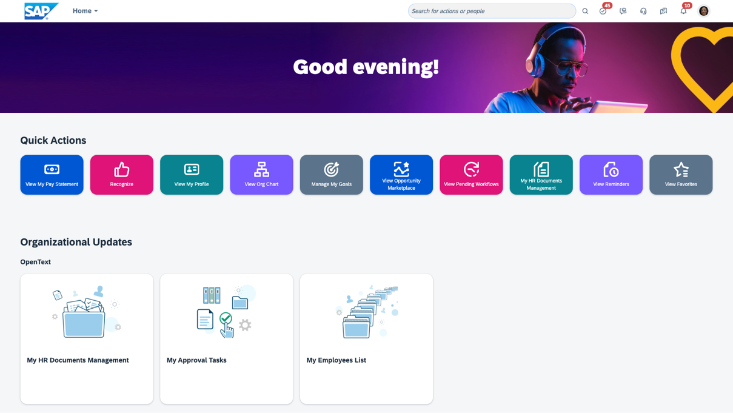

Store, manage and create employee documents from within your HR platform
Provide a comprehensive platform to manage the entire document lifecycle from creation, to disposition
  Establish a centralized digital repository as the single source of truth for all HR employee documentation
  Access employee documents directly from the SAP SuccessFactors homepage—fast, secure, and user-friendly
  Ensure secure access with role-based permissions aligned to your SAP SuccessFactors configuration
  Seamlessly integrate with core HR modules like Employee Central, Recruiting, and Onboarding for a connected HR experience
Notes:
SAP SuccessFactors serves as the single access point to your employee files. Quick actions and engagement cards on the SAP SuccessFactors homepage make it easy to securely access HR document management capabilities. Documents created and uploaded in SAP SuccessFactors solutions are automatically stored in the appropriate employee folder. And, with a role-based permission sync, you can leverage the permissions defined in SAP SuccessFactors to control access to those employee documents.

Slide 27
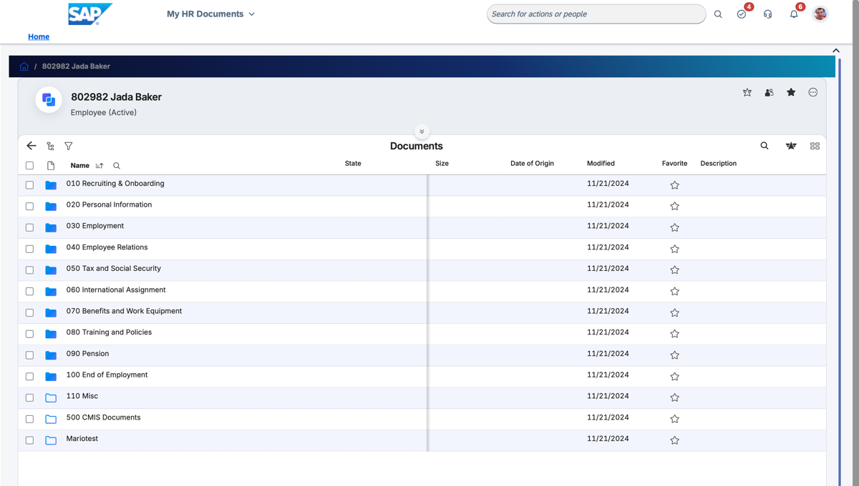
Reduce the administrative burden on HR with the digitalization of document management
Centralize the storage and management of all employee documents
  Avoid duplication and manual updates by managing HR documents directly within your existing HR system
  Quickly find what you need with a unified document workspace offering a complete view of each employee file
  Automate compliance checks with alerts for missing or outdated documents using file completeness tracking
  Streamline reviews and approvals with configurable workflows that route documents to the right stakeholders
Notes:
Help your HR managers make the best use of their limited resources with all employee files in a digital, organized and structured format so that your HR team can be more efficient. Stay organized with ease using a pre-defined HR folder structure, metadata, and taxonomy tailored for employee records. With our solution, HR leaders can focus their time on high-value strategic work, while providing certainty that every base is covered when it comes to employee document management and compliance with local legislation.
You can now have confidence that your employee files are updated and complete. You can define rules on what documents are required for each employee based on certain criteria, such as their location or job, and set document expiration dates on when they need to be updated or renewed. A dashboard alerts you when a required document is missing, outdated, incomplete or pending approval based on the criteria set by organization so appropriate action can be taken to rectify the issue. This approach both reduces organization risk and the administrative burden of managing employee files.
As employees have the ability to upload documents through self-service, it becomes increasingly important for the supporting HRBP to review the accuracy of the documents before committing to the employee’s permanent digital file. Configurable workflows enable HRBPs to validate employee documents, add metadata and appropriate tagging, and ensure the required approvals are secured before adding the document to the employee folder. Throughout this process, the interaction with the employee is positive and compliance is tracked without compromising security.

Slide 28
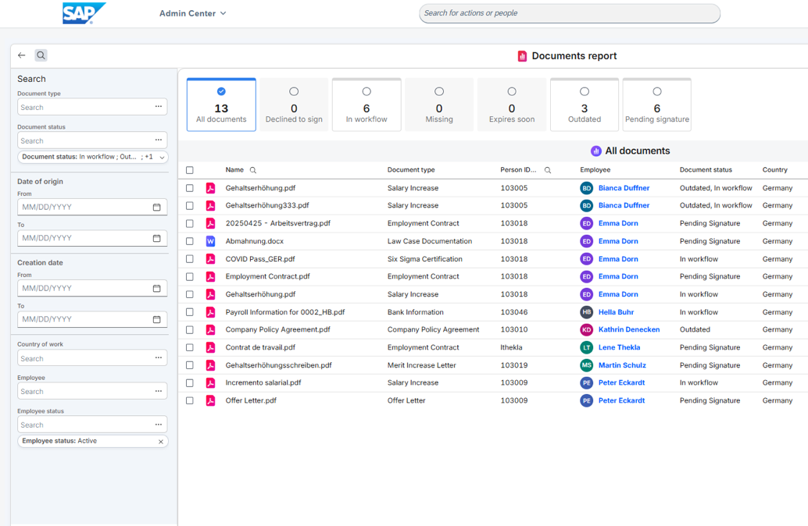
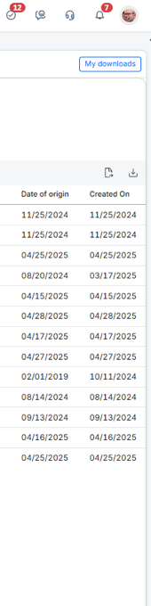
Improve HR service delivery with flexible reporting
Reduce HR response time to document requests with centralized document reporting
  Create tailored document reports to match your organization’s needs—unlock deeper visibility and actionable workforce insights
  Standardize reporting with consistent metadata and taxonomy for faster, more reliable document analysis
  Quickly find critical records with cross-employee search functionality—ideal for audits, internal reviews, and compliance checks
  Easily export documents in bulk by employee or document type to streamline sharing and external reporting
Notes:
Responding to audits or compliance requests no longer has to be a daunting task. Easily find and organize documents for an audit, legal request or any other need. With flexible reporting capabilities, you can run reports based on specific criteria across groups or individuals using HR taxonomy and metadata. You can export the report in Excel, or download selected documents, if required. This helps organizations comply with requirements such as data portability in GDPR, as all employee documents can be quickly located and downloaded to share with the employee.
Locating the right documents at the right time to respond to employee requests improves overall engagement levels AND efficiencies for the HRBP. But employees are not the only constituents asking for information, there are managers, auditors, legal and others that need almost instantaneous responses.
The key to superior support for all resources is locating documents quickly, simply and securely. Tools supporting this include full-text search and search filters to identify and access the rights documents just in time.

Slide 29
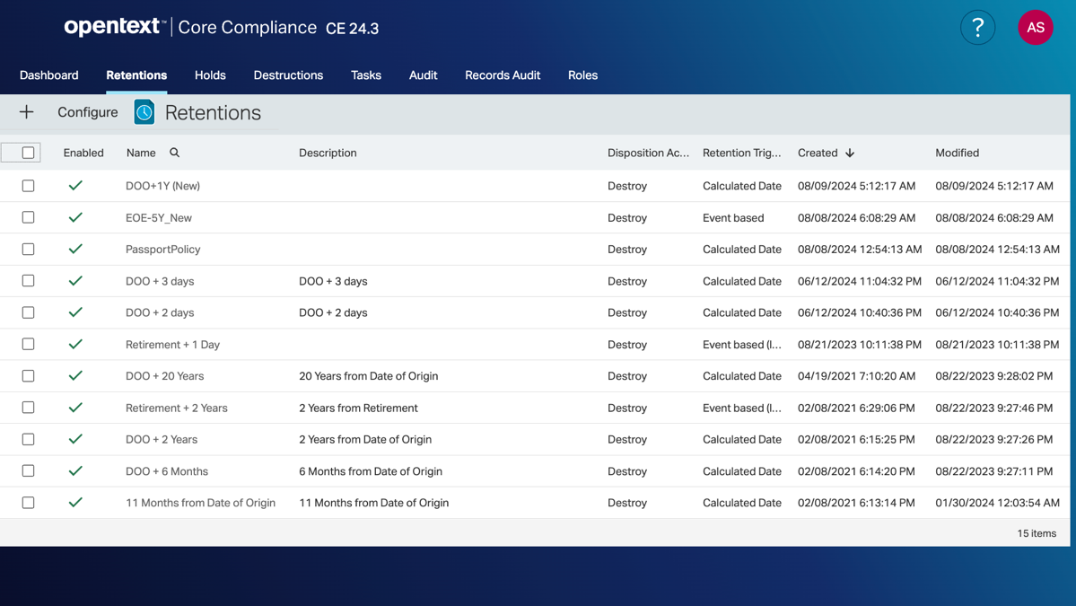
Easily manage HR compliance obligations with records management
Reduce risk with streamlined, secure and compliant records management
  Align with retention policies and legal requirements, including GDPR, through automated rule-based archiving
  Automatically apply retention schedules based on real-time employee lifecycle events in SAP SuccessFactors
  Safeguard critical records with legal holds to prevent tampering or deletion during litigation
  Ensure accountability with a complete, tamper-proof audit trail of all document access and activity
Notes:
Regulatory compliance continues to grow more complex with ever-changing global and legal requirements. Robust records management capabilities help you ensure compliance with the ability to define retention schedules for specific types of documents, with variations to accommodate specific regional and country-specific requirements. You can define the retention trigger such as an event like employee termination, time-based or permanent, and what action is to be taken upon that trigger, such as deletion, document archival, or reduced access permissions, etc. Our solution helps you easily define, apply and track your retention policies.
Legal holds enable HR, Legal and Auditors to lock down documents associated with a legal action. Using document search capabilities, the required employee documents can be easily located and placed on a legal hold, prohibiting the document from being edited or deleted. You can even create a unique workspace for the legal case where you consolidate all documents from both SAP SuccessFactors and Outlook, providing your legal department with all documents and correspondence in one place where they can leverage the previously mentioned full-text search to speed up legal discovery.

Slide 30

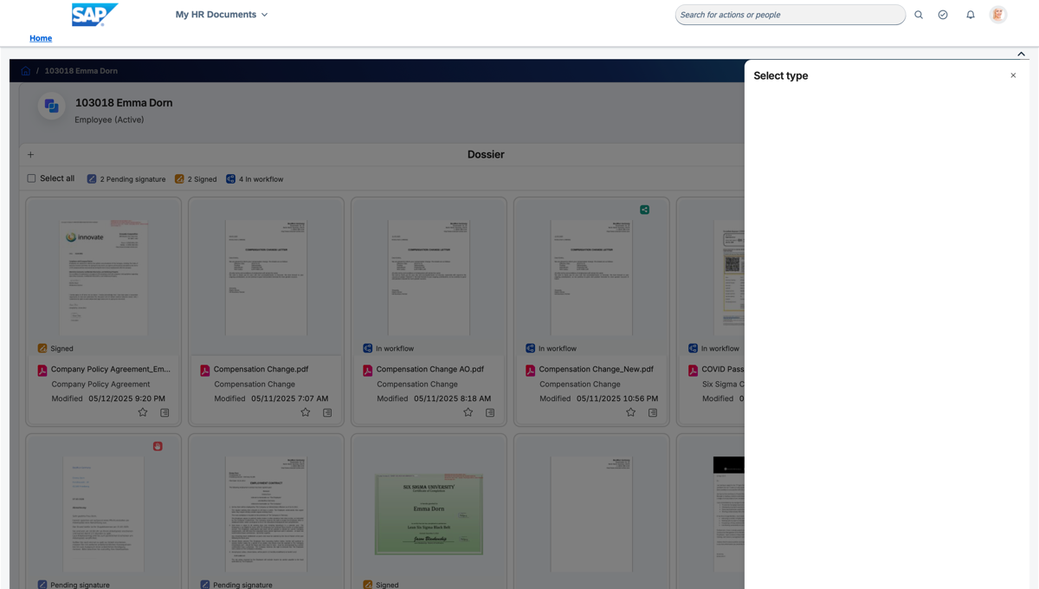
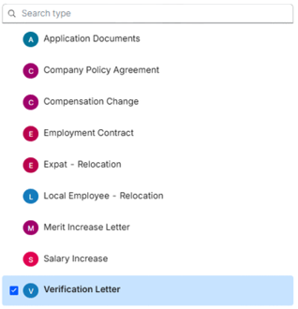
Elevate the employee experience with self-service tools
Empower your employees with quick and easy access to HR-related transactions and services
  Enable secure self-service so employees can easily view and retrieve documents from their own file
  Keep records up to date by allowing employees to upload or update documents as needed
  Reduce routine HR requests by letting employees generate common documents like employment verification letters
  Boost manager efficiency with self-service tools that support team oversight and reduce back-and-forth with HR
Notes:
Today’s employees expect quick and easy access to HR-related transactions and services. With Document Management Solutions for SAP SuccessFactors, you can empower your employees with self-service tools for document access, generation and updates. For example, if an employee has a missing or outdated document in their file, they no longer need to rely on the HR help desk as they can now upload a new document directly into their employee file. If required by the organization, the document can automatically trigger an approval workflow that must be completed before the document is added to the employee file. Further streamlining the document process and reducing administrative burden on HR and service delivery teams, if permissioned, employees can access documents in their own file and generate documents, such as employment verification letters, directly from their employee workspace.

Slide 31
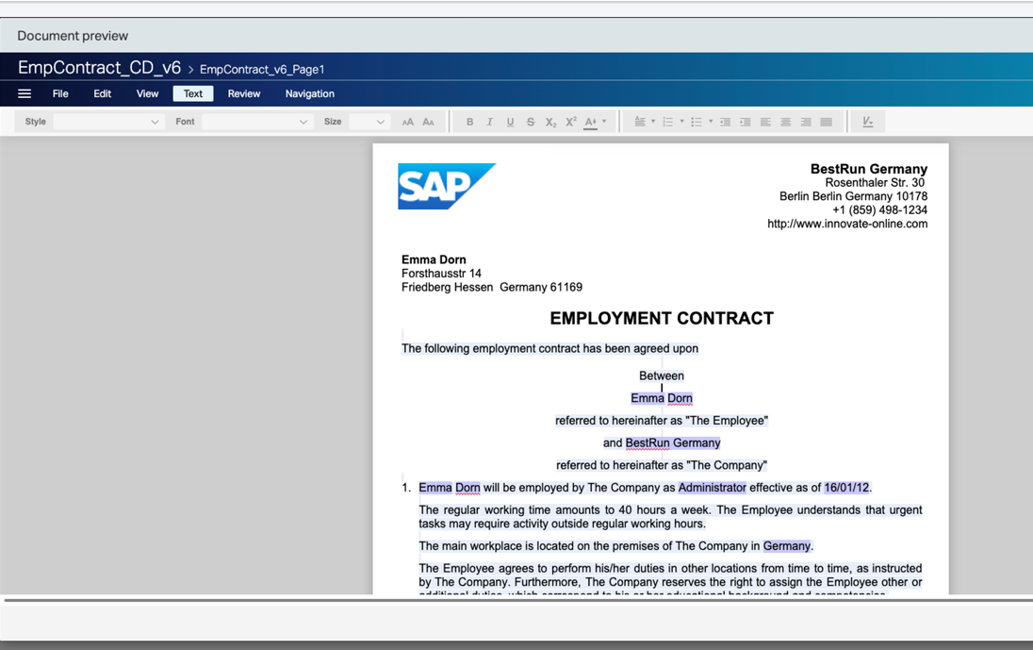


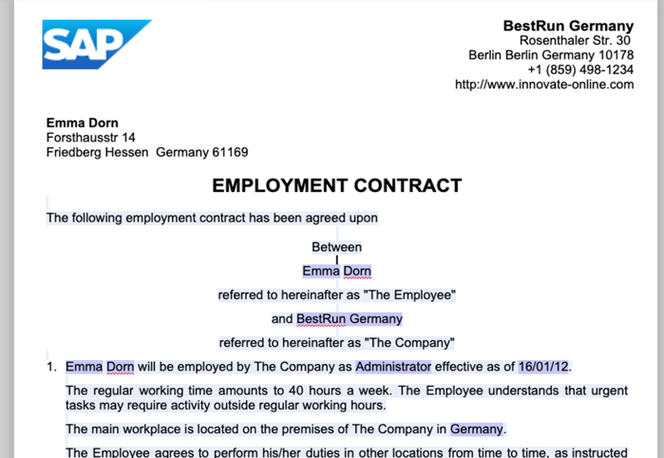
Streamline HR communications with document generation
Simplify and standardize the creation of employee documents across the organization
  Ensure brand and policy alignment by using a centralized library of pre-approved, styled templates
  Save time with automation—generate documents in bulk or based on employee events (e.g., promotions, exits) with multi-channel delivery*
  Accelerate approvals by integrating secure electronic signature workflows
  Personalize at scale with a dynamic text resource library that adapts documents using conditional formatting
Notes:
Communicating with candidates and employees personally and promptly is essential to a great employee experience. Document generation capabilities enable you to trigger the generation of employee documents on an ad-hoc basis, through employee self-service, or automatically based on events in SAP SuccessFactors* (functionality only available with SAP SuccessFactors Extended ECM). For example, an employee relocation event in SAP SuccessFactors can be configured to trigger the automatic generation of a change in employment letter, new employment contract, or a contract amendment.
You can use the template designer to build and update document templates, including conditional text formatting and free text fields to personalize the documents to the employee and the region or job they work in. A centrally managed template library enables you to ensure document style and branding consistency across departments and regions. Additionally, a text resource library allows you to create copy blocks such as legal disclaimers or employment contract rules and utilize these copy blocks in the templates. This library enables you to establish one version of the truth and make changes only once, and those changes will be reflected in all templates where that copy block is being used. It improves the accuracy of the document and speeds the document creation process. Bulk document generation* ((functionality only available with SAP SuccessFactors Extended ECM) and multi-channel distribution creates further process efficiencies.
The fully digital process is further streamlined with the ability collect signatures digitally. With SAP Signature Management by DocuSign, you can delight candidates, employees and HR teams by executing the signing of documents on any device from any location.
All documents generated are versioned, helping ensure that everybody knows the most relevant iteration of every document in an employee’s file. Once you send the document to your employee, the application automatically stores a copy, capturing full audit information in the employee’s file and minimizing compliance risk.
**Recruiting / Onboarding example **
For recruiting you can deliver an offer letter in minutes and capture their approval from any device. And, when used in conjunction with Onboarding, candidates, now new hires, can complete their forms with DocuSign, creating a delightful, welcoming experience for new hires, and of course the completed onboarding documents can be automatically saved in the employees workspace.

Slide 32
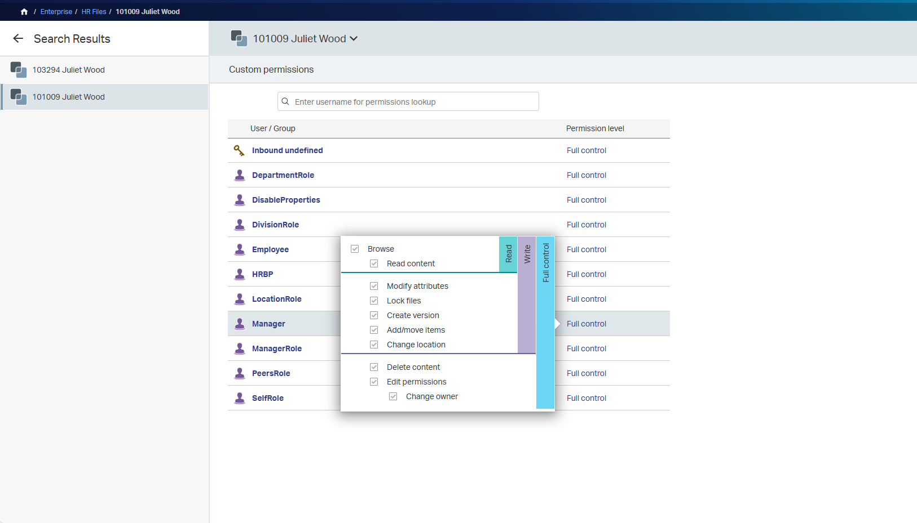
Simplify the complexity of managing multiple employments
Easily manage multi-role employees with dedicated folders for each role, even across countries or departments
  Streamline contract updates and version control to eliminate manual oversight and reduce administrative burden
  Protect sensitive records by automatically adjusting permissions as employees change roles, managers, or working hours
  Enhance operational efficiency by centralizing management of contract, contingent, and temporary worker documents
  Mitigate compliance risk by ensuring accurate, complete records across all employment relationships
Notes:
Anther major challenge is managing employees who wear multiple hats—whether that means holding two roles, working across departments, or even across borders. We can make this easier by creating a dedicated folder for each role, automatically—ensuring clear separation of documents and responsibilities. When employees change roles, managers, or working hours, permissions update automatically to keep sensitive information protected. You can also streamline contract updates and version control, so you’re not chasing paperwork or duplicating effort. With a centralized workspace, even contingent and temporary staff are tracked accurately—enhancing both operational efficiency and compliance. No more missing files, no more manual oversight—just clean, consistent, and confident multi-role management.
--VT– I have not overwritten the talk track just updated slightly
Another major challenge is managing employees who wear multiple hats—whether that means holding two roles, working across departments, or even across borders. We can make this easier by creating a dedicated employee workspace for each role, automatically ensuring clear separation of documents, responsibilities and access.
When employees have more than one role or manager, permissions update automatically to keep personnel information personal. Hr can streamline contract updates and version control, so you’re not chasing paperwork or duplicating effort. With a centralized workspace, contingent or staff with multiple jobs can track all their documents from one place—enhancing both operational efficiency and compliance. No more missing files, no more manual oversight—just clean, consistent, and confident multi-role management.

