Slide 1
Procurement Transformation
SAP Ariba Buying:
Simplify Procurement,
Maximize Compliance

Slide 2




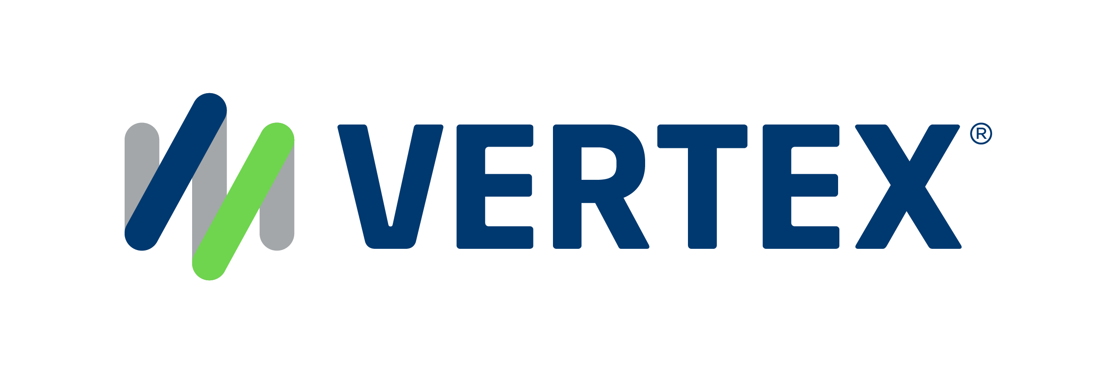
1,500
10,500+
25 Yrs
$1.5B
Successful Projects
TB of Data
Managed
Transforming Companies
Total Customer Savings
Driving Innovation, Empowering Transformations.
Data Volume Management
Data Quality Enablement
Document Management
Finance Optimization
Reduce size and complexity and control data growth across transactional and legacy SAP environments.
Cleanse, govern, and unify enterprise data to support trusted transactions, analytics, and AI-driven decision-making.
Centralize, govern and optimize enterprise content for operational efficiency, compliance, and AI readiness.
Automate and optimize AP/AR, invoicing, environmental reporting, tax, and royalty processes and functions.
  Rightsizing/Archiving
  Data ASSIST by Auritas
  SAP ILM
  Decommissioning
  Data GUARD by Auritas
  Governance
    SAP MDG
    SimpleMDG
  AI-Ready Enterprise Data
    Reltio
    Collibra
  OpenText for SAP Solutions
    Extended ECM
    Document Presentment
  DMS+ by Auritas
  Auritas Storage Manager
  Invoice Management
  SAP Ariba
  Auritas Intelligent Accrual
  ESG reporting
  SAP Vertex
  SAP Vistex
PartnerEdge®
CCFlex

Slide 3




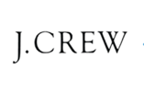








Customer Success
Services Across Multiple Industries – Verticals:

Slide 4
Agenda
A focused journey from challenge to solution — designed for procurement leaders and IT decision-makers evaluating transformation.
01
02
The Procurement Challenge
SAP Ariba Buying Overview
Where savings leak and risk hides
What it is and how it works
03
04
Core Capabilities
Integration with SAP S/4HANA
Guided Buying, catalogs, and automation
Seamless connectivity, single source of truth
05
06
Business Value & ROI
Implementation & Next Steps
Measurable outcomes from day one
A proven path to go live

Slide 5
The Procurement Challenge
Manual processes and off-contract buying quietly erode savings and create compliance exposure
Maverick Spend
Manual Bottlenecks
Fragmented Catalogs
Off-contract purchasing bypasses negotiated rates, silently eroding savings.
Manual PO creation slows requesters and burns procurement capacity.
Inconsistent pricing across units makes compliance nearly impossible.
Blind Spend Commitments
Audit & Compliance Risk
Without pre-invoice visibility, finance can't forecast or control budgets.
Email and paper-based purchasing creates gaps no auditor will overlook.

Slide 6
What Is SAP Ariba Buying?
SAP Ariba Buying is a cloud-based, self-service procurement platform that gives every employee an intuitive, Amazon-like experience, while enforcing policy, approvals, and contract compliance automatically.
Automated Approvals
Self-Service Requisitioning
Policy controls and approval workflows are
Embedded, no manual routing required.
Employees shop from approved suppliers and
contracted catalogs without procurement involvement.
SAP Business Network Connected
Manages Indirect Spend
(Direct with Addons)
Part of SAP Business Network, connecting buyers
and suppliers globally on one platform.
Cloud-based Amazon shopping experience

Slide 7
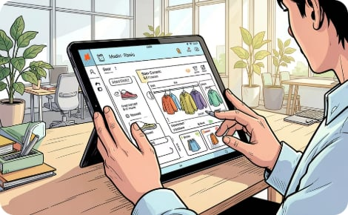
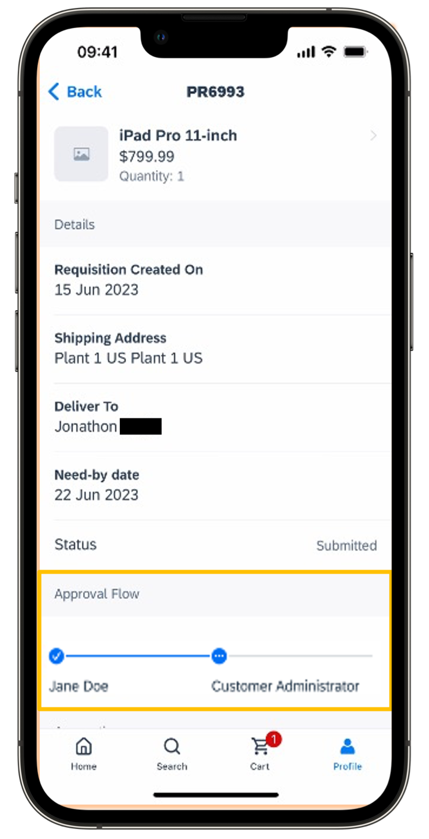
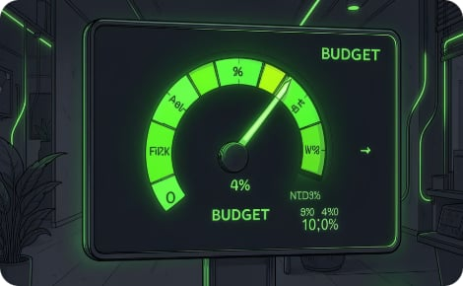
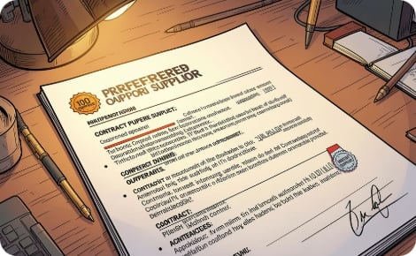
Guided Buying: Procurement That Feels Like Shopping
Guided Buying is a simplified, role-based front end that steers every requester, from power buyers to occasional users, toward the right supplier, contract, and approval path automatically.
Intuitive, No Training Needed
Mobile-Ready Approvals
Real-Time Budget Checks
Preferred Supplier Steering
Smart forms and guided prompts replace procurement expertise. Casual requesters are productive from day one.
Approvers act instantly from any device. Out-of-office delegation ensures nothing stalls.
Budget validation and approval routing happen in real time, before the PO is submitted.
Requesters are automatically directed to contracted suppliers and negotiated pricing, compliance by design.

Slide 8
Catalog Management & Workflow Automation
Catalog & Supplier Enablement
Workflow & Approval Automation
Centralized catalogs ensure contracted pricing is always current and accessible.
Configurable, condition-based approval flows eliminate manual chasing.
Punchout & Hosted Catalogs
SAP Business Network
Controlled Non-Catalog Buying
Direct connection to supplier storefronts keeps pricing live.
Access thousands of pre-integrated suppliers globally.
Free-text requisitions with policy gates prevent maverick spend.
Condition-Based Routing
Full Audit Trail
Faster Cycle Times
Route by amount, cost center, commodity, or entity automatically.
Every requisition, approval, and PO change is logged and traceable.
Requisition-to-PO drops from days to hours vs. manual processes.

Slide 9

Next-gen SAP Ariba: AI-native. Modern platform.
The world’s most advanced source-to-pay suite.
AI-native intelligence
Suite orchestration
Best-in-class user experience
Guided deployments and self-service configurations
Modern, extensible platform
Business network–centricity

Slide 10
Here’s how it works
Supplier Sends Catalog
PO Received
PO Confirmation
ASN
PO Updated
SUPPLIER
Validate & Publish Catalog
Shop for Goods & Services
Review & Checkout
Budget Check
Approvals
Purchase Order (PO) Generated
Goods Receipt
SAP ARIBA
Master Data
PO copy
Goods Receipt
ERP

Slide 11
Seamless Integration with SAP S/4HANA & ECC
Ariba Buying integrates natively with your existing SAP landscape, preserving finance processes while extending procurement capability to the cloud.
Master Data Sync
Requisition Created
PO Replicated to SAP
Source-to-Pay Visibility
Integration is delivered via SAP Cloud Integration Gateway (CIG) or standard middleware, with real-time or batch options. Finance and controlling processes remain uninterrupted, PO replication ensures a single source of truth across systems.

Slide 12
Business Value & ROI
Measured outcomes from streamlined procurement and stronger compliance.
Requisition Cycle Time
↓80%
From days to hours with automated approvals and guided workflows.
Contract Compliance
↑30%
Preferred supplier steering and catalog enforcement capture negotiated savings.
Processing Cost
↓40%
Automation reduces cost per requisition by eliminating manual handling.
Spend Visibility
100%
Real-time commitment tracking before invoices arrive improves forecasting.
* Actual results vary by organization. These benchmarks are based on typical SAP Ariba customer outcomes across indirect spend transformations.

Slide 13

Why SAP Ariba Buying?
Largest B2B Network
Direct connectivity to millions of suppliers on SAP Business Network.
Native SAP Integration
Single vendor, single roadmap with S/4HANA, no integration risk.
Faster Time to Value
Configurable without heavy custom development, go live in weeks, not months.
AI-Powered Solution
Enabled & ongoing innovation in AI-assisted sourcing, buying, and spend intelligence.

Slide 14
Auritas Implementation Approach & Next Steps
A phased approach minimizes disruption and delivers value early. Typical timeline: 12–20 weeks, depending on scope and landscape complexity.
Phase 1: Discover & Design
1
Map processes, org structure, and approval matrix
2
Phase 2: Configure
Set up catalogs, workflows, integration, and Guided Buying
Phase 3: Test & UAT
3
Validate end-to-end flows with key stakeholders
4
Phase 4: Go Live & Hypercare
Change management, training, and post-launch support
Recommended
Next Steps
1
Discovery Workshop
2
Spend Analysis
3
Implementation Proposal & Timeline
Map current-state procurement and identify quick-win catalog candidates
Receive a tailored Spend Analysis based on your data
Based on agreed scope from Spend Analysis, an implementation proposal with a proposed timeline is delivered

Slide 16
Appendix

Slide 17
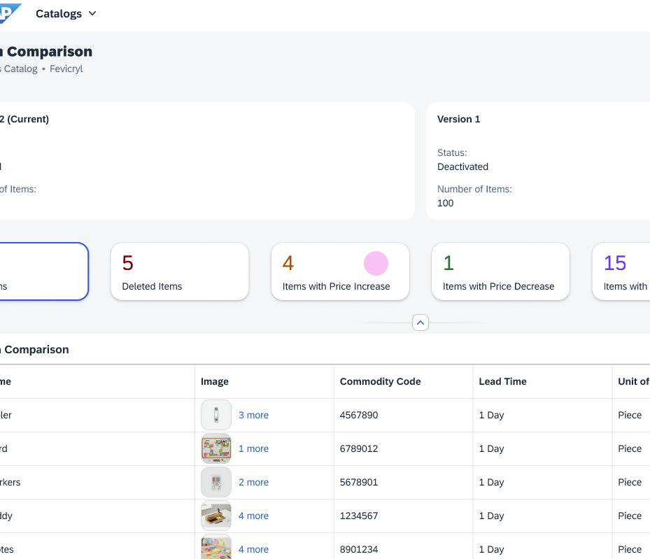
Enhanced Catalog Management capabilities
  Capabilities
  Real-time catalog activation
  Richer catalog Version History & Comparison
  Streamlined catalog approval process
  Shopping Site support (via OCI)
  Benefits
  Automated catalog verification speeds updates, reduces workload, and improves accuracy
  Simplified catalog creation and activation drastically improves efficiencies
Notes:
Provide user-friendly procurement catalog content to help employees buy from the right suppliers at the right prices
Multiple approaches to managing and accessing catalog content: internal, supplier managed, and punch-out
Intuitive tools that enable supply catalogs to be updated in minutes
Automated catalog verification capability that helps speed updates, reduce workload, and improve accuracy

Slide 18
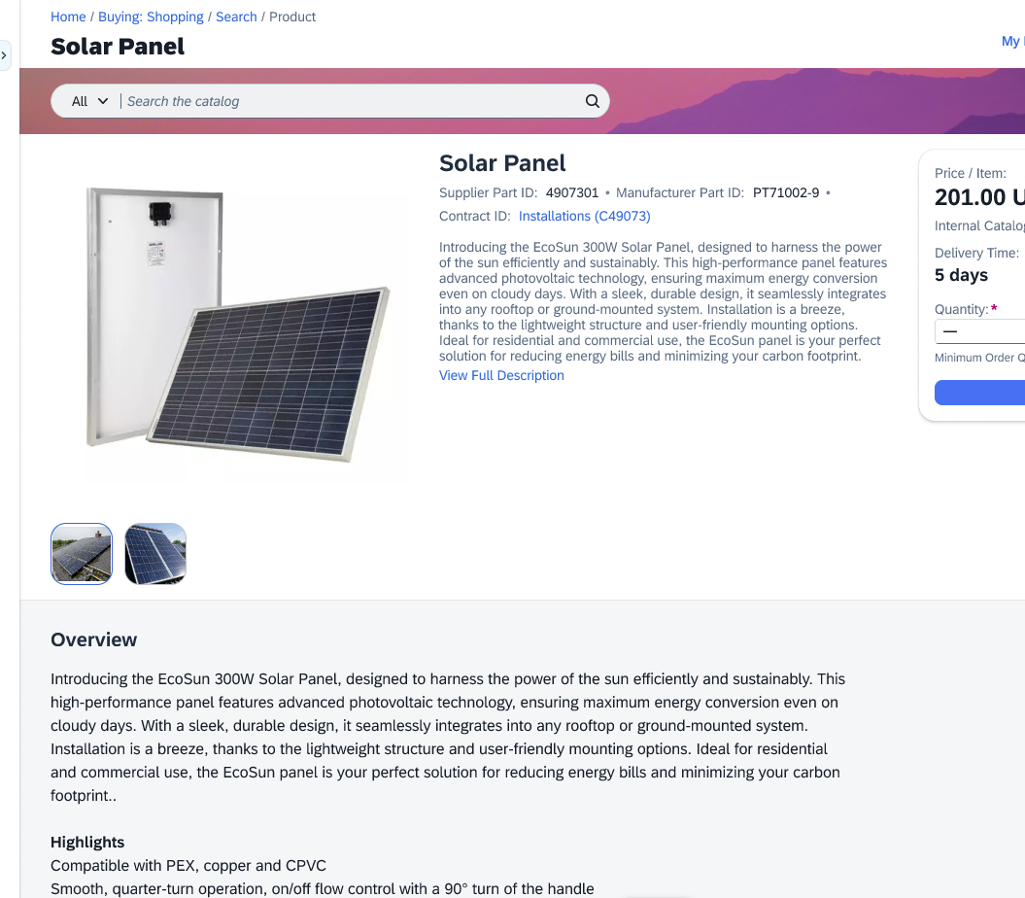
Compliant purchasing with
  Capabilities
  Purchases directed to preferred suppliers
  Ability to easily generate quotes
  Free forms to configure specific requests
  Benefits
  Improved user compliance to negotiated rates and preferred suppliers
  Reduced cycle times
  Reduced costs with self-service buying
Notes:
Equip users to follow procurement guidelines – without having to read them first – so they can quickly and easily buy non-sourced goods from preferred suppliers and marketplaces with minimal support from your procurement teams.
Drive compliance with purchasing policies through the guided buying capability. It provides a smart and intuitive shopping experience and guides employees to preferred buying channels, processes, and policies. As a result, employees have one place to search for goods and services, collaborate with suppliers, and quickly make compliant purchases with little to no involvement from procurement departments. Use existing catalogs and approval flows to direct your employees to the right items, the right policies, and preferred suppliers within your supply chain and Ariba Network.

Slide 19
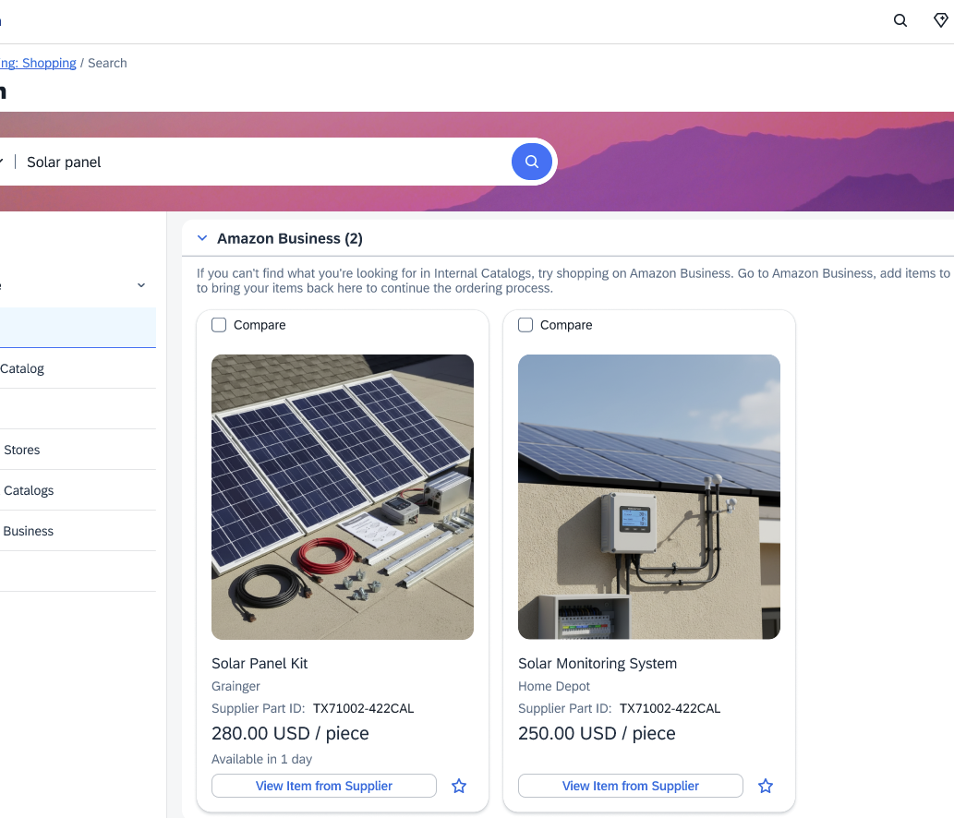
Increase control over one-off purchasing
  Capabilities
  Quick and easy access to over 100 million items from preferred suppliers and marketplaces
  Configurable business rules and workflows
  Single buying process for all spending
  Benefits
  Elimination of tail suppliers and maverick spending
  Customization that allows for increased control and adherence to policy
Notes:
Regardless of how comprehensive your catalogs are, there will come a time when an employee can’t find exactly what your organization needs when it needs it. In most companies, this means employees will buy from one-off suppliers. While this may meet the need in the moment, these purchases very often pose a managerial challenge because they’re outside of the normal procurement checks, balances, and paper trails. The Spot Buy capability addresses this need by providing:
An easier way to connect to content providers available from the capability’s ecosystem of suppliers, including marketplaces and qualified Ariba Network suppliers, enabling users to quickly find and buy what they need from among more than 100 million items.
A trusted source of supply from hundreds of preenabled marketplaces such as Amazon Business in the United States and Canada, and Unite in Europe, the Middle East, and Asia.
Control, because you customize it according to your policies and procedures, search criteria, and administrative contacts to manage spot buy requisitions
Detailed data for monitoring and reconciling transactions

Slide 20
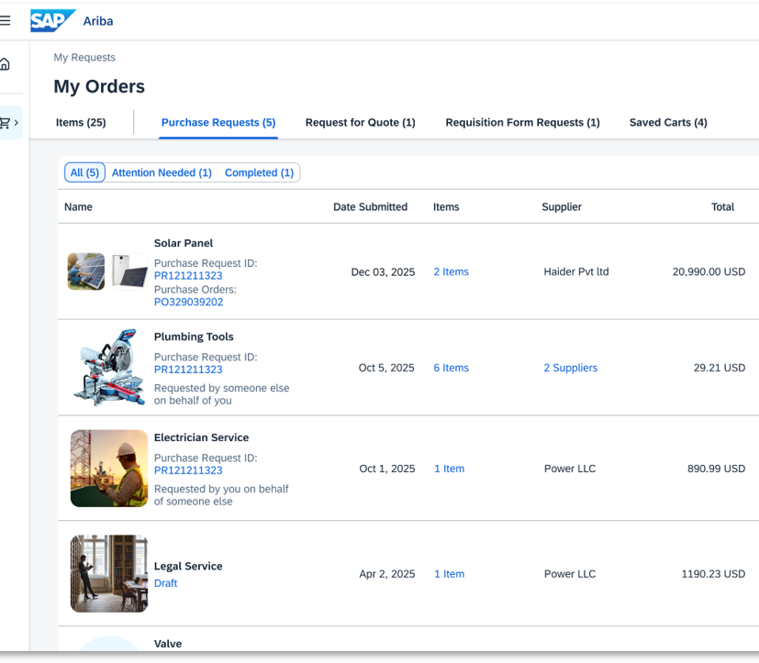
Upgraded Checkout and tracking experience
  Capabilities
  Simple checkout for casual buyers, with AI-powered field defaulting, policy guidelines, and integrated budget checks
  Powerful, flexible experience for professional buyers, with total landed cost, discounts, taxes, and bulk edit
  End-to-end tracking experience with item and request level details
  Benefits
  Simpler and quicker compliant purchasing
  Faster approvals with quick turnaround time
Notes:
Regardless of how comprehensive your catalogs are, there will come a time when an employee can’t find exactly what your organization needs when it needs it. In most companies, this means employees will buy from one-off suppliers. While this may meet the need in the moment, these purchases very often pose a managerial challenge because they’re outside of the normal procurement checks, balances, and paper trails. The Spot Buy capability addresses this need by providing:
An easier way to connect to content providers available from the capability’s ecosystem of suppliers, including marketplaces and qualified Ariba Network suppliers, enabling users to quickly find and buy what they need from among more than 100 million items.
A trusted source of supply from hundreds of preenabled marketplaces such as Amazon Business in the United States and Canada, and Unite in Europe, the Middle East, and Asia.
Control, because you customize it according to your policies and procedures, search criteria, and administrative contacts to manage spot buy requisitions
Detailed data for monitoring and reconciling transactions

