Slide 1
SAP Ariba Invoicing: Touchless Globally Compliant Invoice Processing

Slide 2





1,500
10,500+
25 Yrs
$1.5B
Successful Projects
TB of Data
Managed
Transforming Companies
Total Customer Savings
Driving Innovation, Empowering Transformations.
Data Management
Solution
implementation
Product
& Innovations
Strategic
Partnerships
  Data Archiving & ILM
  Retention Management
  HANA Memory Optimization (NSE)
  Data Governance
  Data Migration
  Cloud Migrations
  Data Privacy and Security
  Legacy Decommissioning
  Data Volume Assessment
  Data Quality Assessment
SAP S/4HANA & RISE
SAP BTP Deployment
  SAP Integration Suite
AI Implementation
SAP OpenText
  Extended ECM (xECM)
  Vendor Invoice Management
  Document Presentment
SAP Ariba
SAP Vertex
SAP Vistex
Geospatial Intelligence (GIS)
  Data ASSIST by Auritas
  (Data Archiving Automation)
  Data GUARD by Auritas
  (Legacy Decommissioning)
  Auritas Intelligent Accrual
  (Financial Automation)
  DMS+ by Auritas
  (Enhanced Document Storage)
SAP Gold Partner
SAP PartnerEdge, Sell
CCFlex – Cloud Choice Flex
PartnerEdge®
  (AMS + Hypercare)
CCFlex

Slide 3













Customer Success
Services Across Multiple Industries – Verticals:

Slide 4
Agenda
A focused journey from challenge to solution — designed for finance leaders and IT decision-makers evaluating AP transformation.
01
02
The AP Challenge
What is SAP Ariba Invoicing
Why manual, non-compliant invoicing is a growing risk
for global enterprises
From CIM to a global e-invoicing & AP automation platform
03
04
How it works
Global Compliance
From supplier submission to posting — end to end, touchless by design
Keeping pace with e-invoicing mandates worldwide across every region
05
06
Business Impact
Implementation & Next Steps
The numbers that matter most to Finance and Procurement leaders
A proven path to go live

Slide 5

Invoice Processing Is
Still a Bottleneck
70%+
Of invoice exceptions are still resolved manually via email and spreadsheets — adding days and error risk to every cycle
Manual Exception Resolution
60+
Nations now enforce e-invoicing or real-time
reporting mandates, with more coming each
quarter
Countries with Mandates
8–12
Average cycle time for a non-PO invoice in
a fully manual AP process, delaying
payments and losing discounts
Days Average Cycle Time
€100s
Annual penalty exposure from non-compliant
e-invoicing, a risk that grows with every new
country mandate
Thousands in Penalty Exposure
Disconnected AP tools, country-by-country compliance patches, and limited supplier visibility compound
each other, driving up processing cost, late payments, missed discounts, and audit risk.

Slide 6
Boost productivity and performance with next-generation advantages
SAP Ariba Invoicing is SAP's cloud invoice-to-pay solution — the evolution of Central Invoice Management (CIM). It combines PO and non-PO invoice automation, exception workflow, and built-in global e-invoicing compliance, delivered on the Ariba Network and natively integrated to S/4HANA and ECC.
1
2
3
4
Invoice processing from any source, anywhere
Process invoices from any source, globally—including PDFs, emails, e-invoices, SAP Business Network, and third-party networks
Best-in-class UX
A single launchpad feature offers unified navigation, Joule assistant, and intelligent insights
AI-native intelligence and automation
Leverage embedded AI to achieve touchless invoice processing, automatic matching, and always-on fraud prevention
Procurement suite and SAP ERP synergies
Operate seamlessly across procure-to-pay solutions and SAP ERP, SAP Business Network, and SAP Taulia​

Slide 7
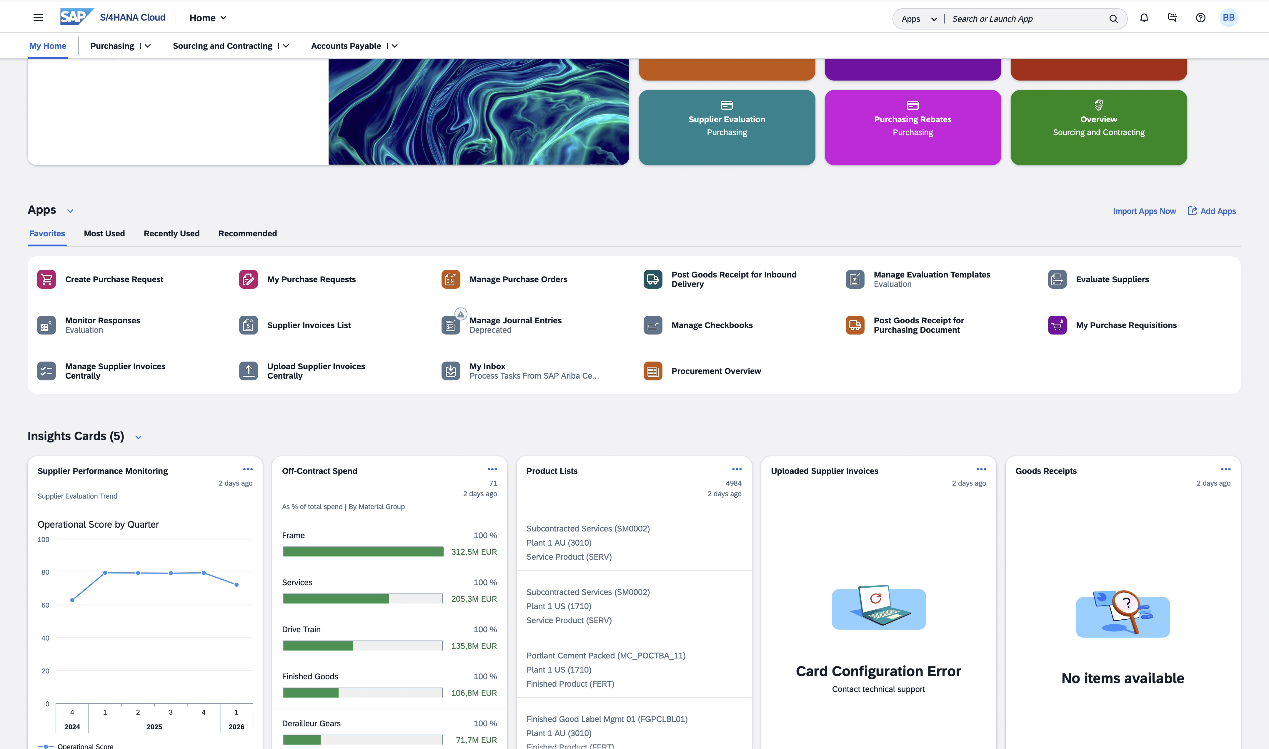
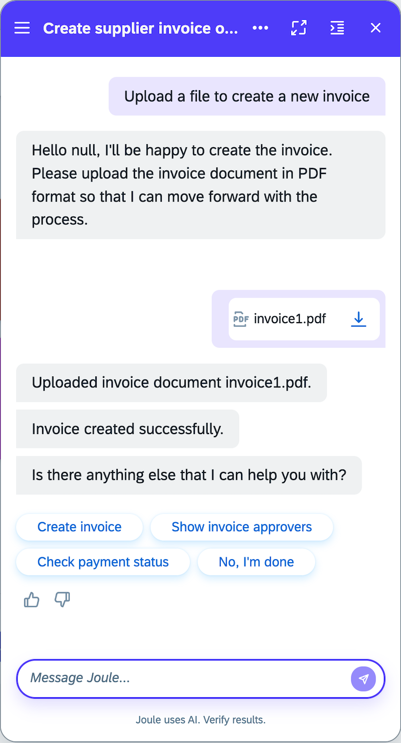
Joule-assisted invoice creation for casual users
Maximize adoption and minimize administration overhead
Enable end users to easily upload via Joule, or your AP team to simply drag and drop invoices into the solution
Leverage multiple inbound channels, including email, e-invoices from SAP Business Network, the Peppol network, or APIs
Continuously improve results with native recognition of invoice data from images via SAP Document AI, intelligent metadata extraction of PDFs, and multiple LLMs
Notes:
SAP Ariba Invoicing supports virtually any inbound channel:
An included email service that extract invoices attachments from emails
E-invoices from SAP Business Network or the Peppol network (SAP Document and Reporting Compliance, cloud edition, may be required)
Via APIs for both structured invoice data as well as images
Drag-and-drop of invoices into the application itself
Or lastly, any end user can simply ask Joule for guidance and upload an invoice directly from their device
The solution comes with a truly innovative image recognition framework, leveraging SAP Document AI, metadata extraction from PDF, and multiple LLM engines like Google Gemini, Claude, and ChatGPT.
A feedback loop takes input from the user and continuously improves the recognition rate and accuracy of invoices.

Slide 8
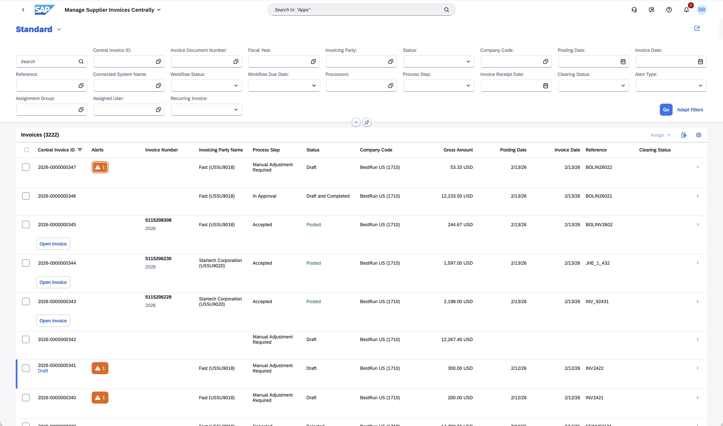
Central invoice worklist for AP
Gain knowledge and insights for efficient invoice processing
One view of invoices and their status across any SAP ERP
Powerful filtering and automatic AP team assignment to maximize processing speed
Seamless integration with Joule for querying any SAP business document
Notes:
SAP Ariba Invoicing supports virtually any inbound channel:
An included email service that extract invoices attachments from emails
E-invoices from SAP Business Network or the Peppol network (SAP Document and Reporting Compliance, cloud edition, may be required)
Via APIs for both structured invoice data as well as images
Drag-and-drop of invoices into the application itself
Or lastly, any end user can simply ask Joule for guidance and upload an invoice directly from their device
The solution comes with a truly innovative image recognition framework, leveraging SAP Document AI, metadata extraction from PDF, and multiple LLM engines like Google Gemini, Claude, and ChatGPT.
A feedback loop takes input from the user and continuously improves the recognition rate and accuracy of invoices.

Slide 9
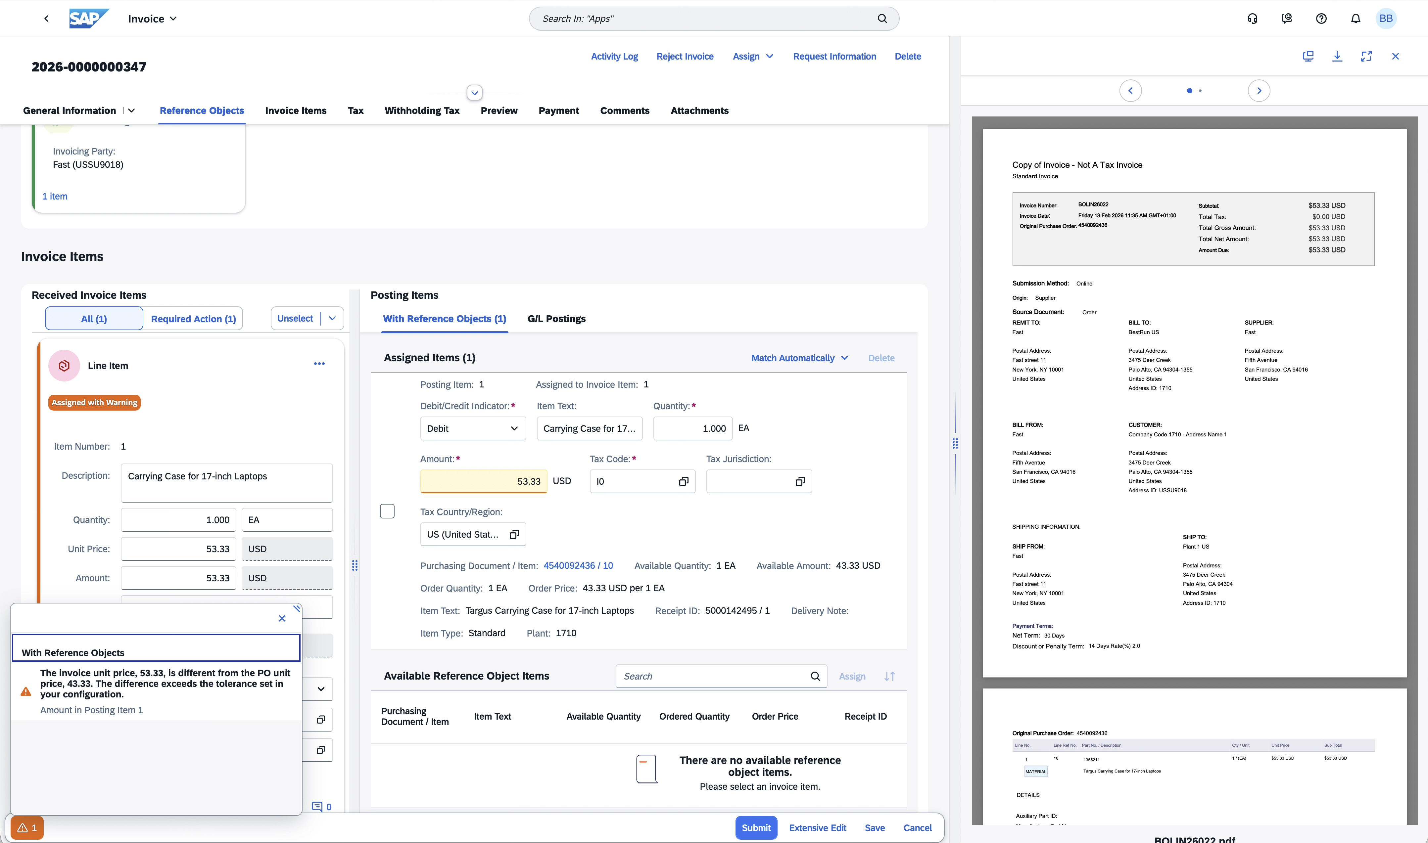
Embedded automation and AI
Improve invoice processing speed and insights
Automatic cost assignment leveraging AI/ML
Automatic and optimized match and re-match of line items leveraging text, amount, and part number
Native tax validation or option to use third-party tax services available on SAP Store or via API
Joule assistance to improve decision-making and provide data-driven insights
Notes:
SAP Ariba Invoicing supports virtually any inbound channel:
An included email service that extract invoices attachments from emails
E-invoices from SAP Business Network or the Peppol network (SAP Document and Reporting Compliance, cloud edition, may be required)
Via APIs for both structured invoice data as well as images
Drag-and-drop of invoices into the application itself
Or lastly, any end user can simply ask Joule for guidance and upload an invoice directly from their device
The solution comes with a truly innovative image recognition framework, leveraging SAP Document AI, metadata extraction from PDF, and multiple LLM engines like Google Gemini, Claude, and ChatGPT.
A feedback loop takes input from the user and continuously improves the recognition rate and accuracy of invoices.

Slide 10
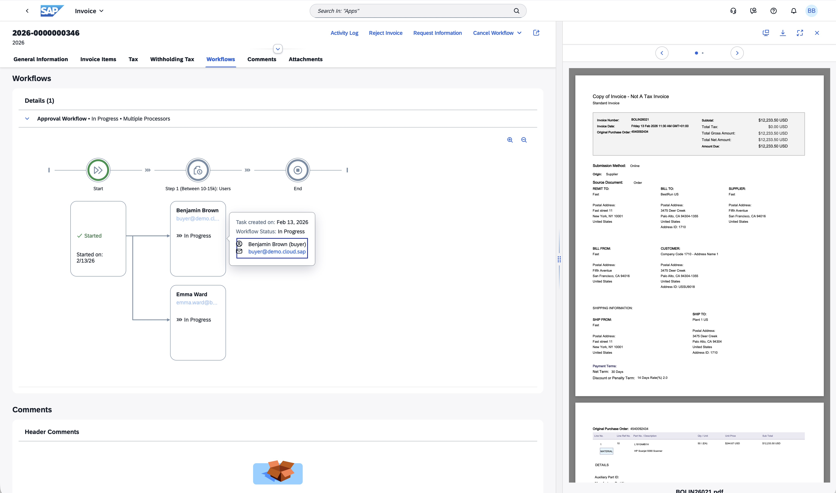
Simple End User Approval
Access powerful approval workflow capabilities with tasks integrated to SAP S/4HANA
Approve invoices efficiently through integration with SAP Task Center, or use a central to-do option in SAP Ariba launchpad
Configure complex business logic supporting complicated use cases, including exception-based scenarios or APIs for external logic
Easily process series, parallel, or multi-level approvals
Notes:
SAP Ariba Invoicing supports virtually any inbound channel:
An included email service that extract invoices attachments from emails
E-invoices from SAP Business Network or the Peppol network (SAP Document and Reporting Compliance, cloud edition, may be required)
Via APIs for both structured invoice data as well as images
Drag-and-drop of invoices into the application itself
Or lastly, any end user can simply ask Joule for guidance and upload an invoice directly from their device
The solution comes with a truly innovative image recognition framework, leveraging SAP Document AI, metadata extraction from PDF, and multiple LLM engines like Google Gemini, Claude, and ChatGPT.
A feedback loop takes input from the user and continuously improves the recognition rate and accuracy of invoices.

Slide 11
Built for AP Teams and Global Compliance
Touchless Matching
Global E-Invoicing
Smart Exception Routing
Automated 2-/3-way match with configurable tolerances, dramatically reducing manual line-item review and human error
Native integration with SAP Document & Reporting Compliance for clearance and real-time reporting mandates across all regions
Rules-based workflow sends only real exceptions to the right approver, first time, eliminating misrouting and approval delays
Supplier Self-Service
Tax Determination
Real-Time ERP Integration
Suppliers submit, track, and resolve invoices directly on the Ariba Network, reducing inquiry calls and improving satisfaction
Automated tax validation and calculation aligned to local requirements, ensuring accuracy before posting
Native connectivity to S/4HANA (Public & Private Cloud) and ECC, no middleware, no reconciliation lag
Notes:
Mani

Slide 12
Optimize workflows across sources and systems with SAP Ariba Invoicing
START
HERE
Supplier uploads invoice to government portal
Invoice is registered at government portal
Supplier
Automated
User
Government portal
SAP Document and Reporting Compliance
START
HERE
Supplier sends invoice via Peppol network
Peppol network exchange service
Data conversion and validation
Supplier sends invoice as attachment to email
Invoice attachment is received via email
German XRechnung
Manage rejection
Manage exception
Request for information
Non-PO invoices
AI/ML cost account defaulting
START
HERE
Supplier sends paper invoice
Mail clerk scans and uploads invoice
Multimodal data extraction OCR
Local or third-party tax determination
Central invoice worklist
Approval workflow
Post approved invoices to SAP ERP or SAP
S/4HANA
SAP Ariba Invoicing
PO invoices
Smart PO line- item matching
End user uploads invoice via Joule
End user uploads invoice via Joule
Retrieve assignment candidates
Purchase order
Payment status update
Schedule and pay invoice
SAP ERP or SAP S/4HANA
* SAP Document and Reporting Compliance may be required in some regions for e-invoicing regulatory requirements
Notes:
This flow depicts the multiple sources through which an invoice may originate.
1
In e-invoicing regulated countries, invoices may be submitted by a supplier directly to the government portal or sent via Peppol network.
The system also supports direct upload of invoices into the solution, either from an email or via drag-and-drop images or Excel. End users can leverage Joule to upload invoices into the solution using virtually any device.
Last but not least, several APIs exist to support upload of either structured invoices or images.
Independently of the source, images are processed by a framework of services, including intelligent metadata extraction from PDF, image recognition through SAP Document AI, and several GenAI LLMs including Google Gemini, Claude, and ChatGPT. A feedback loop ensures that customer corrections are fed back into the logic for continuous improvements.
The solution leverages SAP Document and Reporting Compliance to address German XRechnung invoices received via email.
2
The system automatically performs cost object assignment based on historical invoices using SAP Business AI services or business rules.
PO invoices are automatically matched against PO line items using optimized algorithms.
Automatic tax code determination and tax amount validation occur through local tax tables or third-party tax solutions from Vertex, Thomson Reuters, or Sovos – or any other solution via APIs.
The system also validates the invoice, and any issues raise an exception and alert for the AP team.
3
On the invoice work list, the solution can route invoices to the correct AP team based on the issue.
The invoice work list shows an overview of all invoices in the solution as well as invoices replicated from any SAP ERP for visibility.
A detailed invoice screen allows AP to address any issue with the invoice, and can raise additional workflows through an RFI.
4
The invoice can be approved either locally by the SAP Ariba launchpad or in the SAP Task Center.
Once the invoice is approved, it is automatically posted to SAP S/4HANA for payment.
Any payment status is fed back to the invoice work list.

Slide 13

A Moving Target, Handled for You
E-invoicing mandates are expanding fast, with different models by country, clearance, real-time reporting, and Peppol-based exchange. SAP Ariba Invoicing, paired with SAP Document & Reporting Compliance, keeps that complexity out of your AP team's hands entirely.
Europe
Peppol, ViDA-driven mandates, and country-specific clearance models including Italy SdI, France, and Poland KSeF
Latin America
Complex clearance models, Mexico CFDI, Brazil NF-e, and additional requirements across the region
Asia Pacific
Emerging real-time reporting and e-invoicing mandates across key markets with rapid regulatory evolution
Middle East & Africa
Fast-growing clearance and reporting requirements, including Saudi Arabia ZATCA and UAE frameworks

Slide 14
Finance and Procurement Gain
Higher touchless rate — fewer manual keystrokes, fewer errors, and faster throughput across your entire invoice volume
Faster cycle times — shorter approval windows unlock more early-payment discount opportunities with strategic suppliers
Lower cost-per-invoice — reduced exception handling and audit exposure drives measurable savings in AP operating cost
Improved supplier satisfaction — self-service status visibility eliminates the flood of "where's my payment?" inquiry calls

Slide 15
Why a Single, Network-Connected Platform Wins
Not all AP automation approaches deliver the same outcomes. See how SAP Ariba Invoicing compares against manual processes and point e-invoicing tools across the dimensions that matter most to global enterprise finance teams.
Capability | Manual / Email AP | Point E-Invoicing Tools | Ariba Invoicing
Native ERP Integration | No | Partial / custom | Yes — S/4HANA & ECC
Global Compliance Engine | No | Country-limited | Yes — via SAP DRC
Supplier Network Effects | No | No | Yes — Ariba Network
Single Platform for PO & Non-PO | No | Varies | Yes
Exception Workflow Automation | No | Basic | Yes — fully configurable

Slide 16
A Phased Path to Touchless AP
SAP Ariba Invoicing is designed for a structured, low-risk deployment, starting with discovery and growing into a fully global rollout. Each phase builds on the last, ensuring your team is ready before expanding scope.
Phase 1
Phase 2
Phase 3
Phase 4
Discover & Design
Assess invoice volumes, countries in scope, current AP process gaps, and key pain points to define the target-state architecture.
Configure & Comply
Set up matching rules, exception workflows, and country-specific compliance configurations via SAP DRC for all in-scope geographies.
Pilot
Roll out to one country or business unit; validate performance with real suppliers and live invoice volumes before broader expansion
Scale Globally
Expand country-by-country, layering in new compliance mandates as they emerge, building toward a fully touchless global AP operation

Slide 17
Let's See It on Your Invoices
The best way to understand the impact of SAP Ariba Invoicing is to walk through it in your own process context. Choose the engagement that fits where you are today.
1 — Solution Demo
2 — Value Assessment
3 — Roadmap Workshop
Walk through PO and non-PO invoice scenarios mapped to your specific process context and industry — see touchless AP in action
Quantify the cycle-time reduction, cost savings, and compliance-risk impact for your actual invoice volumes and country footprint
Define scope, country sequencing, and integration approach — leaving with a concrete deployment plan your team can act on

