Slide 1
Procurement Transformation
SAP Business Network:
Connect Once,
Transact with Everyone

Slide 2

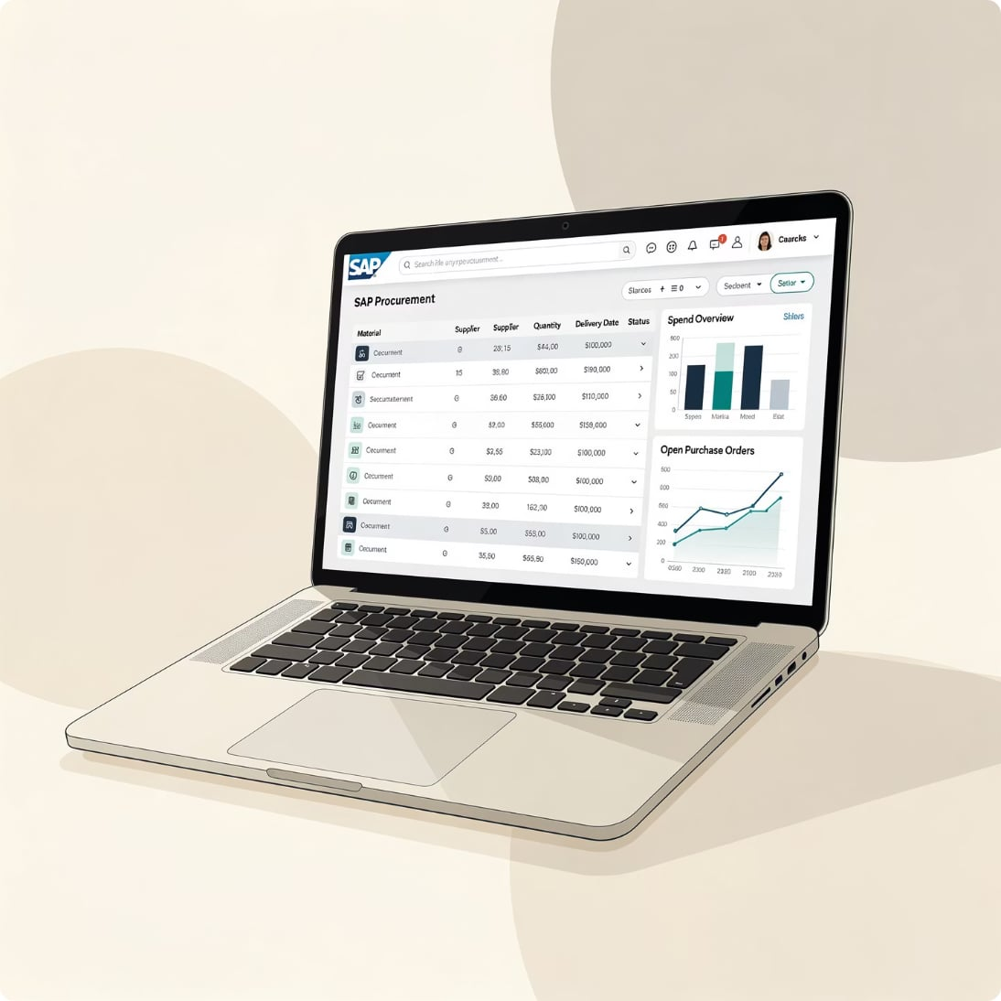
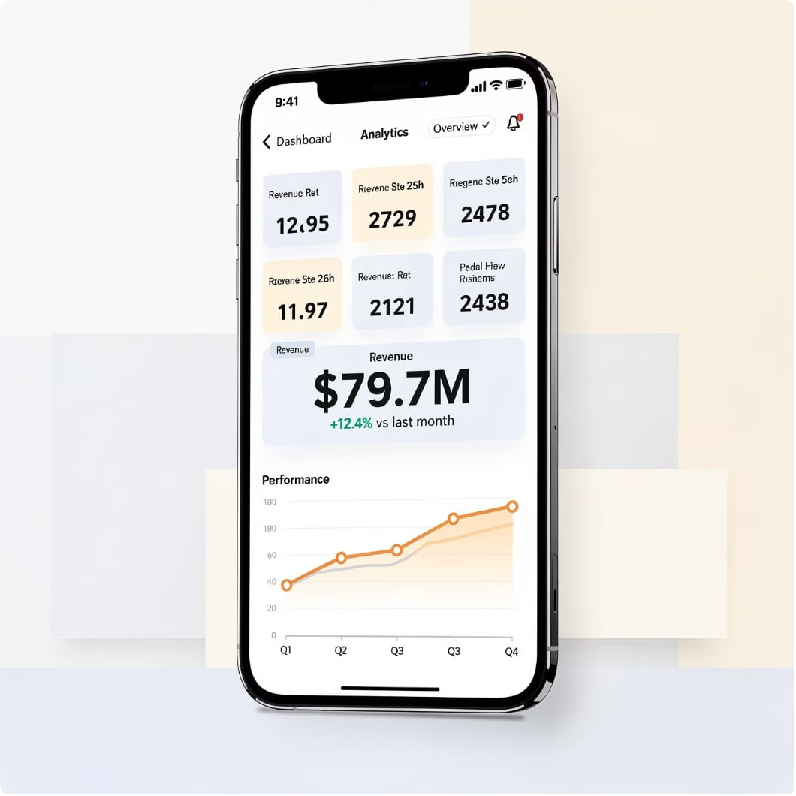
What is SAP Commerce Automation Foundation?
SAP Supplier Portal solution for customers running S/4HANA and SAP ECC
SAP Digital Supplier Network
Procurement Dashboard
Mobile Analytics
Many-to-many collaboration connecting buyers and suppliers globally
Streamlined purchasing workflows and
Order management
Real-time supplier performance and
Spend visibility on the go

Slide 3

Integrating To SAP Business Network:
Connecting To World's Largest B2B Trading Platform
4.1M
5.4s
Companies
Seconds
Connected businesses across the network.
Every 5 seconds a company joins.
$3.1T
494M
Annual commerce
Documents
Total commerce flowing through the platform.
Documents annually processed across all types.
597K
189
Timesheets
Countries
Timesheets processed annually.
Where customers and suppliers are located.
200K
461K
Catalogs
Leads
Catalogs on Ariba Network.
Leads sent annually to sellers.
26M
Users
Active users across the network.

Slide 4









B2B Collaboration keeps changing and evolving
Personal Life
Supply Chain
We’re HERE!
Social Network, Sharing Economy, Global Community
“Many-to-many Collaboration”
Sharing, networking, visibility
B2B Collaboration Network with Supplier Community
3
“Peer-to-Peer Communication”
Bi-directional, real-time, continuity
Vendor Portal (1:N)
EDI / VAN
ERP
2
E-mail, SMS, Chat, Blog
1
Phone call, Greeting Cards
“Sending information”
1-way, intermittent, no visibility
Spread Sheet
EMS, FAX

Slide 5
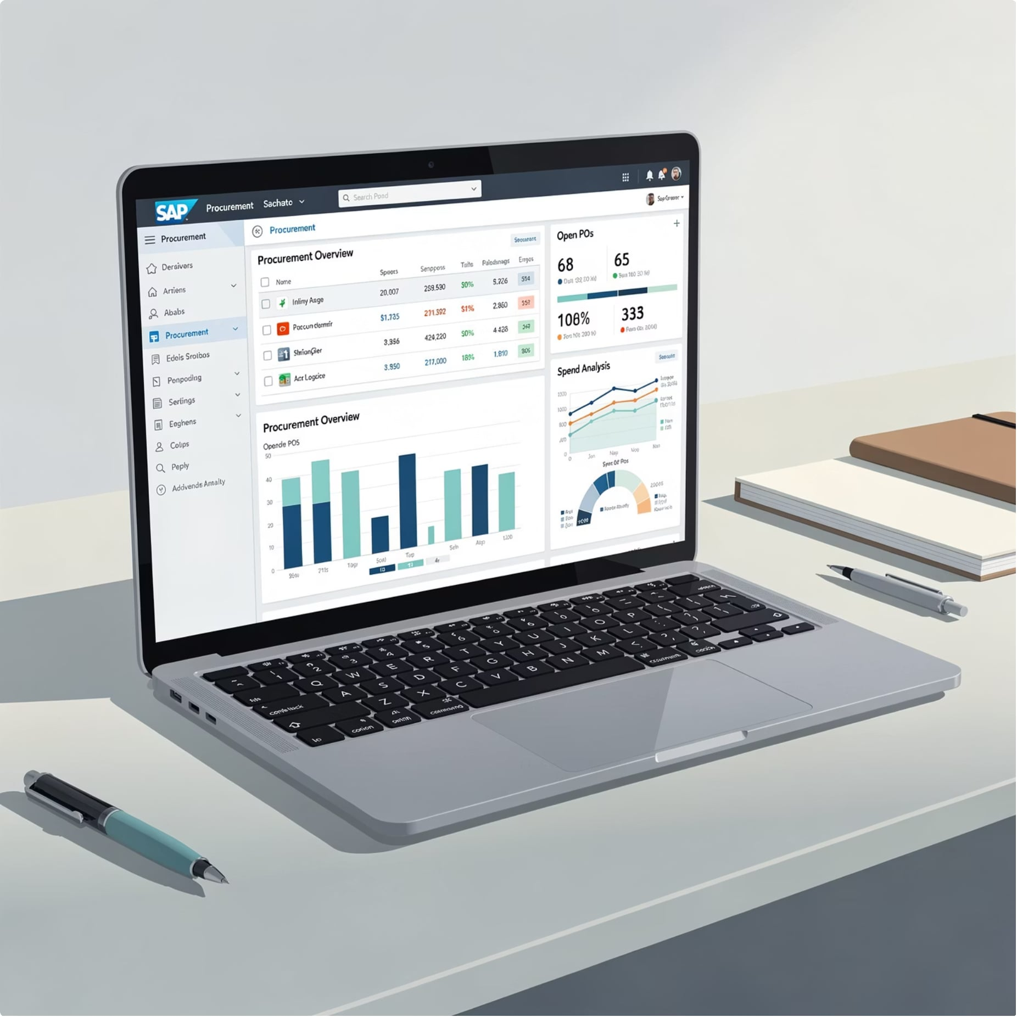
Enable digital commerce for your suppliers
You really can't run an Intelligent Enterprise on email, phone & paper.
Error-Prone
Slow
High-Cost
Data Poor

Slide 6
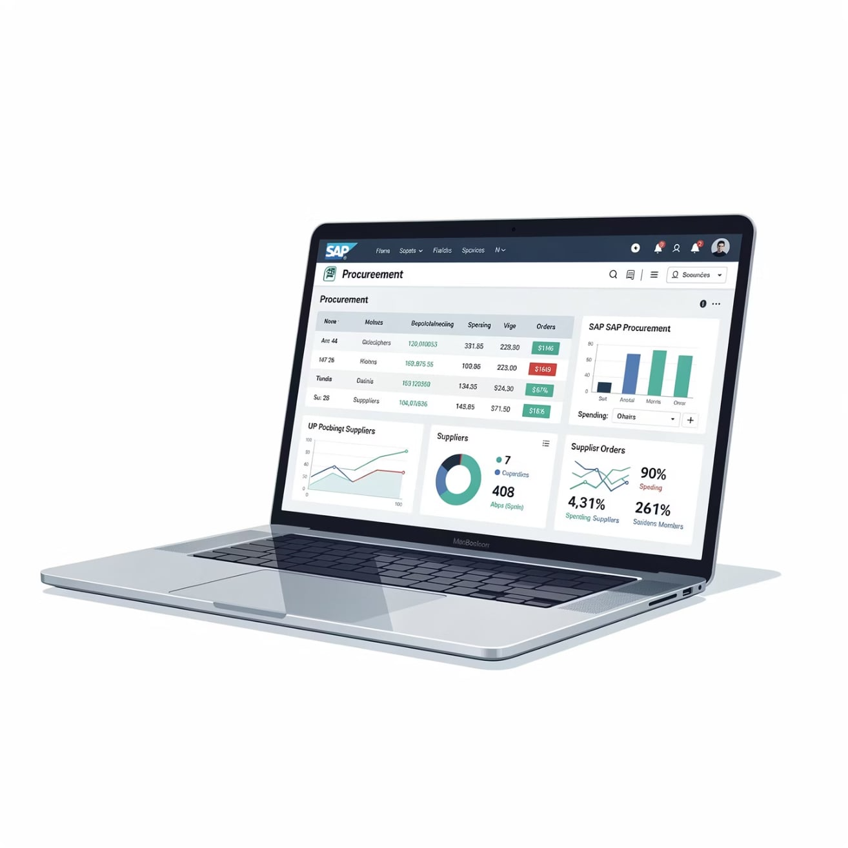
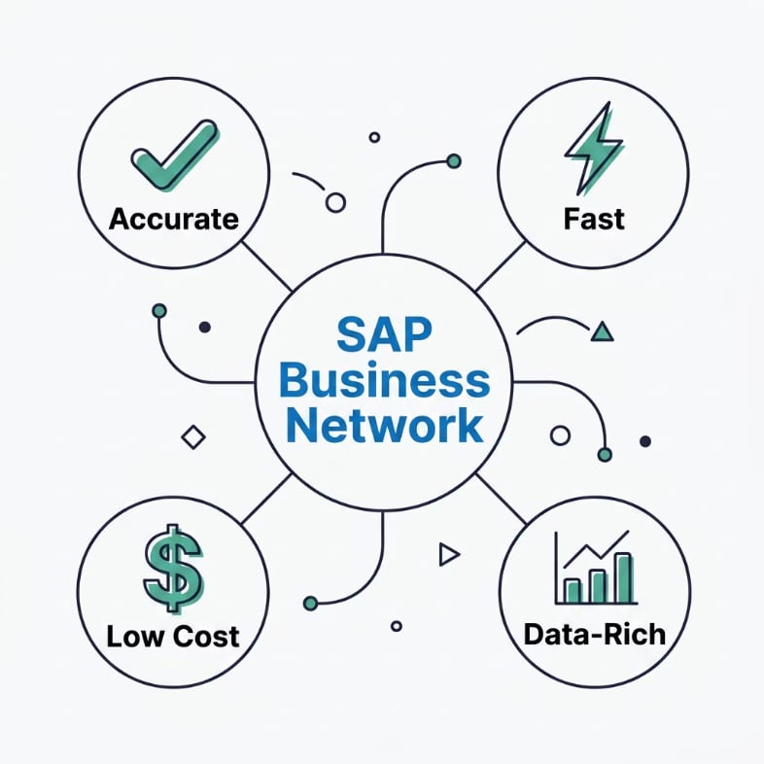
Enable digital commerce for your suppliers
SAP Business Network is the proven solution for digital supplier collaboration.
$3.1T
in commerce on an
annual basis
4.1M
companies on the Network
490M+
business commerce
transactions per year
76%
Accelerating your digital transformation on the path to becoming an Autonomous Enterprise
of Fortune 2000 companies

Slide 7

One could say, it's like
the best Smart Phone
in the world…
Without a SIM card.

Slide 8
SAP CA Business Case
$500m in spend is $1m in savings*
BUYER VALUE
SUPPLIER VALUE
Eliminate payment of duplicate invoices
Reduce the cost of processing invoices
Capture missed early payment discounts
Avoid being charged with late payment fees
Augment visibility of cash-flows
Improve Employee Experience
Top 5 Questions answered
Do I have a new order?
Did the customer receive my goods/services?
What is the status of my invoice?
When will I be paid?
Do I have leads to respond to?

Slide 9
Here is how you transact today

Slide 10
Here is the future state

Slide 11


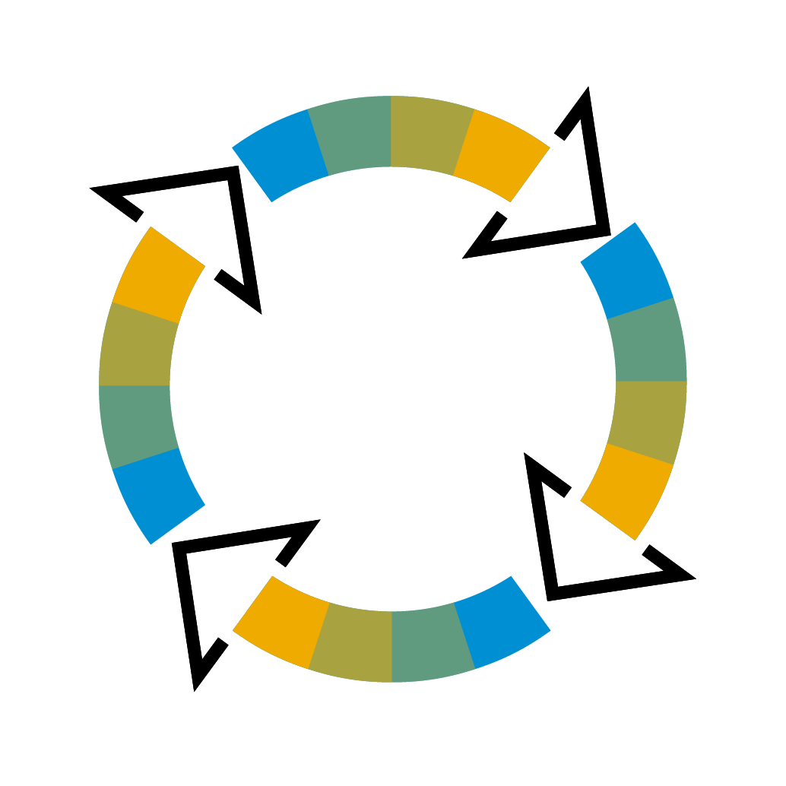






SAP Business Network and VIM
Perfect fit. Natural Progression. Achieve Optimized Invoice Automation
SAP S/4HANA or ECC
+
SAP Invoice Management
SAP Business Network
Invoice
Verification
Collaboration
& Monitoring
Invoice
Approval
Invoice
Completion
Email
Paper
Invoice Processing to Pay
Automated reconciliation and posting
Payment
SAP Business Network
cXML
EDI
CSV
SAP II
Supplier Portal
  The SAP Business Network ensures a very high degree of automated invoice processing. However, workflow approvals might still be required
  Having passed the SAP Business Network business rules invoices are received in the (central) ERP-System. Required workflows are being triggered. Finally, the invoice is matched and posted in the (local) SAP ERP system

Slide 12
Commerce Automation Scope and Document Flow
SAP
Supplier Network
ECC or S/4HANA
Buyer Roles: Purchaser, Warehouse Clerk
Role: Supplier
Create Purchase Order
Receive Purchase Order
Update Purchase Order
Confirm Purchase Order
Update Purchase Order
Send Advance Shipment Notice
Create Goods Receipt
Receive Goods Receipt Notice
Post Supplier Invoice
Send Invoice
Release Invoice for Payment
Receive Invoice Status Update

