Slide 1
Auritas + OpenText Webinar | Thursday, April 23, 2026
Turning Operational Data into ESG Intelligence with SAP Invoice Management (IM) by OpenText

Slide 2
.
ESG Reporting – Trends & Key Drivers
Organizational Strategy
Investment Benefits
Stakeholder Pressure
Regulatory Compliance
Regulatory Readiness
84%
76%
81%
155%
29%
84% of companies engage with ESG ratings & reporting frameworks as part of their sustainability strategy.
76% of investors say sustainability-related financial information is important or very important in investment decisions.
81% of executives report stakeholder pressure to increase sustainability actions. 46% say investor demand is the main reason they engage in ESG reporting.
ESG-related regulations have increased by about 155% over the last decade. Since 2021, it has increased by 552%.
Only about 29% of companies felt sufficiently prepared for ESG data assurance despite tightening regulatory deadlines.
Notes:
https://kpmg.com/xx/en/media/press-releases/2024/06/29-percent-of-companies-feel-ready-to-have-esg-data.html
https://esglore.com/analytics/esg-regulations-have-increased-155-in-the-last-decade
https://enable.green/news/esg-reporting-in-the-us-what-companies-need-to-know/
https://blog.worldfavor.com/countries-affected-by-mandatory-esg-reporting-here-is-the-list
https://corpgov.law.harvard.edu/2025/04/12/regulatory-shifts-in-esg-what-comes-next-for-companies/
https://www.pulsora.com/blog/esg-reporting-obligations
https://www.elliottdavis.com/insights/esg-compliance-guide-for-us-states-in-2025
https://optro.ai/blog/esg-reporting

Slide 3
ESG reporting is shifting from voluntary to mandatory, with strict deadlines
2019
Streamlined Energy and Carbon Reporting (SECR) – UK
Climate Leadership and Community Protection Act – New York, USA
EU Taxonomy Regulation (first reporting 2022) – EU
Climate Commitment Act – Washington, USA
International Sustainability Standards Board (ISSB – IFRS S1 & S2)
Corporate Sustainability Reporting Directive (CSRD) – EU
Minnesota Climate Risk Disclosure for financial institutions – Minnesota, USA
SB 253 (Scope 1 & 2) – California, USA
SB 261 – California, USA
SB 253 (Scope 3) – California, USA
SB 3456 (Scope 1 & 2) – New York, USA
SB 3697 (Scope 3) – New York, USA
CSRD – EU, Non-EU companies with EU operations
Upcoming – SEC Climate Disclosure Rule – USA
Upcoming – Greenhouse Gas Pollution Reduction Roadmap – Colorado, USA
S4117 Climate Corporate Data Accountability Act (proposed) – New Jersey, USA
2019
2019
2022
2022
2023
2023
2024
2024
2025
2025
2025
2026
2026
2026
2027
2027
2027
2028
2028+

Slide 4
Path to ESG reporting mandates
ESG Metrics
Enterprise Sources
  Posted Invoices
  Invoice Images
Carbon Footprint
  Electricity, Gas, Fuel, Waste Management, Others…
ESG Reports
Merge & View
  Enterprise Reporting
  Operational Insights
Control Tower
Compliance & Improvements
  Regulatory Submissions
  Drive Progress
  Forecasting
SAP + OpenText: ERP-Based Capture and Reporting

Slide 5
Extend OpenText - ESG Reporting
Clearly identifiable source
Owned Platform for multiple document types
Pre-built solution
SAP embedded and easy data export
State of art Machine Learning & AI
Business rules engine
Seamless hand off from AP -> Sustainability
No additional license cost for given volume
Reliable outcome with low one-time cost
Native tie into SAP master data, forecast, cash flow and reporting
Knowledge Base + LLM with Guardrails
Strong validation and anomaly detection

Slide 6






SAP Intelligent Capture & SAP Beyond Invoices
SAP Information Capture by OpenText
Capture / extraction solution
for all SAP documents
SAP Invoice Management by OpenText
Processing and workflow engine
Invoices
Machine Learning
Sustainability!!1
Order Confirmations
Capture
Identify
Learn
Optimize
Remittance
Sales Orders
Delivery Notes
Notes:
Most of the corporate processes start, when a document enters an organization. Before anything else happens, the information contained on this document has to be captured (made readable for the computer). This process is also know as Optical Character recognition (OCR). SAP Information Capture is the product, that can help take care of this particular process.
After information from the document is captured by SAP Information Capture, it has to be passed to the leading application for further processing. In our case it is passed to SAP. Inside SAP it has to be processed to achieve a specific business outcome: dispatch goods ordered by a customer, process a quotation and send a response, or reconcile a remittance advice. Usually processing such information is done by hand, manually, and it is a highly labor intensive process, which is slow, error prone and costly. SAP Information Capture helps to fully automate processing of incoming information.

Slide 7
Sustainability Data Capture Flow
OD INVOICE POSTED
(EMAIL, SCANNING, EDI)
INTAKE
(OD Invoices)
OD INVOICE
RECOGNITION
OD INVOICE
VERIFICATION
OD MAP
COMPLETION
REPORTING
PROCESS:
Register OD-related invoices.
Capture pertinent data points.
Reporting Options:
Excel dump
BI reporting
POST INVOICES
INTAKE
TRANSFORM
VERIFY & COMPLETE
MAPPING DATA
KPI
EMAIL/EDI
REPROCESS UTIL INVOICES
INTEGRATION
VALIDATE DATA
MAP DATA
ARCHIVING
REGISTER
VALIDATION
FINALIZE
APPROVALS
OCR OPTION FOR APPL
AUTOMATE AND MAPPING
POST INVOICE
SAP INVOICE MANAGEMENT
BUSINESS CENTER (BC)
ERP (BW)

Slide 8
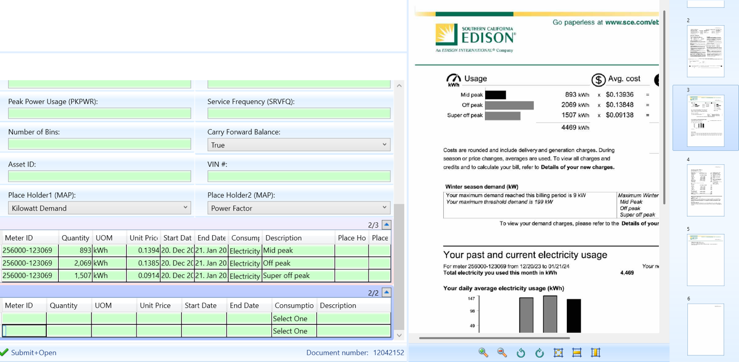
Capture ESG Metrics
HEADER
RATE SLABS
ITEMS
Header | Used for capture of Invoices with just one item
Rate Slabs | Used to capture Rate slabs for utilities
Item | Generally used for cases where an Invoice has more than one consumption category

Slide 9
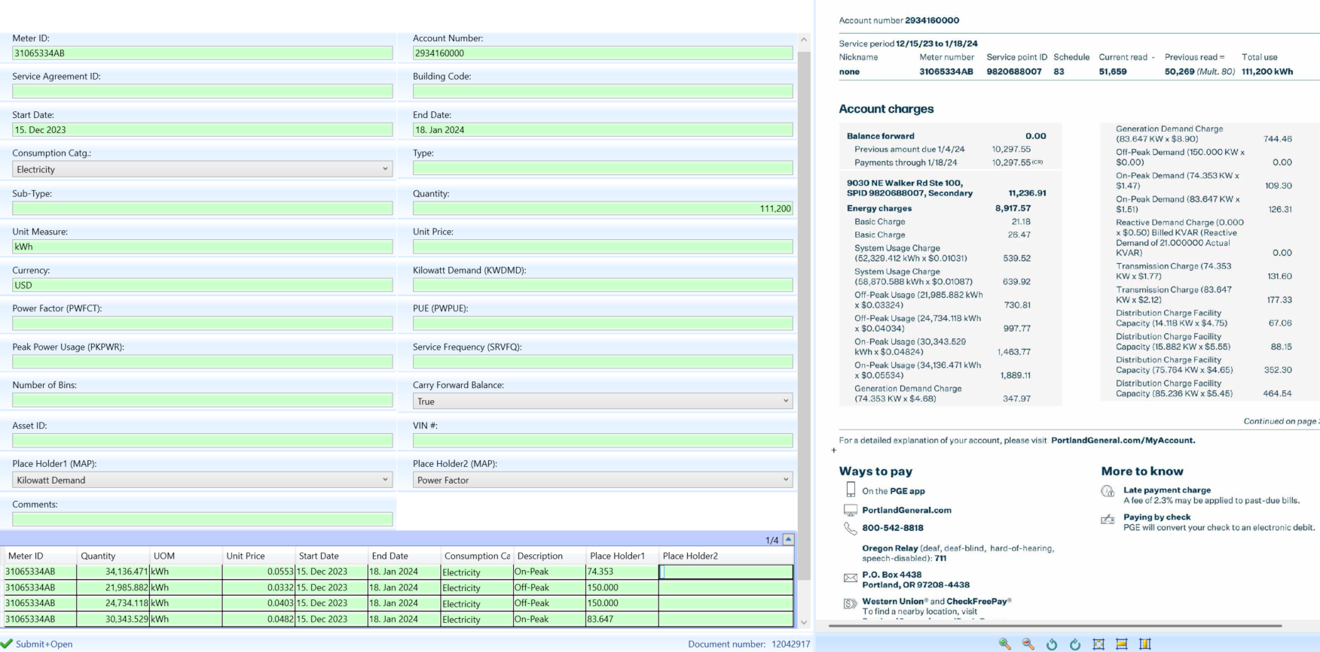
Intelligent Capture Overview

Slide 10
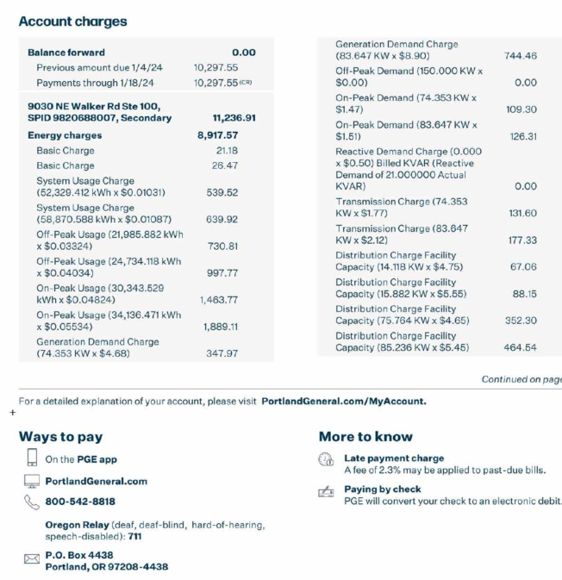
Attribute / Placeholder
Details
Itemized
Consumption

Slide 11
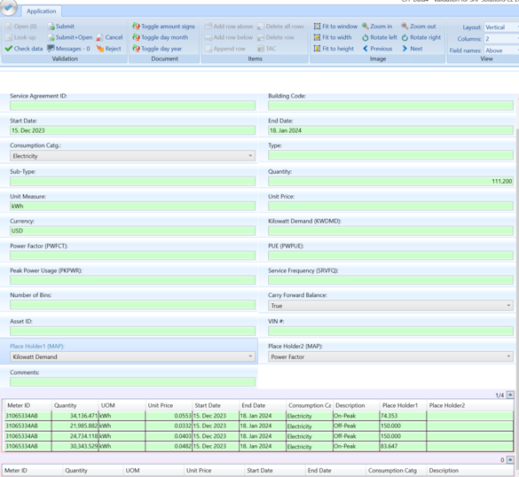
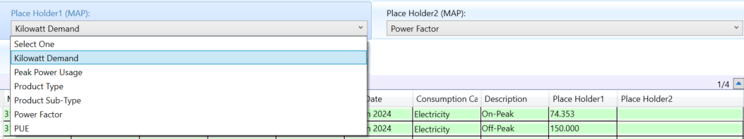
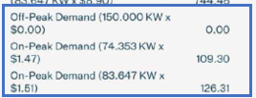
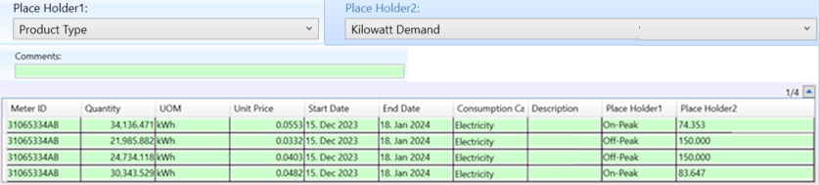
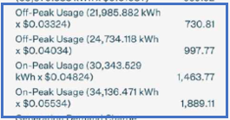
Carbon Footprint Data Attributes
Attributes
Consumptions

Slide 12

How RPA is Used
Document Classification, Invoice Intake and Rejections
Enrich information
Match to Master Data for Reporting
Apply the right set of business rules
Audited Data: Ready for publishing

Slide 13
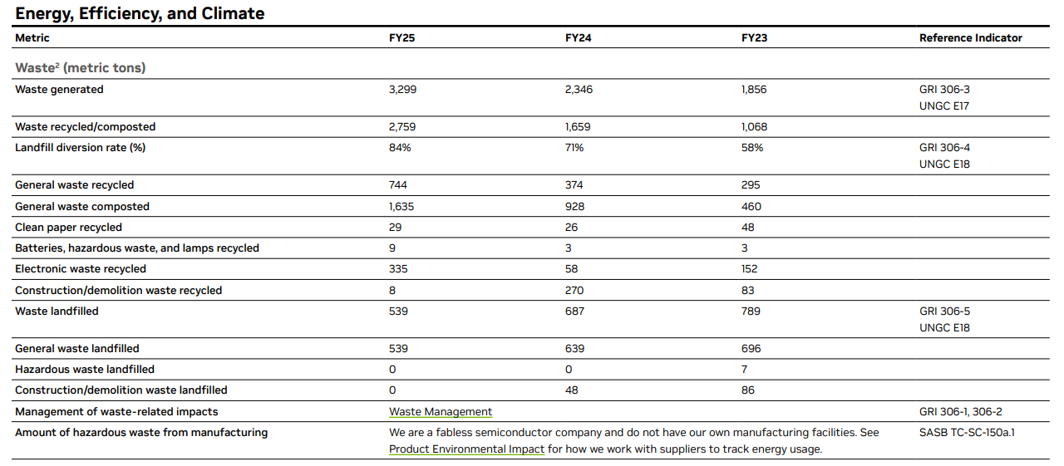
ESG reporting (Example 1)

Slide 14
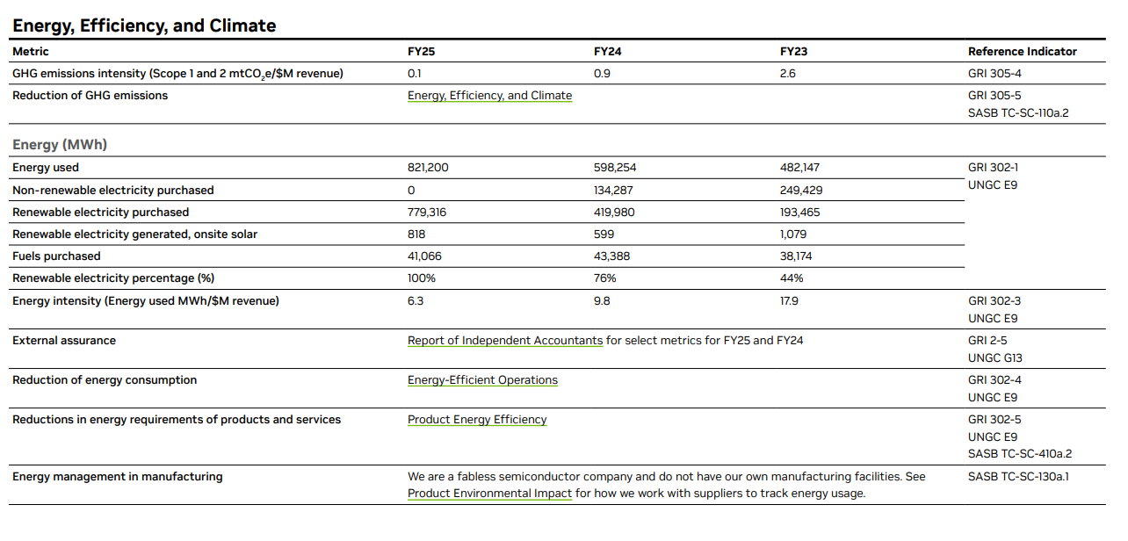
ESG reporting (Example 2)
JULIA, ASK ANIL!!

Slide 15
Live Q&A

