Slide 1
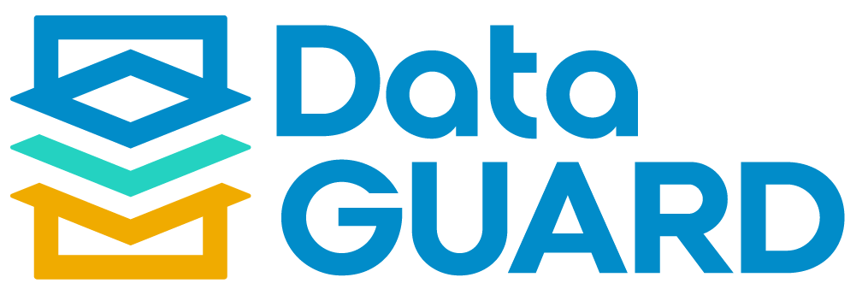
Multi-system Decommissioning & Retention Tool

Slide 2




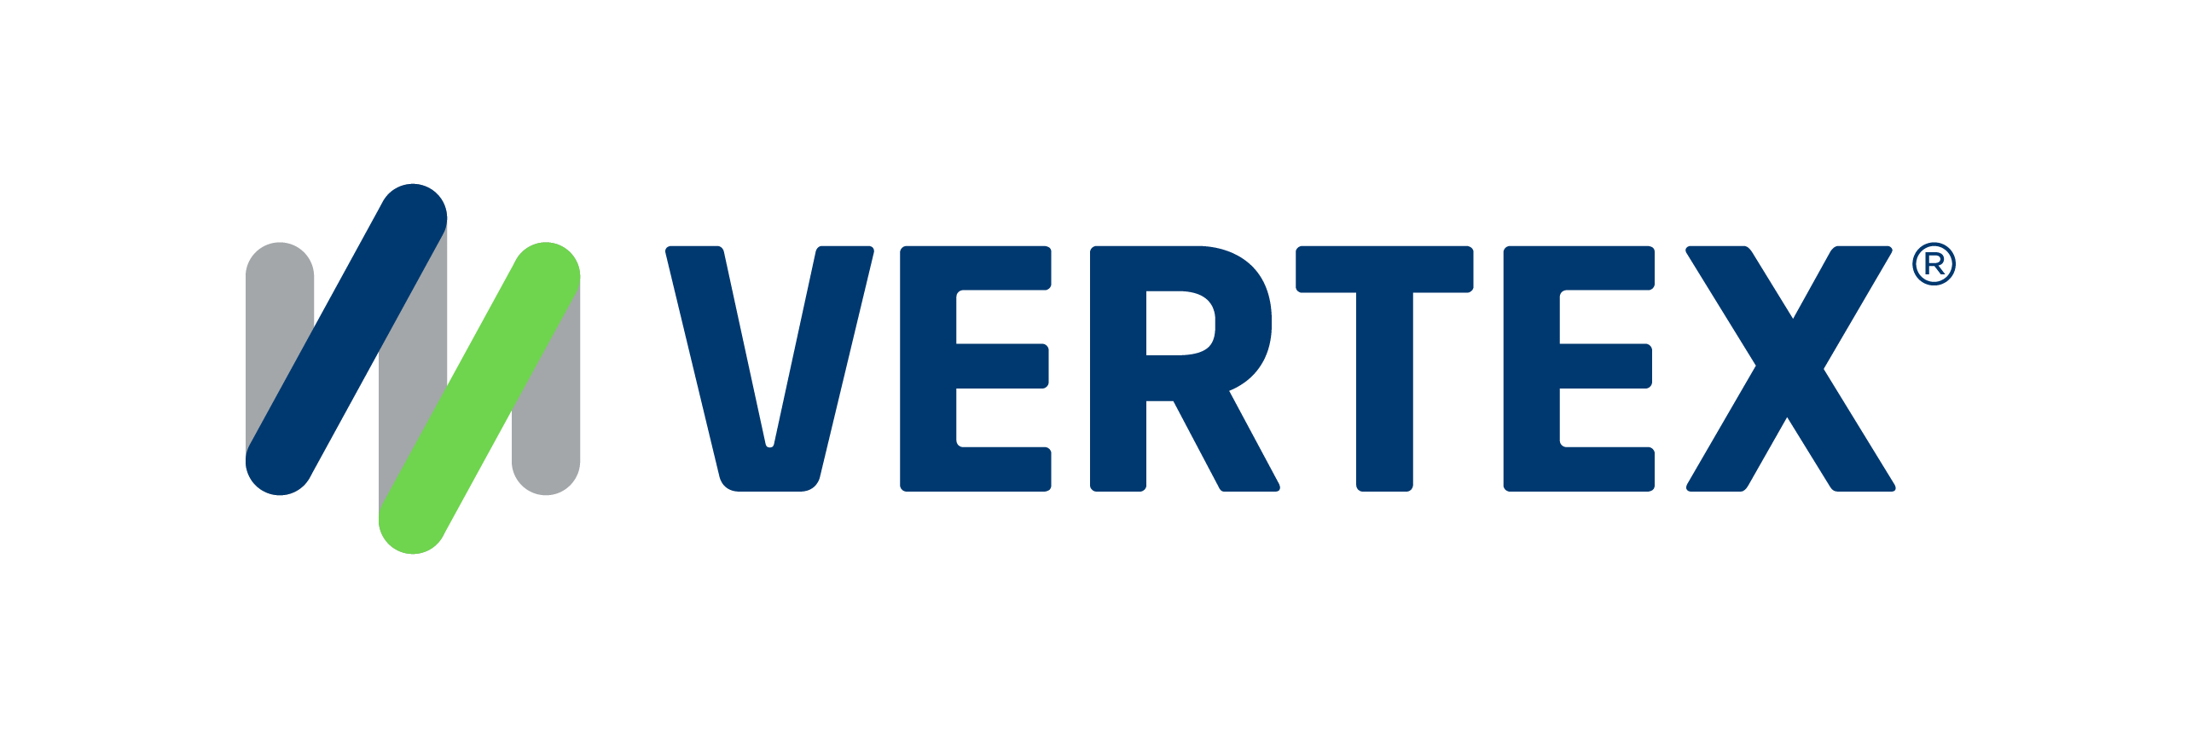
1,500
10,500+
25 Yrs
$1.5B
Successful Projects
TB of Data
Managed
Transforming Companies
Total Customer Savings
Driving Innovation, Empowering Transformations.
Data Volume Management
Data Quality Enablement
Document Management
Finance Optimization
Reduce size and complexity and control data growth across transactional and legacy SAP environments.
Cleanse, govern, and unify enterprise data to support trusted transactions, analytics, and AI-driven decision-making.
Centralize, govern and optimize enterprise content for operational efficiency, compliance, and AI readiness.
Automate and optimize AP/AR, invoicing, environmental reporting, tax, and royalty processes and functions.
  Rightsizing/Archiving
  Data ASSIST by Auritas
  SAP ILM
  Decommissioning
  Data GUARD by Auritas
  Governance
    SAP MDG
    SimpleMDG
  AI-Ready Enterprise Data
    Reltio
    Collibra
  OpenText for SAP Solutions
    Extended ECM
    Document Presentment
  DMS+ by Auritas
  Auritas Storage Manager
  Invoice Management
  SAP Ariba
  Auritas Intelligent Accrual
  ESG reporting
  SAP Vertex
  SAP Vistex
PartnerEdge®
CCFlex

Slide 3






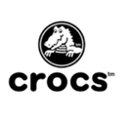


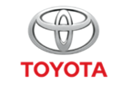



Customer Success
Services Across Multiple Industries – Verticals:

Slide 4

Legacy System Decommissioning

Slide 5
  Growing maintenance and hardware costs
  Security risks on outdated systems
  Limited data access due to technology constraints
  Compliance for data retention and preservation
  Inefficient data management causing silos
  Lack of skilled personnel for legacy maintenance
  Incompatible with modern technologies and apps
  High energy use and carbon footprint
Challenges of Aging Systems
Notes:
Get Deepak and David’s input here

Slide 6
The Solution:
The Power of Decommissioning
One Source of Truth to Legacy Data
50% reduction in costs related to legacy data retrieval and delivery.
Audit/Legal/Regulatory Readiness 32% reduction in storage costs, 20% faster handling inquiries.
Cloud Architecture Flexibility 70% efficiency gain in shared services center.
Meet Sustainability Goals
Cloud migration can lower energy consumption by 65% & carbon emissions by 84%.
Lower TCO for Hardware & Infrastructure
Redirect financial resources saved from decommissioning to more strategic areas.
Notes:
For the messaging/title for each feature:
What feature are we talking about? (automated scheduling) – Advantage – What benefit/outcome it drives to the customers?
Visual rework

Slide 7

Data GUARD by Auritas

Slide 8
Data GUARD by Auritas facilitate organizations to decommission legacy SAP and non-SAP systems while retaining accessibility to the data for regulatory, legal, and business purposes. Ensure reporting capability on data and documents retired and stored in Data GUARD. For decommissioned SAP systems, take advantage of 70+ T-code viewable interface screens.
Run advanced, tailored reports on decommissioned data through third-party analytic applications
Ensure the security of decommissioned data through Active Directory, SAP, and manual controls.
Decommission SAP and non-SAP systems while ensuring audit compliance with secure and immutable data storage.
Notes:
We can add screenshots here
-- Rework the visual of slide 5

Slide 9
Maximizing Archiving Success:
The Power of Data GUARD Automation
Unified system access
Manage data from multiple retired SAP and non-SAP systems.
Audit-ready compliance
Secure, immutable data storage simplifies audits and compliance.
Familiar SAP interface
70+ SAP transaction screens for a seamless user experience.
Flexible reporting
Create standard and custom reports within solution or third-party tools.
Divestiture readiness
Maintain secure data access during carve-outs and divestitures.
Secure data access
Control access through Active Directory, SAP, or manually.
Notes:
For the messaging/title for each feature:
What feature are we talking about? (automated scheduling) – Advantage – What benefit/outcome it drives to the customers?
Visual rework

Slide 10






Data GUARD: Capabilities
Decommission and manage multiple systems within your Data GUARD instance
Store structured and unstructured data within Data GUARD for single source of truth.
Migration capabilities: Convert any kind of source system into Data GUARD storage
Supported ERP Platforms
And more…

Slide 11
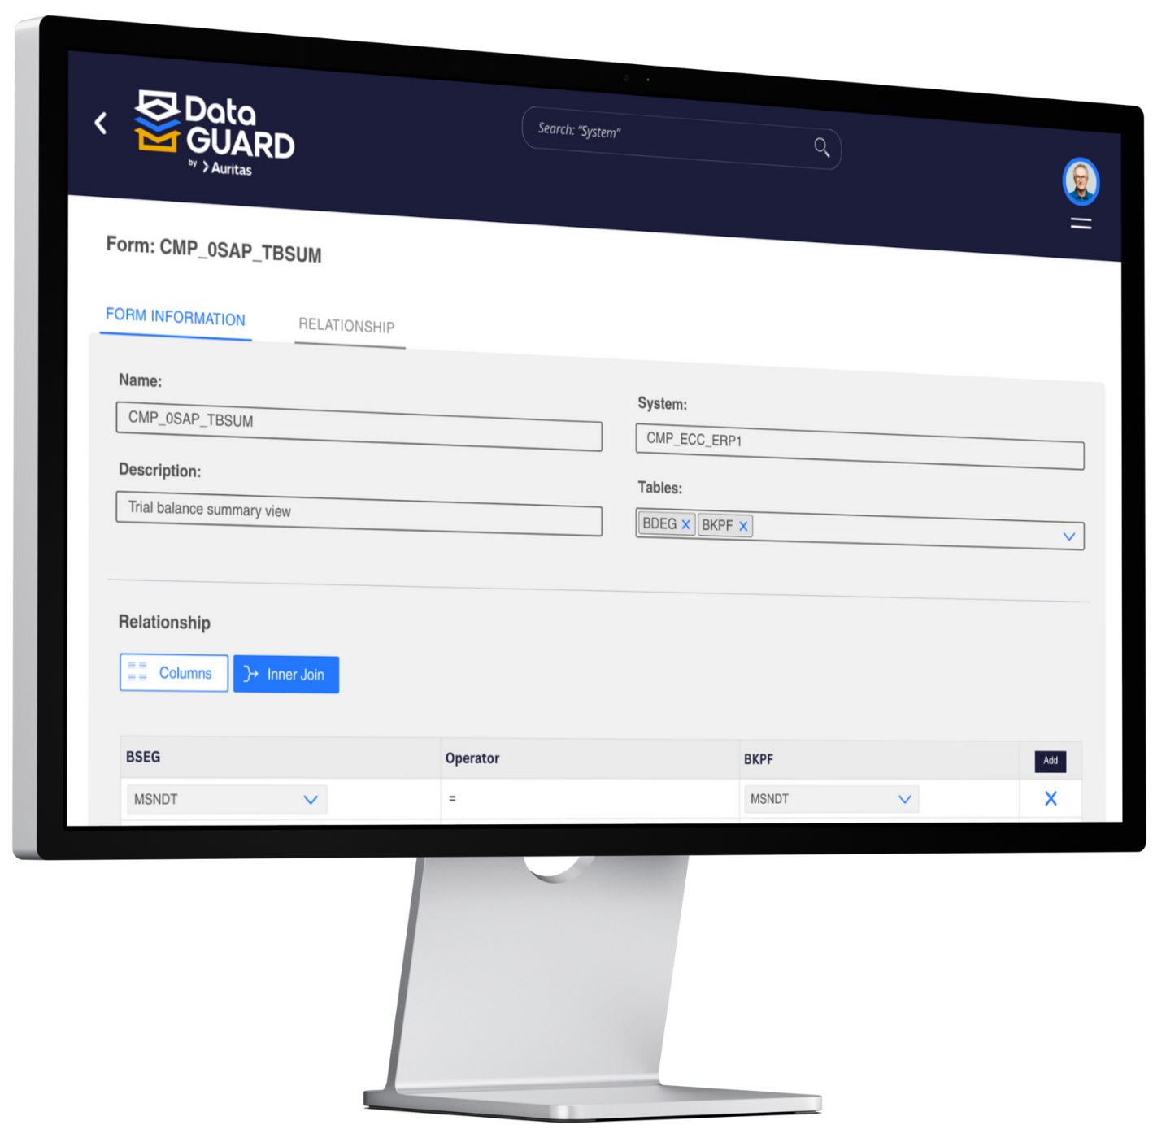
Data GUARD:
Reporting Capabilities
Data GUARD’s capabilities for reporting on the data, documents, and tables stored in the tool allow for organizations to get access and insights into all the information decommissioned systems.
Users can customize their reports, providing different layouts, views and filters tailored to the organization’s needs.
Data GUARD’ reporting methods:
Report Viewer
Document Viewer
Data Filter Viewer (Table View)
SQL Viewer
Notes:
For the messaging/title for each feature:
What feature are we talking about? (automated scheduling) – Advantage – What benefit/outcome it drives to the customers?
Visual rework

Slide 12
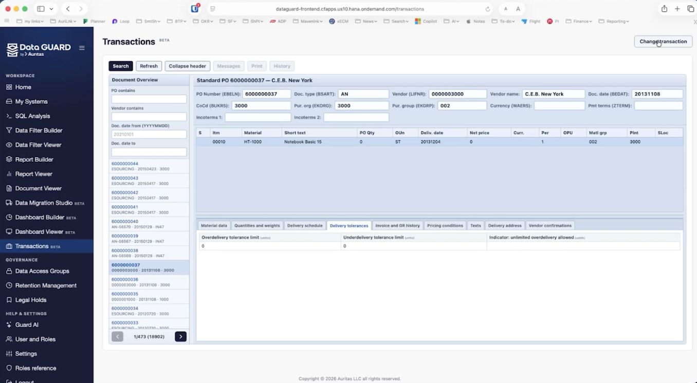
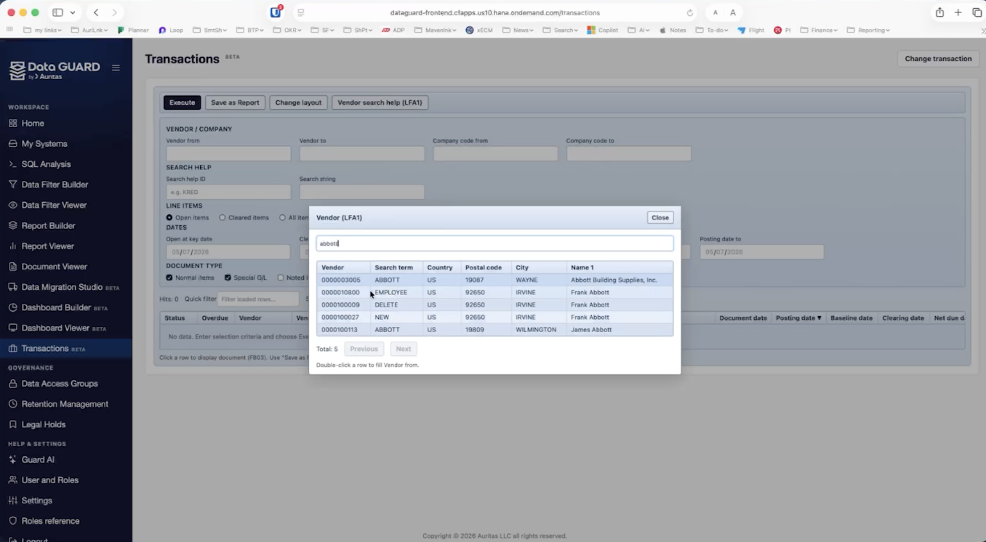
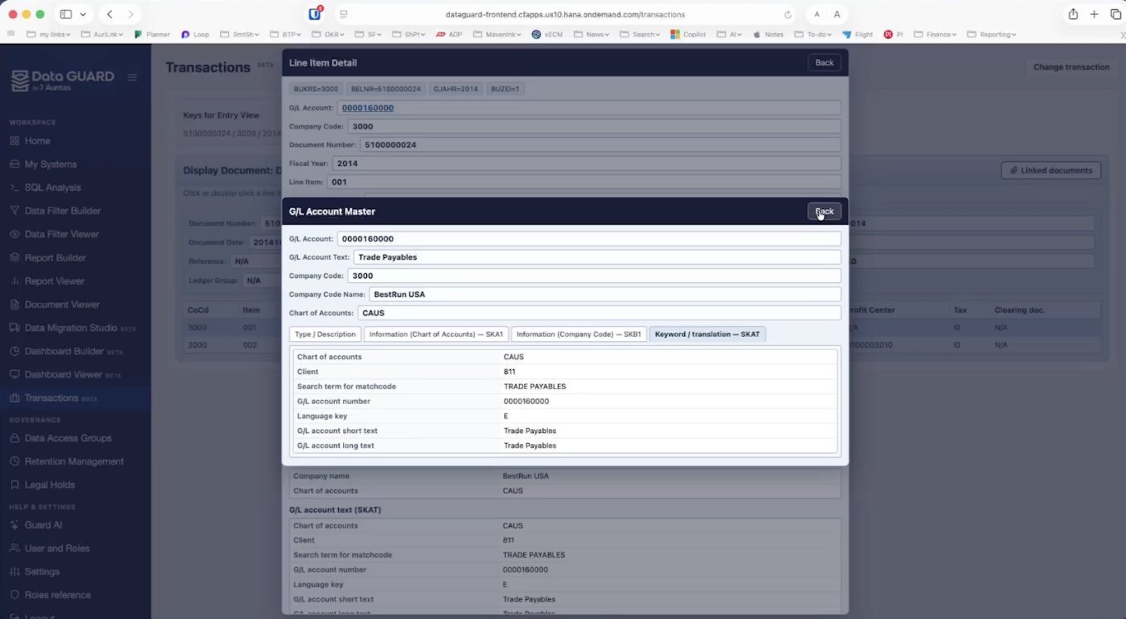
Data GUARD:
Transactions Capability
Data GUARD Transactions feature allows users to execute specific tasks or reports instantly similarly to how it’s completed in SAP.
Data GUARD visualization closely resembles SAP transaction screens, minimizing learning curve for new users.
Eliminate the need to navigate complex, hierarchical menus to generate reports.
Users can add any transaction from SAP into data GUARD and view it in a FIORI-like screen.
Notes:
For the messaging/title for each feature:
What feature are we talking about? (automated scheduling) – Advantage – What benefit/outcome it drives to the customers?
Visual rework

Slide 13
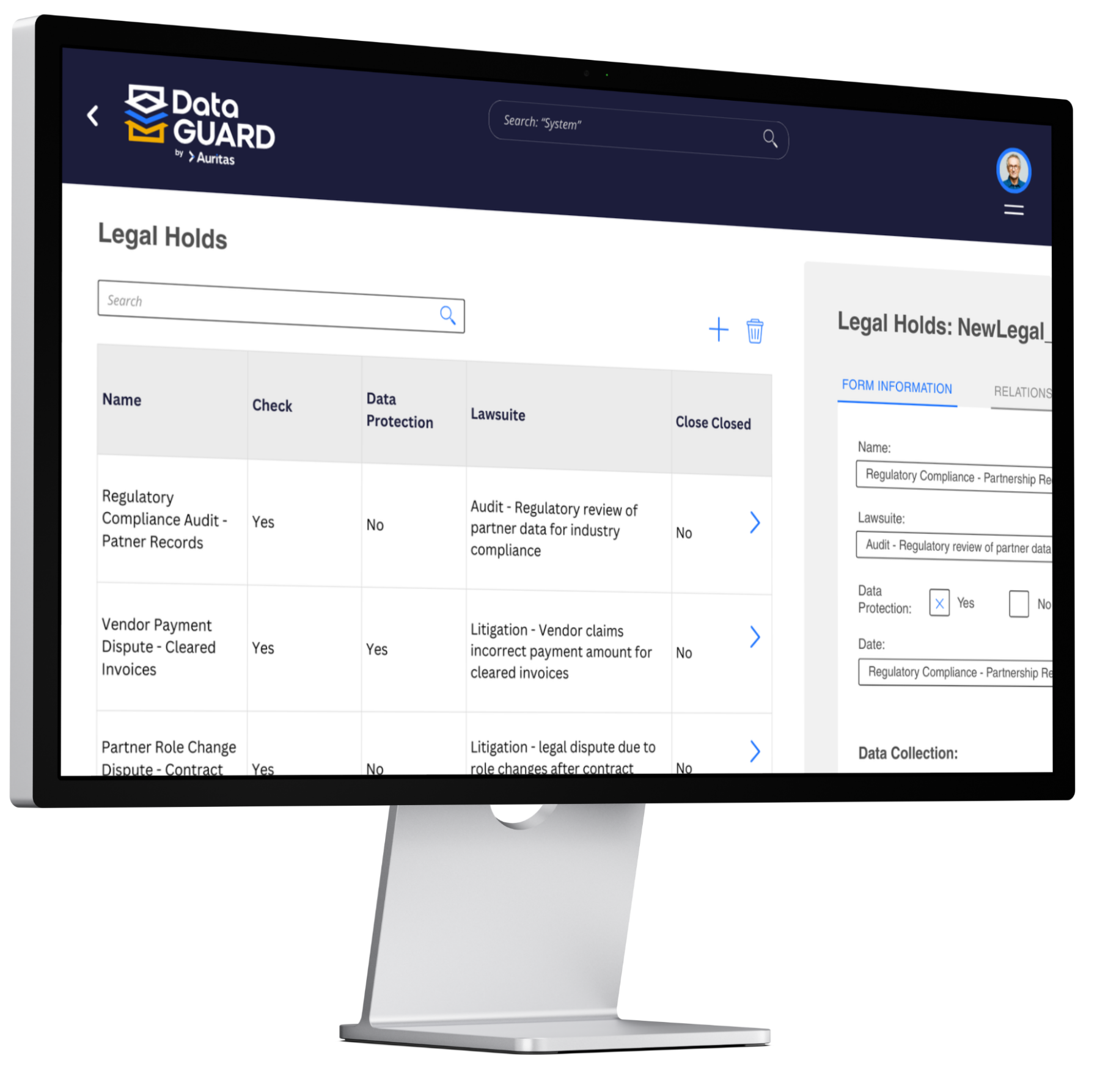
Data GUARD:
Compliance & Control
Apply retention compliance for retired data
Audit logs for overview on historical changes made to reports, access groups, documents, system, retention and more
Legal hold capability
Data GUARD allows for data disposition ensuring compliance and security
Access control for data security. Create user groups and define visibility limits.
  Audit-ready reports while ensuring security & privacy compliance
Notes:
For the messaging/title for each feature:
What feature are we talking about? (automated scheduling) – Advantage – What benefit/outcome it drives to the customers?
Visual rework

Slide 14
Auritas Legacy System
Retirement Tools
Extract
Database
File System
Transform
Table conversions
Store
Report
Business Objects
Document Viewer
Main Frames
BLOB
Formats
SAP BTP Cloud
DB (Prop., OpenSource)
Cloud (AWS, Azure)
Tableau
Excel

Slide 15
Data GUARD by Auritas
SAP BTP pre-requisite services:
Service Name | Role / Functionality | Plan | Metric | Small | Medium | Large | Extra Large
 |  |  |  | Qty. | Qty. | Qty. | Qty.
HANA Cloud | Data GUARD Application Database | HANA Service | CU | 500 | 1,000 | 1,500 | 2,000
Work Zone Standard Edition | Pre-requisite for BTP application | Standard | Users | Up to 100 | Up to 100 | Up to 500 | Up to 500
Job Scheduling | Pre-requisite for retention compliance | Standard | Block of 10K jobs | 5 | 10 | 25 | 50
Integration Suite | Required for migration of data from the source legacy system to the Data GUARD. | Standard | Tenant | 1 | 2 | 2 | 2
Cloud Foundry Runtime | Pre-requisite for BTP application | Standard | GB | 5 | 10 | 15 | 20
Application Logging | Pre-requisite for BTP application | Standard | Tenant | 1 | 2 | 3 | 4
Total

Slide 16
Data GUARD by Auritas
SAP BTP optional services:
Service Name | Details on the why this is required/optional | Plan | Metric | Small |  | Medium |  | Large |  | Extra Large
 |  |  |  | Qty. | ACV | Qty. | ACV | Qty. | ACV | Qty. | ACV
SAP Document Management service | Required if documents or archive files are to be stored in SAP BTP platform | Standard | Block of 50K API calls, 100 GB Blocks storage | 1, 5 | $4,428 | 2, 10 | $8,856 | 4, 20 | $17,712 | 10, 40 | $41,280
Data Retention Manager | Required when SAP Document Management Service is used | Standard | Tenant | 1 | $1,176 | 2 | $2,352 | 3 | $3,528 | 4 | $4,704
Analytics Cloud | Used as a Global reporting tool for all decommissioned systems in the customer Data GUARD instance | Standard | Hours | 200 | $5,976 | 400 | $11,952 | 800 | $23,904 | 1,200 | $35,856

Slide 17

Success Stories

Slide 18


Success Story:
SAP ECC Decommissioning with Data GUARD for S/4HANA Prep
Finance
Challenge & Pain Points:
  Needing to prepare for S/4HANA migration and mitigate risks and complexity
  Legacy data retained in the ECC system caused performance degradation
  Rising infrastructure costs
  DB volume increased backup durations and recovery time objectives
  Need to maintain historical data & attachments secure, auditable, and accessible
Solution Data GUARD:
  Extract and transfer 1 TB of data and attachments from SAP ECC to Data GUARD
  Implementation of Data GUARD and a PostgreSQL database
  Build custom reports in Data GUARD, including vendor reports, GL transaction details, WBS codes to see deal costs, and financial statements
  Implement SAP BTP as the new content repository layer with a cloud connector link
Results:
  Maintain auditability and long-term accessibility to legacy data
  Improve current system performance and operational stability
  Prepare for S/4HANA migration, saving costs & lowered complexity and risk
  Reduced infrastructure costs and operational risk
  Secure, governed access to legacy data via Data GUARD

Slide 19

Manufacturing/Customer Goods
Success Story:
Managing and Retiring Multiple Legacy Systems with Data GUARD
Background & Pain Points:
  Growing maintenance and hardware costs.
  Security risks on outdated systems.
  Limited data access due to technology constraints.
  Compliance for data retention and preservation.
  Inefficient data management causing silos.
  Lack of skilled personnel for legacy maintenance.
  Incompatible with modern technologies and apps.
  High energy use and carbon footprint.
Results & ROI:
  Manage and retire multiple legacy systems with a single view.
  Apply corporate retention policies to all connected legacy systems.
  Decrease total cost of ownership of legacy hardware
  Securely access decommissioned data
  Run advanced tailored reports for retired legacy data

Slide 20
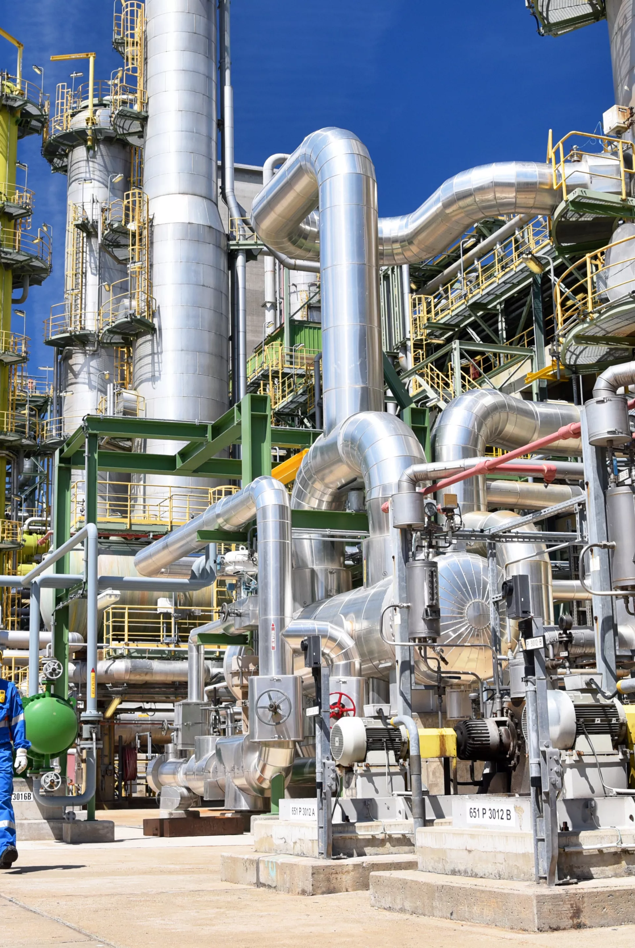
Chemicals
Success Story:
Legacy System Retirement & Retention Management
Pain Points:
  Over 200 legacy applications needed decommissioning
  Had diverse set of legacy systems, including both SAP and non-SAP systems
  Extracted data needed to be retrieved in a cost-effective manner
  Data within these legacy applications had to remain readily available
Benefits:
  Successfully decommissioned legacy SAP and Non-SAP Applications.
  Easy access to the data held within legacy environments
  Established a Clean Lean and Compliant Data Strategy
  Compliance and reduction of operational and legal risk
  Secured long-term storage in durable, tamperproof form
ROI:
  Millions in savings from decommissioned systems' licensing/infrastructure costs
  Lower TCO of IT landscape
  Reduced administration & resource consumption of legacy applications
  Increased process efficiency to access SAP data & documents
  Leverage storage lifecycle for lower costs

